Slide 1
The War on Search: Search Engines vs. Social Media

Slide 2
Two Goals
Be visible
Make sure that others can easily search you or your product
Wish that your searches are quickly visible
Make sure that you can easily locate what you are searching for.

Slide 3
Where search engines excel
Think about our habits
When we usually look for businesses or products, most of us (at least I) go for
search engines.
Google AdWord tool
Keywords are words or phrases you choose that can trigger your ad to
show on search and other sites. For example, if you deliver fresh
flowers, you could use "fresh flower delivery" as one keyword in your
AdWords campaign

Slide 4
Where social media is helpful
Peer recommendations (the like button)
Even in 2010, 75% of people in the 18 – 26 age group used
recommendations on social sites in product research before
making a purchase. (Source: Report from Econsultancy Inc)
Six more buttons: Love, Haha, Yay, Wow, Sad, Angry.
Responding to criticism in real time
A bad review or damaging articles about a business cannot be
(easily) removed. Reputation management is a thriving business.
On social media, however, you will have a chance to turn those
complaints into compliments by responding back in real time.

Slide 5
Where social media is helpful
Results are immediately available for search
Google web crawlers take a few weeks to discover new businesses / entities
Confirm results from search engines as trustworthy
Not sure if you should trust the search engine results as trustworthy?
Also check the social media.

Slide 6
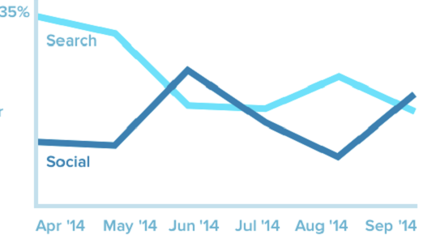
Search vs. Social: The Trend Now
Source: Forbes Magazine, Feb 3, 2015

Slide 7
Search vs. Social
We need both. Things are changing fast. They are trying to copy the
Good features from each other as much as possible.
Google’s 1+ button is shorthand for 'this is pretty cool' or 'you should check this out.
Microsoft’s Bing incorporates Facebook updates in its results

