Slide 1
Multi-core processors

Slide 2
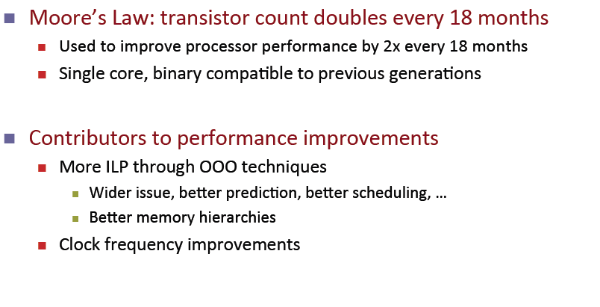
Processor development till 2004
Out-of-order
Instruction scheduling

Slide 3
Why multi-core ?
Difficult to make single-core clock frequencies even higher – heat problems
Deeply pipelined circuits:
heat problems, needs special cooling arrangements
Intel’s NetBurst architecture was not continued
Many new applications are multithreaded
General trend in computer architecture (shift towards more parallelism)

Slide 4
Why multi-core ?

Slide 5
Single-core computer

Slide 6
Single-core CPU chip
the single core

Slide 7
Multi-core architectures
Replicate multiple processor cores on a single die.
Core 1
Core 2
Core 3
Core 4
Multi-core CPU chip

Slide 8
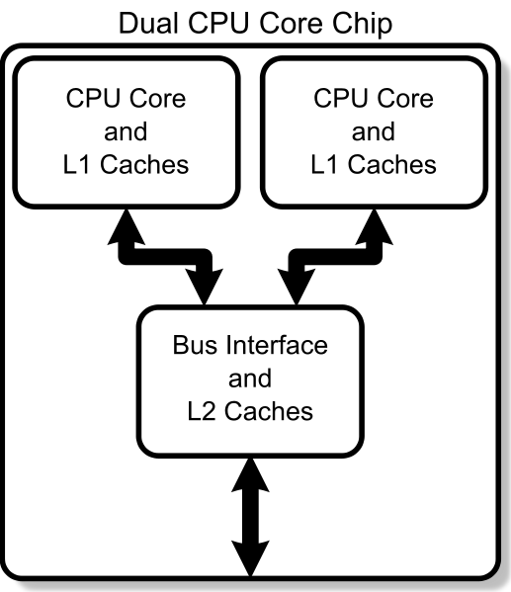
Multi-core processor

Slide 9
Multi-core CPU chip
The cores fit on a single processor socket
Also called CMP (Chip Multi-Processor)
core
1
core
2
core
3
core
4

Slide 10
The cores run in parallel
thread 1
thread 2
thread 3
thread 4
core
1
core
2
core
3
core
4

Slide 11
Within each core, threads are time-sliced (just like on a uniprocessor)
several threads
several threads
several threads
several threads
core
1
core
2
core
3
core
4

Slide 12
Interaction with the Operating System
OS perceives each core as a separate processor
OS scheduler maps threads/processes to different cores
Most major OS support multi-core today: Windows, Linux, Mac OS X, …

Slide 13
Instruction-level parallelism
Parallelism at the machine-instruction level
The processor can re-order, pipeline instructions, split them into microinstructions, do aggressive branch prediction, etc.
Instruction-level parallelism enabled rapid increases in processor speeds over the last 15 years

Slide 14
Thread-level parallelism (TLP)
This is parallelism on a more coarser scale
Server can serve each client in a separate thread (Web server, database server)
A computer game can do AI, graphics, and a physics-related computation in three separate threads
Single-core superscalar processors cannot fully exploit TLP
Multi-core architectures are the next step in processor evolution: explicitly exploiting TLP

Slide 15
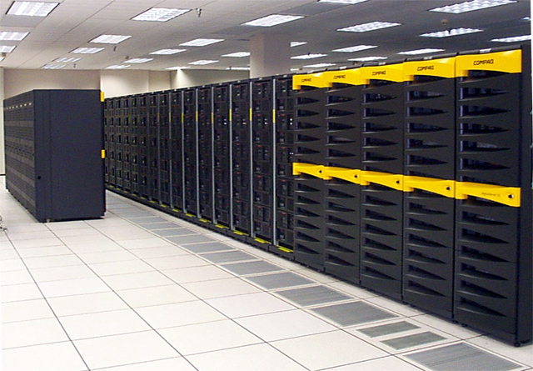
General context: Multiprocessors
Multiprocessor is any computer with several processors
SIMD
Single instruction, multiple data
Modern graphics cards
MIMD
Multiple instructions, multiple data
Lemieux cluster, Pittsburgh supercomputing center

Slide 16
Multiprocessor memory types
Shared memory: In this model, there is one (large) common shared memory for all processors
Distributed memory: In this model, each processor has its own (small) local memory, and its content is not replicated anywhere else

Slide 17
Multi-core processor is a special kind of a multiprocessor: All processors are on the same chip
Multi-core processors are MIMD: Different cores execute different threads (Multiple Instructions), operating on different parts of memory (Multiple Data).
Multi-core is a shared memory multiprocessor: All cores share the same memory

Slide 18
What applications benefit from multi-core?
Database servers
Web servers (Web commerce)
Multimedia applications
Scientific applications, CAD/CAM
In general, applications with Thread-level parallelism (as opposed to instruction-level parallelism) are better supported
Each can run on its own core

Slide 19
More examples
Editing a photo while recording a TV show through a digital video recorder
Downloading software while running an anti-virus program
“Anything that can be threaded today will map efficiently to multi-core”
BUT: some applications difficult to parallelize

