Slide 1
Blockchain

Slide 2

What is blockchain
Open ledger, a technology for securely transferring assets (without a trusted 3rd party). Third parties
often charge a sizeable fee, and
slow down transactions (think of banks, credit card companies) and
are a potential risk to privacy.
Blockchain technology provides an answer. An open ledger is one that any client can access but cannot tamper.

Slide 3
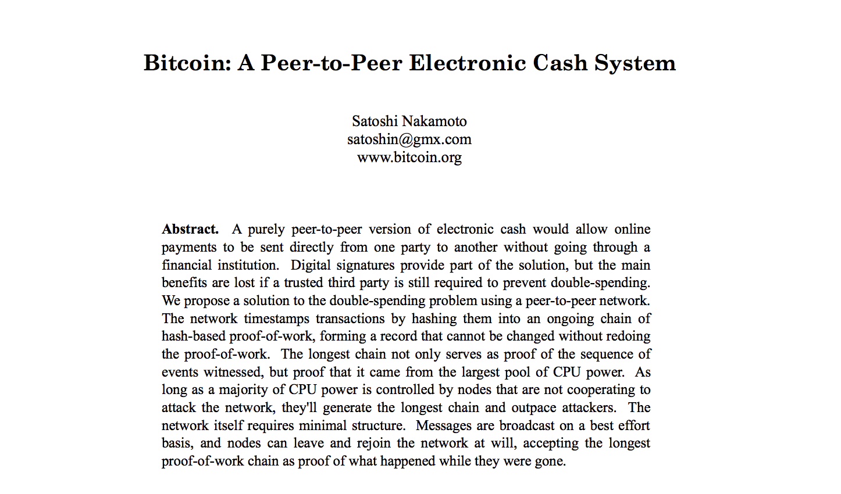
History
Inspired by a 2008 paper by Satoshi Nakamoto (a pseudonym) who introduced the basic idea along with he digital currency Bitcoin

Slide 4
The Network
Each node is a computer in a P2P network.
Each client has two keys:
the public key (known to all) used as the address of the client’s account
The private key is known to the client only

Slide 5
Open ledger
A ledger is an account book used to record transactions.
Blockchain is an open distributed ledger that records all transactions between clients in a verifiable way, and all changes are irreversible, so the records are permanent. No one can tamper it.

Slide 6
Permissionless vs permissioned blockchain
Permissionless (public or open) blockchain
Anyone can join, access and verify the records.
Bitcoin and Ethereum use permissionless blockchain
Permissioned (private or closed) blockchain
Need permission to join. Privately controlled. In a way, flips the
whole idea of a blockchain on its head. But works within an enterprise.

Slide 7
Simple money transfer using cryptography
M = A transfers $5 to B. A sends
out the signed message (M,S) to B.
B verifies the match as follows:
d_{A} (e_{A} (H(M)) = H(M)
The match confirms the transfer.
Sender A cannot deny it.
Hash is a fingerprint of the
arbitrarily large digital data.
The output has a fixed size

Slide 8
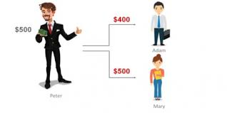
Double spending attack
Beware of double spending.
A could send the same bit pattern to both B and C, with the promise of sending $500 to each, although $A has only $500 with him.
B, C can deliver the goods in exchange for this payment but the promise cannot be fulfilled.
Blockchain guarantees that this never happens. The entire history is checked.
One major reason that earlier attempts to
Introduce digital money failed was the double
Spending attack

Slide 9
Ownership established via a chain of blocks
Ownership (of assets) established via a chain of digital signatures as recorded in the blockchain.
Owner A transfers asset to the next by digitally signing a hash of the previous transaction and the public key of the next owner B and adding these to the end (i.e., top) of chain.
The recipient can verify the signatures in the chain to verify ownership:

Slide 10
Peers broadcast their transactions
Miners are special nodes
with powerful hardware
Each peer / client sends out their transactions to all. Miners independently pick them up and form blocks of transactions.

Slide 11
Blocks and miners
Header
+
transactions
Miners are responsible for validating the blocks created in the network,
and adding to the chain. They get rewarded for their efforts

Slide 12
What is a blockchain?
Each block stores the hash of the previous block. Every client has an identical
copy of the blockchain, which records all the transactions in the entire system.

Slide 13
More on blockchain
Block 0 is called the genesis block. It was created by Nakamoto, the
unknown developer of Bitcoin. Now. there are >500,000 blocks in the
Bitcoin blockchain.
Blockchain technology lets one verify any transaction by visiting
the entire chain following the links.

Slide 14
A blockchain is immutable or tamper resistant
Alter a transaction in block k and the hash of
block k stored in block (k+1) will no more match,
making the chain invalid.
To cover it up, the hash of the previous block in (k+1) should be updated. But based on how a block is generated and added to the chain, this takes a long time for an individual..
This must be repeated for all blocks in the chain after block k. By that time, many new blocks will be generated within the system and disrupt the attempted cover-up. This is the key to tamper resistance.

Slide 15
Miners validate blocks
Miners pick transaction from an unconfirmed pool, and form blocks.
For inclusion in a block, miners check the feasibility of the transaction
by walking sown the chain and examining relevant past transactions.
Then they take the responsibility of confirming or validating a block by
solving a cryptographic puzzle.

Slide 16
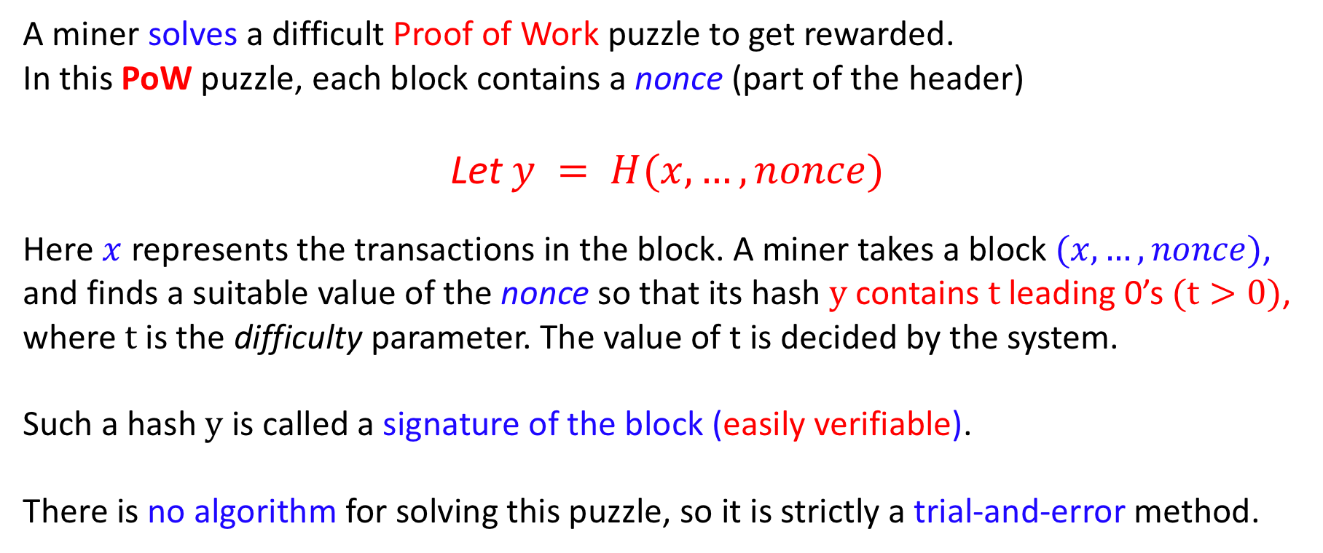
Cryptographic puzzle: Proof of Work
A miner solves a difficult Proof of Work puzzle to get rewarded.
In this PoW puzzle, each block contains a nonce (part of the header)
Let $y = H(x, …, nonce)$
Here $x$ represents the transactions in the block. A miner takes a block $(x, …, nonce)$,
and finds a suitable value of the nonce so that its hash $y$ contains $t$ leading 0’s $(t>0)$,
where $t$ is the difficulty parameter. The value of t is decided by the system.
Such a hash $y$ is called a signature of the block (easily verifiable).
There is no algorithm for solving this puzzle, so it is strictly a trial-and-error method.

Slide 17
Cryptographic puzzle continued
As an analogy, consider using a random number generator to generate a
random number N between 0 and 2⁶⁴ - 1, such that N has t leading 0’s in it.
The problem becomes more difficult when t increases. On an average, one needs many
more trials to find such a number. In the Bitcoin blockchain, the difficulty parameter is so
adjusted that on an average, a block is validated by some miner in approximately 10 min.
Only valid blocks are appended to the blockchain.
.

Slide 18
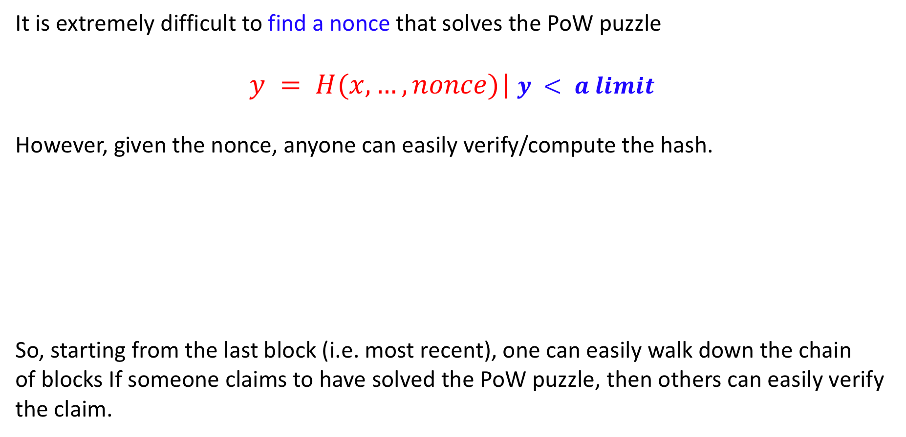
Cryptographic Puzzle continued
It is extremely difficult to find a nonce that solves the PoW puzzle
$y = H(x, …, nonce)$| $y < a limit$
However, given the nonce, anyone can easily verify/compute the hash.
So, starting from the last block (i.e. most recent), one can easily walk down the chain
of blocks If someone claims to have solved the PoW puzzle, then others can easily verify
the claim.

Slide 19
Reward for the miners
Whichever miner solves the puzzle (i.e. mines a block), and succeeds in propagating that to all, gets rewarded (now 12.5 Bitcoins) for contributing
his / her computing resources.
(What if two miners solve the same block around the same time? Discussed later)
(How much energy is wasted? Enormous amount … not eco friendly)
Block Rewards gets halved after every 210,000 of blocks gets mined, and the average time for halving comes around 4 years (this is what Satoshi Nakamoto originally planned while launching Bitcoin)

Slide 20
Bitcoin block mining data (3/5/2019) source https://www.bitcoinblockhalf.com/
Total Bitcoins in circulation: | 17,571,500
Total Bitcoins to be ever produced: | 21,000,000
Percentage of total Bitcoins mined: | 83.67%
Total Bitcoins left to mine: | 3,428,500
Bitcoin price (USD): | $3,805.10
Total blocks | 565,720
Blocks until mining reward is halved | 64,280
Total number of block reward halvings | 2
Approximate block generation time | 10.00 minutes
Approximate blocks generated per day | 144
Difficulty | 6,071,846,049,921
Hash rate | 40.17 Exahashes/s

Slide 21
Merkle Tree
The Merkle tree is a binary tree that encodes the transactions in the block for
efficient auditing. Helps answer the query “Is Tx 3 corrupted in this block?”
Root hash
Returns H(2), H(0,1)
From H(2) and H(3), compute H(2,3)
From H(0,1) and H(2,3), compute H(0,1,2,3)
Match it with the root hash ! Log N steps
Hash of the leaves
Hash of the leaves
In blockchains one may want to verify if a data from an
untrusted peer is part of the real content they requested.
No need to download the entire blockchain,
which, for Bitcoin is approx. 200GB in size
Each leaf is the hash of a transaction

Slide 22
How the blockchain grows
All peers must have the same view of the blockchain. So they must agree to which block will be added next to the blockchain. (Consensus problem)
Ideally, when a new block is mined, every
peer should append it to its local blockchain,
so that they reach a consensus.
The successful miner will send the mined block to all,
Anyone can easily verify that it has been correctly mined.
This block is appended to the blockchain by all, and the
chain grows from height n to height (n+1)

Slide 23
How the blockchain grows
When a newly solved block reaches other nodes in the network, each receiving node validates it via a set of tests before forwarding it to a neighboring node. This ensures that only honest miners’ efforts get rewarded.
A dishonest miner can include phony transactions into its block, and may claim to have solved the proof-of-work-puzzle without actually doing so. Such dishonest miners not only receive no rewards, but also waste their computation effort that acts as a deterrent.

Slide 24
How does a miner forms a block
Miners independently pick transactions to form blocks.
Peers often pay a small fee for mining each transaction, and a miner picks the transactions with the largest fee. The first miner that successfully solves a block containing that transaction, collects that fee.
It is possible for two or more miners to pick the same transactions Tx in a block.
The first miner who solves the block with Tx, gets rewarded. The second miner while broadcasting its validated block will find that Tx is already claimed in another block, so this block will be invalid.
Contention can lead to a fork. Fork resolution will be discussed later.

Slide 25
Types of nodes in Bitcoin Blockchain
Bitcoin uses three types of nodes : mining nodes, full nodes, and light nodes.
Mining nodes have acquired substantial computing power to solve the cryptographic puzzle in a reasonable time.
Full nodes hold and distribute the copies of the entire ledger (fast reaching 200 GB ) to other full nodes. Form the trust base of Bitcoin.
Light nodes are thin clients with limited memory hold only a small fraction of the blockchain. A light node typically connects to a full node that has a copy of the entire blockchain.

Slide 26
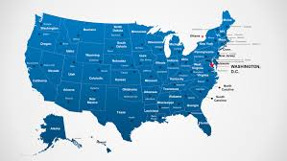
Fork and its resolution
3999 × 2250
B
E
B, E are two
distant peers

Slide 27
Fork resolution
Both B, E validate a block at the same time –
node E validates the orange block and
B validates the blue block. (FORK)
The blue block reaches E after some time.
Meanwhile, B receives the red block and appends it
to the chain B forwards it to all, and E also receives it.
E grows according to the longest chain, and the
orange block becomes an orphan and its
transactions have to be reversed.

Slide 28
Double spending and 51% attack
The bad guys want to spend the same money more than once
The attackers collude among themselves by broadcasting
their validated blocks only to themselves, and not to the
rest of the network
The attackers fork off from the primary chain and
grow a secondary chain of blocks that is visible to
them only, while they ignore the validated blocks
from the rest of the network
This is visible to B and his accomplices

Slide 29
Double spending and 51% attack
The malicious miners know about both chains,
but the rest know about only the primary chain
A race starts …
If the malicious miners have more computing power,
i.e. >50%, then the secondary chain grows faster !
The a malicious miner announces to all about the latest block they added.
Everybody finds that the new block has a larger height, so all switch to the secondary chain.

Slide 30
Double spending and 51% attack
All transactions in the primary blockchain from
the point of fork upwards will now be reversed
(see block 6).
The corrupt miners can now use the refunded money
to create new transactions without returning their
purchases, i.e. they are able to double spend their money

Slide 31
Byzantine Fault Tolerance
First, think of how you, as a bad guy, will launch a Byzantine attack on Blockchain.
Broadcast different blocks (say two different blocks p, q both with valid and with
the same block #) to different peers, so that no consensus is reached ?
Then the attacker has to generate two such blocks in quick succession, and get both
accepted before newer valid blocks are mined.

