Slide 1
Peer-to-Peer and Social Networks
An overview of Gnutella and KaZaA

Slide 2
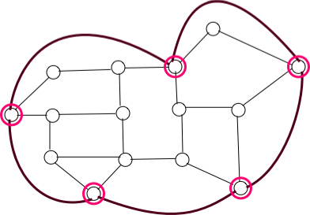
Overlay networks
Overlay networks are logical networks defined on top of a physical network. The nodes (peers) are a subset of the real nodes at the edge of the physical network, but the links are logical links. The links can be modified by the peers if necessary. No central server is there to oversee this.

Slide 3
History
The Gnutella network is a fully distributed alternative
of the centralized Napster. Initial popularity of the network received a boost after Napster's legal demise in early 2001.

Slide 4
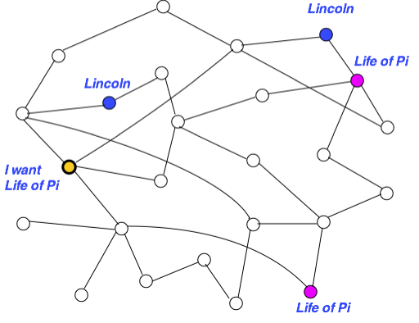
What is Gnutella
Big Hero 6
Gnutella is a search protocol with no central authority.

Slide 5
Gnutella Jargon
object
Each node is both a server and a client (“servent”).
2 Hops
1 Hop
client
TTL (time-to-live): how many hops a search can progress before it is terminated (default setting is 7 in Gnutella)

Slide 6
Gnutella Scenario
Step 0: Join the network
Step 1: Determining who is on the network
  "Ping" packet is used to announce your presence on the network.
  Other peers respond with a "Pong" packet.
  Also forward your Ping to other connected peers with open connections
  A Pong packet also contains:
    an IP address
    port number
    Pong packets come back via same route
Step 2: Searching
  Gnutella "Query" ask other peers if they have the file you desire. A Query packet might ask, "Do you have any song whose name matches “Once upon a time"?
  Peers check to see if they have matches & respond (if they have any matches) & send packet to connected peers. Otherwise the query is forwarded
  Continues for TTL
Step 3: Downloading
  Peers respond with a “QueryHit” (contains contact info)
  File transfers use direct connection using HTTP protocol’s GET method
Notes:
Step 1: Determining who is on the network

Slide 7
Remarks
Very simple idea , but lacks scalability, since query flooding wastes bandwidth.
Sometimes, existing objects may not be located due to limited TTL.
Various improved search strategies have been proposed. These have been used by newer client of the Gnutella protocol, like Limewire. Improvements use Ultrapeer, pong caching etc.

Slide 8
Searching in Gnutella
The topology is dynamic, i.e. constantly changing. How do
we model a constantly changing topology? Usually, we begin
with a static topology, and later account for the effect of churn.
Measurements provide useful information about the topology.
Candidate topologies are
-- Random graph
-- Power law graph
-- Small world graphs

Slide 9
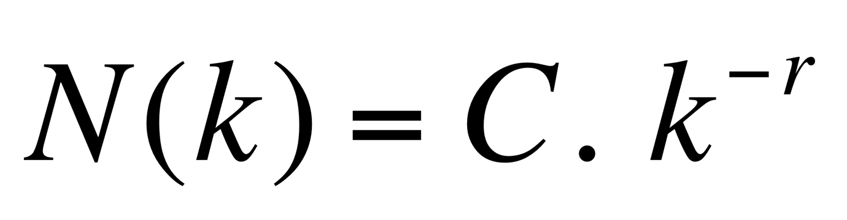
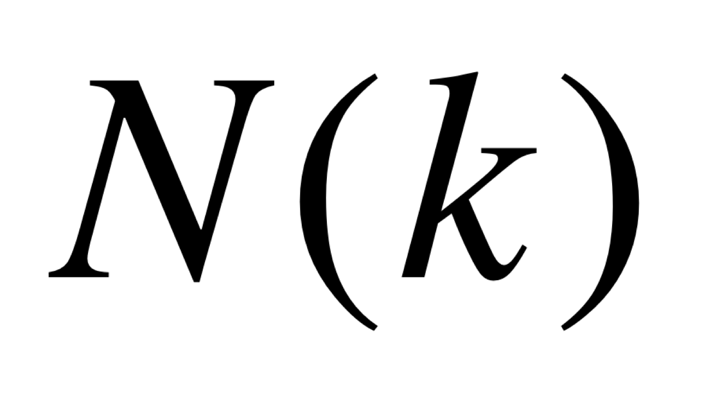
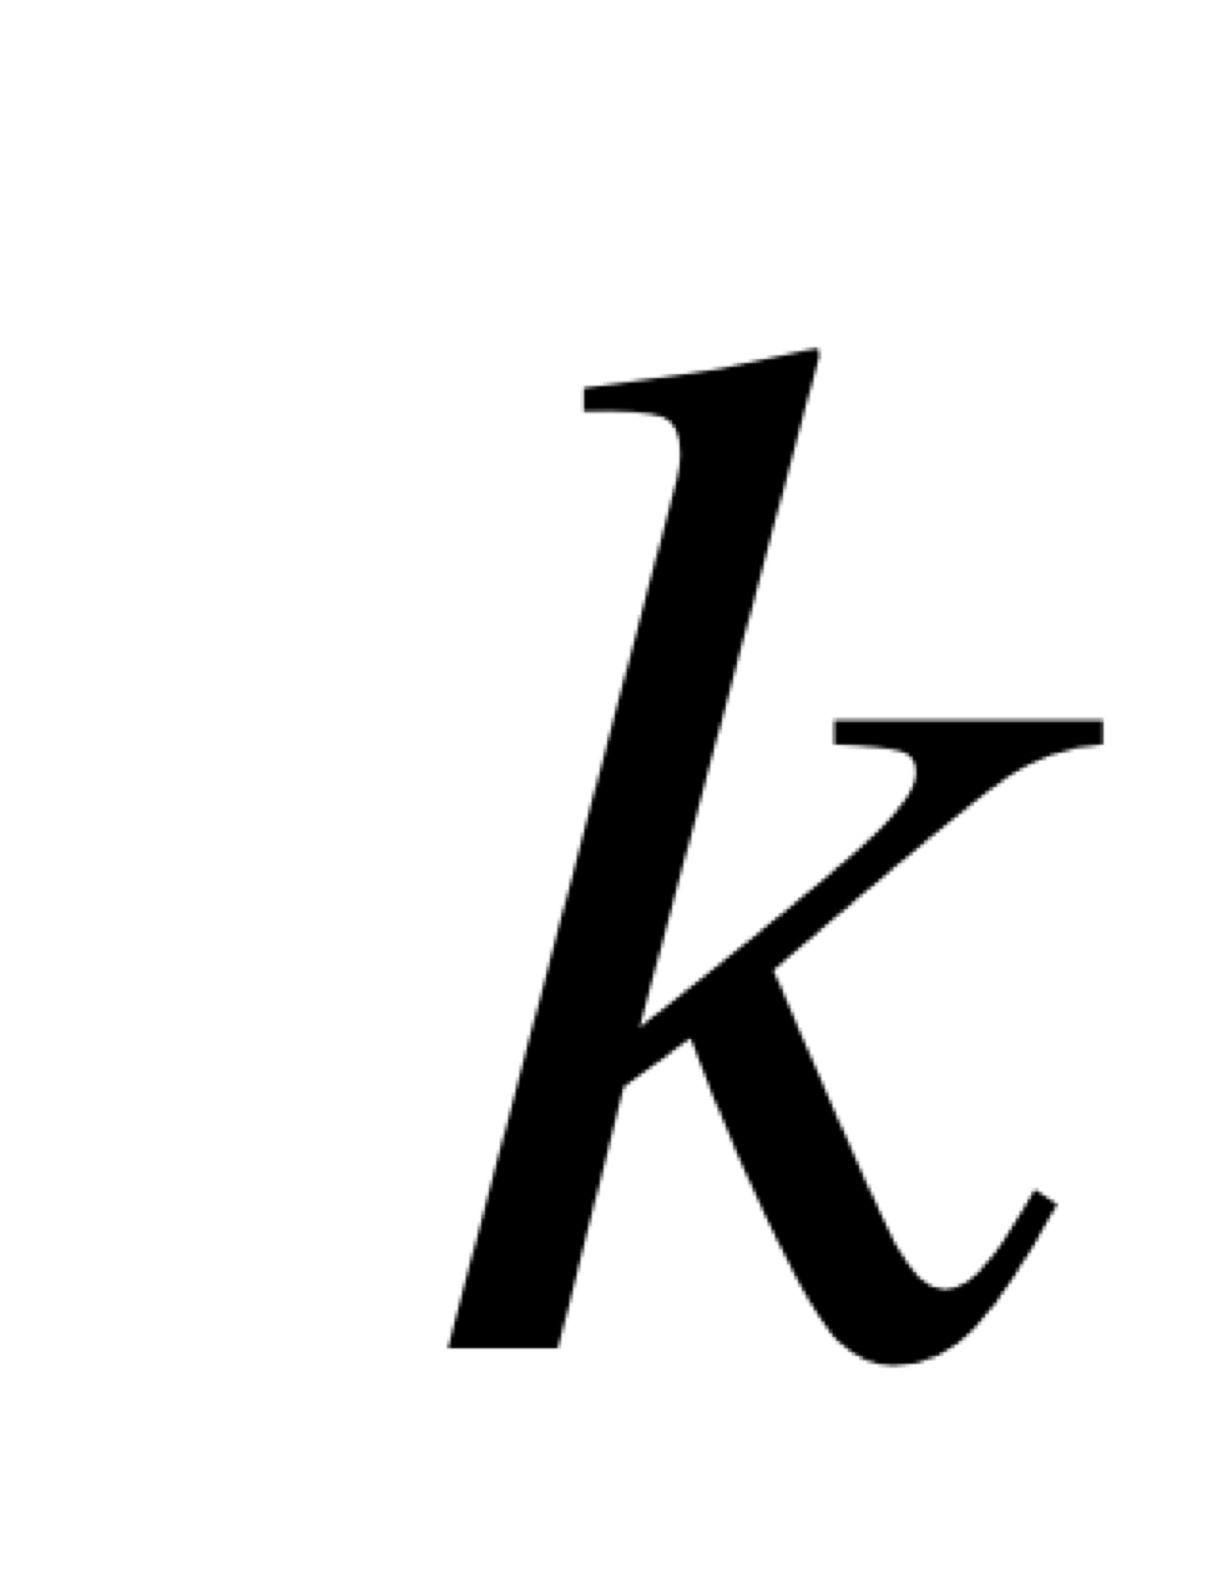
Gnutella topology
Gnutella topology is actually a power-law graph
The number of nodes with degree obeys
The primary reason appears to be the idea of “rich gets richer”
- popular web pages attract more peers
- peers prefer to connect to the well-connected nodes

Slide 10
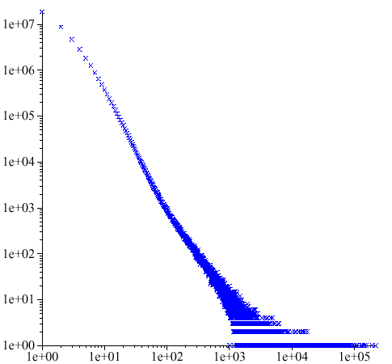
AT&T Call Graph
How many telephone
numbers receive calls from k
different telephone numbers?
# of telephone numbers
from which calls were made
# of telephone numbers called
4

Slide 11
Gnutella network
data
10
2
power-law fit
τ
= 2.07
10
1
number of nodes
10
0
10
0
10
1
number of neighbors
summer 2000,
data provided by Clip2
power-law distribution
5

Slide 12
Search strategies
Flooding
Random walk /
- Biased random walk/
- Multiple walker random walk
(Combined with)
One-hop replication /
Two-hop replication
k-hop replication

Slide 13
On Random walk
Rich history. Let p(d) be the probability that a random walk on a d-dimensional lattice returns to the origin. In 1921, Pólya proved that,
(1) p(1)=p(2)=1, but
(2) p(d) < 1 for d > 2
There are similar results
on two walkers meeting
each other via random walk

Slide 14
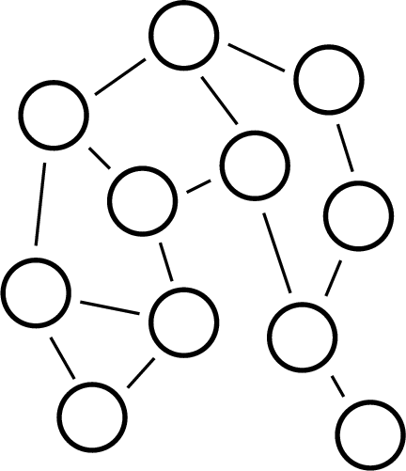
Search via random walk
Existence of a path does
not necessarily mean that
such a path can be discovered

Slide 15
Search via Random Walk
Search metrics
Delay = discovery time in hops
Overhead = total distance covered (i.e. total nodes visited by the walker)
(Both should be as small as possible).
For a single random walker, these are equal.
K random walkers (K>1) leads to a smaller delay
For search by flooding, if delay = h then
overhead ≤ d + d² + … + d^{h} where d = max degree of a node.

Slide 16
A simple analysis of random walk
Searching for
Let p = Population of the object. i.e. the fraction of nodes hosting the object
T = TTL (time to live)
Hop count h | Probability of success
1 | p
2 | (1-p).p
3 | (1-p)².p
T | (1-p)^{T-1}.p
Geometric
distribution

Slide 17
A simple analysis of random walk
Expected hop count E(h) =
1.p + 2.(1-p).p + 3(1-p)².p + …+ T.(1-p)^{T-1}.p
= 1/p. (1-(1-p)^{T}) - T(1-p)^{T}
With a large TTL, E(h) = 1/p, which is intuitive.
With a small TTL, there is a risk that search will time out before an existing object is located.

Slide 18
K random walkers
Assume they all k walkers start in unison. Probability that none could find the object after one hop = (1-p)^{k}. The probability that none succeeded after T hops = (1-p)^{kT.} So the probability that at least one walker succeeded is 1-(1-p)^{kT.} A typical assumption is that the search is abandoned as soon as at least one walker succeeds.
As k increases, the overhead increases, but the delay decreases. There is a tradeoff.

Slide 19
Increasing search efficiency
Major strategies
Biased walk utilizing node degree heterogeneity.
Utilizing structural properties (power-law property)
Topology adaptation for faster search
Introducing ultrapeers (i.e supernodes) in the graph

Slide 20
One hop replication
Each node keeps track of the indices of the files belonging to its
immediate neighbors. As a result, high capacity / high degree nodes
can provide useful clues for a large number of search queries.
Where is

Slide 21
Biased random walk
P=5/10
P=2/10
P=3/10
Each node records the degree of the neighboring nodes. Search gravitates towards high degree nodes that hold more clues.

Slide 22
Ultrapeers or supernodes
To overcome the scalability problem, some resource-rich nodes were given the status of as ultrapeers or supernodes. Search requests (and responses) by edge nodes are handled by the closest ultrapeer, which served as local index servers. This scaled down the decentralization. Used by KaZaA, Limewire and many subsequent clients. These are more successful than Napster and Gnutella. KaZaA and FastTrack were originally created and developed by Estonian programmers from BlueMoon Interactive, including Jaan Tallinn and sold to Swede Niklas Zennström and Janus Friis (who later created Skype)

Slide 23
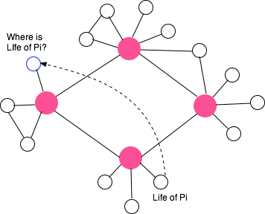
Ultrapeers or supernodes
Each ordinary node is associated to a supernode, which are
resource rich nodes picked on the fly. Each SN is a Napster like
hub for its children.
Two-layered architecture reduces search time

