Slide 1
Peer-to-Peer and Social Networks
Centrality measures

Slide 2
Centrality measures
Centrality is related to the potential importance of a node. Some
nodes have greater “influence” over others compared to the rest,
or are more easily accessible to other, or act as a go-between in
most node-to-node communications. These are represented by
various centrality measures. Some important ones are
Degree centrality
Closeness centrality
Betweenness centrality

Slide 3
Degree centrality
The more neighbors a given node has, the greater is its influence.
In human society, a person with a large number of friends is believed
to be in a favorable position compared to persons with fewer.
This leads to the idea of degree centrality, which refers to the
degree of a given node in the graph representing a social network.

Slide 4
Closeness centrality
Nodes that are able to reach other nodes via shorter paths, or who
are “more reachable” by other nodes via shorter paths, are in more
favored positions. This structural advantage can be translated into
power, and it leads to the notion of closeness centrality.

Slide 5
Closeness centrality
normalized
6
4/6
4
1
6
4/6
5
4/5
5
4/5
Let denote the set of nodes, and represent the distance between and .
A yardstick of the closeness of a node from the other nodes is .
This number is normalized in various ways: one is . However, a problem
occurs when the graph is partitioned, so an alternative is to consider the inverse of it
i.e.
as shown above.

Slide 6
Betweenness centrality
For each pair of nodes in a social network, consider one of the shortest paths –- all nodes
in this path are intermediaries. The node that belongs to the shortest paths between the
maximum number of such communications, is a special node – it is a potential deal maker
and is in a special position since most other nodes have to channel their communications
through it. Such a node has a high betweenness centrality.

Slide 7
Computing betweenness centrality
From each source node u to each destination node v, push 1 unit of
flow via shortest paths. If there are multiple shortest paths, then the
flow will be evenly split. The amount of flow handled by a node or an
edge is a measure of its betweenness centrality.

Slide 8
Computing betweenness centrality
½
½
½
½
½
½
Betweenness centrality of C with respect to (A, G)
If each node sends 1 unit of flow to every other node (excluding C),
then C will handle only 2. (1 + + ) = 4 units of flow. Why?
½
½

Slide 9
Random Walk Betweenness Centrality
Proposed by Newman, the random walk betweenness is centrality is based on
random walks, counting how often a given node is traversed by a random walk
between two other nodes. This is in contrast with the deterministic approach in
The previous slide that is based on shortest paths. Unlike the shortest path
based centrality, random walk based centrality does not require the knowledge
of the topology of the network.

Slide 10
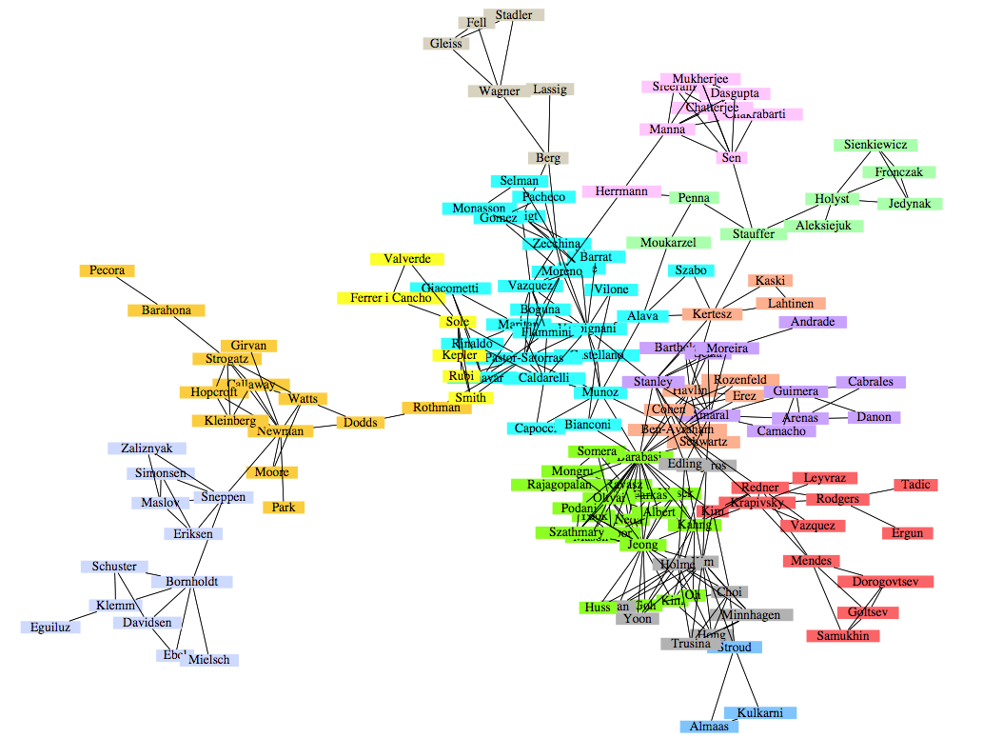
Community detection
A co-authorship network of physicists and mathematicians
(Courtesy: Easley & Kleinberg)

Slide 11
What is a community?
Informally a community is a “tightly-knit region” of the network.
How to identify such a region, and how to separate them
from a different tightly-knit region? It depends on how we
quantify the notion of tightly-knit. Visual check of the graph
is not enough, and can sometimes be misleading. Also,
such regions can be nested.

Slide 12
What is a community?
Formally, given a network with n nodes and m edges, a community
detection algorithm finds subgroups of nodes C₁, C₂, …, C_{p}
(communities) that satisfy the following two constraints:
C_{i} ∩ C_{j} = ∅ for i ≠ j, and
∪_{i}C_{i} = set of all nodes in the network.
Overlapping communities are not impossible, but are generally
not addressed by the community detection algorithms.

Slide 13
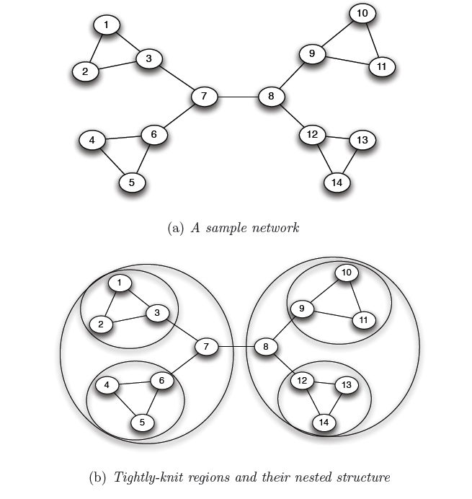
What is a community?
Removal of a bridge separates the graph into
disjoint components
bridge
An example of a nested structure of the communities
(Courtesy: Easley & Kleinberg)

Slide 14
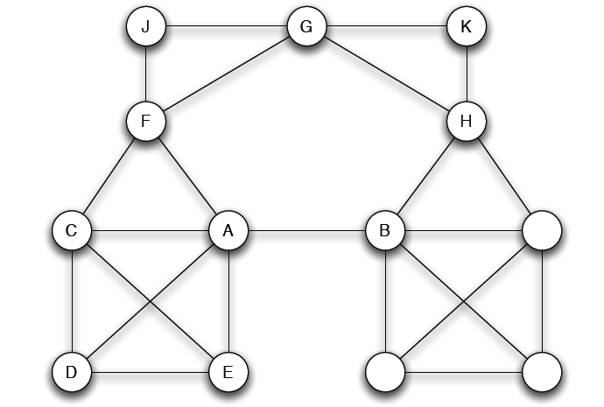
What is a community?
A-B is not a bridge,
but a local bridge
A, B have no
common friends
(Courtesy: Easley & Kleinberg)

Slide 15
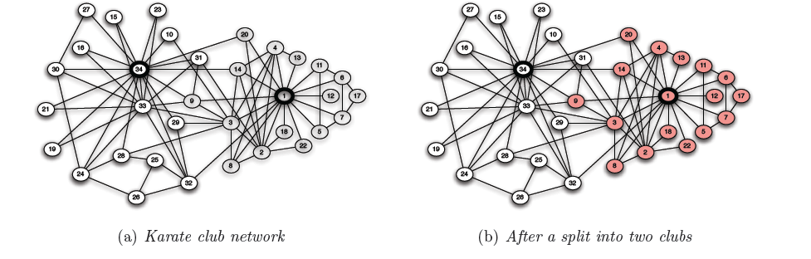
What is a community?
Is there a bridge here?
A dispute caused the club to split into two clubs. How can you identify them?
(Courtesy: Easley & Kleinberg)

Slide 16
Community detection
Girvan-Newman Method
Remove the edges of highest betweenness first.
Repeat the same step with the remainder graph.
Continue this until the graph breaks down into individual nodes.
As the graph breaks down into pieces, the tightly knit community
structure is exposed.

Slide 17
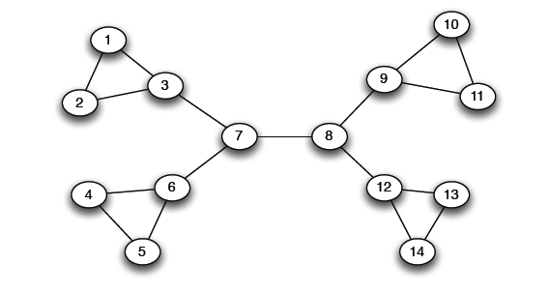
Girvan Newman method: An example
Betweenness(7-8)= 7x7 = 49
Betweenness(1-3) = 1X12=12
Betweenness(3-7)=betweenness(6-7)=betweenness(8-9) = betweenness(8-12)= 3X11=33

Slide 18
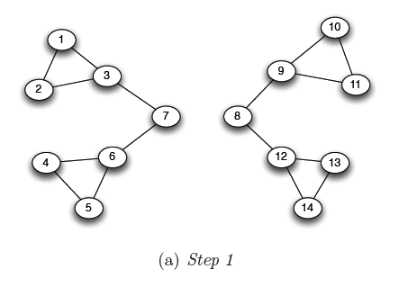
Girvan Newman method: An example
Betweenness(1-3) = 1X5=5
Betweenness(3-7)=betweenness(6-7)=betweenness(8-9) = betweenness(8-12)= 3X4=12

Slide 19
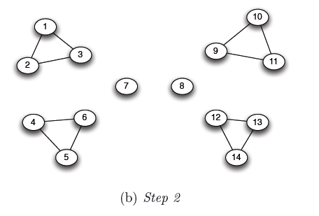
Girvan Newman method: An example
Betweenness of every edge = 1

Slide 20
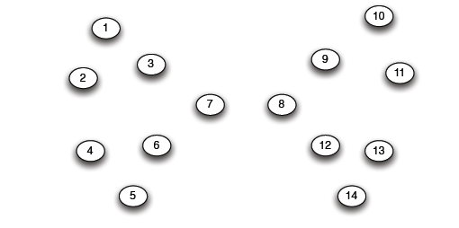
Girvan Newman method: An example

Slide 21
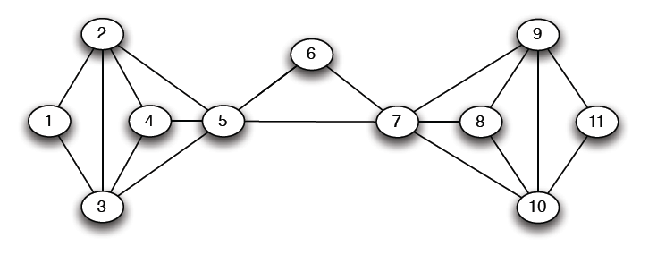
Another example
5X5=25

Slide 22
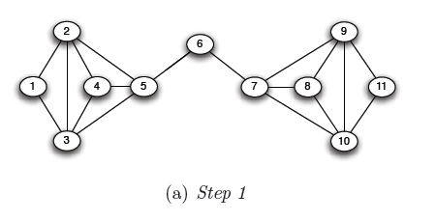
Another example
5X6=30
5X6=30

Slide 23
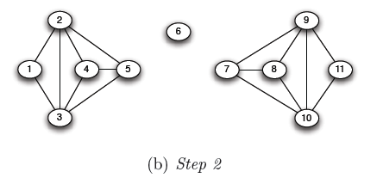
Another example

Slide 24
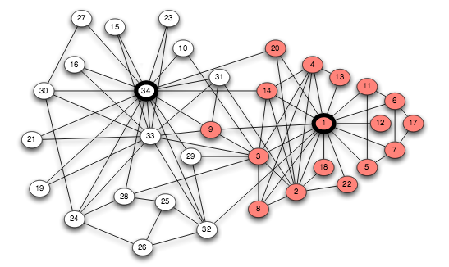
Revisiting Karate Club Network
A set of minimum total strength whose removal will disconnect the rival leaders.
Zachary followed this to identify the split.

Slide 25
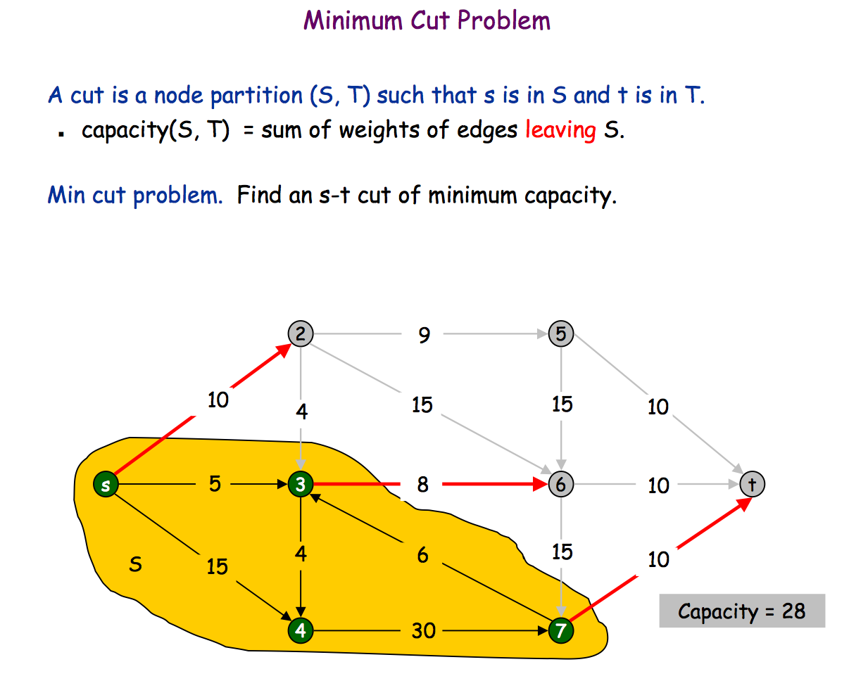
Min Cut Problem

Slide 26
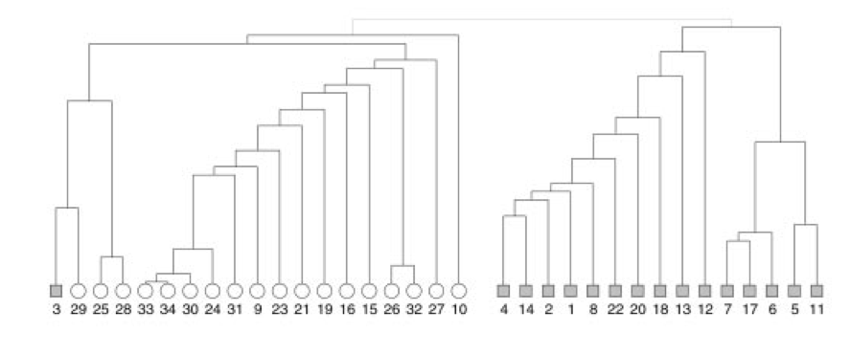
Revisiting Karate Club Network
Zachary initially assigned weight to each edge and then partitioned the graph
by computing the min-cut. Successive application of this produces a dendogram
A Dendogram

Slide 27
Revisiting Karate Club Network
Girvan-Newman’s community detection algorithm produced almost the exact solution, except for one node (node 9)
However, it is not computationally efficient.

