Slide 1
Peer-to-Peer and Social Networks
Small World Graphs

Slide 2
The small-world model
[Watts and Strogatz (1998)]
They followed up on Milgram’s work and reason about why there is a small degree of separation between individuals in a social network. Research originally inspired by Watt’s efforts to understand the synchronization of cricket chirps, which show a high degree of coordination over long ranges, as though the insects are being guided by an invisible conductor.
Disease spreads faster over a small-world network.

Slide 3
Questions not answered by Milgram
Why six degrees of separation? Any scientific reason? What properties do these social graphs have?
Is clustering the only missing link? (Human beings prefer clustered environments). But the diameter must also be low!
Time to reverse engineer this.

Slide 4
What are small-world graphs
Completely regular
Small-world graphs ( )
Completely random
n = number of nodes, k= number of neighbors of each node

Slide 5
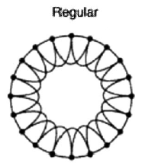
Completely regular
If then
The clustering coefficient is OK, but
Diameter is too large!
A ring lattice

Slide 6
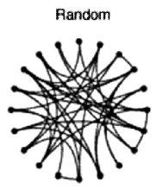
Completely random
Diameter is small, but the
Clustering coefficient is too small!

Slide 7
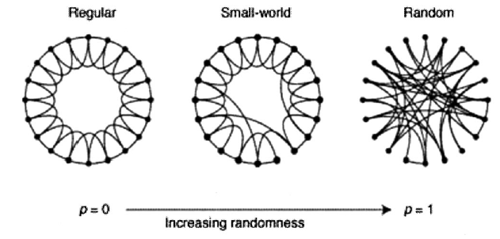
Small-world graphs
Start with the regular graph, and with probability p rewire each link to a randomly selected node. It results in a graph that has high clustering coefficient but low diameter …

Slide 8
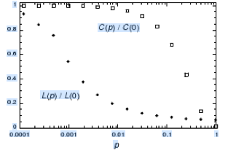
Small-world graphs
Small-world
properties hold

Slide 9
Limitation of Watts-Strogatz model
Jon Kleinberg argues …
Watts-Strogatz small-world model illustrates the existence of
short paths between pairs of nodes. But it does not give any clue about how those short paths will be discovered. A greedy search for the destination will not lead to the discovery of these short paths.

Slide 10
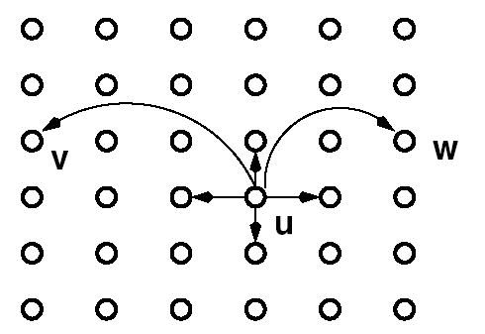
Kleinberg’s Small-World Model
  Consider an grid. Each node has a link to every node at lattice distance
  (short range neighbors) & long range links. Choose long-range links at
  lattice distance with a probability proportional to (**See note below)
n
p = 1, q = 2
r = 2
n
**Here r denotes the dimension of the space. Since we are considering a 2D grid, r=2

Slide 11
Results
Theorem 1. There is a constant (depending on and
but independent of ), so that when , the expected
delivery time of any decentralized algorithm is at least
** The above result is valid for a 2D grid only. For a 1D space like a
Linear topology of a ring, the expected time will be different

Slide 12
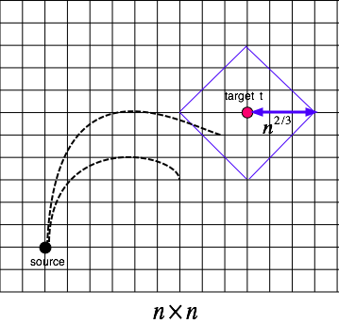
Proof of theorem 1
Probability to reach within
a lattice distance from
the target is
So, it will take an expected
steps
to reach the target.

Slide 13
More results
Theorem 2. There is a decentralized algorithm A and a constant (dependent on and ) but independent of n, such that when r=2 and , the expected delivery time of A is at most
For a one-dimensional search space, the same result will hold for
i.e the expected delivery time is O(log²n) when long-range
links at distance d are chosen with probability proportional to d⁻¹

Slide 14
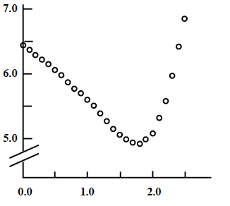
Variation of search time with r
This is for a 2D topology
Log T
Exponent r

Slide 15
Proof of Theorem 2
Main idea.
We show that in phase j, the expected time before the current message holder has a long-range contact within lattice distance 2^{j} from t is O(log n); at this point, phase j will come to an end. As there are at most log n phases, a bound proportional to log²n follows.

Slide 16
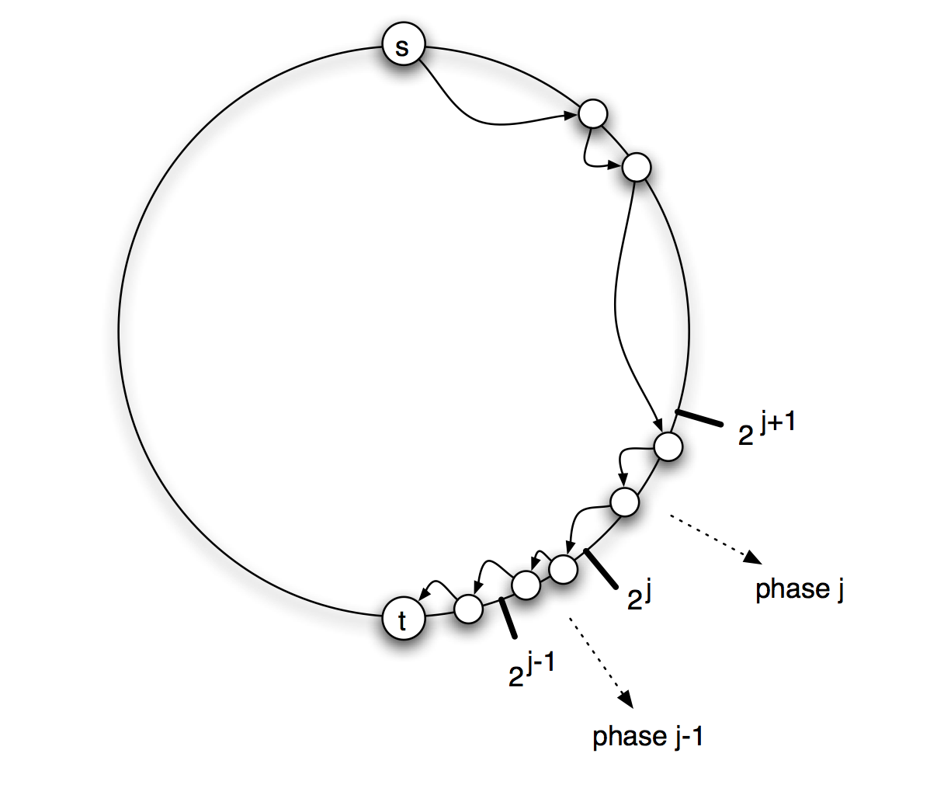
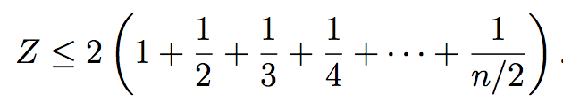
Proof of Kleinberg’s theorem
For simplicity we prove it for a one
dimensional ring topology, so r =1
Probability (u linking to v) =
Since

Slide 17
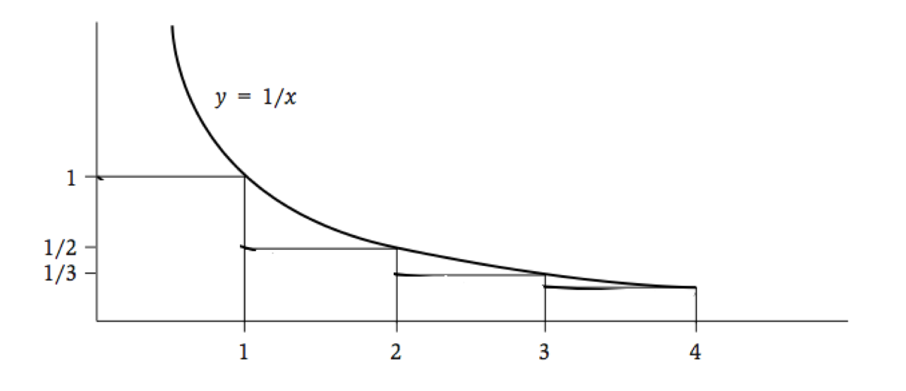
Proof continued
An upper bound of the normalizing constant is the area under the curve which is

Slide 18
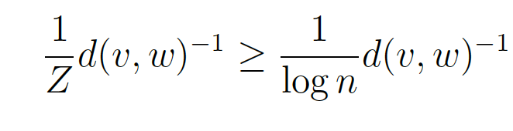
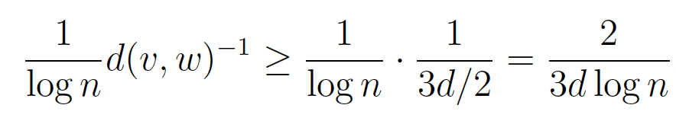
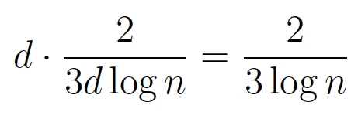
Proof continued
Thus, probability that a link (v,w) exists is =
We now calculate the time taken in one phase (implies that the distance
to the target becomes less than d/2.
Probability in one step the search reaches a given node in the target zone ≥
Why?
Probability that in one step the search reaches some node within distance d/2 ≥

Slide 19




Proof continued
How can this continue? Let be the number of steps in phase
The probability that this phase continues for at least i steps ≤
The expected number of steps to complete phase j is
=
So,
This leads to

Slide 20
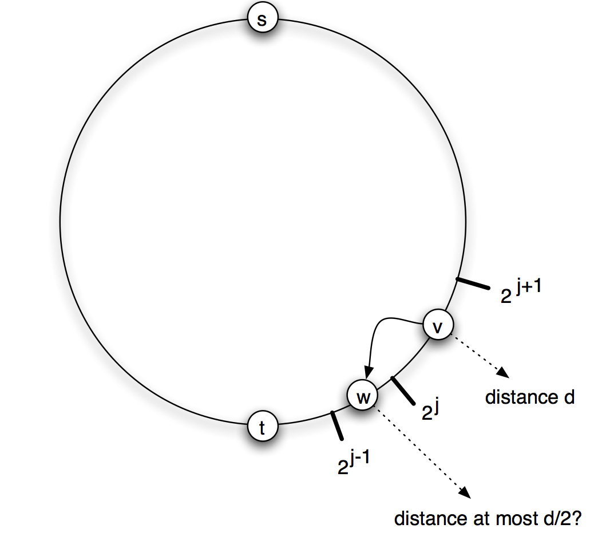
Proof continued
The expected number of steps for the total search

