Slide 1
Peer-to-Peer and Social Networks
Power law graphs

Slide 2
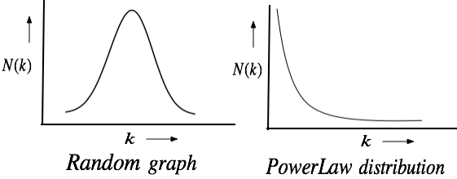
Random vs. Power-law Graphs
The degree distribution in of the webpages in the
World Wide Web follows a power-law
Binomial
distribution

Slide 3
Random vs. Power-Law networks

Slide 4
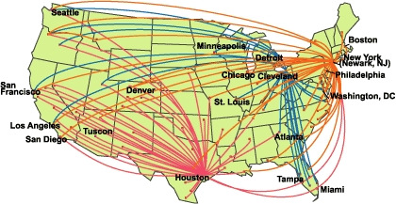
Example: Airline Routes
Think of how new routes are added to an existing network

Slide 5
Examples of Power law distribution
Also known as scale-free graph. Other examples are
-- Airport network
-- Income and number of people with that income
-- Magnitude and number of earthquakes of that magnitude
-- Population and number of cities with that population

Slide 6
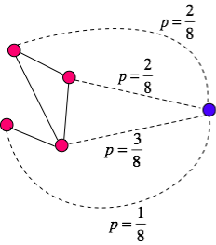
Preferential attachment
A new node connects with an
existing node with a probability
proportional to its degree. The
sum of the node degrees = 8
Existing
network
New node
Also known as “Rich gets richer” policy
This leads to a power-law distribution (Barabási & Albert)

Slide 7
Preferential attachment
Barabási and Albert showed that when large networks are formed
by the rules of preferential attachment , the resulting graph shows
a power-law distribution of the node degrees.
We will derive it in the class, so follow the lecture.

Slide 8
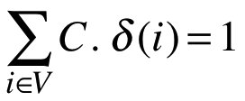
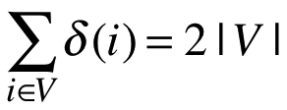
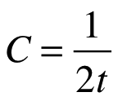



Preferential attachment
At t = 0, there are no nodes.
At t = 1, one node appears.
Thereafter, each time unit,
a new node is added
Degree of node =
The probability that the new node connects with an existing node =
Since and so

Slide 9
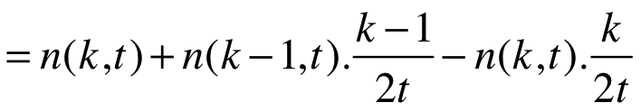


Preferential attachment
= number of nodes with degree k after time step t

Slide 10
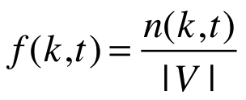
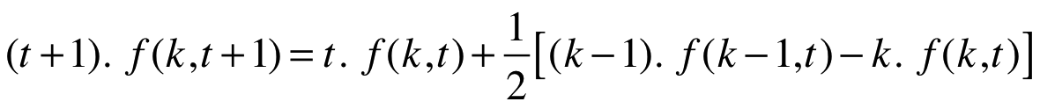
Preferential attachment
is then fraction of nodes
with degree k at time t

Slide 11
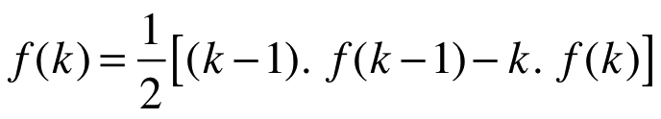
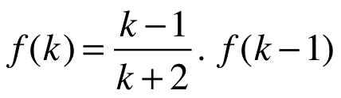


Preferential attachment
As
Call it

Slide 12

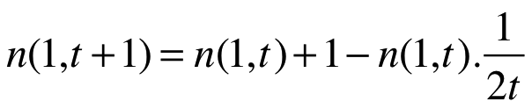
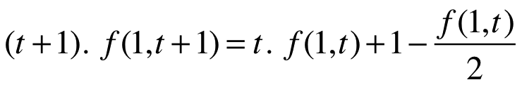

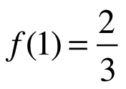
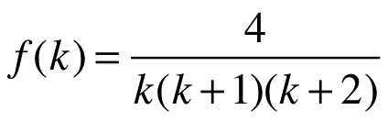
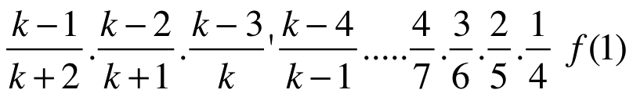
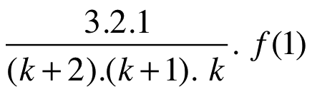
Preferential attachment
*
* Before time step (t+1), the new node
is the only node with degree 0, and its
degree will change to 1
is of the order of

Slide 13
Other properties of power law graphs
Graphs following a power-law distribution
have a small diameter (n = number of nodes).
The clustering coefficient decreases as the node degree increases
(power law again)
Graphs following a power-law distribution tend to be highly resilient
to random edge removal, but quite vulnerable to targeted attacks on
the hubs.

