Slide 1
Peer-to-Peer and Social Networks
Fall 2017
Random Graphs

Slide 2
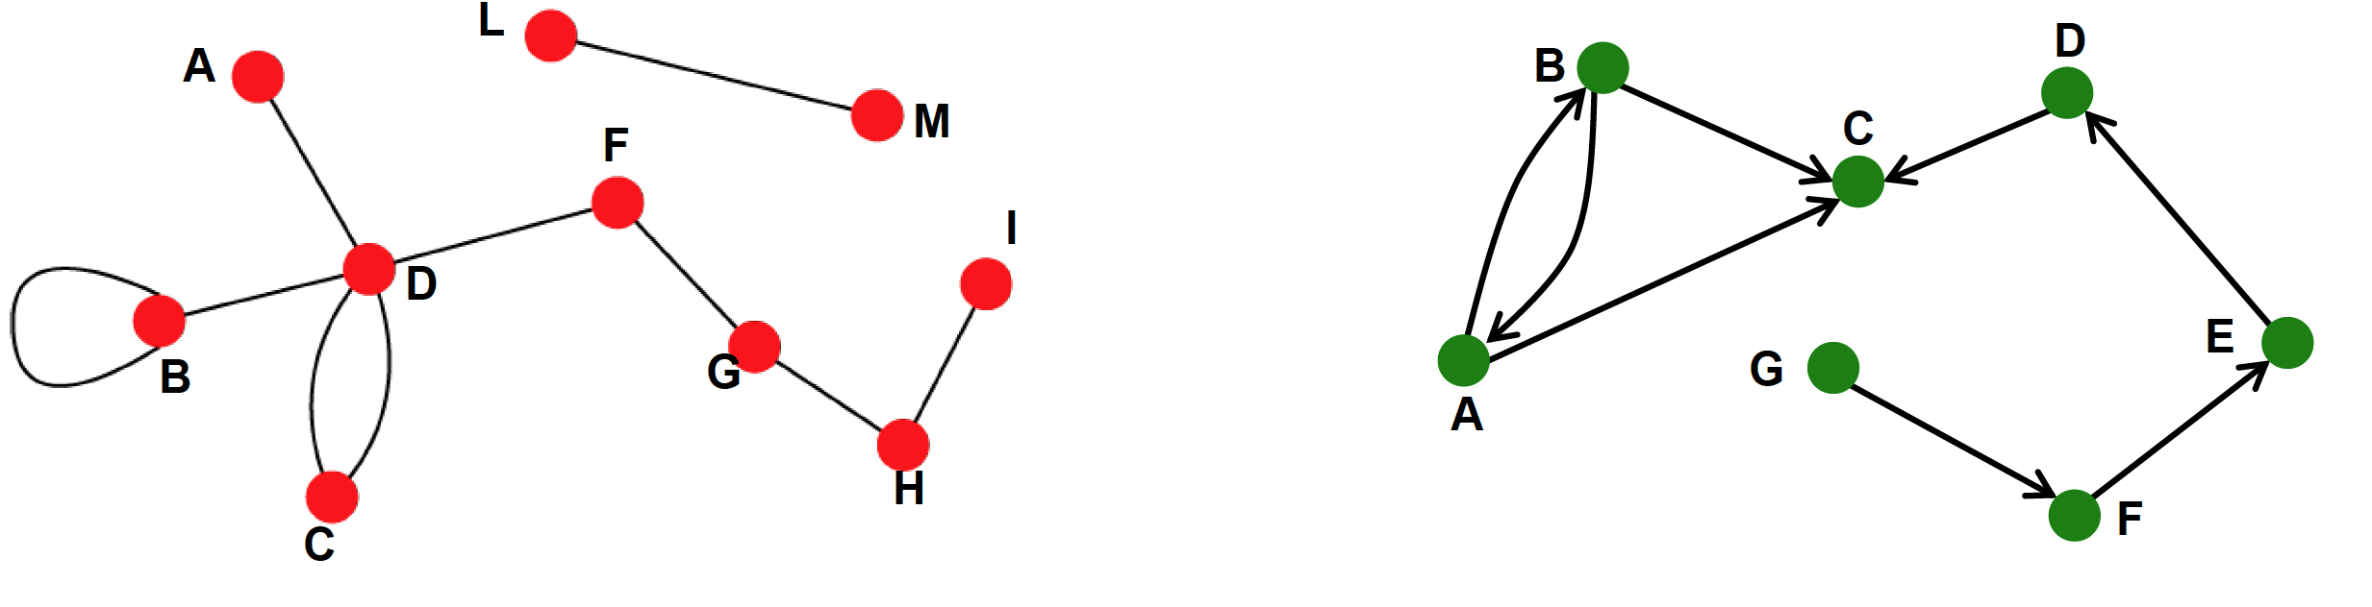
Directed vs. Undirected graphs
Collaborations,
Friendship on Facebook
(Symmetric relationship)
Emails, citations,
Following on Twitter
(asymmetric relationship)

Slide 3
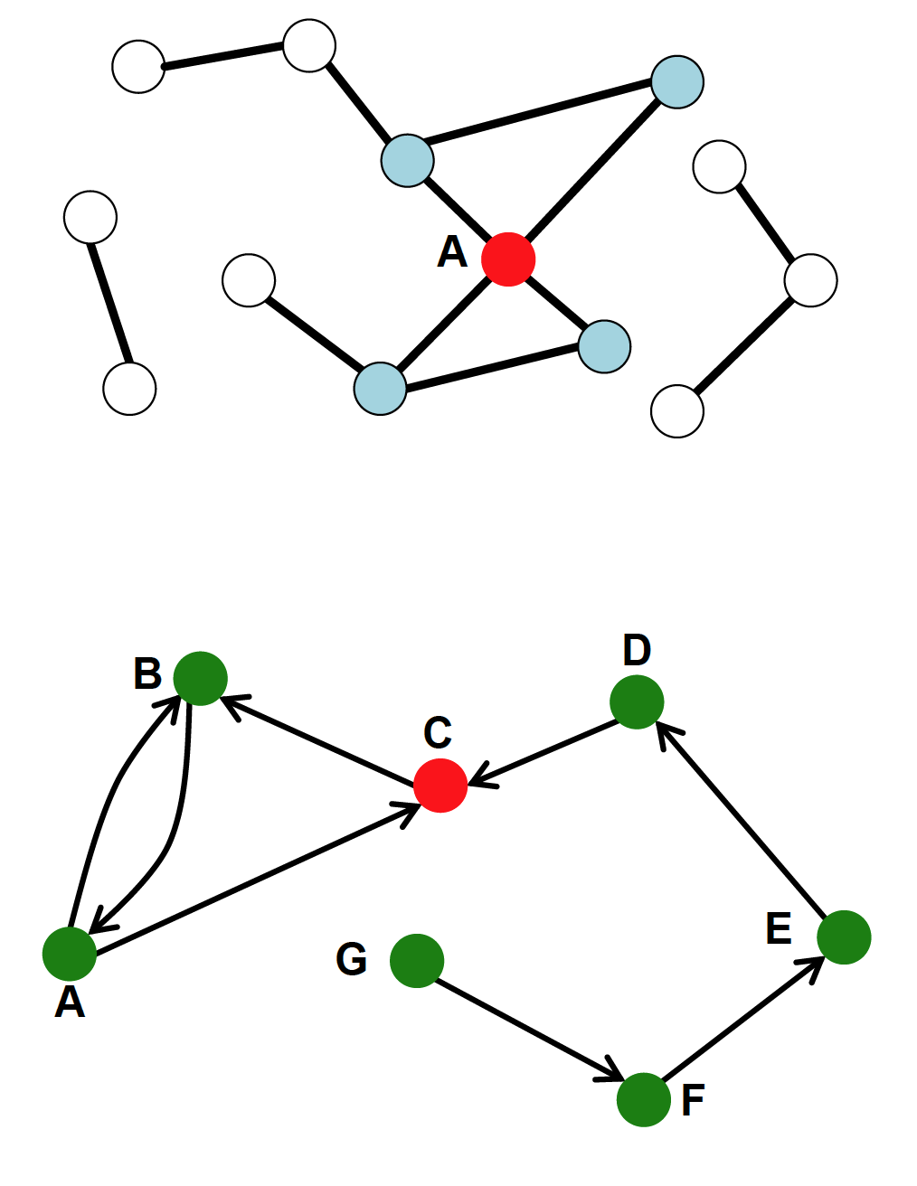
Directed vs. Undirected graphs
Degree of a node
= number of edges incident on it.
Degree of A = 4
The average degree of nodes in an
n-node graph G = (V, E) is
In directed graphs, we have to
define in-degree and out-degree
of nodes. What is the average in-degree
of the directed graph to the right?

Slide 4
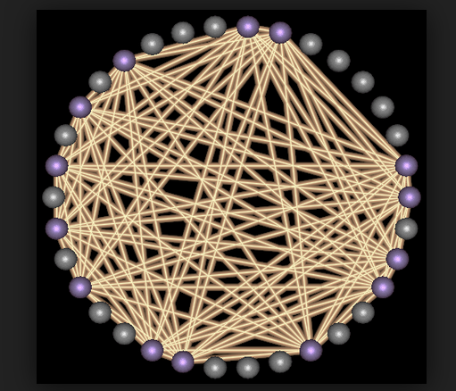
Sparse and dense graphs
In a clique with n nodes, the
degree of each node is (n-1).
In dense graphs, the average
node degree is O(n). In sparse
graphs, the average degree is
much smaller.
Are most real world social
networks dense or sparse?
A clique

Slide 5
Real-world graphs
Most real world graphs are sparse, i.e. the average degree is
much less than n-1 for an n-node graph. Some examples are
LinkedIn N=6,946,668 Average degree = 8.87
Co-authorship (DBLP) = 317,080 Average degree = 6.62
Graphs can be weighted or un-weighted.
Is the co-authorship network weighted or un-weighted?

Slide 6
Random graphs
Erdös-Renyi model
One of several models of real world networks
Presents a theory of how social webs are formed.
Start with a set of isolated nodes
Connect each pair of nodes with a probability
The resulting graph is known as

Slide 7
Random graphs
ER model is different from the model
The model randomly selects one from the entire
family of graphs with nodes and edges.

Slide 8
Properties of ER graphs
Property 1. The expected number of edges is
Property 2. The expected degree per node is
Property 3. The expected diameter of is
Why?
[deg = expected degree of a node] [Note the word expected]

Slide 9
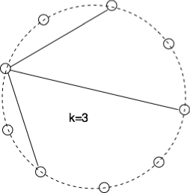
Degree distribution in random graphs
Probability that a node connects with a given set of nodes (and not to the remaining remaining nodes) is
One can choose out of the remaining nodes in ways.
So the probability distribution is
(binomial distribution)
(For large and small it is equivalent to Poisson distribution)

Slide 10
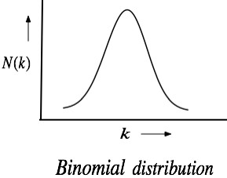
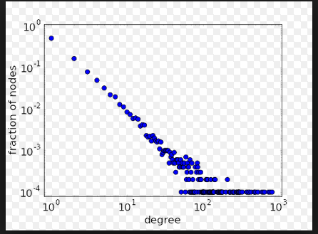
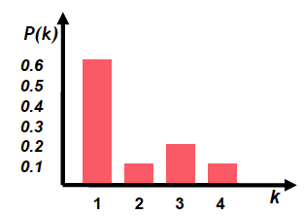
Degree distribution
What distribution is this?
P(k) = fraction of nodes that has degree k

Slide 11
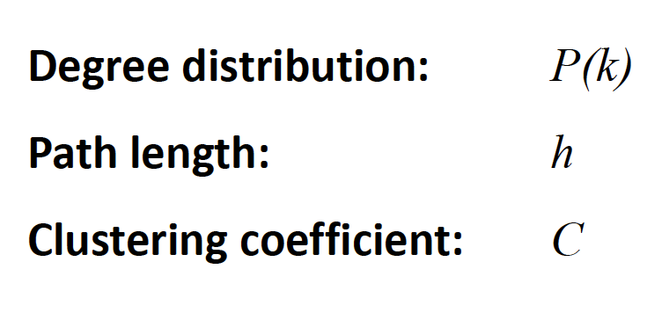
Important network properties
Here path length means average path length between pairs of nodes

Slide 12

Clustering coefficient
For a given node, its local clustering coefficient (CC) measures what fraction of its various pairs of neighbors are neighbors of each other.
B’s neighbors are
{A,C,D,E}. Only (A,D), (D,E), (E,C) are connected
CC of a graph is the
mean of the CC of its
various nodes
CC(B) = 3/6 = ½ CC(D) = 2/3 = CC(E)
The global CC is the average of the local CC values.

Slide 13
Properties of ER graphs
-- When , an ER graph is a collection of
disjoint trees.
-- When suddenly one giant (connected)
component emerges. Other components have a much smaller size [Phase change]

Slide 14
Properties of ER graphs
When the graph is almost always connected
why?
(i.e. connected with high probability)
Hints. The probability that a single node remains disconnected is
(1-p)^(n-1). Substitute p = c.logn/n
The clustering coefficient of an ER graph = p (why?}
But a social network is not necessarily an ER graph! Human society is a “clustered” society, but ER graphs have poor (i.e. very low) clustering coefficient.

Slide 15
How social are you?
Malcom Gladwell, a staff writer at the New Yorker magazine
describes in his book The Tipping Point, an experiment to measure
how social a person is.
He started with a list of 248 last names
A person scores a point if he or she knows someone with a last name
from this list. If he/she knows three persons with the same last name,
then he/she scores 3 points

Slide 16
How social are you?
(Outcome of the Tipping Point experiment)
Altogether 400 people from different groups were tested.
(min) 9, (max) 118 {from a random sample}
(min) 16, (max) 108 {from a highly homogeneous group}
(min) 2, (max) 95 {from a college class}
[Conclusion: Some people are very social, even in small or homogeneous
samples. They are connectors]

Slide 17
Connectors
Barabási observed that connectors are not unique to human society
only, but true for many complex networks ranging from biology to
computer science, where there are some nodes with an anomalously
large number of links. Certainly these types of clustering cannot be
expected in ER graphs.
The world wide web, the ultimate forum of democracy, is not a
random network, as Barabási’s web-mapping project revealed.

Slide 18
Anatomy of the web
Barabási first experimented with the Univ. of Notre Dame’s web.
325,000 pages
270,000 pages (i.e. 82%) had three or fewer links
42 had 1000+ incoming links each.
The entire WWW exhibited even more disparity. 90% had ≤ 10 links, whereas a few (4-5) like Yahoo were referenced by close to a million pages! These are the hubs of the web. They help create short paths between nodes (mean distance = 19 for WWW obtained via extrapolation). (Some dispute this figure now)

Slide 19
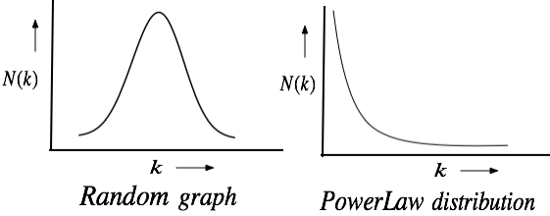
Random vs. Power-law Graphs
The degree distribution in of the webpages in the
World Wide Web follows a power-law

Slide 20
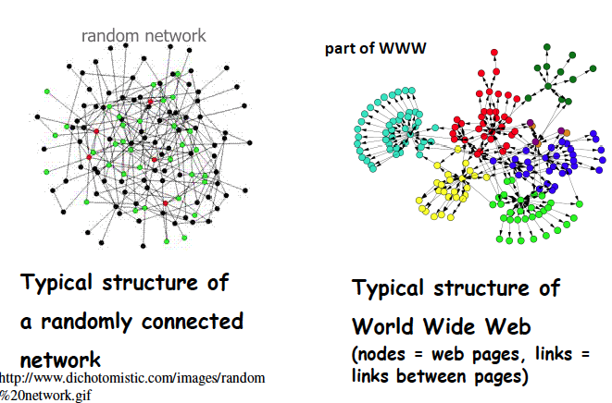
Random vs. Power-law Graphs

Slide 21
Random vs. Power-Law networks

Slide 22
Evolution of Scale-free networks

Slide 23
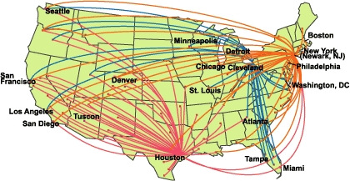
Example: Airline Routes
Think of how new routes are added to an existing network

Slide 24
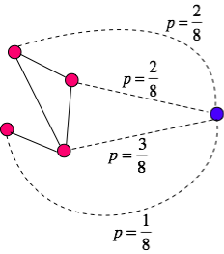
Preferential attachment
A new node connects with an
existing node with a probability
proportional to its degree. The
sum of the node degrees = 8
Existing
network
New node
Also known as “Rich gets richer” policy
This leads to a power-law distribution (Barabási & Albert)

Slide 25
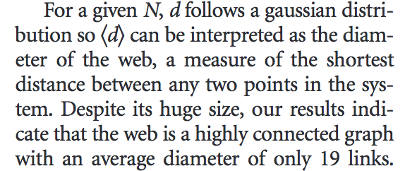
Anatomy of the web
Albert, Jeong, Barabasi: Diameter of the World Wide Web.
(Brief Communication). Nature 401, 9 Sep 1999

Slide 26
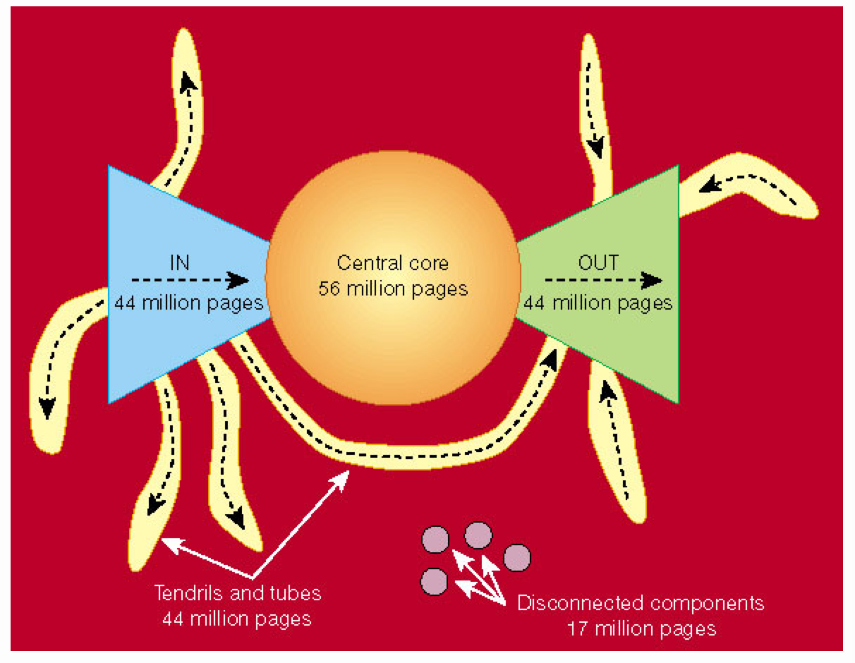
The web is a bow tie
Reference: Nature 405, 113(11 May 2000)

Slide 27
Power law graph
The degree distribution in of the webpages in the World Wide Web follow a power-law. In a power-law graph, the number of nodes with degree satisfies the condition
Also known as scale-free graph. Other examples are
-- Income and number of people with that income
-- Magnitude and number of earthquakes of that magnitude
-- Population and number of cities with that population

