Slide 1
CS 2210 Discrete Structures
Counting
Fall 2019
Sukumar Ghosh

Slide 2
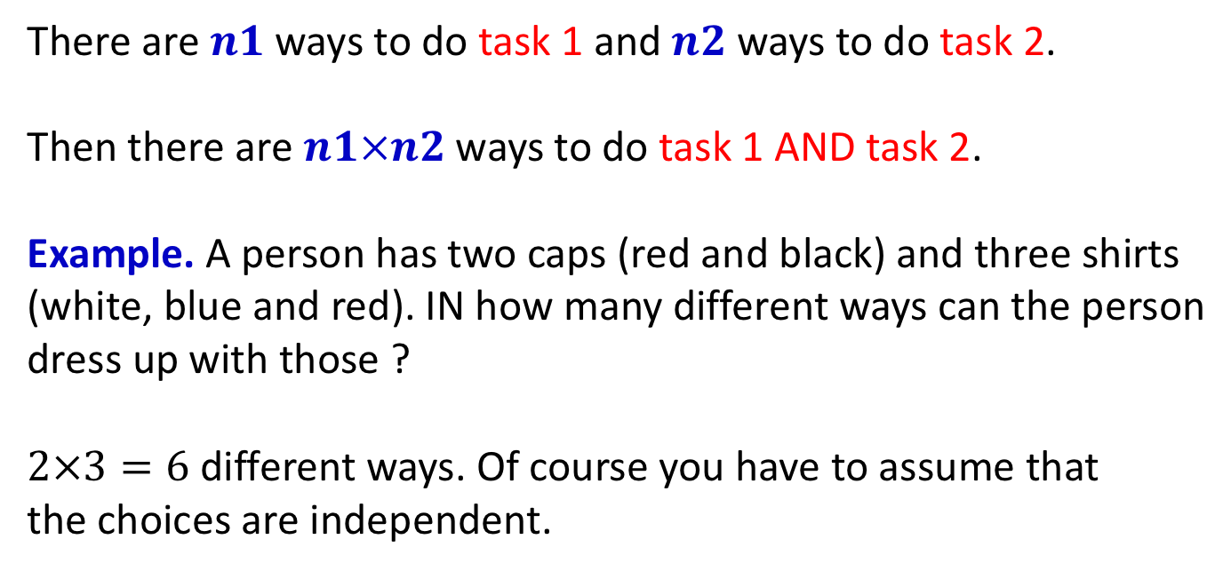
The Product Rule
There are $n1$ ways to do task 1 and $n2$ways to do task 2.
Then there are $n1×n2$ways to do task 1 AND task 2.
Example. A person has two caps (red and black) and three shirts
(white, blue and red). IN how many different ways can the person
dress up with those ?
$2×3=6$ different ways. Of course you have to assume that
the choices are independent.

Slide 3
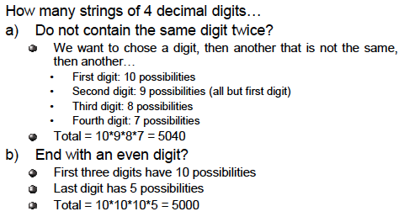
Example of Product Rule

Slide 4
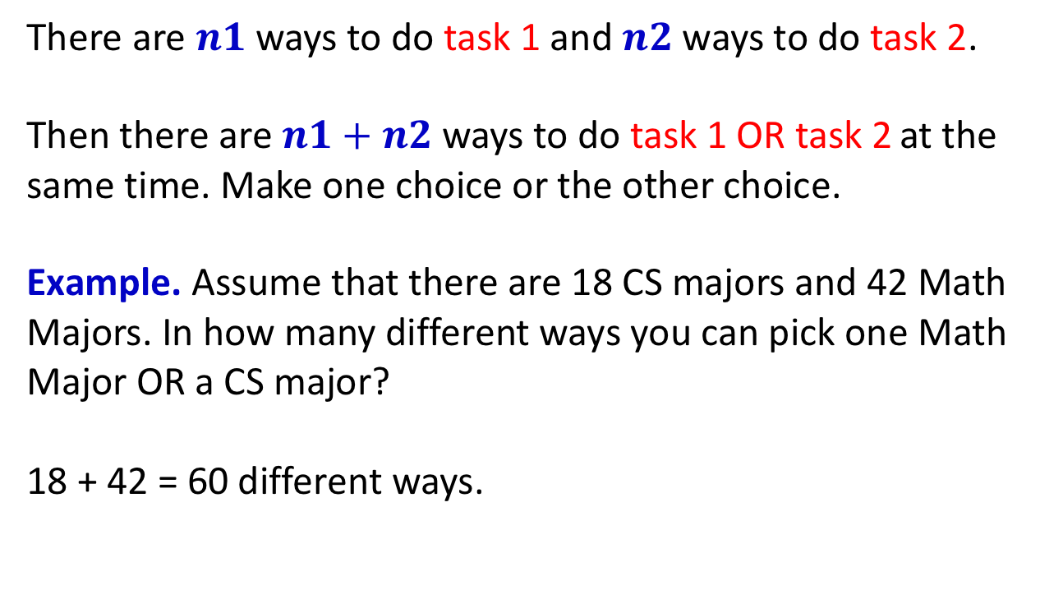
The Sum Rule
There are $n1$ ways to do task 1 and $n2$ways to do task 2.
Then there are $n1+n2$ways to do task 1 OR task 2 at the
same time. Make one choice or the other choice.
Example. Assume that there are 18 CS majors and 42 Math
Majors. In how many different ways you can pick one Math
Major OR a CS major?
18 + 42 = 60 different ways.

Slide 5
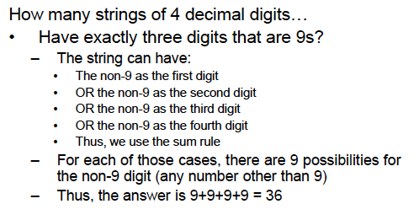
Example of Sum Rule

Slide 6
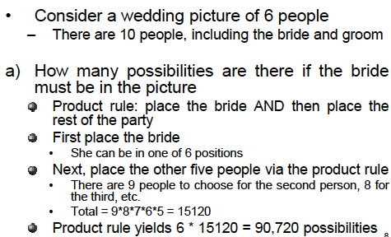
Wedding picture example

Slide 7
Wedding picture example

Slide 8
Counting subsets of a finite set
Let S be a finite set. Use product rule to show that the
number of different subsets of S is 2^{|S|}

Slide 9
Counting loops
How many times will the following program loop iterate
before the final solution is generated? What is the final
value of K?
K:=0
for i1: = 1 to n1
for i2 := 1 to n2
for i3:= 1 to n3
K:= K+1

Slide 10
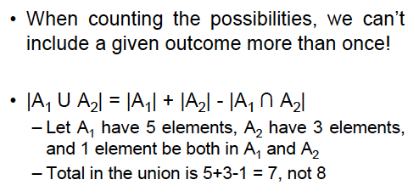
The Inclusion-Exclusion Principle

Slide 11
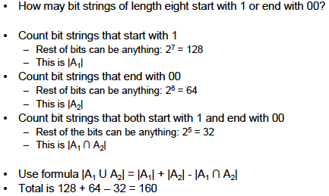
The Inclusion-Exclusion Principle

Slide 12
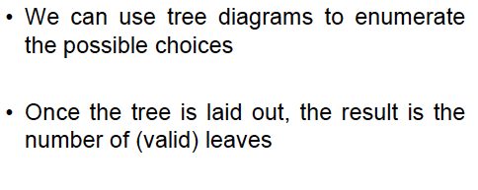
Tree diagrams

Slide 13
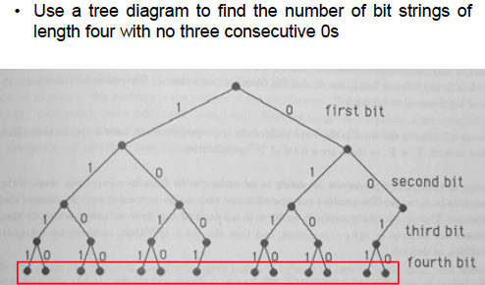
Tree diagrams

Slide 14
Pigeonhole Principle
If 20 pigeons fly into 19 pigeonholes, then at least one of
the pigeonholes must have two or more pigeons in it. Such
observations lead to the pigeonhole principle.
THE PIGEONHOLE PRINCIPLE. Let k be a positive integer. If
more than k objects are placed into k boxes, then at least
one box will contain two or more objects.

Slide 15
Application of Pigeonhole Principle
An exam is graded on a scale 0-100. How many students
should be there in the class so that at least two students
get the same score? (Do not consider scores with fractional points.)
Answer: More than 101.

Slide 16
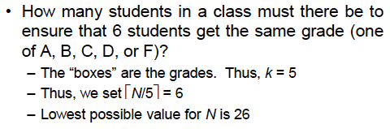
Generalized Pigeonhole Principle
If N objects are placed in k boxes, then there is at least
one box containing at least ꜒N/k˥objects.
Application 1.
In a class of 73 students, there are at least ꜒73/12˥=7 who are born in the same month.
Application 2.

Slide 17
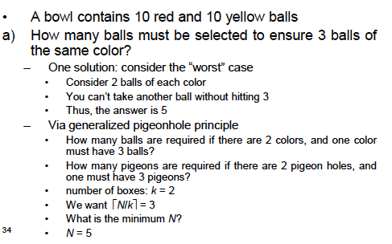
More examples

Slide 18
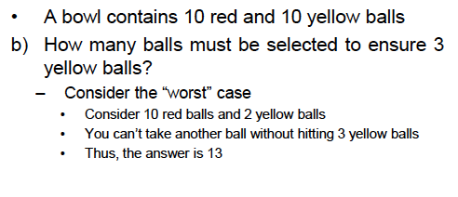
More examples

Slide 19
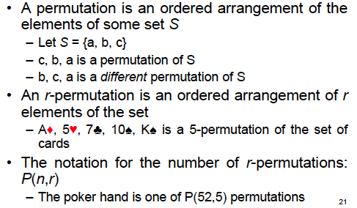
Permutation

Slide 20
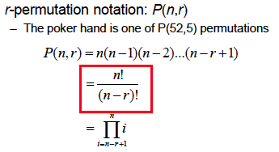
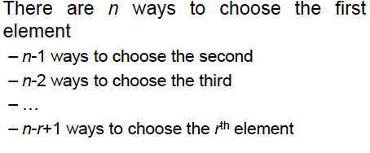
Permutation
Note that P (n, n) = n!

Slide 21
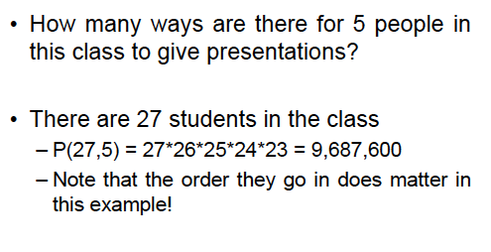
Example of permutation

Slide 22
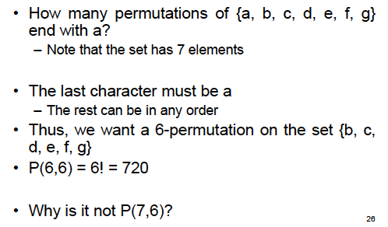
Exercise

Slide 23
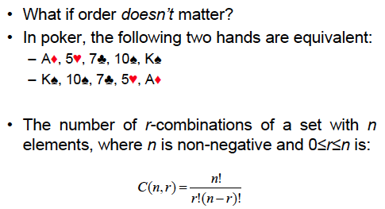
Combination
In permutation, order matters, in combination, it doesn’t.

Slide 24
Example of combination
In how many bit strings of length 10, there are
exactly four 1’s?
Answer: C(10, 4) = 210

Slide 25
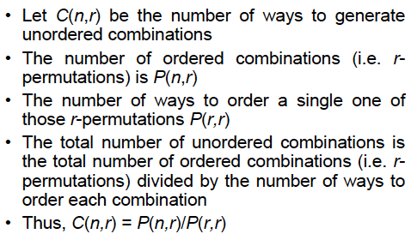
Proof of combination formula

Slide 26
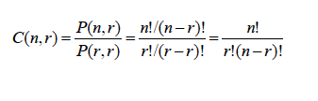
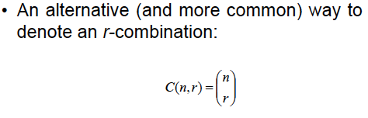
Proof of combination formula

Slide 27
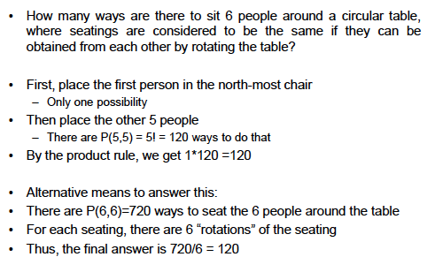
Circular seating

Slide 28
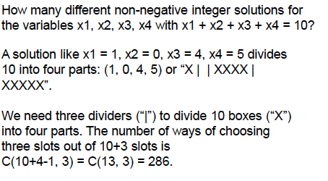
Other applications

Slide 29
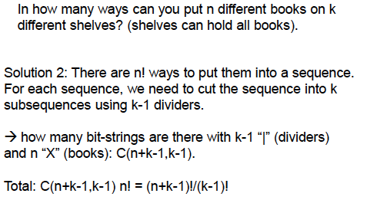
Book shelf problem

Slide 30
Pascal’s Identity
If n, k are positive integers and n ≥ k , then

Slide 31
Pascal’s Triangle

Slide 32
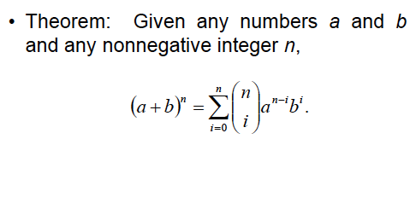
Binomial Theorem

Slide 33
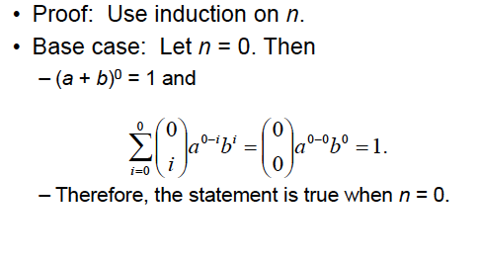
Proof of Binomial Theorem

Slide 34
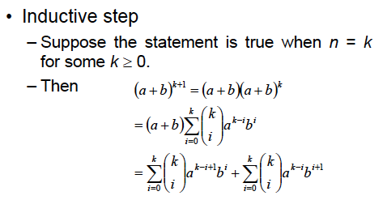
Proof of Binomial Theorem

Slide 35
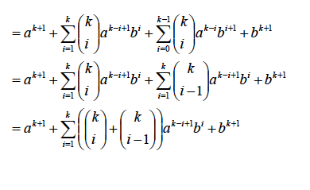
Proof of Binomial Theorem

Slide 36
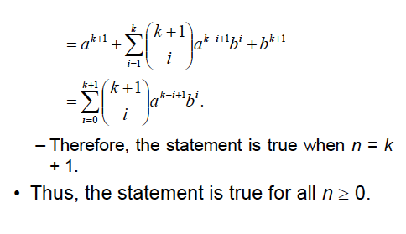
Proof of Binomial Theorem

Slide 37
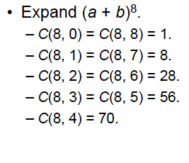
Example of Binomial Theorem

Slide 38
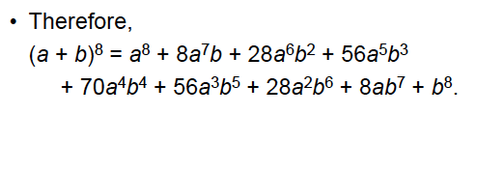
Example of Binomial Theorem

Slide 39
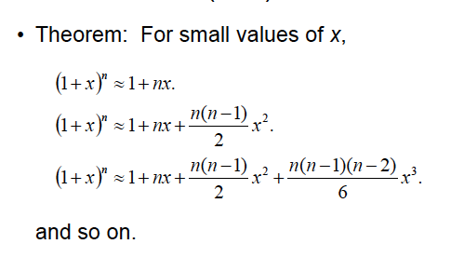
Example: Approximating (1+x)^{n}
The number of terms to be included will depend on the desired accuracy.

