Slide 1
CS 2210:0001Discrete Structures
Modular Arithmetic and Cryptography
Fall 2019
Sukumar Ghosh

Slide 2
Preamble
Historically, number theory was of interest in pure mathematics. However, in modern times, number theory has found important applications in the area of privacy and security. Encryption algorithms heavily depend on modular arithmetic, and our ability (or inability) to deal with large integers.

Slide 3
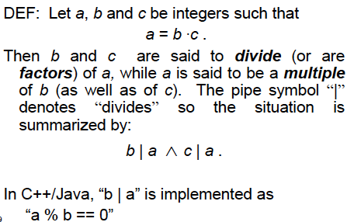
Divisors

Slide 4
Examples
77|7 is FALSE (Bigger number can’t divide a
smaller positive number)
7|77 is TRUE, because 77 = 7.11
24|24 is TRUE
1|2 is TRUE, but 2|1 is FALSE
0|24 is FALSE (No number is divisible by 0), but
24|0 is TRUE, since 0 is divisible by every non-zero number

Slide 5
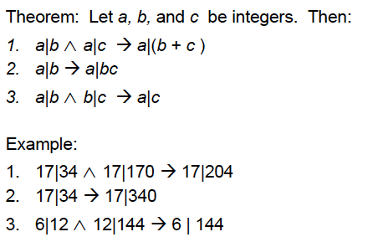
Divisor Theorem

Slide 6
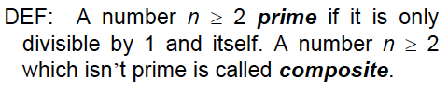

Prime Numbers

Slide 7
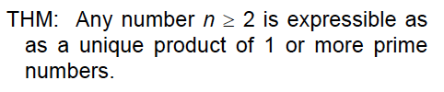

A theorem

Slide 8
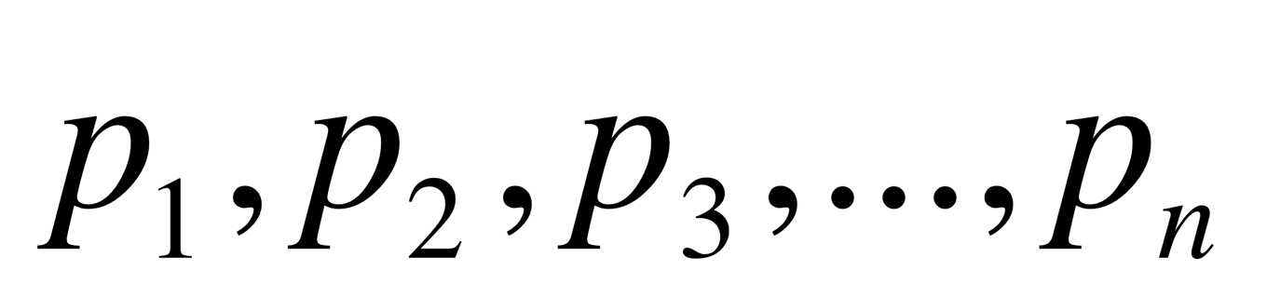
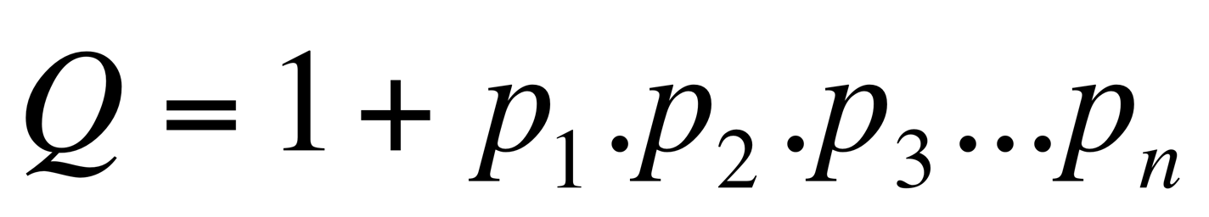
Another theorem
Theorem. There are infinitely many prime numbers.
Proof. Suppose it is not true, and let be the
complete set of primes that we have. Then
is a number that is not divisible by
any of the known primes p1-pn. We can thus conclude that
Either Q is a prime, or
Q has a prime factor that does not belong to the known set
of primes.
Either way, we discover one more new prime. So the set of
prime numbers must be infinite.

Slide 9

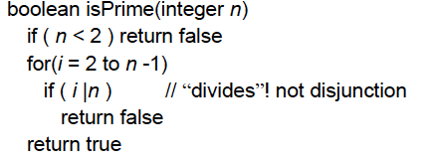
Testing Prime Numbers

Slide 10

Time Complexity
The previous algorithm has a time complexity O(n)
(assuming that a|b can be tested in O(1) time).
For an 8-digit decimal number, it is thus O(10⁸).
This is terrible. Can we do better?
Yes! Try only smaller prime numbers as divisors.

Slide 11


Primality testing theorem
Proof (by contradiction). Suppose the smallest prime factor p is greater than
Then n = p.q where q > p and p >
This is a contradiction, since the right hand side > n.

Slide 12
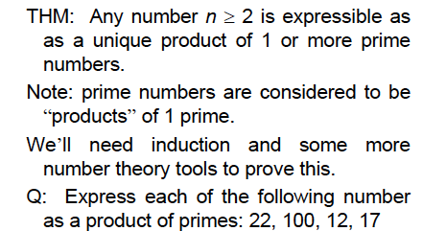
A Fundamental Theorem

Slide 13
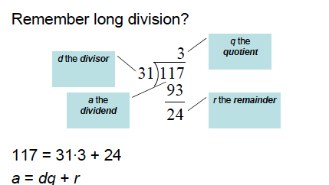
Division

Slide 14
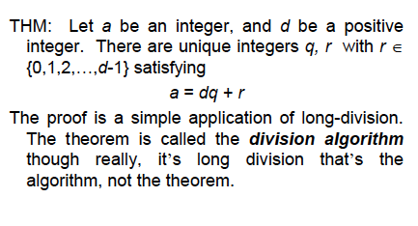
Division

Slide 15
Greatest Common Divisor
Definition.
Let a, b (a, b ≠ 0) be two integers. The greatest common divisor
gcd (a,b) is the largest integer that divides both a and b.
Definition.
a and b are relatively prime (also called co-prime or
mutually prime, when gcd (a,b) = 1

Slide 16
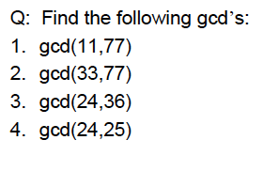
Greatest Common Divisor
Q: Compute gcd (36, 54, 81)

Slide 17
Euclid’s gcd Algorithm
procedure gcd (a, b)
x:= a; y := b (x>y)
while y ≠ 0
begin
r:= x mod y
x:= y
y:= r
end
The gcd of (a, b) is x.
Let a = 12, b= 21
gcd (21, 12)
= gcd (12, 9)
= gcd (9, 3)
Since 9 mod 3 = 0
The gcd is 3

Slide 18
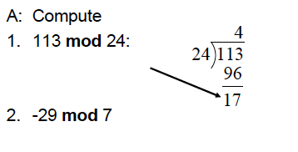
The mod Function

Slide 19
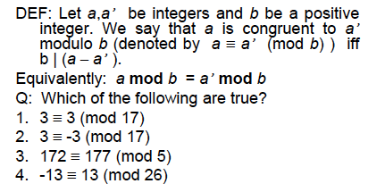
(mod) Congruence

Slide 20
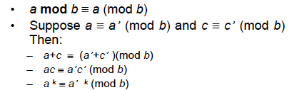
(mod) Congruence

Slide 21
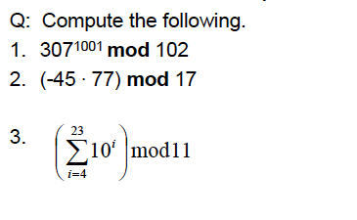
Modular Arithmetic: harder examples

Slide 22
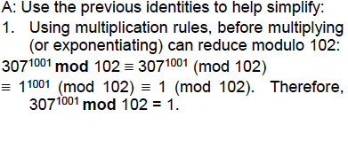
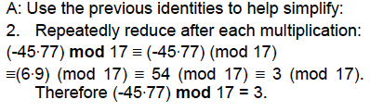
Modular Arithmetic: harder examples

Slide 23
Linear Congruence
A linear congruence is of the form
ax = b (mod m)
Where a, b, m are integers, and x is a variable.
To solve it, find all integers that satisfy this congruence
For example, what is the solution of 3x = 4 (mod 7)?

Slide 24
Discrete Logarithm
Consider y = 2^{x} mod 11 (11 is prime)
x=1, y=2 x=6, y=9
x=2, y=4 x=7, y=7
x=3, y=8 x=8, y=3
x=4, y=5 x=9, y=6
x=5, y=10 x=10, y=1
Each non-zero value in the set Z₁₁= {0,1,2,3,4,5,6,7,8,9,10} is a value of x for some y. In such a case, 2 is a primitive root of the set Z₁₁= {1,2,3,4,5,6,7,8,9,10} .

Slide 25
Discrete Logarithm
A primitive root modulo a prime number p is an
integer r in Z_{p} such that every nonzero element of
Z_{p} is a power of r

Slide 26
Discrete Logarithm
Given 2^{x} (mod 11) = y in the set {1,2,3,4,5,6,7,8,9,10} , you can find a unique value of x for a given y. We will say that x is the discrete logarithm of y (mod 11) (to the base 2).

Slide 27
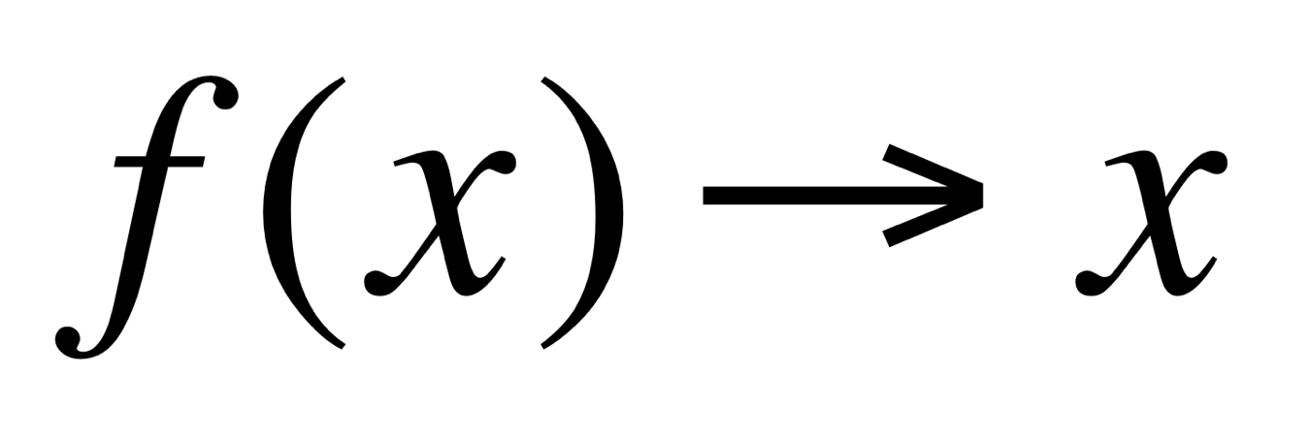
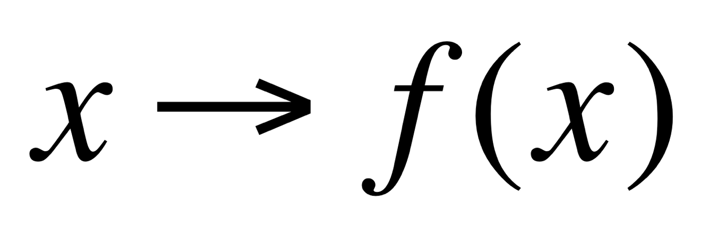
Discrete Logarithm
It is easy to compute 2^{x} (mod 11) = y. But it is extremely difficult to solve 2? (mod 11) = y. This is the discrete logarithm problem. For example, how difficult is it to compute g? mod p = q where p is a 100 digit prime number? This is a cornerstone of modern cryptography.
It is easy to compute
But is is extremely difficult to compute
One-way function

Slide 28
The Inverse
a mod m has an inverse a', if a.a’ ≡ 1 (mod m).
The inverse exists whenever a and m are relatively prime,
i.e. gcd (a, m) = 1.
Example. What is the inverse of 3 mod 7?
Since gcd (3, 7) = 1, it has an inverse.
The inverse is -2

Slide 29
Solution of linear congruence
Solve 3x ≡ 4 (mod 7)
First, compute the inverse of 3 mod 7. The inverse is -2.
(-6 mod 7 = 1 mod 7)
Multiplying both sides by the inverse,
-2. 3x = -2.4 (mod 7) = -8 (mod 7)
x = -8 mod 7 = -1 mod 7 = 6 mod 7 = ..

Slide 30
Chinese remainder theorem
In the first century, Chinese mathematician Sun-Tsu asked:
Consider an unknown number x. When divided by 3 the remainder is 2, when
divided by 5, the remainder is 3, and when divided by 7, the remainder is 2.
What is x?
This is equivalent to solving the system of linear congruences
x ≡ 2 (mod 3)
x ≡ 3 (mod 5)
x ≡ 2 (mod 7)

Slide 31
Chinese remainder theorem
Let m₁, m_{2,} m₃, …m_{n} be pairwise relatively prime integers, and
a₁, a₂,…, a_{n} be arbitrary integers. Then the system of equations
x ≡ a₁ (mod m₁)
x ≡ a₂ (mod m₂)
... … … …
x ≡ a_{n} (mod m_{n})
has a unique solution modulo m = m₁ m₂ m₃ ... m_{n}
[It is x = a₁ M₁ y₁ + a₂ M₂ y₂ + ... + a_{n} M_{n} y_{n},
where M_{k} = m/m_{k} and y_{k} = the inverse of M_{k} mod m_{k}]

Slide 32
Chinese remainder theorem
Apply the theorem to solve the problem posed by Sun-Tsu:
x ≡ 2 (mod 3) m₁=3
x ≡ 3 (mod 5) m₂=5
x ≡ 2 (mod 7) m₃=7
So, m = 3.5.7 = 105 and M₁=5.7=35, M₂=3.7=21, M₃=3.5= 15
M₁y₁=1 (mod 3), M₂y₂=1 (mod 5), M₃y₃=1 (mod 7)
So, y₁=2 (mod 3), y₂=1 (mod 5), y₃=1 (mod 7)
Therefore, x = 2.35.2 + 3.21.1 + 2.15.1 (mod 105)
= 233 (mod 105) = 23 (mod 105)

Slide 33
Fermat’s Little Theorem*
If p is prime and a is an integer not divisible by p, then
a^{p-1} = 1 (mod p)
This also means that a^{p} = a (mod p)
* Should not be confused with Fermat’s Last theorem

Slide 34
Fermat’s Little Theorem
Compute 7²²² (mod 11)
7²²² (mod 11) = (7¹⁰)²² . 7² (mod 11)
7¹⁰ (mod 11) =1 (Fermat’s little theorem)
7²²² (mod 11) = 1²².49 (mod 11) = 49 (mod 11) = 5 (mod 11)

Slide 35
More on prime numbers
Are there very efficient ways to generate prime numbers?
Ancient Chinese mathematicians believed that n is a prime
if and only if
2^{n-1} = 1 (mod n)
For example 2⁷⁻¹ = 1 (mod 7) (and 7 is a prime)
But unfortunately, the “if” part is not true. Note that
2³⁴¹⁻¹ = 1 (mod 341),
But 341 is not prime (341 = 11 X 31).
(these are called pseudo-prime numbers).
When n is composite, and b^{n-1} = 1 (mod n), n is called a pseudo-prime to the base b

Slide 36
Modular Exponentiation
A computationally efficient way to compute a^{x} mod b when x is large. The key idea is to represent x in the binary form first.
Example. What is 3¹³³ mod 645?
3¹³³ mod 645 = 3¹⁰⁰⁰⁰¹⁰¹ mod 645 = 3¹²⁸⁺⁴⁺¹ mod 645
3¹ mod 645 = 3, 3² mod 645 = 9, 3⁴ mod 645 = 81
3⁸ mod 645 = 81² mod 645 = 111
3⁶⁴ mod 845 = 111² mod 645 = 66
3¹²⁸ mod 845 = 66² mod 645 = 486
So, 3¹²⁸⁺⁴⁺¹ mod 645 = 486.81.3 mod 645 = you calculate

Slide 37
Applications of Congruence
Hashing function
A hashing function is a mapping
key ➞ a storage location
(larger domain) (smaller size storage)
So that it can be efficiently stored
and retrieved.
0
1
2
m-2
m-1

Slide 38
Applications of Congruence:
Hashing function
A hashing function maps data of arbitrary size to fixed or smaller size values. The values returned by a hash function are called hash values, digests, or simply hashes.
Assume that University of Iowa plans to maintain a record of its 5000 employees using SSN as the key. How will it assign a memory location to the record for an employee with key = k? One solution is to use a hashing function h like
h(k) = k² mod m
(where m = number of available memory locations, m ≥ 5000)
0
1
2
m-2
m-1

Slide 39
Hashing functions
A hashing function (a.k.a hash function) must be easy to evaluate. There is a risk of collision (two keys mapped to the same location), but in that case the first free location after the occupied location has to be assigned by the hashing function.
For good hashing functions, collisions are rare.
0
1
2
Key k1
Collision
Key 2
m-2
m-1

Slide 40
Applications of Congruence:
Parity Check
When a string of n bits b₁ b₂ b₃ … b_{n} is transmitted, sometimes a single bit is corrupted due to communication error. To safeguard this, an extra bit b_{n+1} is added. The extra bit is chosen so that mod 2 sum of all the bits is 0 (for even parity) or 1 (for odd parity).
1 1 0 1 0 1 0
0 1 0 1 1 0 0 1 1 1 (even parity bit in red)
Parity checking helps detect such transmission errors. Works for single bit corruption only

Slide 41
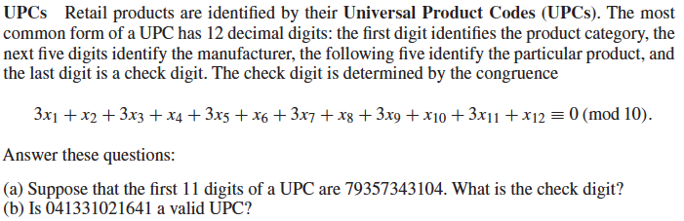
Applications of Congruence:
UPC

Slide 42
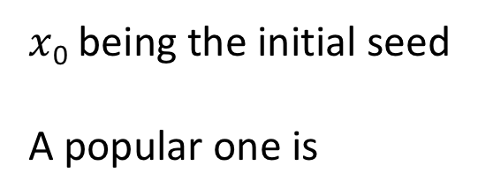
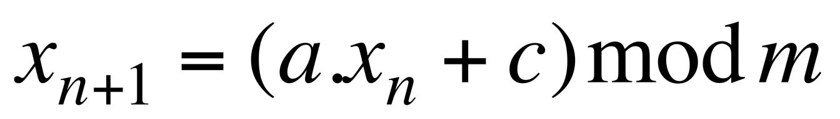
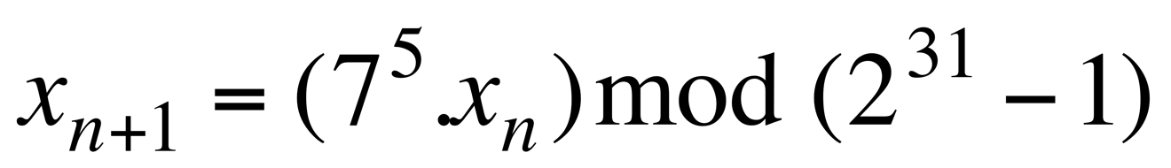
Applications of Congruence:
Pseudo-random number generation
Consider the recursive definition:
It generates a pseudo-random sequence (what is this?) of numbers
where
$x$₀ being the initial seed
A popular one is

Slide 43
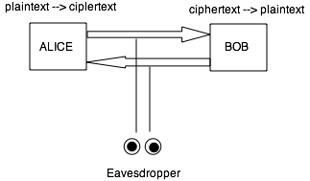
Cryptography

Slide 44
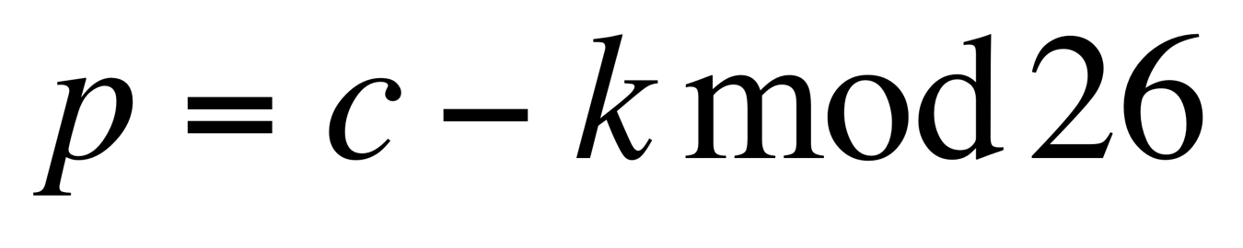
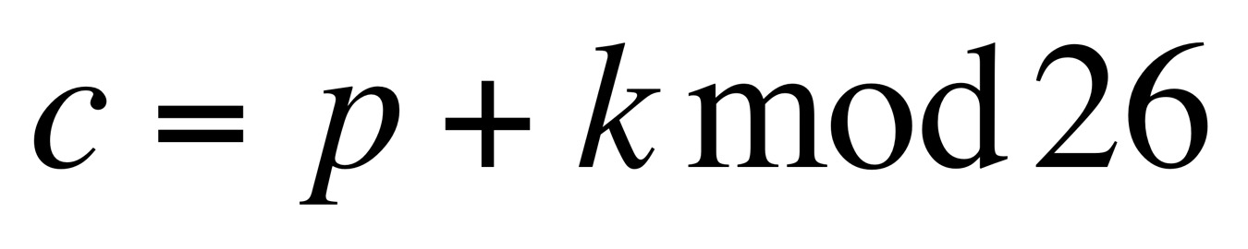
Private Key Cryptography
The oldest example is Caesar cipher used by Julius Caesar to
communicate with his generals.
For example, LOVE ➞ ORYH (circular shift by 3 places)
In general, for Caesar Cipher, let
p = plain text c= cipher text, k = encryption key (secret)
The encryption algorithm is
The decryption algorithm is
Both parties must share a common secret key.

Slide 45
Private Key Cryptography
One problem with private key cryptography is the distribution of the private key. To send a secret message, you need a key. How would you transmit the key? Would you use another key for it?
This led to the introduction of public key cryptography

Slide 46
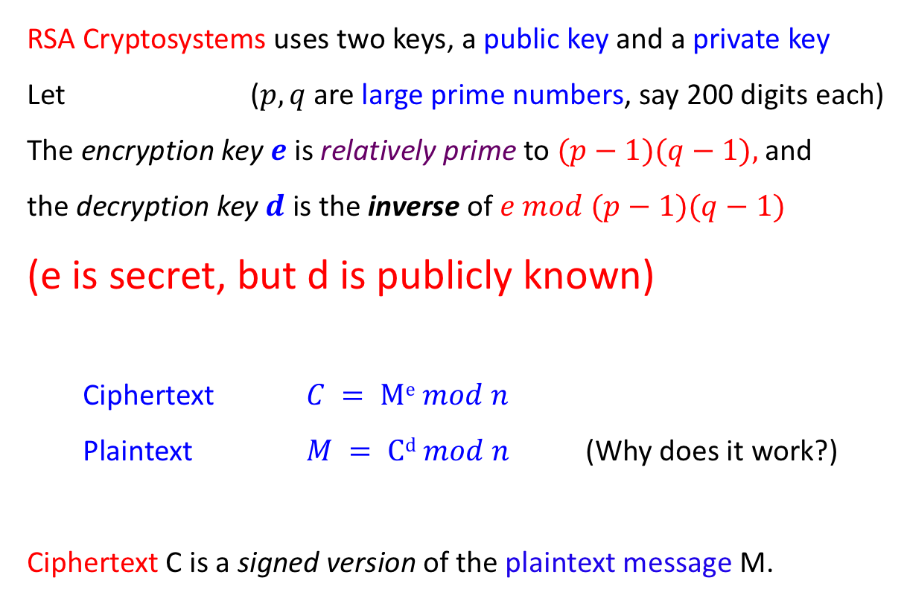
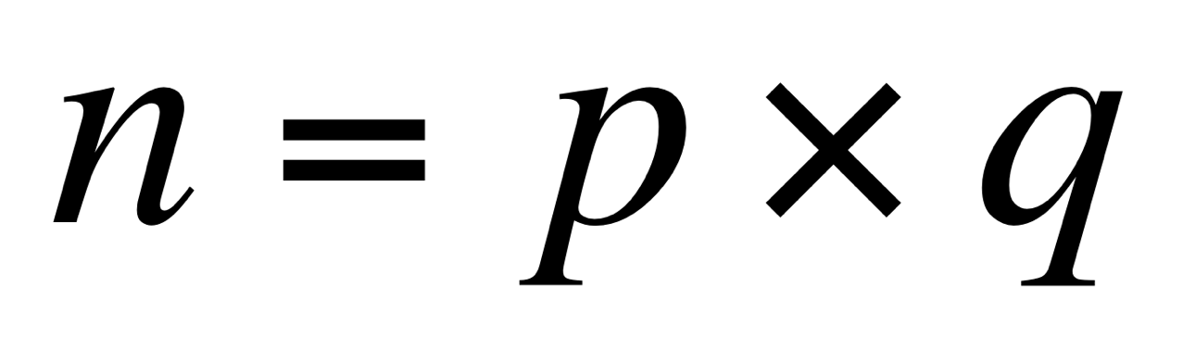
Public Key encryption
RSA Cryptosystems uses two keys, a public key and a private key
Let ($p, q$are large prime numbers, say 200 digits each)
The encryption key $e$ is relatively prime to $(p−1)(q−1),$and
the decryption key $d$ is the inverse of $e mod (p−1)(q−1)$
(e is secret, but d is publicly known)
Ciphertext $C = Me mod n$
Plaintext $M = Cd mod n$ (Why does it work?)
Ciphertext C is a signed version of the plaintext message M.

Slide 47
Public Key encryption
.
Anyone receiving C can find out M, and Alice cannot say
“I didn’t send the message”, since it is signed by her. No
one else could have done it.

Slide 48
Public Key encryption
.

Slide 49
Example
n = 43 x 59 = 2537 (i.e. p = 43, q = 59). Everybody knows n. but nobody knows p or q – they are secret.
(p-1)(q-1) = 42 x 58 = 2436
Encryption key e = 13 (must be relatively prime with 2436) (secret).
Decryption key d = 937 (is the inverse of e mod (p-1)(q-1)) (public knowledge)
Encrypt 1819: 1819¹³ mod 2537 = 2081
Decrypt 2081: 2081⁹³⁷ mod 2537 =1819

Slide 50
Proof of RSA encryption
Ciphertext C = Me mod n
C^{d} = M^{d.e} = M^{1+k(p-1)(q-1)} mod n (Here n = p.q)
(since d is the inverse of e mod (p-1)(q-1), d.e = 1 mod (p-1)(q-1)
= M .(M^{(p-1)})^{k(q-1)} mod n
Usually, M is not a multiple of p or q
Now, C^{d} = M .(M^{(p-1)})^{k(q-1)} mod p = M.1 mod p
(Using Fermat’s Little Theorem: M^{(p-1)} = 1 mod p)
Similarly, C^{d} = M .(M^{(q-1)})^{k(p-1)} mod q = M.1 mod q

Slide 51
Proof of RSA encryption (continued)
C^{d} = M mod p
C^{d} = M mod q
Since gcd (p,q) = 1,
C^{d} = M.1 mod p.q (Chinese Remainder Theorem)
So, C^{d} = M mod n
Why is it difficult to break into RSA encryption?

