Slide 1
CS 2210:0001 Discrete Structures Sets and Functions
Fall 2019
Sukumar Ghosh

Slide 2
What is a set?
Definition. A set is an unordered collection of objects.
S = {2, 4, 6, 8, …}
COLOR = {red, blue, green, yellow}
Each object is called an element or a member of the set.

Slide 3
Well known Sets
Well known sets
N = {0, 1, 2, 3 …} the set of natural numbers
Z = {…, -2, -1, 0, 1, 2, …} the set of integers
Z+ = {1, 2, 3, …} the set of positive integers
R = the set of real numbers
Note. Some also define N as {1, 2, 3, …}. There does not seem to be a general agreement of whether the element 0 should belong to N.

Slide 4
Set builders
A mechanism to define the elements of a set.
This means, S = {1, 3, 5, 7, 9, 11, 13, 15, 17, 19}
Belongs to,
an element of

Slide 5
Venn diagram
i
e
u
a
o
The set V of vowels
The universal set U contains all objects under consideration

Slide 6
Sets and subsets
The null set (or the empty set} ∅ contains no element.
A ⊆B (A is a subset of B) if every element is also an element of B.
Thus
{1, 2} ⊆ N, S ⊆ S,
∅ ⊆ any set
A ⊂ B (called a proper subset of B) if A ⊆B and A ≠ B
The cardinality of S (|S|) is the number of distinct elements in S.

Slide 7
Power Set
Given a set S, its power set is the set of all subsets of S.
Let S = (a, b, c}
power set of S = {∅, {a}, {b}, {c}, {a, b}, {b, c}, {a, c} {a, b, c}
Question. What is the cardinality of the power set of S?

Slide 8
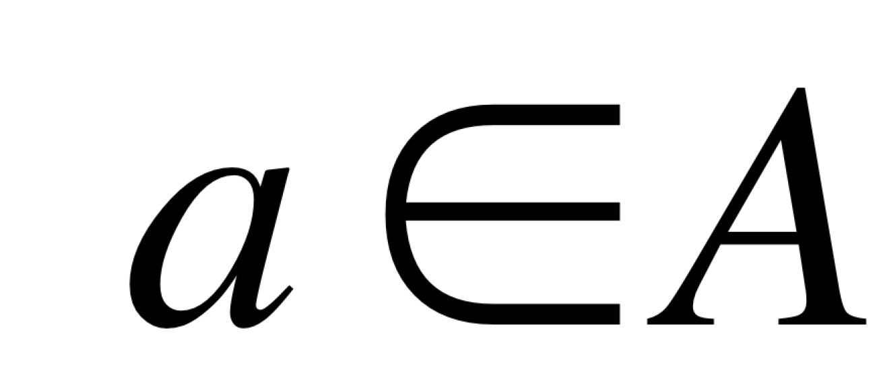
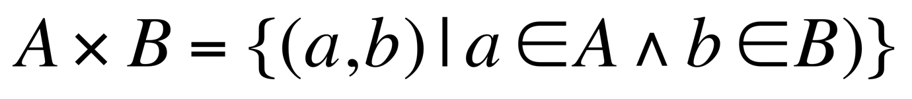
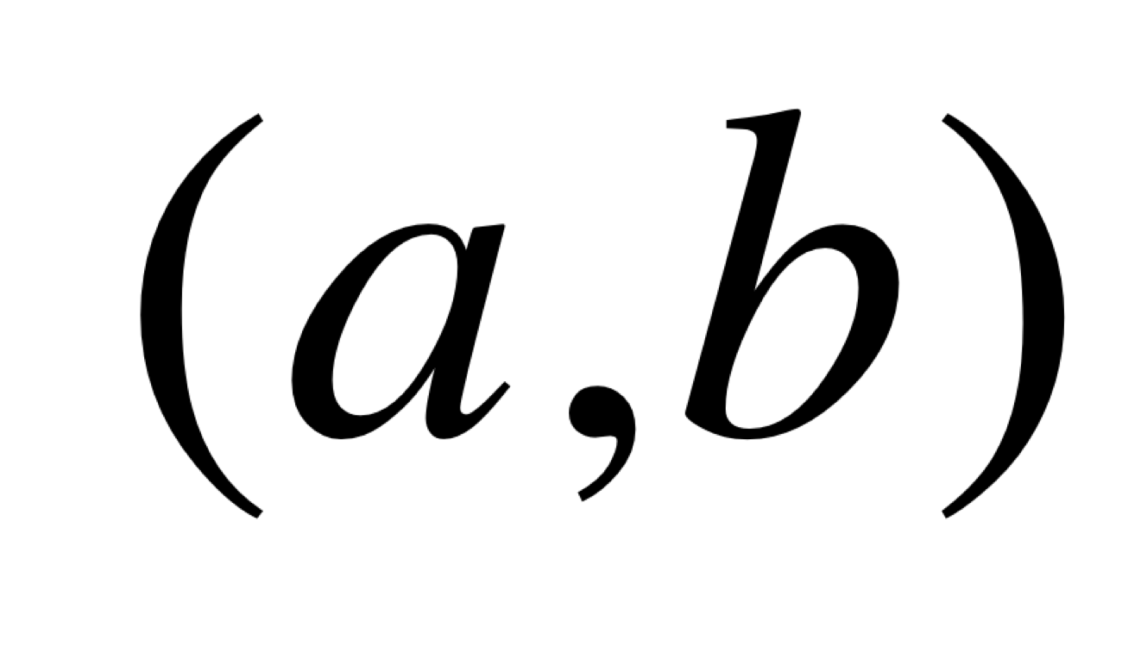
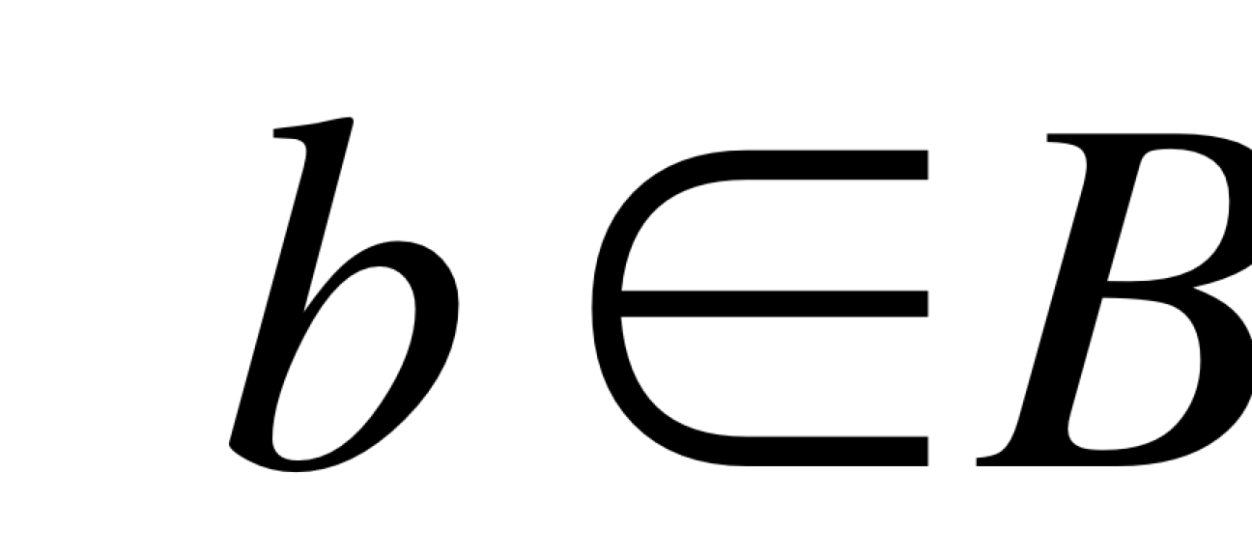
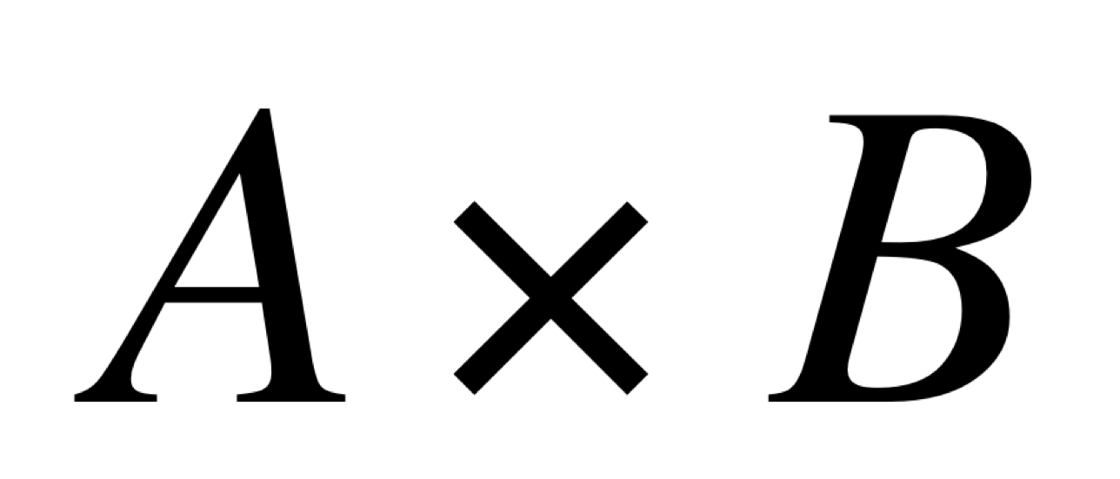
Cartesian Product of Sets
Ordered pair. It is a pair (a, b) for which the order is important (unlike a set)
Example. The coordinate (x, y) of a point. (3, 5) is not the same as (5,3), so the order matters.
Cartesian Product. The Cartesian product of two sets A, B, denoted by is the set of all ordered pairs
Where and . Thus

Slide 9
Example of Cartesian Product
Cartesian Product of Set (Example)
A = {a1, a2, a3} B= {b1, b2}
A ⨉ B = {(a1, b1), (a1, b2), (a2, b1), (a2, b2), (a3, b1), (a3, b2)}
We define A² = A X A, A³ = A² X A and so on.
Thus, {0, 1}³ = {(0,0,0), (0,0,1), (0,1,0), (0,1,1), (1,0,0), (1,0,1), (1,1,0), (1,1,1)}
Exercise. {a, b, c}² =?

Slide 10
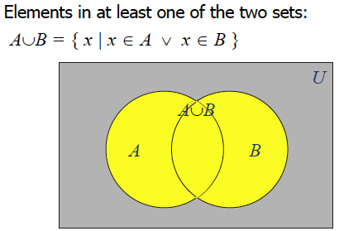
Union of Sets

Slide 11
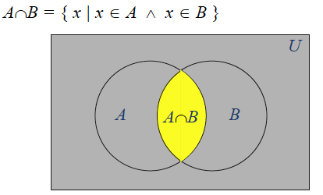
Intersection of Sets
Set of elements that belong to both sets

Slide 12
Union and Intersection
Let A = {1, 2, 3, 4, 5} and B = {0, 2, 5, 8}
Then A ⋃ B = {0, 1, 2, 3, 4, 5, 8} (A union B)
And A ⋂ B = {2, 5} (A intersection B)

Slide 13
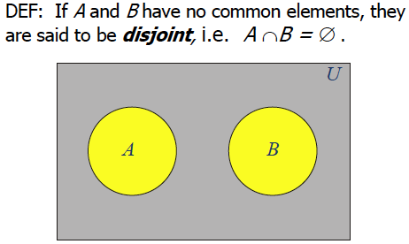
Disjoint Sets

Slide 14
Set difference & complement
Let A = {1, 2, 3, 4, 5} and B = {0, 2, 5, 8}
A – B = {x | x ∈A ∧ x ∉ B}
So, in this case, A – B = {1, 3, 4}
Also A = {x | x ∉ A}

Slide 15
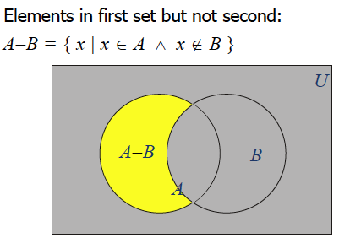
Set difference

Slide 16
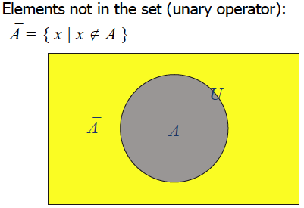
Complement

Slide 17
Set identities
Recall the laws (also called identities or theorems) with propositions (see page 27).
Each such law can be transformed into a corresponding law for sets.
Identity law
Domination law
Idempotent laws
Double negation
Commutative law
Associative law
De Morgan’s law
Absorption law
Negation law
Replace ⋁ by ⋃
Replace ⋀ by ⋂
Replace ¬ by complementation
Replace F by the empty set
Replace T by the Universal set U

Slide 18
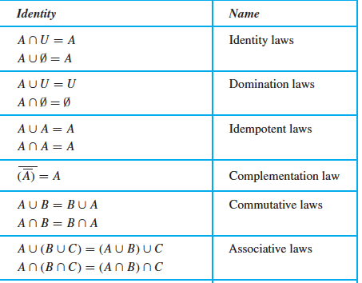
Set identities

Slide 19
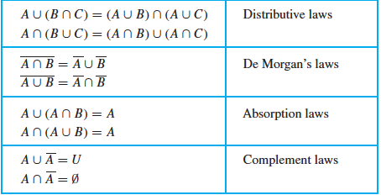
Set identities

Slide 20
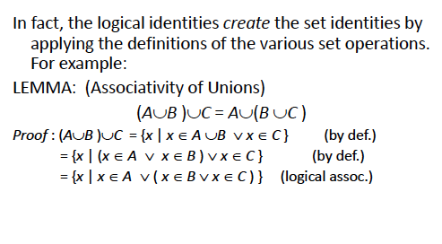
Example of set identity

Slide 21
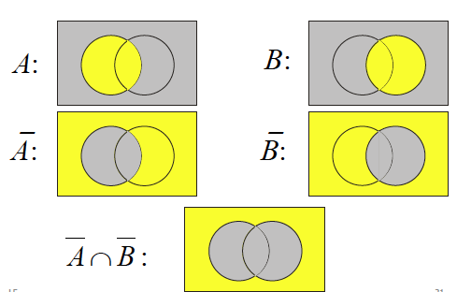
Visualizing DeMorgan’s theorem

Slide 22
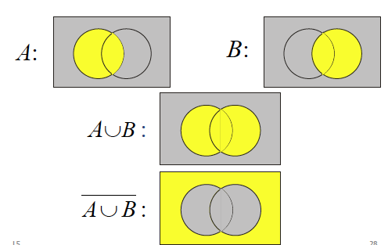
Visualizing DeMorgan’s theorem

Slide 23
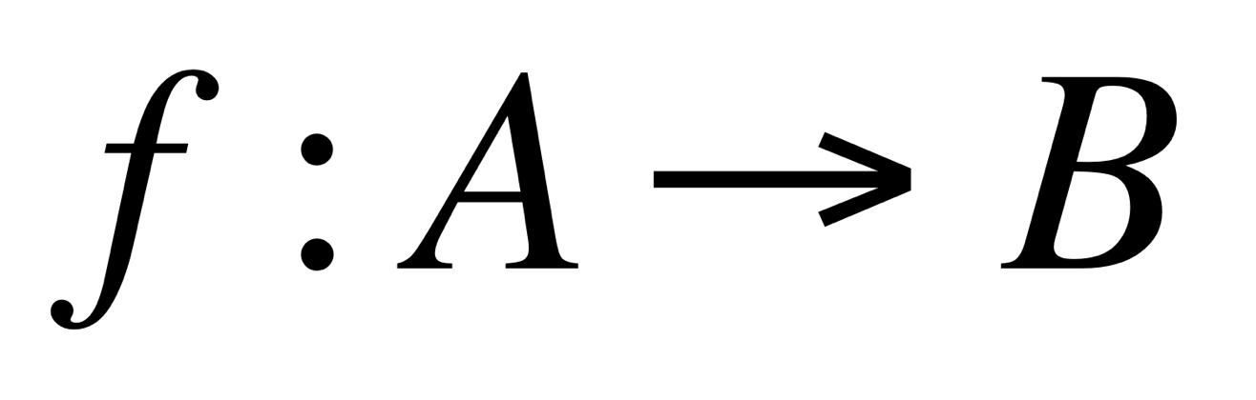
Function
Let A, B be two non-empty sets. (Example: A = set of students,
B = set of integers). Then, a function f assigns exactly one element
of B to each element of A
Also called mapping or transformation …
(As an example, if the function f is age, then it “maps” each student from set A
To an integer from B to like age (Bob) = 19, age (Alice) = 21 …}
function
Co-domain
domain

Slide 24
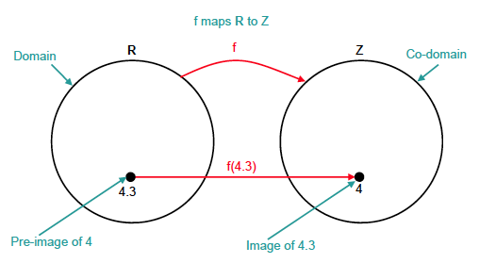
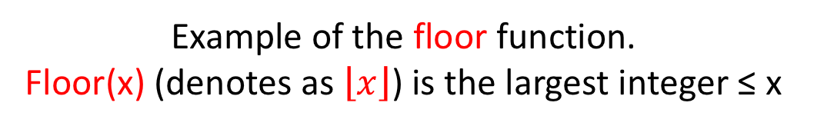
The Floor function
Example of the floor function.
Floor(x) (denotes as $\left\lfloor x\right\rfloor$) is the largest integer ≤ x

Slide 25
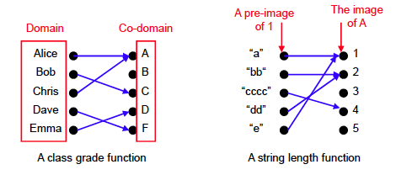
More examples

Slide 26
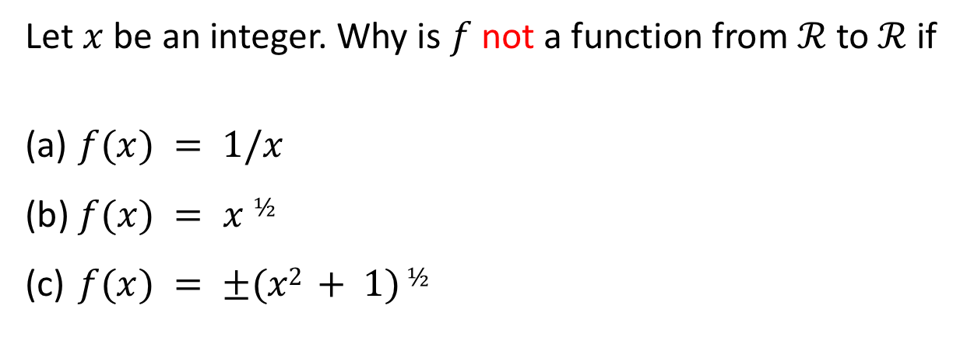
Exercises
Let $x$ be an integer. Why is $f$ not a function from $ℛ$ to $ℛ$ if
$f(x) = 1/x$
$f(x) = x ½$
$f(x) = ±(x2 + 1) ½$

Slide 27
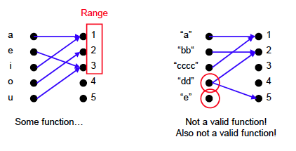
More examples
What is the distinction between co-domain and range?

Slide 28
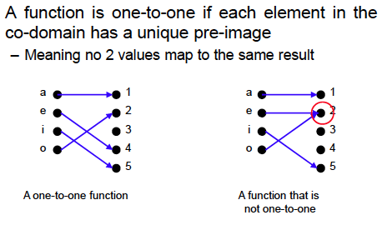
One-to-one functions
The term injective is synonymous with one-to-one

Slide 29
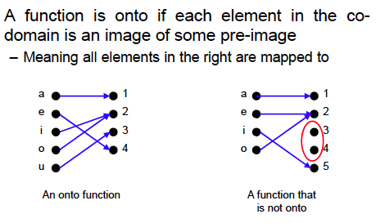
Onto Functions
The term surjective is synonymous with onto.

Slide 30
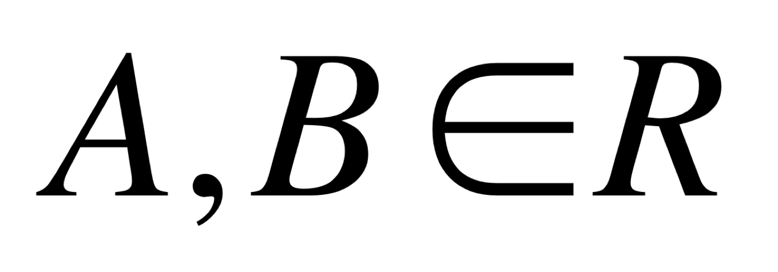
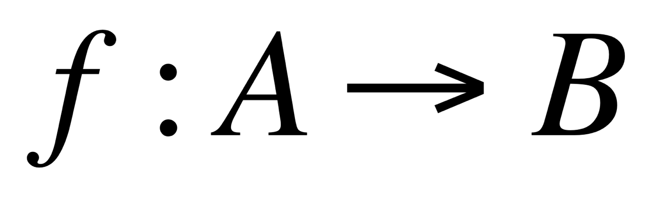
Strictly increasing functions
Let where the set of real numbers
The function f is called strictly increasing if f(x) < f(y), whenever x < y . One can define strictly decreasing functions in the same way.
Is a strictly increasing function a one-to-one function?

Slide 31
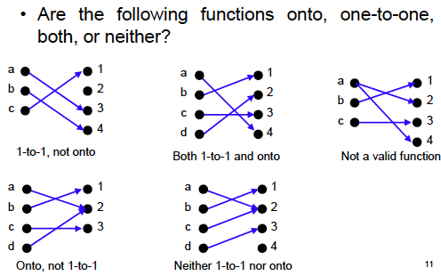
Exercise
1-to-1 and onto function are called bijective.

Slide 32
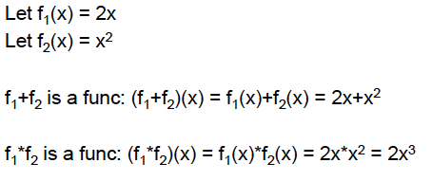
Arithmetic Functions

Slide 33
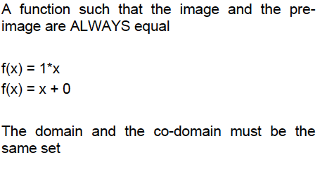
Identity Function

Slide 34
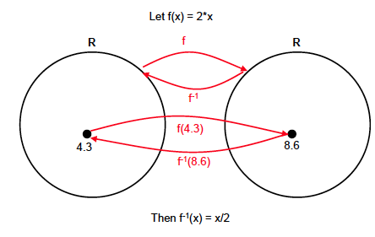
Inverse Function

Slide 35
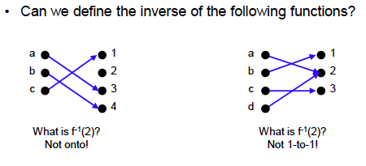
Inverse Function
Inverse functions can be defined only if the original function is
one-to-one and onto

Slide 36
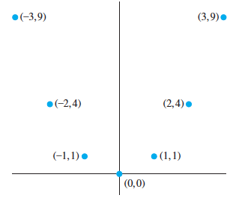
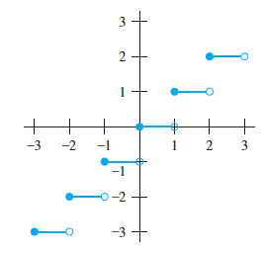
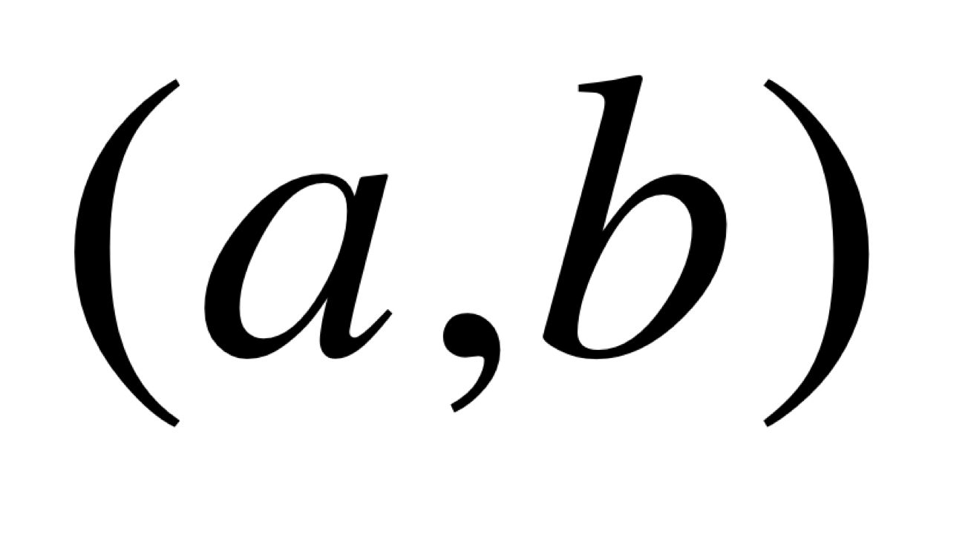
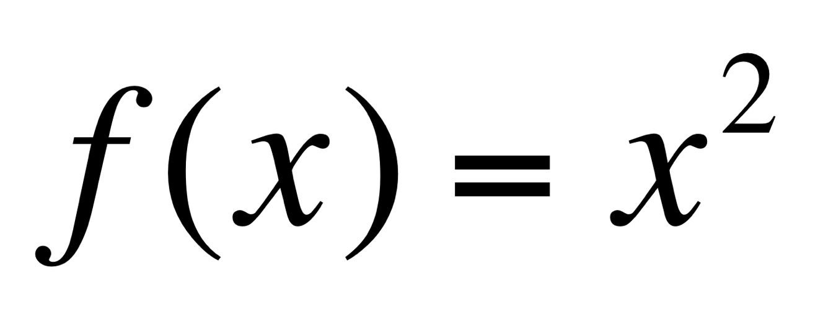
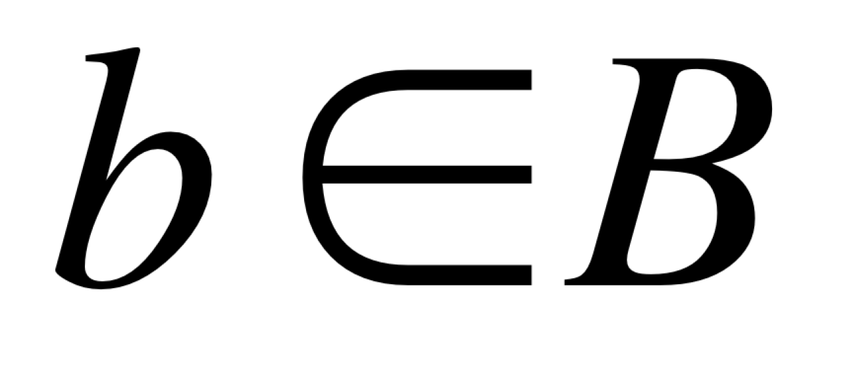
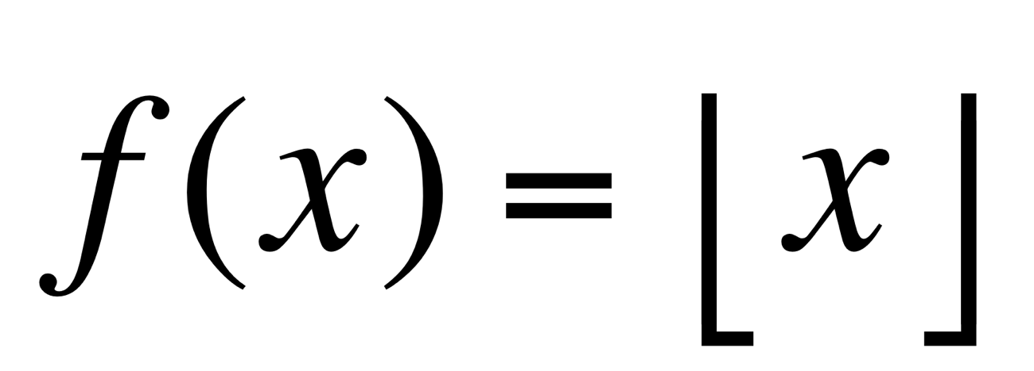
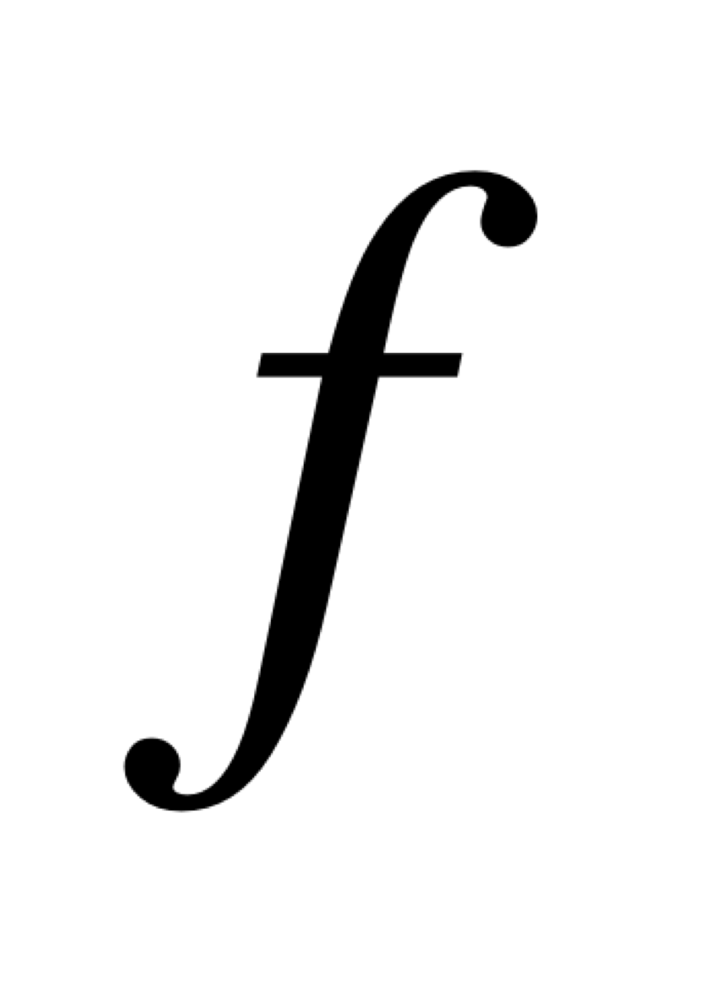
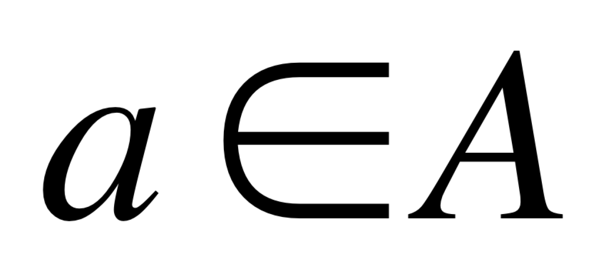
Graph of a function
Let . Then the graph of is the set of ordered pairs
such that and that can be displayed as
a graph.
The floor function

Slide 37
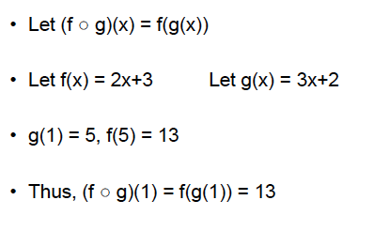
Composition of functions
Note that f(g(x) is not necessarily equal to g(f(x)

Slide 38
Some common functions
Floor and ceiling functions
Exponential function e^{x}
Logarithmic function log x
The function sqrt (x)
Question. Which one grows faster? Log x or sqrt (x)?
Learn about these from the book (and from other sources).

Slide 39
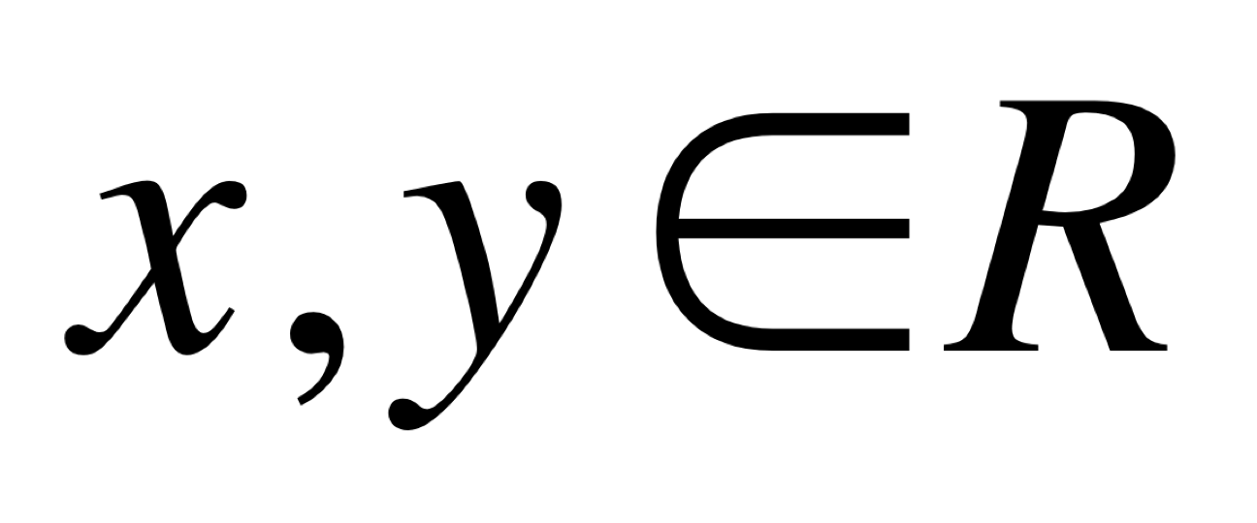
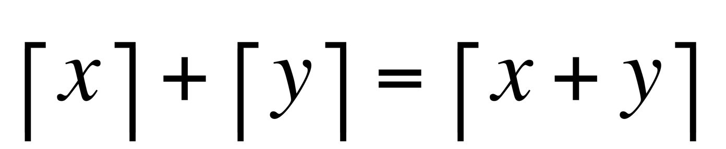
Exercises on functions
1. Let be real numbers. Then prove or disprove

Slide 40
Countable sets
Cardinality measures the number of elements in a set.
DEF. Two sets A and B have the same cardinality, if and only if
there is a one-to-one correspondence from A to B.
Can we extend this to infinite sets?
DEF. A set that is either finite or has the same cardinality
as the set of positive integers is called a countable set.

Slide 41
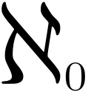
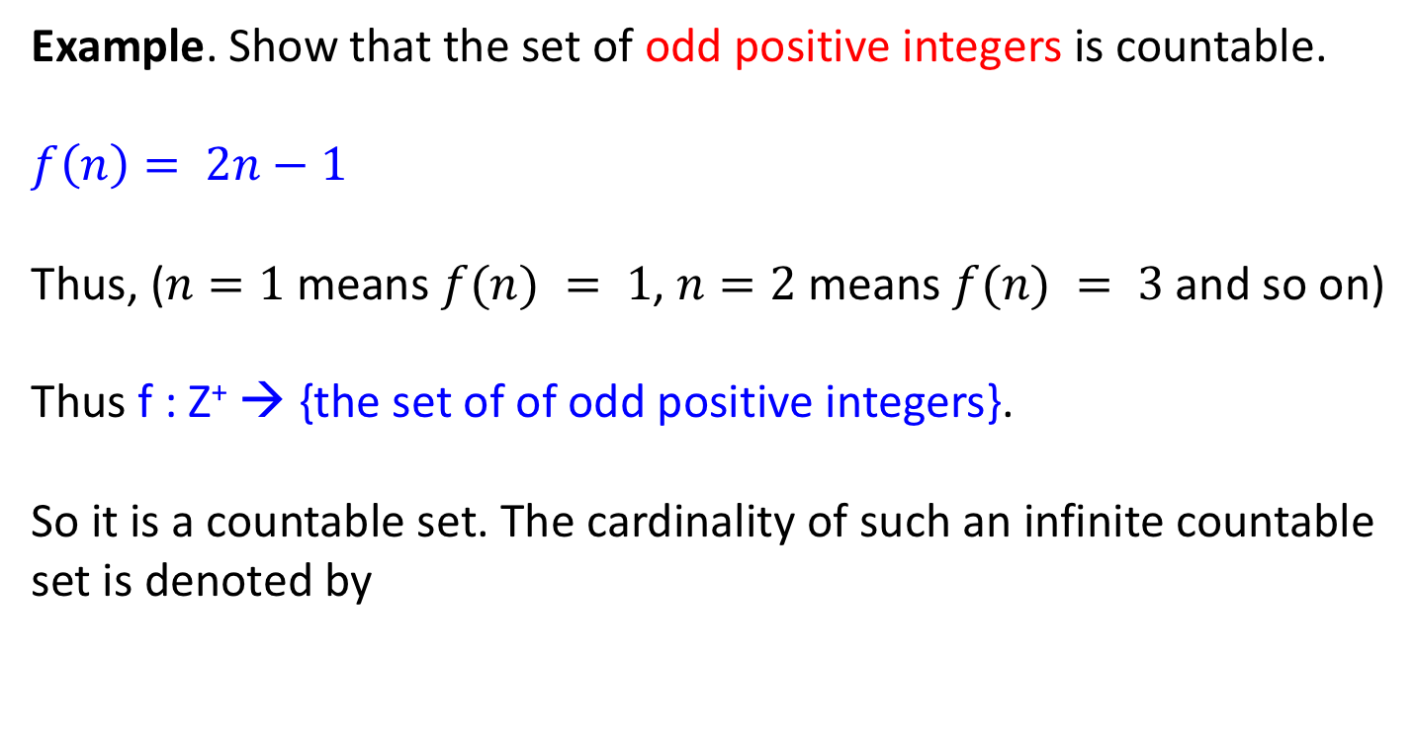
Countable sets
Example. Show that the set of odd positive integers is countable.
$$f\left(n\right)= 2n−1$$
Thus, ($n=1$means $f(n) = 1$, $n=2$means $f(n) = 3$and so on)
Thus f : Z⁺ → {the set of of odd positive integers}.
So it is a countable set. The cardinality of such an infinite countable
set is denoted by
(called aleph null)
Larger and smaller infinities ….

Slide 42
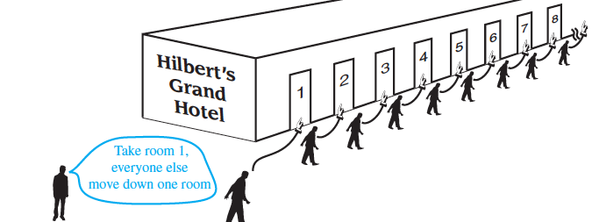
Fun with infinite sets Hilbert’s Grand Hotel
Accommodates a finite number of guests in a full hotel

Slide 43
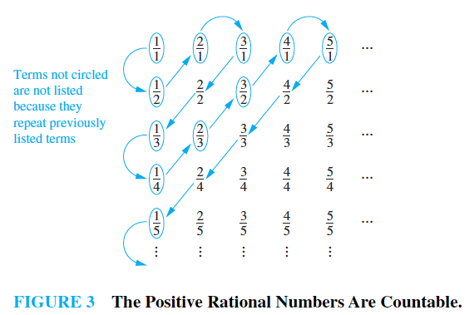
Countable sets
Theorem. The set of rational numbers is countable.
1
3
4
2
5
Counting follows the
direction of the arrows, and
you cover all real numbers

Slide 44
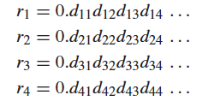

Countable sets
Theorem. The set of real numbers is not countable.
(See pp 173-174 of your textbook)
Proof by contradiction. Consider the set of real numbers between 0 and 1 and list them as
Create a new number
r = 0.d₁.d₂.d₃.d₄… where
(Here, r₁ is the first number, r₂ is the second number, and so on).
But r is a new number different from the rest! So how can you
assign a unique serial number to it?

