Slide 1
CS 2210 Discrete Math
Graphs
Fall 2019
Sukumar Ghosh

Slide 2
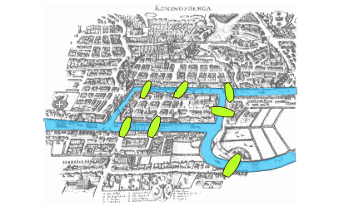
Seven Bridges of K⍥nigsberg
Is it possible to walk along a route that
crosses each bridge exactly once?

Slide 3
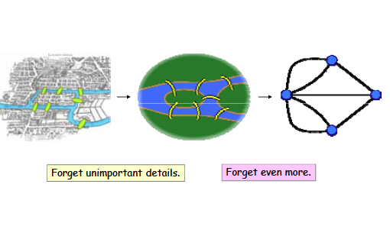
Seven Bridges of K⍥nigsberg

Slide 4
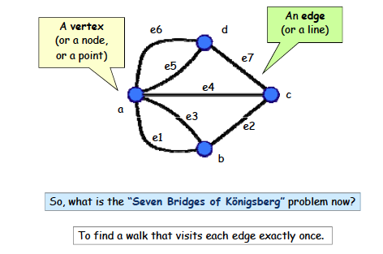
A Graph

Slide 5
What is a Graph
A graph G = (V, E) consists of V, a nonempty set of vertices
(or nodes) and E, a set of edges. Each edge connects a pair
of nodes that are called its endpoints.
Graphs are widely used to model various systems in the
real world

Slide 6
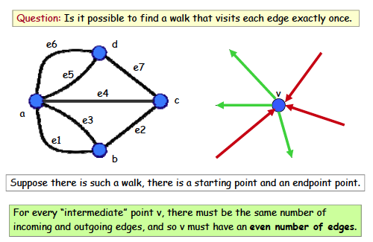
Back to the Bridges of K⍥nigsberg

Slide 7
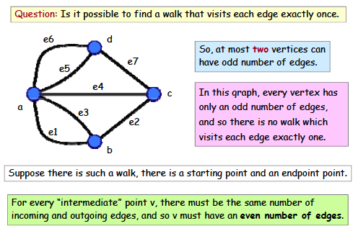
Euler’s solution

Slide 8
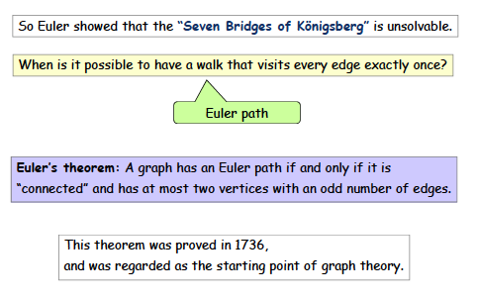
Euler path

Slide 9
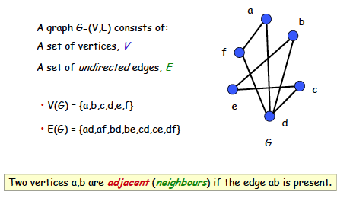
Simple graph

Slide 10
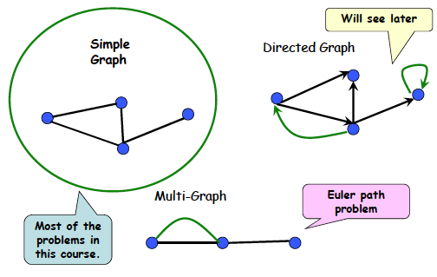
Types of graph
At most one edge between a pair of nodes
Multiple edges between some pair of nodes

Slide 11
More examples of graphs
Each node denotes an actor or an actress, and each edge between P and Q denotes that P, Q worked together in some movie. It is an undirected graph
Hollywood graph
Each node denotes a web page, and each edge from page P to Q Q denotes a link on page P pointing to page Q.
It is a directed graph
Web graph

Slide 12
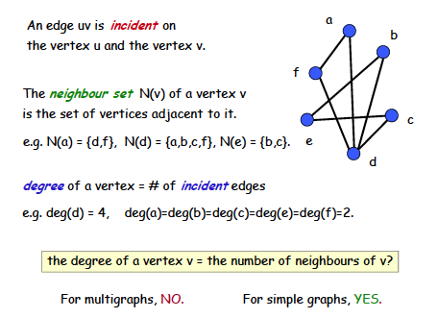
Vertex degree
The max degree of any node
in a simple graph is |V|-1

Slide 13
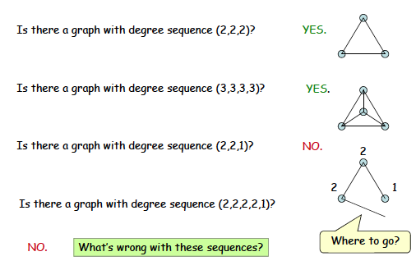
Degree sequence

Slide 14
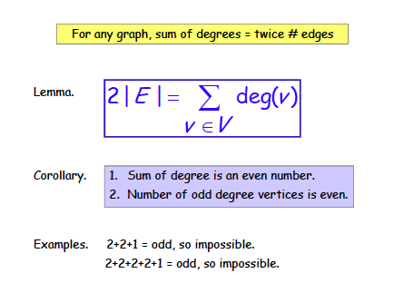
Handshaking theorem
Proof. Each edge contributes
2 to the sum on the RHS

Slide 15
A theorem
THEOREM. An undirected graph has even number of vertices of
odd degree.
Proof. Should follow from the handshaking theorem
Given a degree sequence such that the sum of the degrees is even,
does there always exist a graph with that degree sequence?
No, for simple graphs. Consider (3, 3, 3, 1). Can you draw a graph
With the degree sequence (3, 3, 3, 1)? No (try this out)
What is the maximum possible degree of a node in a simple graph?
It is (n-1) if there are n vertices.

Slide 16
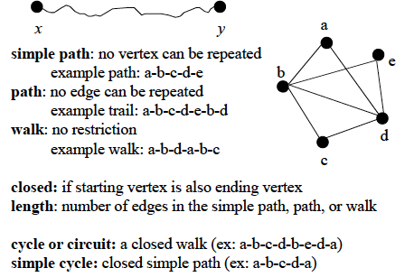
Review of basic definitions

Slide 17
Types of graphs
A cycle of a graph is a subset of its edge set that forms a path such that the
first node of the path corresponds to the last.
A connected graph with no cycle is a tree
A set of one or more trees not necessarily connected
No directed cycle in a DAG

Slide 18
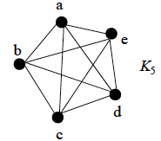
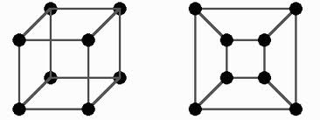
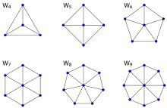
Types of graphs
The n-cube graph
n=3
Complete graph or Clique:
All vertices are adjacent to
one another. A clique with
n vertices is called a K_{n}
Wheel graph

Slide 19
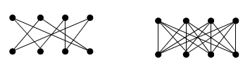
Types of graphs
Bipartite graph
A simple graph is called bipartite if its vertex set V can be
partitioned into two disjoint subsets V1 and V2, such that
every edge in the graph connects one vertex in V1 to another
vertex in V2.
V1
V2
Can always be colored using two colors.

Slide 20
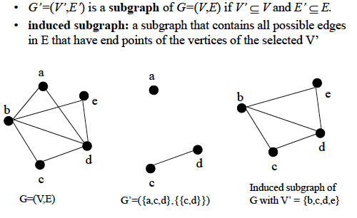
Subgraphs

Slide 21
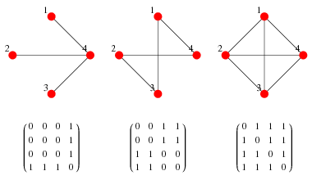
Computer representation of graphs
ADJACENCY MATRIX
(taken from Wolfram Mathworld)

Slide 22
Computer representation of graphs
ADJACENCY LIST
1
Vertex | Adjacent to
1 2 3 4 | 3, 4 3, 4 1, 2 1, 2
2
4
3
Can be represented as a linked list

Slide 23
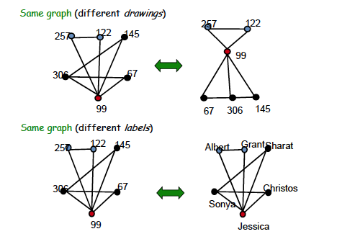
Graph isomorphism
Taken from MIT 6.042J/18.062J

Slide 24
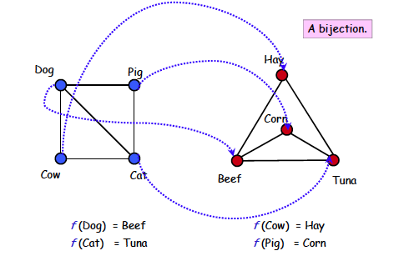
Graph isomorphism
Taken from MIT 6.042J/18.062J

Slide 25
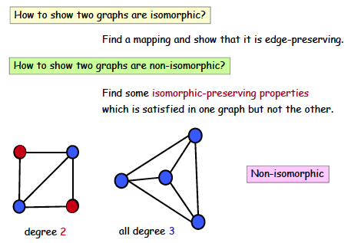
Graph isomorphism
Taken from MIT 6.042J/18.062J

Slide 26
Connectivity
An undirected graph is connected if there is a path between
every pair of distinct vertices of the graph. A connected
component is the maximal connected subgraph of the given graph.

Slide 27
Connectivity issues
Erdös number in academic collaboration graph
Erdös number = n means the person collaborated with someone whose Erdös number is (n-1)
Kevin Bacon number in Hollywood graph
Actor Kevin Bacon once remarked that he worked with everybody in Hollywood, or someone who worked with them.

Slide 28
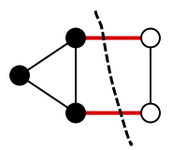
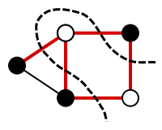
Cut vertex, cut set, cut edge
A cut vertex (or articulation point ) is a vertex, by removing
which one can partition the graph. A cut edge is an edge by removing which one can partition the graph. If multiple edges need to be remove to partition the graph, then the minimal set of such edges a cut set.
Examples taken from Wikipedia

Slide 29

Connectivity in directed graphs
A directed graph is strongly connected if there is a path from
any vertex a to any other vertex b of the graph.
A directed graph is weakly connected if there is a path between
any two vertices of the underlying undirected graph.
Strongly or weakly connected ?

Slide 30
Euler path vs. Hamiltonian path
Hamiltonian path = A path that passes through every vertex
exactly once. A closed path is a Hamiltonian circuit or cycle.
Euler path = A path that includes every edge exactly once.
A closed path is a Euler circuit or cycle.
We have reviewed Euler path in the 7-bridges of Konigsberg
Problem. It did not have an Euler path. Does it have a
Hamiltonian path?

Slide 31
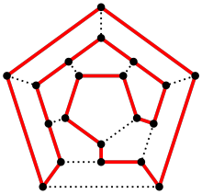
Hamiltonian path
1
2
5
4
3
Does the above graph have
a Hamiltonian cycle? No!
Hamiltonian circuit/cycle
colored red

Slide 32
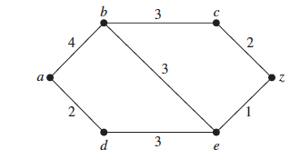
Shortest path
In the above weighted graph, compute the shortest path from a to z

Slide 33
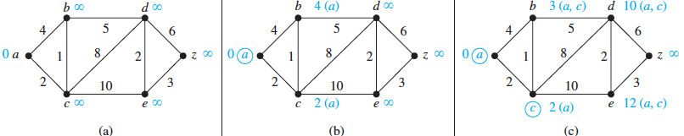
Shortest path: Dijkstra’s algorithm
Read the algorithm from page 747-748 of your text book

Slide 34
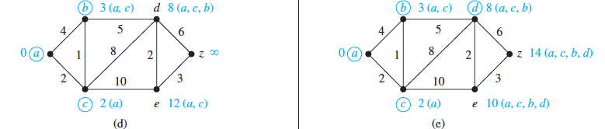
Shortest path: Dijkstra’s algorithm

Slide 35
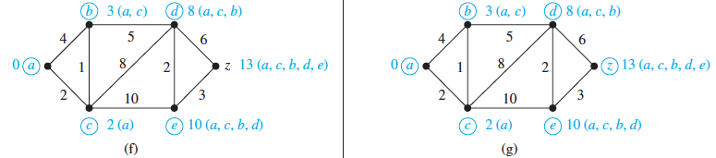
Shortest path: Dijkstra’s algorithm

Slide 36
Shortest path: Dijkstra’s algorithm
Computes the shortest path from a source node to each target node
L (source) = 0, and for all other node u, L(u) := infinity, S:= null
while z is not in S
u := a vertex not in S with L(u) minimal;
S := S ∪ {u};
for all vertices v not in S
if L(u) + w(u, v) < L(v) then L(v) := L(u) + w(u, v)
{known as relaxation: this adds a vertex with minimal label to S and updates the labels of vertices not in S}
return L(z)

Slide 37
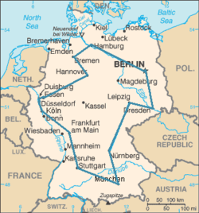
Traveling Salesman Problem (TSP)
A traveling salesman wants to visit each of n cities exactly once, and then return to the starting point. In which order should he
visit the cities to travel the minimum total distance?
TSP = Computing the minimum cost Hamiltonian circuit. TSP is an extremely hard problem to solve (NP-complete)
An optimal TSP tour through
Germany’s largest cities
(Source: Wikipedia)

Slide 38
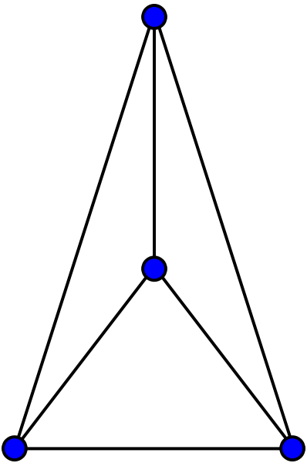
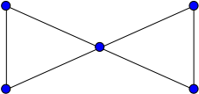
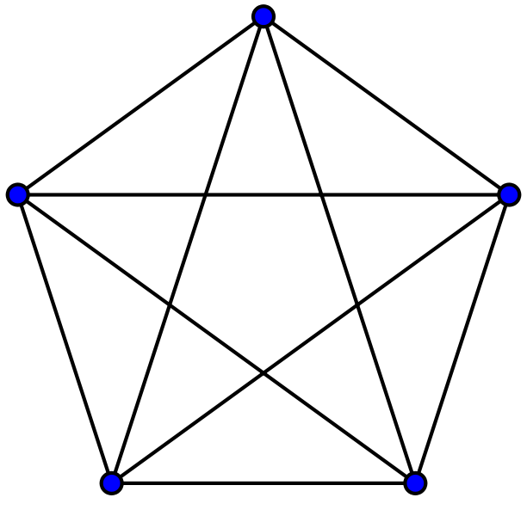

Planar Graph
A planar graph is one that can be embedded in the plane, i.e.,
it can be drawn on the plane in such a way that its edges do
not intersect except only at their endpoints.
planar
K₄
Butterfly
planar
Non-planar
Non-planar
K₅
K_{3,3}

Slide 39
Planar Graph
How to verify that a graph is a planar graph? It should not depend
upon how you draw the graph.
Any graph that contains a K₅ or K_{3,3} as its sub-graph is not planar

Slide 40
Graph Coloring
Let G be a graph, and C be a set of colors. Graph coloring finds an assignment of colors to the different nodes of G, so that no two adjacent nodes have the same color.
The problem becomes challenging when the |C| is small.
Chromatic number. The smallest number of colors needs to color a graph is called its chromatic number.
The chromatic number of a tree is 2. Why?

Slide 41
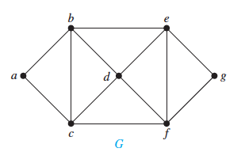
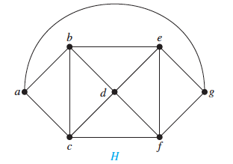
Graph Coloring
What are the chromatic numbers of these two graphs?

Slide 42
Graph Coloring
What are the chromatic numbers of these two graphs?

Slide 43
Four color theorem
Theorem. Any planar graph can be colored using
at most four colors.
It all started with map coloring – bordering states or counties
must be colored with different colors. In 1852, an ex-student
of De Morgan, Francis Guthrie, noticed that the counties in
England could be colored using four colors so that no adjacent
counties were assigned the same color. On this evidence, he
conjectured the four-color theorem. It took nearly 124 years
to find a proof. It was presented by Andrew Appel and
Wolfgang Haken.

Slide 44
Trees

Slide 45
Rooted tree: recursive definition
Base case. A single node is a tree
Recursive step. A graph obtained by
connecting the roots of a set of trees
to a new root is a tree
leaf

Slide 46
Rooted tree: recursive definition
Base case. A single node is a tree
Recursive step. A graph obtained by
connecting the roots of a set of trees
to a new root is a tree
leaf
leaf
leaf
leaf
A Subree of T
leaf
leaf
T
leaf

Slide 47
Rooted tree terminology
Level 0
Level 1
v has a depth of 2
r3 has a height of 3
The tree has a height of 4
Level 2
Level 3
Level 4

Slide 48
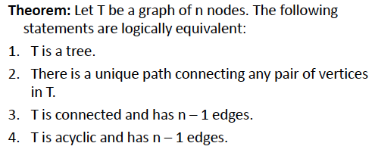
Important properties of trees
Theorem. Every tree is a bipartite graph.
Theorem. Every tree is a planar graph.

Slide 49
Binary and m-ary tree
Binary tree. Each non-leaf node has up to 2 children. If every non-leaf
node has exactly two nodes, then it becomes a full binary tree.
m-ary tree. Each non-leaf node has up to m children. If every non-leaf
node has exactly m nodes, then it becomes a full m-ary tree
Complete binary tree: all levels are completely filled except possibly the last level. Perfect binary tree: a full binary tree where all leaves are at the same depth (a.k.a balanced binary tree)

Slide 50
Examples of various binary trees

Slide 51
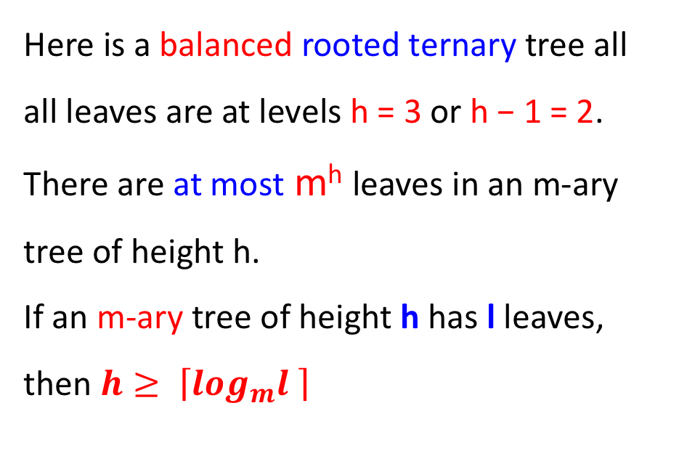
More examples of balanced trees
Here is a balanced rooted ternary tree all all leaves are at levels h = 3 or h − 1 = 2.
There are at most m^{h} leaves in an m-ary tree of height h.
If an m-ary tree of height h has l leaves, then$h≥ \left\lceil \log_{m}l \right\rceil$
A rooted ternary tree

Slide 52
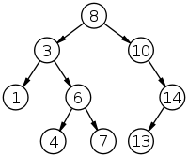
Binary search tree
Ordered binary tree. For any non-leaf node
The left subtree contains the lower keys.
The right subtree contains the higher keys.
How can you search an item? How many steps
does each search take?
A binary search tree of size 9
and depth 3, with root 8 and
leaves 1, 4, 7 and 13

Slide 53
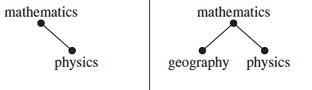
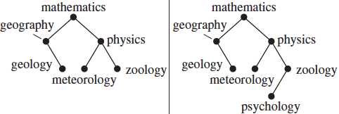
Binary search tree

Slide 54
Decision tree
Decision trees generate solutions via a sequence of decisions.
Example 1. There are seven coins, all of which are of equal weight, and one counterfeit coin that is lighter than the rest. Given a weighing scale, in how many times do you need to weigh (each weighing determines the relative weights of the objects on the the two pans) to identify the counterfeit coin?
{We will solve it in the class}.

Slide 55
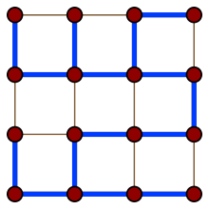
Spanning tree
Consider a connected graph G. A spanning tree is a tree that contains every vertex of G
Many other spanning trees of this graph exist

Slide 56
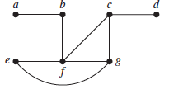
Computing a spanning tree
Given a connected graph G, remove the edges (in some order) without disrupting the connectivity, i.e. not causing a partition of the graph. When no further edges can be removed, a spanning tree is generated.
Graph G

Slide 57
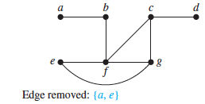
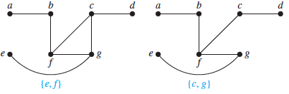
Computing a spanning tree
Spanning tree of G

Slide 58
Enumeration of spanning trees
How many spanning trees do the following graphs have?
B
C
B
C
E
A
D
A
D
G1
G2
B
C
B
C
E
A
D
A
D
G1
G2

Slide 59
Minimum spanning tree
A minimum spanning tree (MST) of a connected weighted graph is a spanning tree for which the sum of the edge weights is the minimum.
B
2
C
4
4
B
C
1
6
E
G2
G1
1
3
7
A
D
A
3
D
5
4
B
C
2
C
6
1
3
B
4
D
1
E
A
A
3
D
7
5

Slide 60
Depth First Search
procedure DFS (G: connected graph with vertices v1…vn)
T := tree consisting only of the vertex v1
visit(v1) {Recursive procedure}
procedure visit (v: vertex of G)
for each vertex w adjacent to v and not yet in T
add vertex w and edge {v, w} to T
visit (w)
The visited nodes and the edges connecting them form a spanning tree. DFS can also be used as a search or traversal algorithm

Slide 61
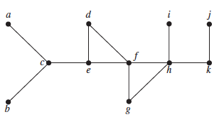
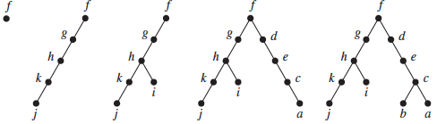
Depth First Search: example

Slide 62
Breadth First Search
ALGORITHM. Breadth-First Search.
procedure BFS (G: connected graph with vertices v1, v2, …vn)
T := tree consisting only of vertex v1
L := empty list
put v1 in the list L of unprocessed vertices
while L is not empty
remove the first vertex v from L
for each neighbor w of v
if w is not in L and not in T then
add w to the end of the list L
add w and edge {v, w} to T

Slide 63
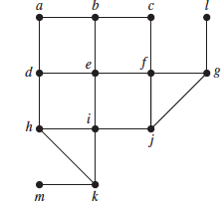
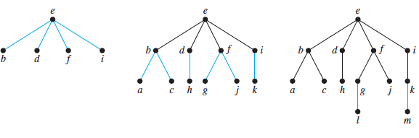
Breadth First Search
A different way of
generating a spanning tree
Given graph G
Spanning tree

Slide 64
Huffman coding
Consider the problem of coding the letters of the English
alphabet using bit-strings. One easy solution is to use
5 bits for each letter (2⁵ > 26). Another such example is
The ASCII code. These are static codes, and do not make
use of the frequency of usage of the letters to reduce the
size of the bit string.
One method of reducing the size of the bit pattern is to use
prefix codes.

Slide 65
Prefix codes
In typical English texts, e is most frequent, followed by, l, n, s, t … The prefix tree assigns to each letter of the alphabet a code whose length depends on the frequency:
e = 0, a = 10, l= 110, n = 1110 etc
Such techniques are popular for
data compression purposes. The
resulting code is a variable-length
code.
0
1
e
0
1
a
0
1
l
0
1
n
1
0
s
t

Slide 66
Huffman codes
Another data compression technique first developed
By David Huffman when he was a graduate student
at MIT in 1951. (see pp. 763-764 of the textbook)
Huffman coding is a fundamental algorithm in data
compression, the subject devoted to reducing the number
of bits required to represent information.

Slide 67
Huffman codes
Example. Use Huffman coding to encode the following
symbols with the frequencies listed:
A: 0.08, B: 0.10, C: 0.12, D: 0.15, E: 0.20, F: 0.35.
What is the average number of bits used to encode a
character?

Slide 68
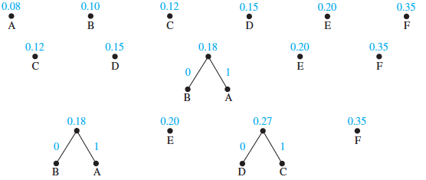
Huffman coding example

Slide 69
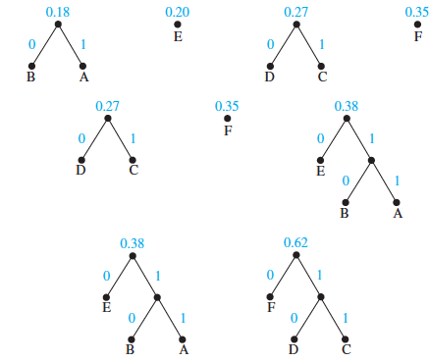
Huffman coding example

Slide 70
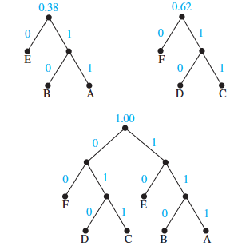
Huffman coding example

Slide 71
Huffman coding example
So, in this example, what is the average number of bits needed
to encode each letter?
3x 0.08 + 3 x 0.10 + 3 x 0.12 + 3 x 0.15 + 2 x 0.20 + 2 x 0.35 = 2.45
instead of 3-bits per letter.

