Slide 1
CS 2210 Discrete Structures Advanced Counting
Fall 2019
Sukumar Ghosh

Slide 2
Compound Interest
A person deposits $10,000 in a savings account that yields
10% interest annually. How much will be there in the account
after 30 years?
Let P_{n} = account balance after n years.
Then P_{n} = P_{n-1} + 0.10 P_{n-1} = 1.1P_{n-1}
Note that the definition is recursive.
What is the solution P_{n}?
P_{n} = P_{n-1} + 0.10 P_{n-1} = 1.1P_{n-1} is a recurrence relation
with P₀ = $10,000 (base case)
By “solving” this, we get the non-recursive version of it.

Slide 3
Recurrence Relation
Recursively defined sequences are also known as recurrence relations. The actual sequence is a solution of the recurrence relations.
Consider the recurrence relation: a_{n+1} = 2a_{n} (n > 0) [Given a₁=1]
The solution is: a_{n} = 2^{n-1} (The sequence is 1, 2, 4, 8, …)
So, a₃₀ = 2²⁹
Given any recurrence relation, can we “solve” it?
Which are the ones that can be solved easily?

Slide 4
More examples of Recurrence Relations
Fibonacci sequence: a_{n} = a_{n-1} + a_{n-2} (n > 2) [Given a₁ = 1, a₂ = 1]
What is the formula for a_{n}?
2. How many bit strings of length n that do not have two consecutive 0s.
For n=1, the strings are 0 and 1
For n=2, the strings are 01, 10, 11
For n=3, the strings are 011, 111, 101, 010, 110
Do you see a pattern here?

Slide 5
Example of Recurrence Relations
Let a_{n} be the number of bit strings of length n that do not have two consecutive 0’s.
This can be represented as a_{n} = a_{n-1} + a_{n-2} (why?)
[bit string of length (n-1) without a 00 anywhere] 1 (a_{n-1})
and [bit string of length (n-2) without a 00 anywhere] 1 0 (a_{n-2})
a_{n} = a_{n-1} + a_{n-2} is a recurrence relation. Given this, can you solve it to find a non-recursive version of a_{n}?

Slide 6
Tower of Hanoi
Transfer these disks from one peg to another. However, at no time,
a larger disk should be placed on a disk of smaller size. Start with
64 disks. When you have finished transferring them one peg to another,
the world will end.

Slide 7
Tower of Hanoi
Let, H_{n} = number of moves to transfer n disks. Then
H_{n} = 2H_{n-1} +1 (why?)
Can you solve this and compute H₆₄? (H₁ = 1)

Slide 8
Solving Linear Homogeneous Recurrence Relations
A linear recurrence relation is of the form
a_{n} = c₁.a_{n-1} + c₂. a_{n-2} + c₃. a_{n-3} + …+ c_{k}. a_{n-k}
(here c₁, c₂, …, c_{n} are constants)
Its solution is of the form a_{n} = r^{n} (where r is a constant) if and only if
r is a solution of
r^{n} = c₁.r^{n-1} + c₂. r^{n-2} + c₃. r^{n-3} + …+ c_{k}. r^{n-k}
This equation is known as the characteristic equation.

Slide 9
Example 1
Solve: a_{n} = a_{n-1} + 2 a_{n-2} (Given that a₀ = 2,a₁ = 7)
Its solution is of the “form” a_{n} = r^{n}
The characteristic equation is: r² = r + 2, i.e. r² - r - 2 = 0.
It has two roots r = 2, and r = -1
The sequence {a_{n}} is a solution to this recurrence relation if and only if
a_{n} = α₁ 2^{n} + α₂ (-1)^{n} (Here α_{1,} α₂ are two constants)
a₀ = 2 = α₁ + α₂
a₁ = 7 = α₁. 2 + α₂.(-1) This leads to α₁= 3, and α₂ = -1
So, the solution is a_{n} = 3. 2^{n} - (-1)^{n}

Slide 10
Example 2: Fibonacci sequence
Solve: f_{n} = f_{n-1} + f_{n-2} (Given that f₀ = 0 and f₁ = 1)
Its solution is of the form f_{n} = r^{n}
The characteristic equation is: r² - r - 1 = 0. It has two roots
r = ½(1 + √5) and ½(1 - √5)
The sequence {a_{n}} is a solution to this recurrence relation iff
f_{n} = α₁ (½(1 + √5))^{n} + α₂ (½(1 - √5))^{n}
(Now, compute α1 and α2 from the initial conditions): α1 = 1/√5 and α2 = -1/√5
The final solution is f_{n} = 1/√5. (½(1 + √5))^{n} - 1/√5.(½(1 - √5))^{n}
☹

Slide 11
Example 3: Case of equal roots
Special Case
If the characteristic equation has only one root r₀ (*), then
the solution will be
a_{n} = α₁ r₀^{n} + α₂ .nr₀^{n}
For this special case, see the example on page 544 of the book.

Slide 12
Example 4: Characteristic equation with complex roots
Solve: a_{n} = 2.a_{n-1} -2.a_{n-2} (Given that a₀ = 0 and a₁ = 2)
The characteristic equation is: r² - 2r + 2 = 0. It has two roots
(1 + i) and (1 - i)
The sequence {a_{n}} is a solution to this recurrence relation iff
a_{n} = α₁ (1+i)^{n} + α₂ (1-i)^{n}
(Now, compute α1 and α2 from the initial conditions): α1 = - i and α2 = i
The final solution is a_{n} = -i.(1+i)^{n} + i.(1-i)^{n}
Check if it works!

Slide 13
Divide and Conquer Recurrence Relations
Some recursive algorithms divide a problem of size “n” into “b” sub-problems each of size “n/b”, and derive the solution by combining the results from these sub-problems.
This is known as the divide-and-conquer approach
Example 1. Binary Search:
If f(n) comparisons are needed to search an object from a list of size n, then
f(n) = f(n/2) + 2, f(1) = 1
[One comparison to decide which half of the list to use, and one more to check if there are remaining items]

Slide 14
Divide and Conquer Recurrence Relations
Example 2: Finding the maximum and minimum of a sequence
f(n) = 2.f(n/2) + 2, f(1)=0
Example 3. Merge Sort:
Divide the list into two sublists, sort each of them and then merge. Here
f(n) = 2.f(n/2) + n, f(1)=0

Slide 15
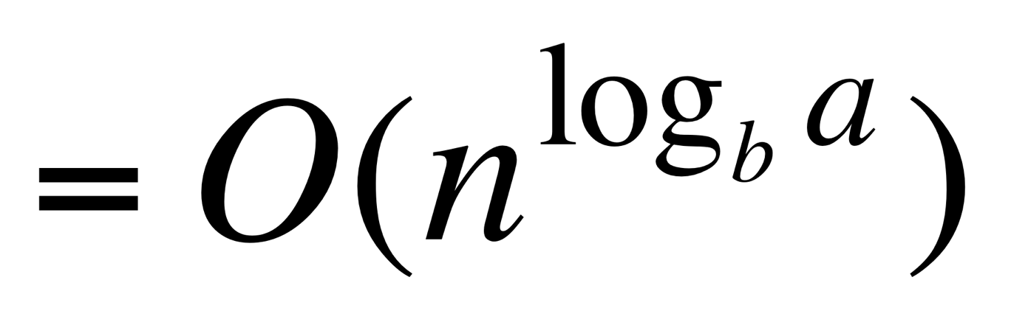
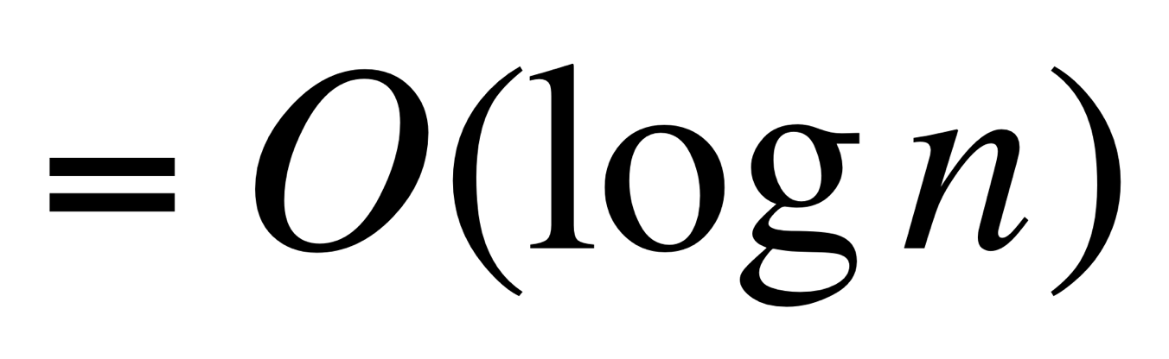
Divide and Conquer Recurrence Relations
Theorem. The solution to a recurrence relations of the form
f(n) = a.f(n/b) + c
(here b divides n, a ≥ 1, b >1, and c is a positive real number) is
f(n) (if a=1)
(if a >1)
(See the complete derivation in page 556)

Slide 16
Divide and Conquer Recurrence Relations
Proof outline. Given f(n) = a.f(n/b) + c
Let n=b^{k}. Then f(n) = a.[a.f(n/b²)+c] + c
= a.[a.[a.f(n/b³)+c]+c]+ c and so on …
= a^{k}. f(n/b^{k}) + c.(a^{k-1}+a^{k-2}+…+1) … (1)
= a^{k}.f(n/b^{k}) + c.(a^{k}-1)/(a-1)
= a^{k}.f(1) + c.(a^{k}-1)/(a-1) … (2)

Slide 17
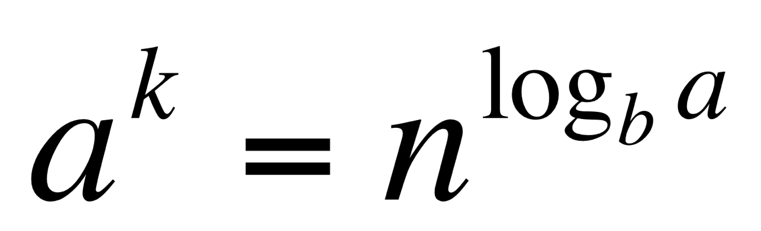
Divide and Conquer Recurrence Relations
Proof outline. Given f(n) = a.f(n/b) + c
When a=1, f(n) = f(1) + c.k (from 1)
Note that n=b^{k}, k = log_{b}n,
So f(n) = f(1) + c. log_{b}n
[Thus f(n) = O(log n)]
When a>1, f(n) = a^{k}.[f(1) + c/(a-1)] - c/(a-1) [ ]

Slide 18
Divide and Conquer Recurrence Relations
What if n ≠ b^{k}? The result still holds.
Assume that b^{k} < n <b^{k+1.}
So, f(n) < f(b^{k+1})
f(b^{k+1}) = f(1) + c.(k+1)
= [f(1) + c] + c.k
= [f(1) + c] + c.log_{b}n
Therefore, f(n) is O(log n)

Slide 19
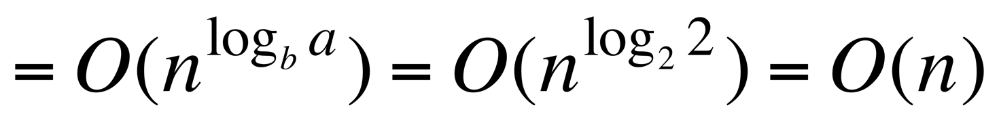
Divide and Conquer Recurrence Relations
Apply to binary search
f(n) = f(n/2) + 2
The complexity of binary search f(n) (since a=1)
What about finding the maximum or minimum of a sequence?
f(n) = 2f(n/2) + 2
So, the complexity is f(n)

Slide 20
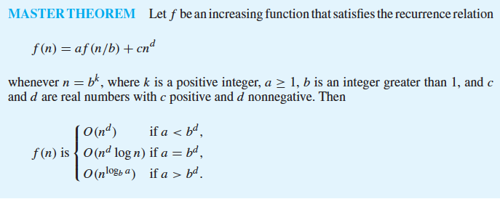
Master Theorem
Note that there are four parameter: a, b, c, d

