Slide 1
CS2210:0001Discrete Structures Induction and Recursion
Fall 2018
Sukumar Ghosh

Slide 2
What is mathematical induction?
It is a method of proving that something holds.
Suppose we have an infinite ladder, and we want to know
if we can reach every step on this ladder.
We know the following two things:
We can reach the base of the ladder
If we can reach a particular step, then we can reach the
next step
Can we conclude that we can reach every step of the ladder?
YES!

Slide 3
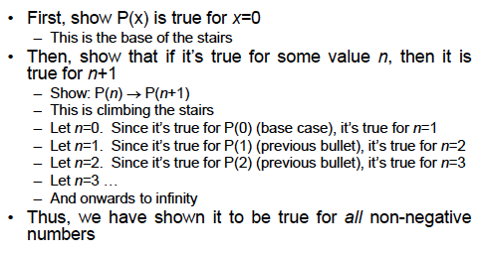
Understanding induction
Suppose we want to prove that P(x) holds for all x

Slide 4
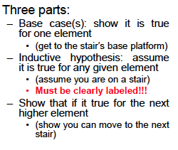
Proof structure

Slide 5
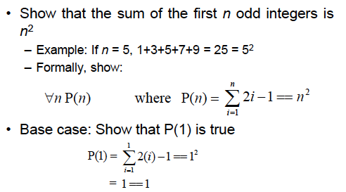
Example 1

Slide 6
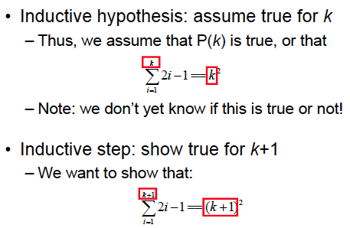
Example continued

Slide 7
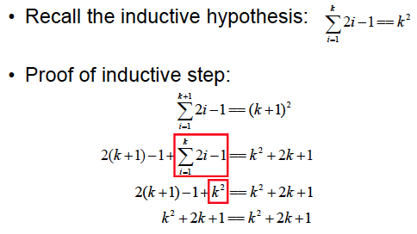
Example continued

Slide 8
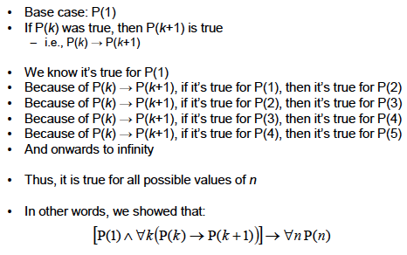
What did we show?

Slide 9
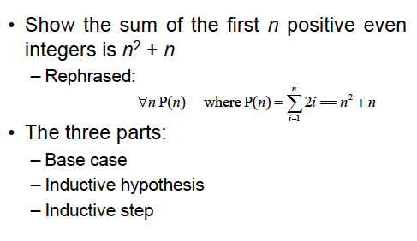
Example 2

Slide 10
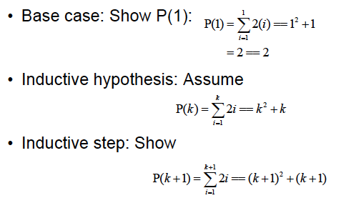
Example continued

Slide 11
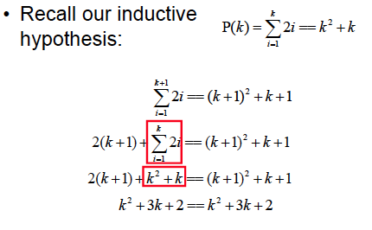
Example continued

Slide 12
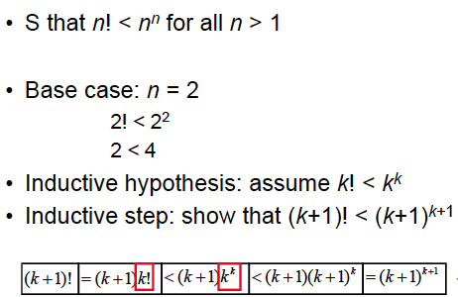
Example 3

Slide 13
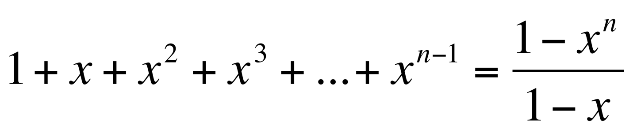
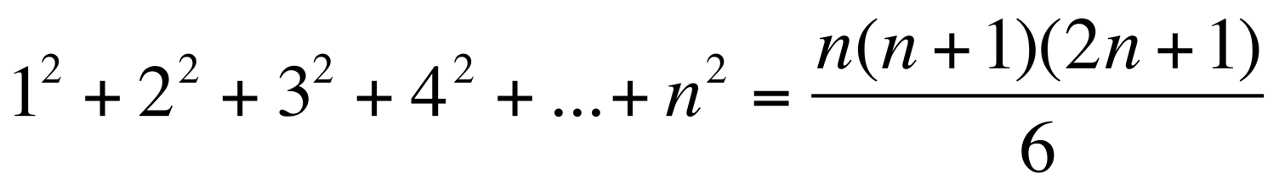
Exercise
Prove by induction the following:
1.
2.

Slide 14
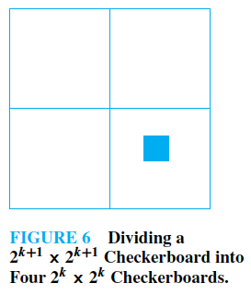

A Tiling Problem
Prove by induction that you can tile any (2^{n} x 2^{n}) checkerboard
(n>1) with one square removed using only the triominoes of Fig 1
removed
Figure 1

Slide 15

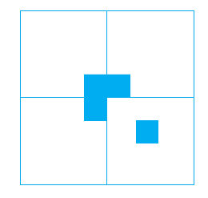
Proof hint
removed
Base cases
Divide the (2^{k+1} x 2^{k+1})
checkerboard
Into four (2^{k} x 2^{k})
checkerboards
Induction hypothesis
Assume that the claim holds
For boards of size (2^{k} x 2^{k})
Inductive step

Slide 16
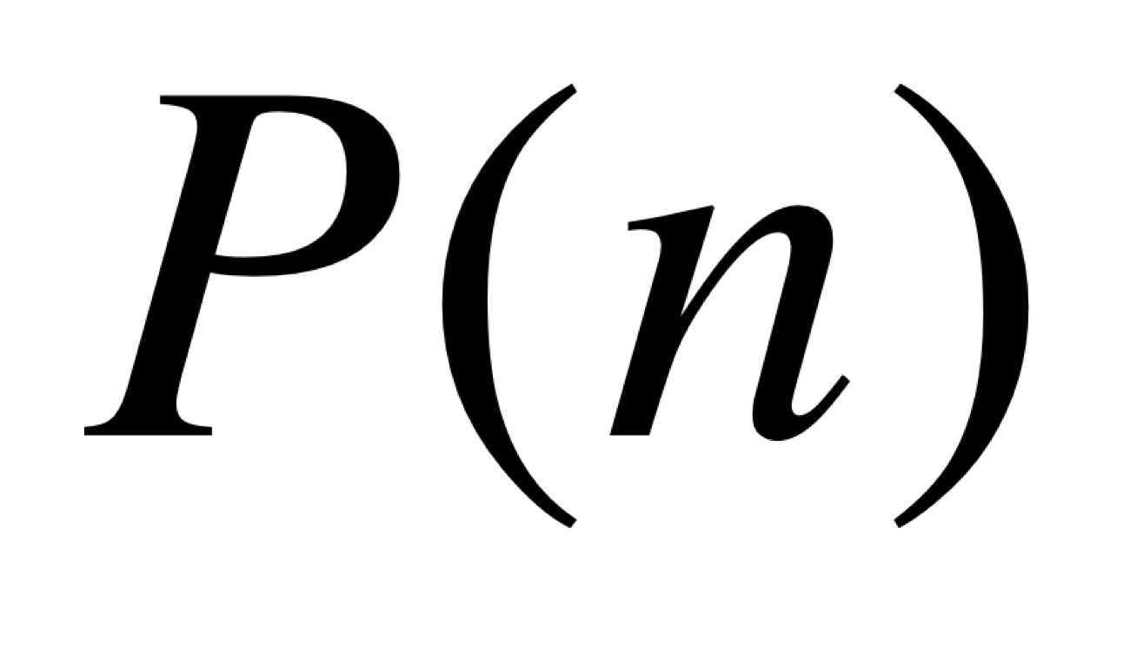
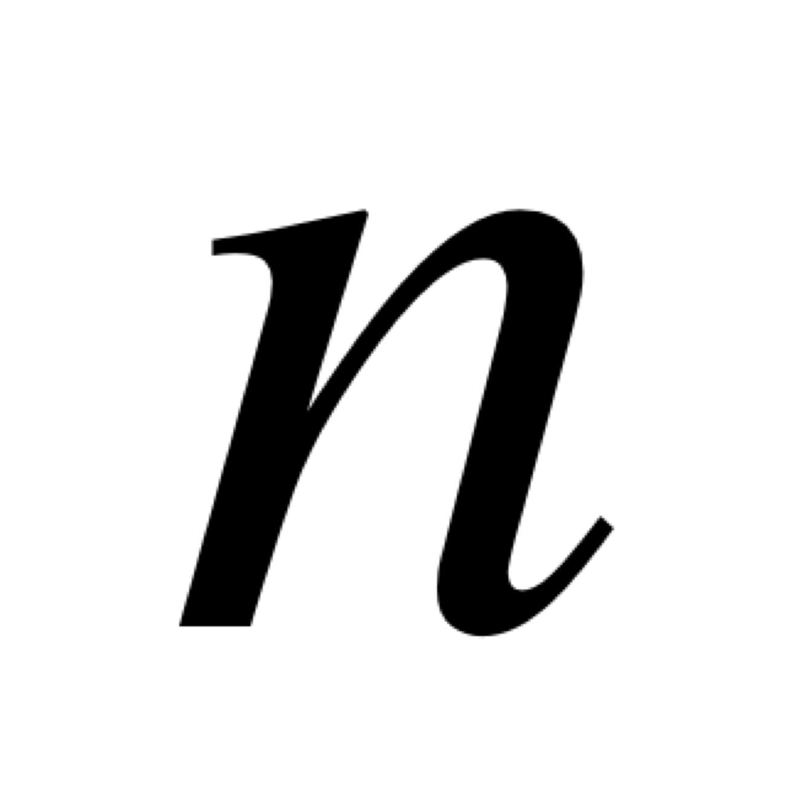
Strong induction
To prove that is true for all integer
We compete two steps:
Basis. We verify that the proposition P(1) is true.
Inductive Step. We show that the conditional statement
Is true for all positive integers k.
Inductive hypothesis
Inductive hypothesis

Slide 17
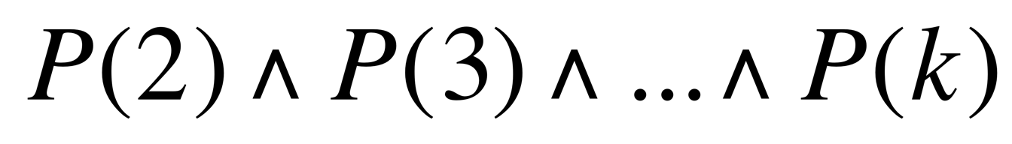
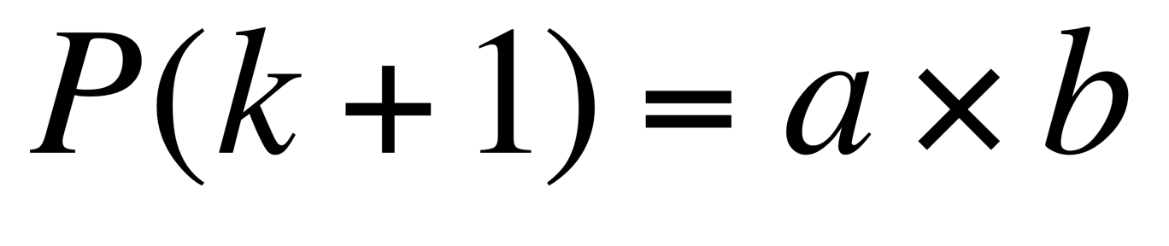
Example 1
Theorem. Show that any integer n > 1 can be expressed as the product of one or more primes. (Let us call it P(n))
Basis. P(2) is true.
Induction hypothesis. Assume holds
Inductive step. We have to show that P (k+1) holds.
If P(k+1) is prime, then the theorem holds. Else
and a, b < k+1, and due to the
induction hypothesis, the theorem holds.

Slide 18
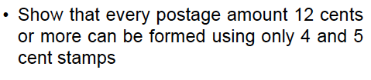
Example 2

Slide 19
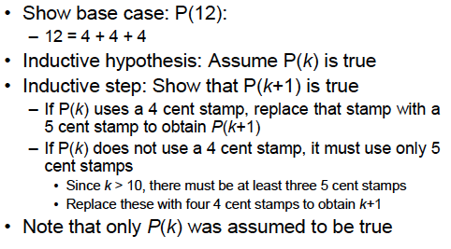
Proof using Mathematical Induction

Slide 20
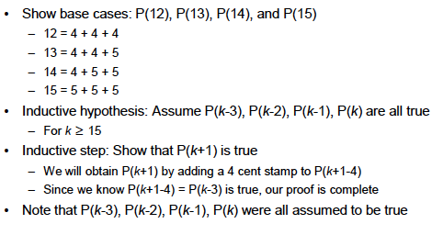
Same Proof using Strong Induction

Slide 21
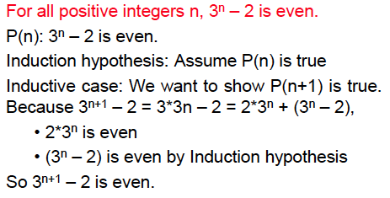
Errors in Induction
Question: What is wrong here?

Slide 22
Errors in Induction
Here is a “proof” that a camel can always carry n straws on
its back, even if n is arbitrarily large
Let P(k) represent “the camel can carry k straws.”
Base case: P(1) is true.
Induction hypothesis: Assume P(k) is true for some k < n
Inductive step: Since the camel can carry k straws, it can carry
one more straw, i.e. (k+1) straws, without any problem.
Question: What is wrong here?

Slide 23
Recursive definition
Recursion means defining or formulating something (such as a function or an algorithm), in terms of itself
– For example, let f(x) = x!
– We can define f(x) as f(x) = x * f(x-1)

Slide 24


Recursive definition
Two parts of a recursive definition:
Base case and a Recursive step
.

Slide 25
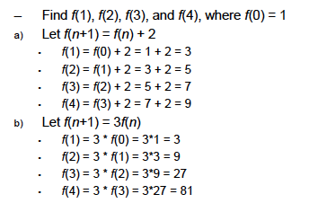
Recursion example

Slide 26
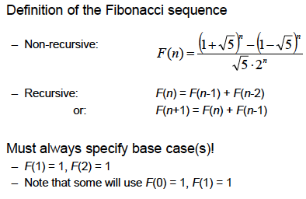
Fibonacci sequence

Slide 27
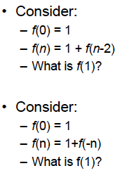
Bad recursive definitions
Why are these definitions bad?

Slide 28
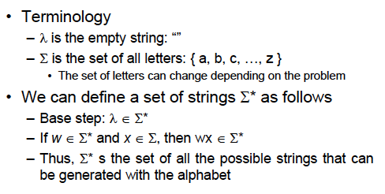
More examples of recursive definitions: defining strings

Slide 29
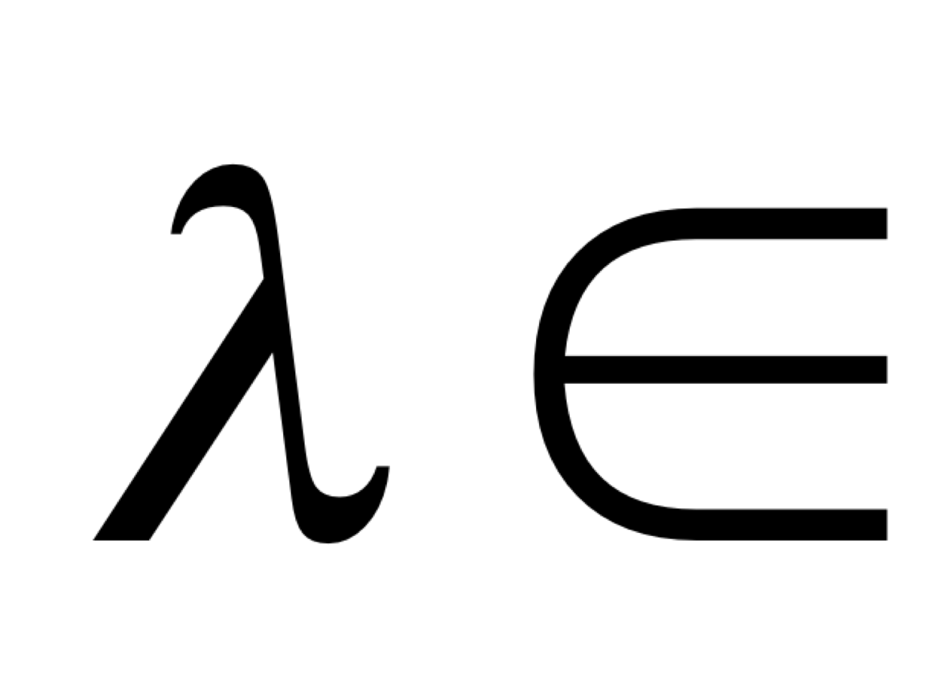
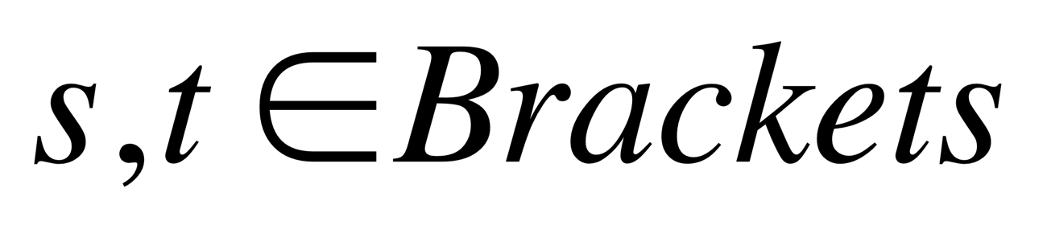
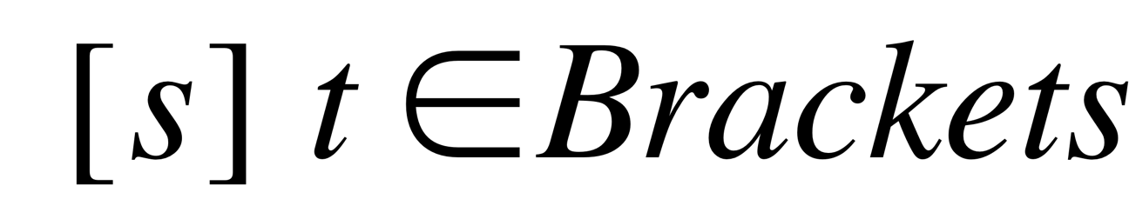
More examples of recursive definitions: Matched strings of parentheses
Data Type Brackets specifies the set of all “matched” sequences of brackets.
For example consider [ [ [ ] ] [ ] ] It is matched.
0 +1 +2 +3 +2 +1 +2 +1 0
(The count should never be negative, and must end up with a zero).
Base case. Brackets
Recursive step. If then

Slide 30
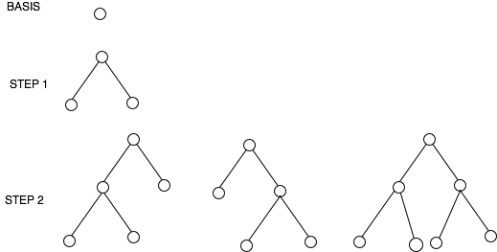
Recursive definition of a full binary tree
Basis. A single vertex is a full binary tree
Recursive step. If T1 and T2 are disjoint full binary trees, then a full
binary tree T1.T2 consisting of a root r and edges connecting r to each
of the roots of T1 and T2 is a full binary tree.

Slide 31
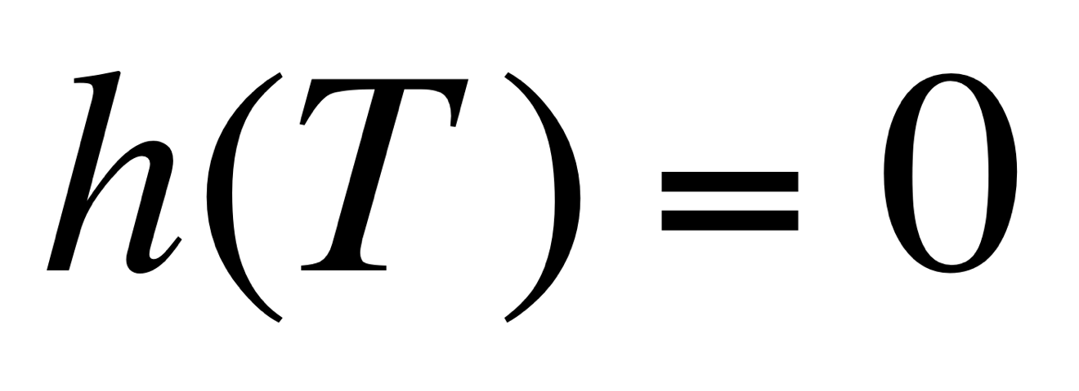
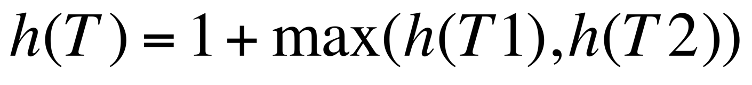
Recursive definition of the height of a full binary tree
Basis. The height of a full binary tree T consisting of only
one node is
Recursive step. If T1 and T2 are two full binary trees, then the full
binary tree T= T1.T2 has height

Slide 32
Structural induction
A technique for proving a property of a recursively defined object.
It is very much like an inductive proof, except that in the inductive
step we try to show that if the statement holds for each of the
element used to construct the new element, then the result holds
for the new element too.
Example. Prove that
if T is a full binary tree, and
h(T) is the height of the tree
then the number of nodes in the tree n(T) ≤ 2 ^{h(T)+1} -1.

Slide 33
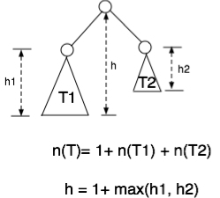
Structural induction continued
Prove that if T is a full binary tree, and h(T) is the height of the tree then the number of nodes in the tree n(T) ≤ 2 ^{h(T)+1} -1.
root
See the textbook
(pages 355-356)

Slide 34
Recursive Algorithm
Example 1. Given a and n, compute a^{n}
procedure power (a : real number, n: non-negative integer)
if n = 0 then power (a, n) := 1
else power (a, n) := a. power (a, n-1)
Revisit Fibonacci, factorial etc.

Slide 35
Recursive Algorithm
Example 2. Compute GCD (a,b) a ≤ b)
procedure gcd(a, b)
if a = 0 then return b
else return gcd(b mod a, a)

Slide 36
Recursive algorithms: Sorting
Here is the recursive algorithm Merge sort. It merges two sorted
Iists to produce a new sorted list
8 2 4 6 10 1 5 3
8 2 4 6
10 1 5 3
8 2
4 6
10 1
5 3

Slide 37
Mergesort
The merge algorithm “merges” two sorted lists
2 4 6 8 merged with 1 3 5 10 will produce 1 2 3 4 5 6 8 10
procedure mergesort (L = a₁, a₂, a₃, … a_{n})
if n > 0 then
m:= ⎣n/2⎦
L1 := a₁, a₂, a₃, … a_{m}
L2 := a_{m+1}, a_{m+2}, a_{m+3}, … a_{n}
L := merge (mergesort(L1), mergesort(L2))

Slide 38
Example of Mergesort
1 2 3 4 5 6 8 10
8 2 4 6 10 1 5 3
2 4 6 8
8 2 4 6
10 1 5 3
1 3 5 10
2 8
8 2
4 6
4 6
10 1
1 10
5 3
3 5
Completes sorting in O(n log n) steps

Slide 39
The Merge Algorithm
procedure merge(L1,L2 : sorted lists)
L := empty list
while L1 ≠ empty and L2 ≠ empty
remove smaller of first elements of L1 and L2 from its list; put it at the left end of L
if this removal makes one list empty then
remove all elements from the other list;
append them to L
return L {L is the merged list with elements in increasing order}

Slide 40
Iteration vs. Recursion
Recursive Fibonacci
Iterative Fibonacci
procedure f (n ≥ 0)
if n = 0 then return 0
else if n = 1 then return 1
else return f(n − 1) + f(n − 2)
{output is f(n)}
procedure f (n ≥ 0)
if n = 0 then return 0 else
x := 0, y := 1
for i := 1 to n − 1
z := x + y; x := y; y := z
return y
{output is f(n)}
What difference do you see?

Slide 41
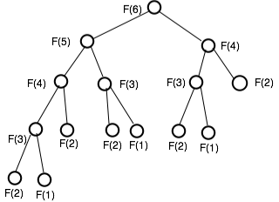
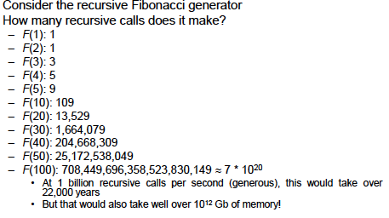
Pros and Cons of Recursion
While recursive definitions are easy to understand
Iterative solutions for Fibonacci sequence are much faster (see page 366)

