Slide 1
CS 2210 Discrete Structures Algorithms and Complexity
Fall 2018
Sukumar Ghosh

Slide 2
What is an algorithm
A finite set (or sequence) of precise instructions for performing a computation.
Example: Maxima finding
procedure max (a₁, a₂, …, a_{n}: integers)
max := a₁
for i :=2 to n
if max < a_{i} then max := a_{i}
return max {the largest element}

Slide 3
Flowchart for maxima finding
start
max := a₁
Given n elements, can you count the total
number of operations?
i: = 2
no
max < a_{i}
yes
max = a_{i}
i: = i + 1
i = n?
no
yes
end

Slide 4
Time complexity of algorithms
Counts the largest number of basic operations required to execute an algorithm.
Example: Maxima finding
procedure max (a1, a2, …, an: integers)
max := a1 1 operation
for i :=2 to n 1 operation i:=2
if max < a1 then max := ai {n-1 times}
{2 ops + 1 op to check if i > n + 1 op to increment i}
return max {the largest element}
The total number of operations is 4(n-1)+2 = 4n-2

Slide 5
Time complexity of algorithms
Example of linear search (Search x in a list a₁ a₂ a_{3 …} a_{n})
k := 1 {1 op}
while k ≤ n do {n ops k ≤ n}
{if x = a_{k} then found else k: = k+1} {2n ops + 1 op}
search failed
The maximum number of operations is 3n+2. If we are lucky,
then search can end even in the first iteration.

Slide 6
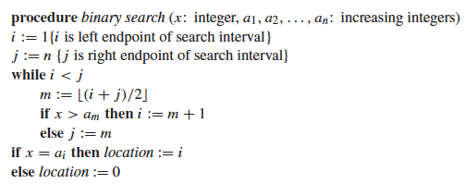
Time complexity of algorithms
Binary search (Search x in a sorted list a₁ < a₂ < a₃ <…< a_{n})
{search failed}
How many operations? Roughly log n. Why?

Slide 7
Bubble Sort
procedure bubblesort ( A : list of items )
n = length (A)
repeat
for i = 1 to n-1 do
if A[i-1] > A[i] then swap (A[i-1], A[i])
end if
end for
n: = n - 1
until n=0
end procedure

Slide 8
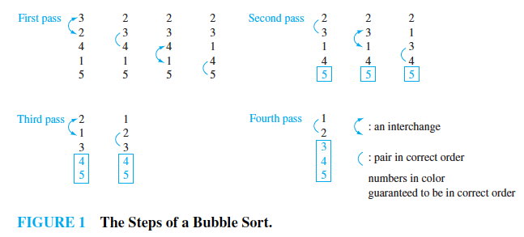
Bubble Sort

Slide 9
Bubble Sort
3 2 4 1 5 [n=5 items are there]
2 3 1 4 5 (first pass) n-1 operations
2 1 3 4 5 (second pass) n-2 operations
1 2 3 4 5 (third pass) n-3 operations …
1 2 3 4 5 (fourth pass) 1
The worst case time complexity is
(n-1) + (n-2) + (n-3) + … + 1
= n(n-1)/2

Slide 10
The Big-O notation
It is a measure of the growth of functions and often used to measure the complexity of algorithms.
DEF. Let f and g be functions from the set of integers (or real numbers) to the set of real numbers. Then f is O(g(x)) if there are constants C and k, such that
|f(x)| ≤ C|g(x)| for all x > k
Intuitively, f(x) grows “slower than” some multiple of g(x) as x grows without bound. Thus O(g(x)) defines an upper bound of f(x).

Slide 11
The Big-O notation
y = x² + 2x + 1
y= 4x²
x² + 2x + 1 = O(x²)
Since = 4 x² > x² + 4x + 1
whenever x > 1, 4x² defines
an upper bound of the
growth of x² + 2x + 1
y = x²
4
3
2
1
1
2
Defines an upper bound of the growth of functions

Slide 12
The Big-Ω (omega) notation
DEF. Let f and g be functions from the set of integers (or real numbers) to the set of real numbers. Then f is Ω(g(x)) if there are constants C and k, such that
|f(x)| ≥ C|g(x)| for all x > k
Example. 7x² + 9x + 4 is Ω(x²), since 7x² + 9x + 4 ≥ 1. x² for all x
Thus Ω defines the lower bound of the growth of a function
Question. Is 7x² + 9x + 4 Ω(x)?

Slide 13
The Big-Theta (Θ) notation
DEF. Let f and g be functions from the set of integers (or real numbers) to the set of real numbers. Then f is Θ(g(x)) if there are constants C₁ and C₂ a positive real number k, such that
C1.|g(x)| ≤ |f(x)| ≤ C2.|g(x)| for all x > k
Example. 7x² + 9x + 4 is Θ(x²),
since 1. x² ≤ 7x² + 9x + 4 ≤ 8. x² for all x > 10

Slide 14
Average case performance
EXAMPLE. Compute the average case complexity of the linear
search algorithm.
a₁ a₂ a₃ a₄ a_{5 …..} a_{n} (Search for x from this list)
If x is the 1st element then it takes 5 steps
If x is the 2nd element then it takes 8 steps
If x is the i^{th} element then it takes (3i + 2) steps
So, the average number of steps = 1/n [5+8+…+(3n+2)] = ?

Slide 15
Classification of complexity
Complexity | Terminology
Θ(1) | Constant complexity
Θ(log n) Θ(log n)^{c} | Logarithmic complexity Poly-logarithmic complexity
Θ(n) | Linear complexity
Θ(n^{c}) | Polynomial complexity
Θ(b^{n}) (b>1) | Exponential complexity
Θ(n!) | Factorial complexity
We also use such terms when Θ is replaced by O (big-O)

Slide 16
Exercise
Complexity of n⁵ O(2^{n}) True or false?
Complexity of 2^{n} O(n⁵) True or false?
Complexity of log (n!) Θ(n log n) True or false?
Complexity of 1²+2²+3²+…+n² Ω(n³) True or false?”
Let S = {0, 1, 2, …, n}. Think of an algorithm that generates all the subsets of three elements from S, and compute its complexity in big-O notation.

Slide 17
Greedy Algorithms
In optimization problems, many algorithms that use the best choice at each step are called greedy algorithms.
Example. Devise an algorithm for making change for n cents using quarters, dimes, nickels, and pennies using the least number of total coins?

Slide 18
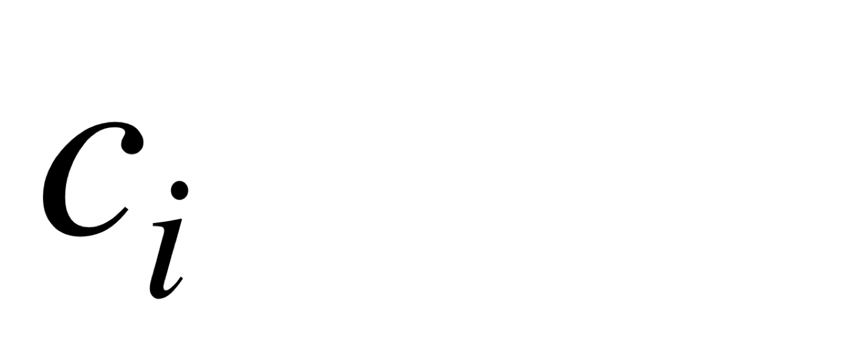
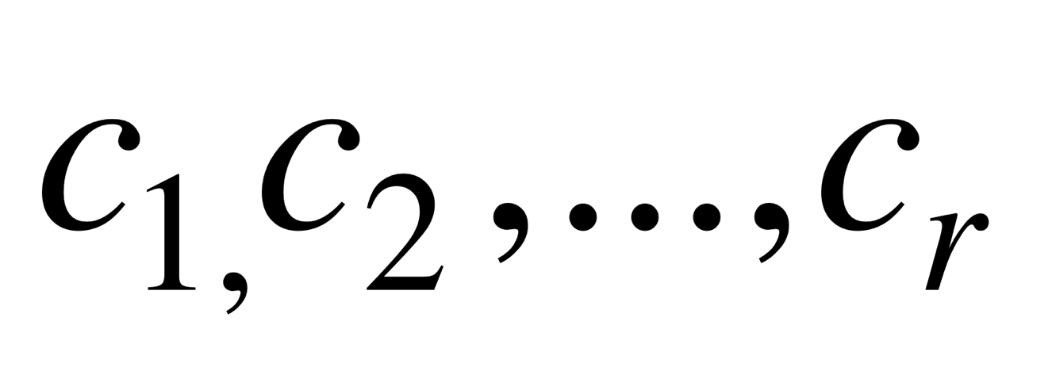
Greedy Change-making Algorithm
Let be the denomination of the coins,
(and )
for i:= 1 to r
while n ≥ c_{i}
begin
add a coin of value c_{i} to the change
n := n- c_{i}
end
Question. Is this optimal? Does it use the least number of coins?
Let the coins be
1, 5, 10, 25 cents. For
making 38 cents, you will use
1 quarter
1 dime
3 cents
The total count is 5,
and it is optimum.

Slide 19
Greedy Change-making Algorithm
But if you don’t use a nickel, and you make a change for
30 cents using the same algorithm, the you will use 1 quarter
and 5 cents (total 6 coins). But the optimum is 3 coins
(use 3 dimes!)
So, greedy algorithms produce results, but the results
may be sub-optimal.

Slide 20
Greedy Routing Algorithm
A
C
B
If you need to reach point B from point A in the fewest number of hops,
Then which route will you take? If the knowledge is local, then you are
tempted to use a greedy algorithm, and reach B in 5 hops, although
it is possible to reach B in only two hops.

Slide 21
Other classification of problems
Problems that have polynomial worst-case complexity are called tractable. Otherwise they are called intractable.
Problems for which no solution exists are known as unsolvable problems (like the halting problem). Otherwise they are called solvable.
Many solvable problems are believed to have the property that no polynomial time solution exists for them, but a solution, if known, can be checked in polynomial time. These belong to the class NP (as opposed to the class of tractable problems that belong to class P)

Slide 22
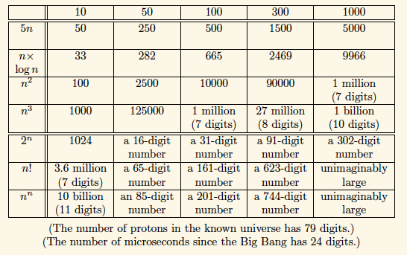
Estimation of complexity
Source: D. Harel. Algorithmics: The Spirit of Computing . Addison-Wesley, 2nd edition, 1992

Slide 23
The Halting Problem
The Halting problem asks the question.
Given a program and an input to the program, determine if the program will eventually stop when it is given that input.
Run the program with that input. If the program stops, then we know it stops.
But if the program doesn't stop in a reasonable amount of time, then we cannot conclude that it won't stop. Maybe we didn't wait long enough!
The question is not decidable in general!

Slide 24
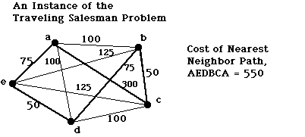
The Traveling Salesman Problem
Starting from a node, you have to visit every other node and return
To you starting point. Find the shortest route? NP-complete

Slide 25
3-Satisfiability Problem
Consider an expression like this:
(x1∨x2∨x3) ∧ (x4∨x5∨x6) ∧ (¬x2∨x4∨¬x7)
∧ (¬ x4∨x8∨x3) ∧ (¬x2∨¬ x4∨¬x9)
Does there exist an assignment of values of x1, x2, … x9
so that this formula is true? NP-Complete problem!

