Slide 1
CS 2210:0001 Discrete Structures Sequence and Sums
Fall 2018
Sukumar Ghosh

Slide 2
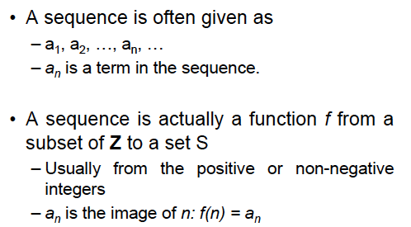
Sequence
A sequence is an ordered list of elements.

Slide 3
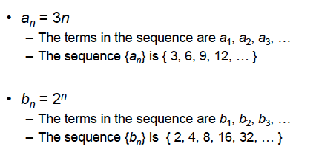
Examples of Sequence

Slide 4
Examples of Sequence

Slide 5
Examples of Sequence
Not all sequences are arithmetic or geometric sequences.
An example is Fibonacci sequence

Slide 6
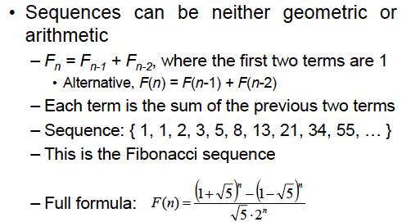
Examples of Sequence

Slide 7
More on Fibonacci Sequence

Slide 8
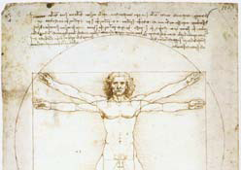
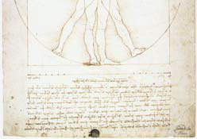
Examples of Golden Ratio

Slide 9
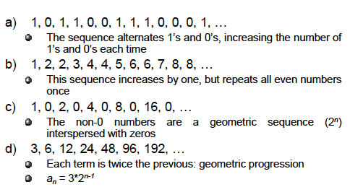
Sequence Formula

Slide 10
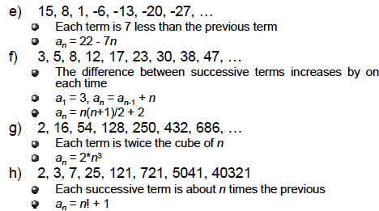
Sequence Formula

Slide 11
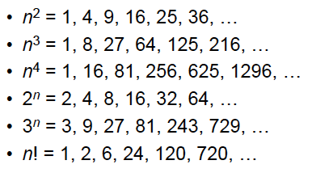
Some useful sequences

Slide 12
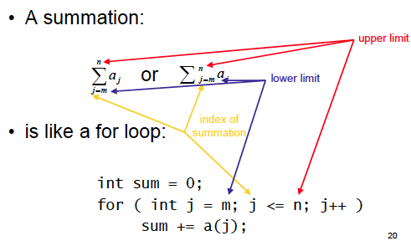
Summation

Slide 13
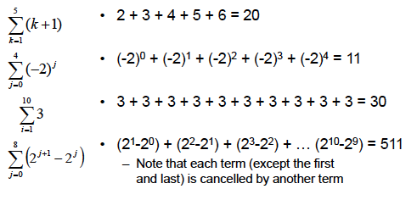
Evaluating sequences

Slide 14
Arithmetic Series
Consider an arithmetic series a₁, a₂, a₃, …, a_{n.} If the common
difference (a_{i+1} - a₁) = d, then we can compute the k^{th} term a_{k}
as follows:
a₂ = a₁ + d
a₃ = a₂ + d = a₁ +2 d
a₄ = a₃ + d = a₁ + 3d
a_{k} = a₁ + (k-1).d

Slide 15
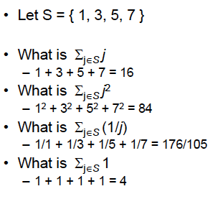
Evaluating sequences

Slide 16
Sum of arithmetic series

Slide 17
Solve this
1 + 2 + 3 + … + n = ?
[Answer: n.(n+1) / 2] why?
Calculate 1² + 2² + 3²+ 4² + … + n²
[Answer n.(n+1).(2n+1) / 6]

Slide 18
Can you evaluate this?
Here is the trick. Note that
Does it help?

Slide 19
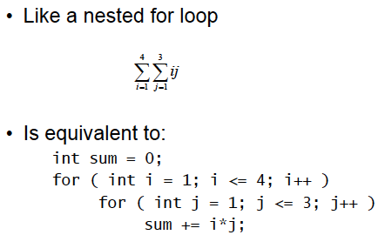
Double Summation

Slide 20
Sum of geometric series
Thus,
So,

Slide 21
Sum of infinite geometric series
So,

Slide 22
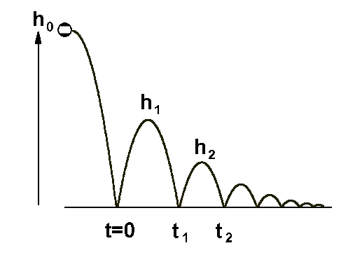
Sum of infinite geometric series
What is the total vertical distance covered by the ball?

Slide 23
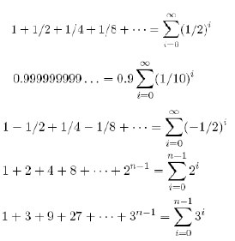
Solve the following
0.9 + 0.99 + 0.999 + 0.9999 + 0.99999 + ….. = ?

Slide 24
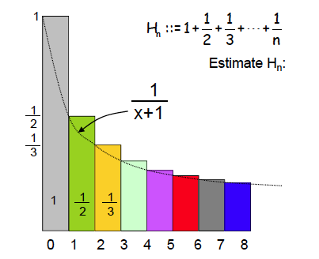
Sum of harmonic series

Slide 25
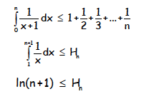
Sum of harmonic series
If n approaches infinity, then H_{n} approaches infinity,
which means the sum of a harmonic series diverges.

Slide 26
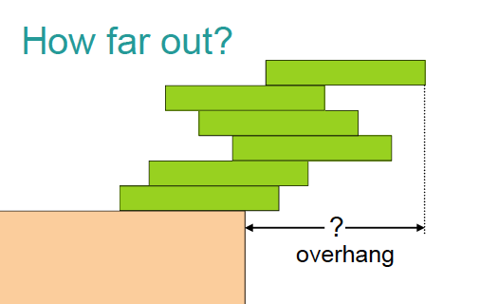
Book stacking example

Slide 27
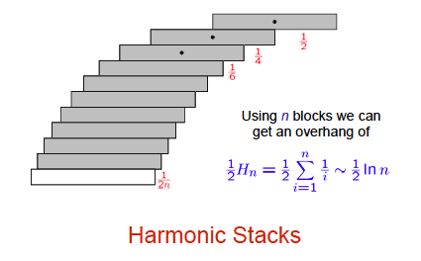
Book stacking example
Lesson: You can build an arbitrarily large overhang

Slide 28
Useful summation formulae
See page 166 of Rosen Volume 7

Slide 29
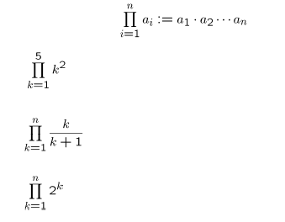
Products

Slide 30
Dealing with Products

Slide 31
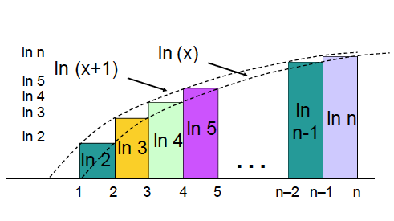
Factorial

Slide 32
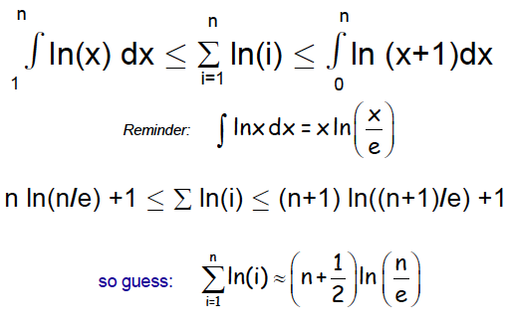
Factorial

Slide 33
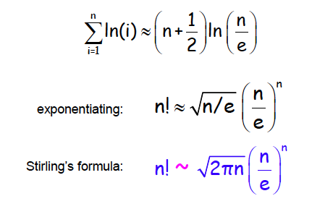
Stirling’s formula
Here ~ means that the ratio of the two sides approaches 1 as n approaches ∞
A few steps are omitted here

