Slide 1
CS 2210:0001 Discrete Structures
Introduction and Scope:
Propositions
Fall 2017
Sukumar Ghosh

Slide 2
The Scope
Discrete mathematics studies mathematical structures that are fundamentally discrete, not supporting or requiring the notion of continuity (Wikipedia).
Deals with countable things.

Slide 3
Why Discrete Math?
Discrete math forms the basis for computer science:
Sequences
Counting, large numbers, cryptography
Digital logic (how computers compute)
Algorithms
Program correctness
Probability (includes analysis of taking risks)
“Continuous” math forms the basis for most physical and biological sciences

Slide 4
Propositions
A proposition is a statement that is either true or false
“The sky is blue”
“Today the temperature is below freezing”
“9 + 3 = 12”
Not propositions:
“Who is Bob?”
“How many persons are there in this group?”
“X + 1 = 7.”

Slide 5
Propositional (or Boolean) variables
These are variables that refer to propositions.
Let us denote them by lower case letters p, q, r, s, etc.
Each can have one of two values true (T) or false (F)
A proposition can be:
A single variable p
A formula of multiple variables like p ∧ q, s ∨¬r)

Slide 6
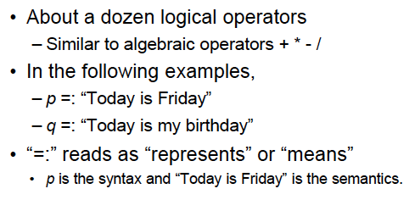
Propositional (or Boolean) operators

Slide 7
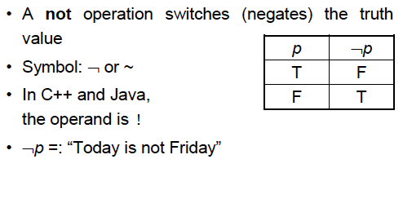
Logical operator: NOT

Slide 8
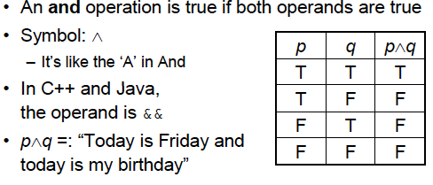
Logical operator: AND

Slide 9
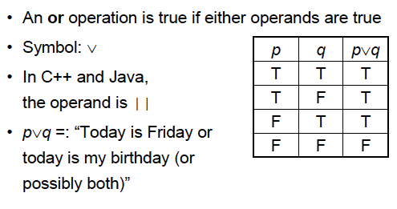
Logical operator: OR

Slide 10
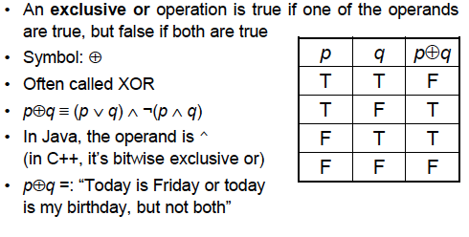
Logical operator: EXCLUSIVE OR
Note. p ⊕ q is false if both p, q are true or both are false

Slide 11
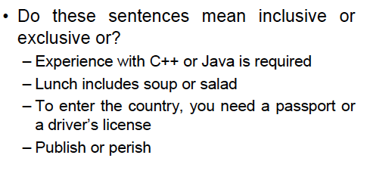
(Inclusive) OR or EXCLUSIVE OR?

Slide 12
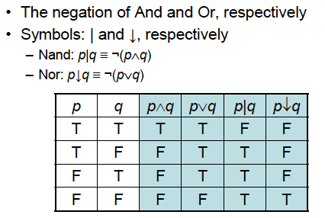
Logical Operator NAND and NOR

Slide 13
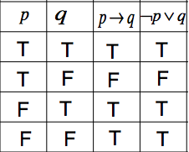
Conditional Operator
A conditional, also means an implication means
“if then ”:
Symbol: as in
Example: If this is an apple ( )
then it is a fruit ( )
The antecedent
The consequence

Slide 14
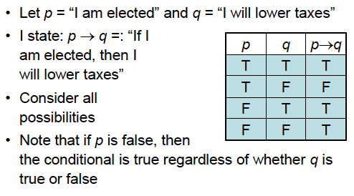
Conditional operators
If pigs can fly then 2+2=44. True or False?

Slide 15
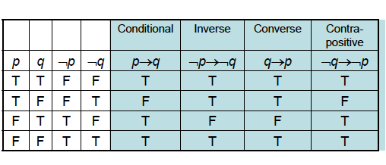
Conditional operators

Slide 16
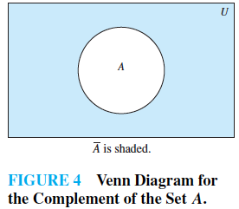
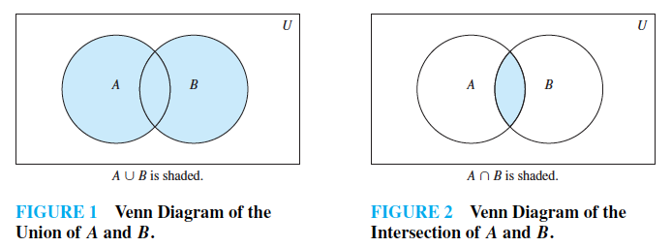
Set representations
A proposition can also be
represented by a set of elements
for which the proposition is true.
(Venn diagram)
Venn diagram

Slide 17
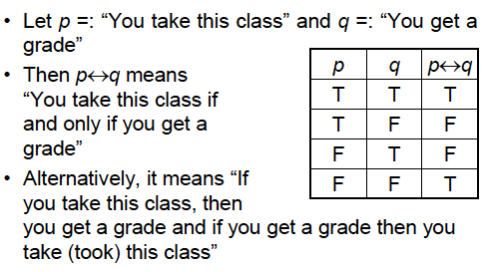
Bi-conditional Statements

Slide 18
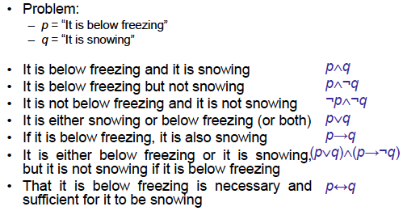
Translating into English

Slide 19
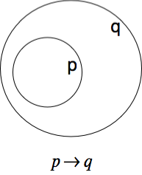
Translating into English
Great for developing intuition about propositional operators.
IF p (is true) then q (must be true)
p (is true) ONLY IF q (is true)
IF I am elected (p) then I will lower taxes (q)
p is a sufficient condition for q
q is a necessary condition for p

Slide 20
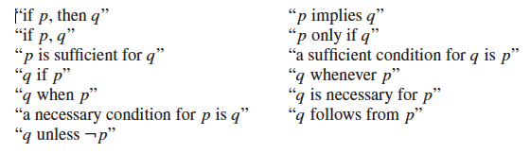
Translating into English

Slide 21
Translating into English
Example 1. p = Iowa q =Midwest
if I live in Iowa then I live in the Midwest
I live in Iowa only if I live in the Midwest
Example 2. You can access the Internet from campus only if you are a CS major or an ECE major or a MATH major, or you are not a freshman (f):
(CS ∨ ECE ∨ MATH ∨ ¬ f) ⟶ Access Internet

Slide 22
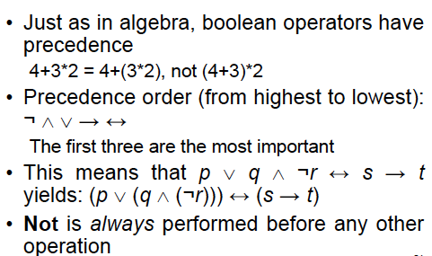
Precedence of Operators

Slide 23
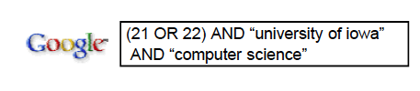
Boolean operators in search

Slide 24
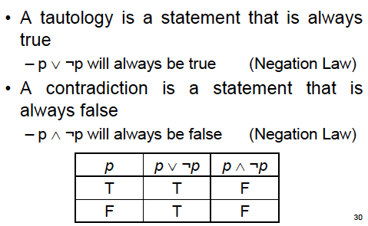
Tautology and Contradiction

Slide 25

Equivalence

Slide 26
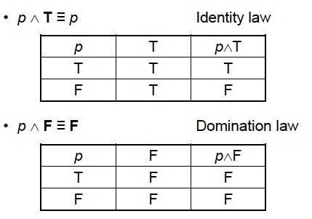
Examples of Equivalence

Slide 27
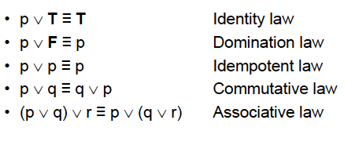
Examples of Equivalence

Slide 28

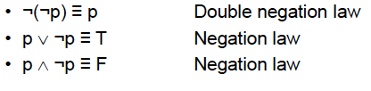


More Equivalences
Associative Laws
Distributive Law
Law of absorption
See page 27-28 for a complete list

Slide 29
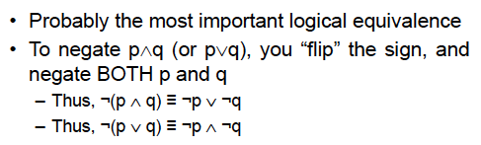
De Morgan’s Law
You can take 22C:21 if you take 22C:16 and 22M:26
You cannot take 22C:21 if you have not taken 22C:16 or 22M:26

Slide 30
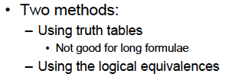
How to prove Equivalences
Examples?

Slide 31

How to prove Equivalences

Slide 32
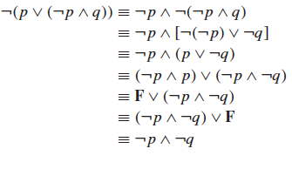
How to prove Equivalences

Slide 33
Propositional Satisfiability
A compound propositional statement is satisfiable, when some
assignment of truth values to the variables makes is true. Otherwise,
the compound propositional statement is not satisfiable.
Check if the following are satisfiable.
1.
2.
3.

Slide 34
Solve this
There are three suspects for a murder: Adams, Brown, and Clark.
Adams says: “I didn't do it. The victim was old acquaintance of
Brown. But Clark hated him.”
Brown says: “I didn't do it. I didn't know the guy.
Besides I was out of town all the week.”
Clark says: “I didn't do it. I saw both Adams and Brown downtown
with the victim that day; one of them must have done it.”
Assume that the two innocent men are telling the truth, but that
the guilty man might not be. Who is possibly the murderer?
(Taken from http://logic.stanford.edu/classes/cs157/2005fall/notes/chap0)

Slide 35
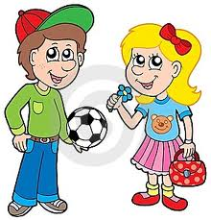
Muddy Children Puzzle
A father tells his two children, a boy and a girl,
to play in the backyard without getting dirty.
While playing, both children get mud on their
foreheads. After they returned home, the father
said: “at least one of you has a muddy forehead,”
and then asked the children to answer YES or
NO to the question: “Do you know if you have a
muddy forehead?” The father asked the question
twice.
How will the children answer each time?

Slide 36
(Russel’s) Paradox
In a town, there is just one barber, he is male. In this town, every man keeps himself clean-shaven. He does so by one of the following two methods.
1. By shaving himself; or
2. Being shaved by the barber.
The barber shaves all those, and those only, who do not shave themselves.
Question: Does the barber shave himself?
What is the answer is Yes?
What if the answer is No?

Slide 37
Wrap up
Understand propositions, logical operators and their usage.
Understand equivalence, tautology, and contradictions.
Practice proving equivalences, tautology, and contradictions.

