Slide 1
CS 2210 (22C:19) Discrete Structures Discrete Probability
Spring 2015
Sukumar Ghosh

Slide 2
Sample Space
DEFINITION. The sample space S of an experiment is the set
of possible outcomes. An event E is a subset of the sample space.

Slide 3
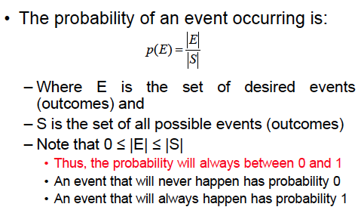
What is probability?

Slide 4
Probability distribution
Consider an experiment where there are n possible outcomes
x₁, x₂, x₃, x₄, … x_{n} . Then
You can treat p as a function that maps the set of all outcomes to
the set of real numbers. This is called the probability distribution
function.

Slide 5
Probability of independent events
When two events E and F are independent, the occurrence of one gives no information about the occurrence of the other.
The probability of two independent events
p(E∩F) = p(E) . p(F)

Slide 6
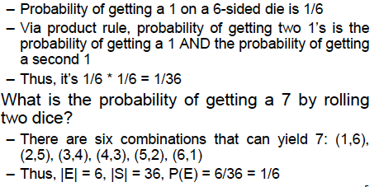
Example of dice
What is the probability of two 1’s on two six-sided dice?

Slide 7

Example from Card games
13
There are (13 x 4) = 52 cards in a pack

Slide 8
Example from Card games
13
13
13
13
There are (13 x 4) = 52 cards in a pack

Slide 9
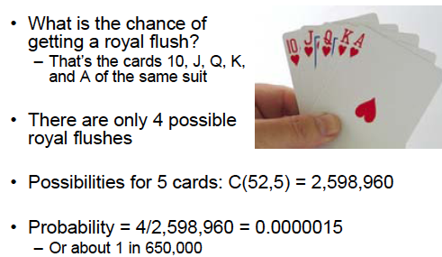
Poker game: Royal flush

Slide 10
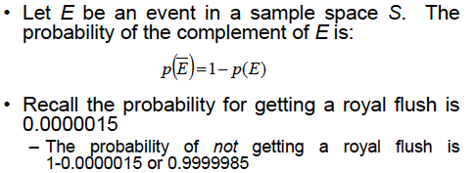
More on probability

Slide 11
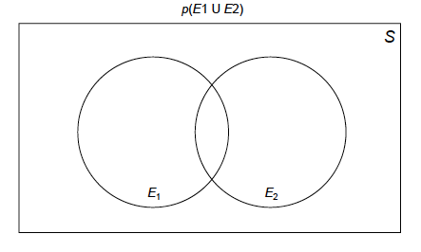
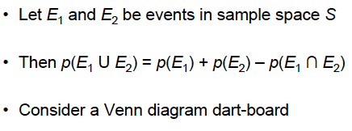
Probability of the union of events

Slide 12
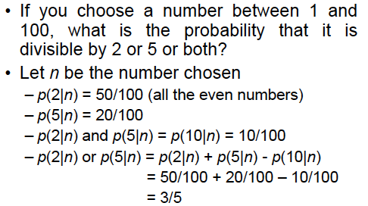
Example

Slide 13
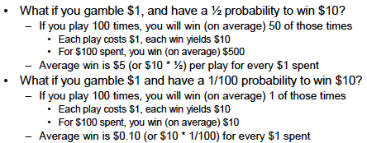
When is gambling worth?
Disclaimer. This is a statistical analysis, not a moral or
ethical discussion

Slide 14
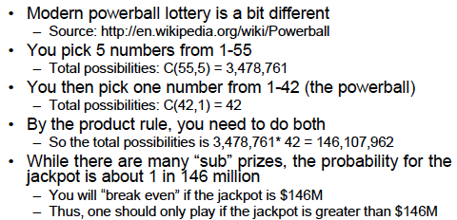
Powerball lottery
Disclaimer. This is a statistical analysis, not a moral or
ethical discussion

Slide 15
Conditional Probability
You are flipping a coin 3 times. The first flip is a tail. Given
this, what is the probability that the 3 flips produce an odd
number of tails?
Deals with the probability of an event E when another event
F has already occurred. The occurrence of F actually shrinks
the sample space.
Given F, the probability of E is p(E|F) = p(E ⋂ F) / p(F)

Slide 16
Conditional Probability
Sample space S = {TTT, THH, THT, TTH, HTT, HHH, HHT, HTH}
F = {TTT, THH, THT, TTH} (the reduced sample space)
E = {TTT, THH} {the target event set)
p(E ⋂ F) = 2/8,
p(F) =4/8.
So p(E|F) = p(E ⋂ F) / p(F) = 1/2

Slide 17
Example of Conditional Probability
What is the probability that a family with two children has
two boys, given that they have at least one boy?
F = {BB, BG, GB}
E = {BB}
If the four events {BB, BG, GB, GG} are equally likely, then
p(F) = ¾, and p(E ⋂ F) = ¼
So the answer is ¼ divided by ¾ = 1/3

Slide 18
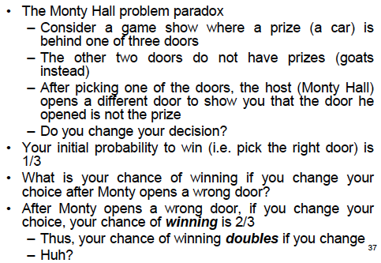
Monty Hall 3-door Puzzle

Slide 19
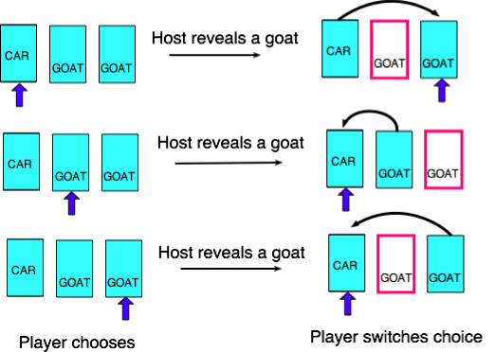
What is behind the doors?

Slide 20
Warm up
Problem 1. A sequence of 10 bits is randomly generated. What is the probability that at least one of these bits is 0?
Answer.
Probability that none of these bits is 0 is 1/2¹⁰
So, the probability that at least one of these bits is 0 is
(1-1/2¹⁰) = 1023/1024

Slide 21
Warm up
Problem 2. Find the probability of selecting none of the correct six integers in a lottery, (where the order in which these integers are selected does not matter) from the positive integers 1-40?
Answer. The number of ways of selecting all wrong numbers is the number of ways of selecting six numbers from the 34 incorrect numbers. There are C(34,6) ways to do this. Since there are C(40,6) ways to choose numbers in total, the probability of selecting none of the correct six integers is
C(34,6)/C(40,6)

Slide 22
Bernoulli trials
An experiment with only two outcomes (like 0, 1 or T, F) is called a Bernoulli trial . Many problems need to compute the probability of exactly k successes when an experiment consists of n independent Bernoulli trials.

Slide 23
Bernoulli trials
Example. A coin is biased so that the probability of heads is 2/3. What is the probability that exactly four heads come up when the coin is flipped exactly seven times?

Slide 24
Bernoulli trials
The number of ways 4-out-of-7 flips can be heads is C(7,4).
H H H H T T T
T H H T H H T
T T T H H H H
Each flip is an independent flips. For each such pattern, the probability of 4 heads (and 3 tails) = (2/3)⁴. (1/3)^{3.} So, in all, the probability of exactly 4 heads is C(7,4). (2/3)⁴. (1/3)³ = 560/2187

Slide 25
The Birthday Problem
The problem. What is the smallest number of people who should be in a room so that the probability that at least two of them have the same birthday is greater than ½?
3
2
1
Consider people entering the room one after another. Assuming birthdays are randomly
assigned dates, the probability that the second person has the same birthday as the
first one is 1 - 365/366
Probability that third person has the same birthday as any one of the previous persons is
1 – 364/366 x 365/366

Slide 26
The Birthday Problem
Continuing like this, probability that the n^{th} person has the same birthday as one of the previous persons is 1 – 365/366 x 364/366 x … x (367 –n)/366
3
2
1
Solve the equation so that for the n^{th} person, this probability
exceeds ½. You will get n = 23
Also sometimes known as the birthday paradox.

Slide 27
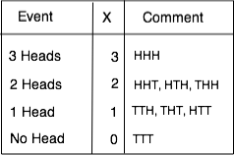
Random variables
DEFINITION. A random variable is a function from the sample space of an experiment to the set of real numbers
Note. A random variable is a function, not a variable ☺
Example. A coin is flipped three times. Let X be the random variable that equals the total number of heads. Thus

Slide 28
Expected Value
Informally, the expected value of a random variable is its average value. Like, “what is the average value of a Die?”
DEFINITION. The expected value of a random variable X(s) is equal to [X(i) means the outcome is i]
EXAMPLE 1. Expected value of a Die
Each number 1, 2, 3, 4, 5, 6 occurs with a probability 1/6. So the expected value is 1/6 (1+2+3+4+5+6) = 21/6 = 7/2

Slide 29
Expected Value (continued)
EXAMPLE 2. A fair coin is flipped three times. Let X be the random variable that assigns to an outcome the number of heads that is the outcome. What is the expected value of X?
There are eight possible outcomes when a fair coin is flipped three times. These are HHH, HHT, HTH, HTT, THH, THT, TTH, TTT. Each occurs with a probability of 1/8. So,
E(X) = 1/8(3+2+2+2+1+1+1+0) = 12/8 = 3/2

Slide 30
Geometric distribution
Consider this:
You flip a coin and the probability of a tail is p. This coin is repeatedly flipped until it comes up tails.
What is the expected number of flips until you see a tail?

Slide 31
Geometric distribution
The sample space {T, HT, HHT, HHHT …} is infinite.
The probability of a tail (T) is p.
Probability of a head (H) is (1-p)
The probability of (HT) is (1-p)p
The probability of (HHT) is (1-p)²p etc. Why?
Let X be the random variable that counts the number of flips to see
a tail. Then
This is known as geometric distribution.

Slide 32
Expectation in a Geometric distribution
X = the random variable that counts the number of flips to see a tail.
So, and so on
This infinite series can be simplified to 1/p.
Thus, if p = 0.2 then the expected number of flips after which you see a tail is 1/0.2 = 5

Slide 33
Explanation
Probability | Value
0.2 0.3 0.5 | 30 40 20
What is the average value?
0.2 x 30 + 0.3 x 40 + 0.5 x 20 = 28

Slide 34
Useful Formulas
(E and F are mutually independent)
(E and F are mutually independent)
(E and F are not independent: Inclusion- Exclusion)
(Conditional probability: given F, the probability of E)

Slide 35
Monte Carlo Algorithms
A class of probabilistic algorithms that make a random choice at one
or more steps.
Example. Has this batch of n chips not been tested by the chip maker?
Randomly pick a chip and test it.
If it is bad, then the answer is true (i.e. it has not been tested).
If the chip is good then the answer is “don’t know.” Then randomly pick another.
After the answer is “don’t know” for K different random picks, with
you certify the batch to be good.
What is the probability of a wrong conclusion?

Slide 36
Monte Carlo Algorithms
Assume that in previously untested batches, the probability that a particular chip is bad has been observed to be 0.1. So the probability of a chip being good from an untested batch is (1-0.1) = 0.9.
Each test is independent. So the probability that all K steps produce the result “don’t know” is 0.9^{k.} By making K large enough, one can make the probability as small as possible. Thus, if K=66, then 0.9⁶⁶ < 0.001
The fact that so many chips are OK tells that the probability that the batch has not been tested is very small. So we certify the batch. Usually K is a constant. Each test takes a constant time – so we can certify (or discard) a batch in constant time.
-- Certification via random witnesses
-- Monte Carlo algorithm for testing prime numbers

Slide 37
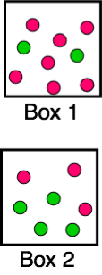
Bayes’ theorem
This is related to conditional probability. We can make a realistic
estimate when some extra information is available.
Problem 1.
There are two boxes.
Bob first chooses one of the two boxes at random.
He then selects one of the balls in this box at random.
If Bob has selected a red ball, what is the probability that he selected a ball from the first box?
(See page 469 of your textbook)

Slide 38
Bayes’ theorem
Let E= “Bob chose a red ball.” So E’ = “Bob chose a green ball”
F= “Bob chose from Box 1”. So F’ = “Bob chose from Box 2”
We have to compute p(F|E)
p(E|F) = 7/9, p(E|F’) = 3/7
We have to find
p(F) = p(F’) = 1/2

Slide 39
Bayes’ theorem
This is the probability that
Bob chose the ball from Box 1

Slide 40
Bayes’ theorem
Let E and F be events from a sample space S such that p(E) ≠ 0 and p(F) ≠ 0. Then
c
given
Compute this
c

Slide 41
Bayes’ theorem
Problem 2
Suppose that one person in 100,000 has a particular rare disease
for which there is a fairly accurate diagnostic test.
2. This test is correct 99.0% of the time when given to a person
selected at random who has the disease;
3. The test is correct 99.5% of the time when given to a person
selected at random who does not have the disease.
Find the probability that a person who tests positive for the disease
really has the disease. (See page 471 of your textbook)

Slide 42
Bayes’ theorem
1 in 100,000 has the rare disease (1)
This test is 99.0% correct if actually infected; (2)
The test is 99.5% correct if not infected (3)
Let F = event that a randomly chosen person has the disease
and E = event that a randomly chosen person tests positive
So, p(F)= 0.00001, p(F’) = 0.99999 {from (1)}
Also, p(E|F) = 0.99 , and p(E’|F) = 1- 0.99 = 0.01 {from (2)}
Also p(E’|F’) = 0.995 , and p(E|F’) = 1- 0.995 = 0.005 {from (3)}
Now, plug into Bayes’ theorem.

Slide 43
Bayes’ theorem
=
So, the probability that a person “who tests positive for the disease”
really has the disease is only 0.2%

