Slide 1
CS2210(22C:19) Discrete Structures
Relations
Spring 2015
Sukumar Ghosh

Slide 2
What is a relation?
Let A, B be two sets. A binary relation R is a subset of A X B.
Example. Let A = {Alice, Bob, Claire, Dan) be a set students,
and B= {CS101, CS201, CS202) be a set of courses. Then,
a possible relation is:
{(Alice, CS101), (Bob, CS201), (Bob, CS202), (Dan, CS201),
(Dan, CS202)}
If |A|= m and |B|= n, then there can be as many 2^{mn} distinct
relations (why?).

Slide 3
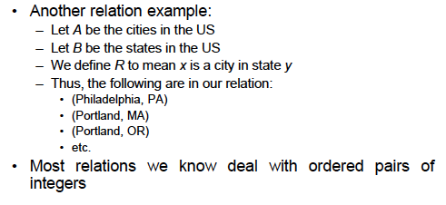
What is a relation?

Slide 4
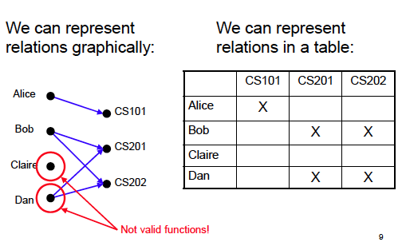
Representing Relations

Slide 5
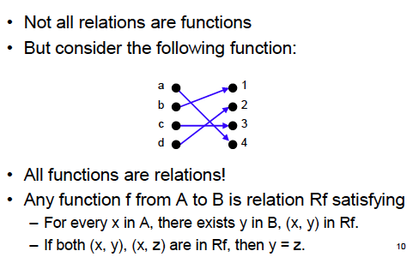
Relations vs. Functions

Slide 6
When to use which?
A function yields a single result for any element in its domain.
Example: age (of a person), square (of an integer) etc.
A relation allows multiple mappings between the domain
and the co-domain.
Example: students enrolled in multiple courses.

Slide 7
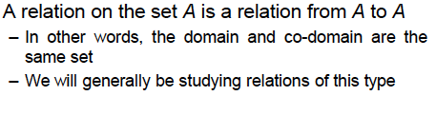
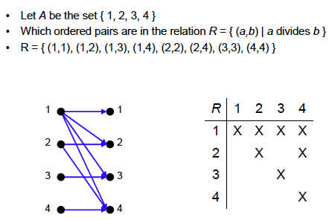
Relation within a set

Slide 8
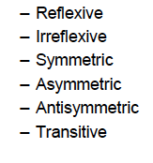
Properties of Relations
We study six properties of relations:
What are these?

Slide 9


Reflexivity
Example.
= is reflexive, since a = a
≤ is reflexive, since a ≤ a
< is not reflexive is a < a is false.

Slide 10
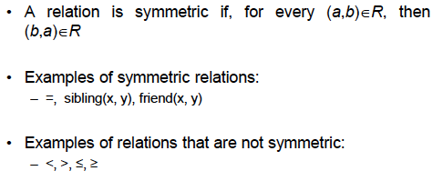
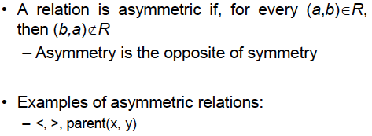
Symmetry

Slide 11
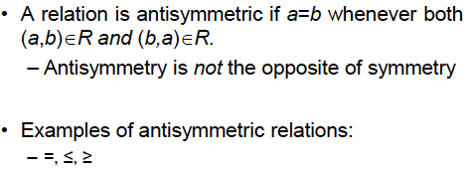

Anti-symmetry

Slide 12
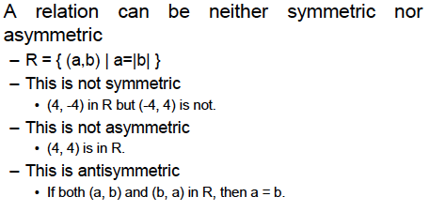
More on symmetric relations

Slide 13
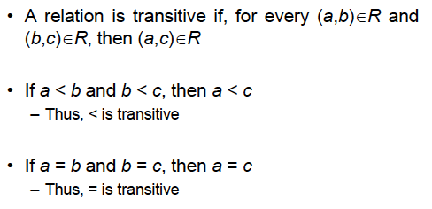
Transitivity

Slide 14
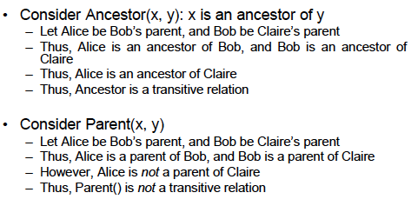
Examples of transitive relations

Slide 15
Summary of properties
 | = | < | > | ≤ | ≥
Reflexive | X |  |  | X | X
Irreflexive |  | X | X
Symmetric | X
Asymmetric |  | X | X
Antisymmetric | X |  |  | X | X
Transitive | X | X | X | X | X

Slide 16
Operations on relations
Let A = {1, 2, 3} and B = (1, 2, 3, 4}. Define two relations
R1 = {(1,1), (1,2), (1,3)}
R2 = {(1,1), (1,3), (1,4)}
Then,
R1 ⋃ R2 = {(1,1), (1,2), (1,3), (1,4)}
R1 ⋂ R2 = {(1,1), (1,3)}
R1 - R2 = {(1,2)}

Slide 17
More operations on relations: Composition
Let S be a relation from the set A to the set B, and R be
and R be a relation from the set B to the set C. Then, the
composition of S and R, denoted by S ◦ R is
{(a, c) | a ∈ A, b ∈ B, c ∈ C such that (a, b) ∈ S and (b, c) ∈ R}
EXAMPLE. Let A = {1, 2, 3}, B = { 1, 2, 3, 4}, C = {0, 1, 2}
S = {(1,1), (1,4), (2,3), (3, 1), (3, 4)}
R = {(1,0), (2,0), (3,1), (3, 2), (4,1)
Then S ◦ R = {(1,0), (1,1), (2,1), (2,2), (3,0), (3,1)

Slide 18
More operations on relations: Composition
R^{n} = R^{n-1} ◦ R = R ◦ R ◦ R ◦ R … (n times)
EXAMPLE. Let R = {(1,1), (2,1), (3,2), (4,3)},. Then
R² = R ◦ R = {(1,1), (2,1), (3, 1), (4,2)}
R³ = R² ◦ R = {(1,1), (2,1), (3, 1), (4,1)}
R⁴ = R³ ◦ R = {(1,1), (2,1), (3, 1), (4,1)}
Notice that in this case for all n > 3, R^{n} = R³

Slide 19
Transitive Closure
The transitive closure of a binary relation R on a set S is the
transitive relation R* on S such that
EXAMPLE. Let S = {1, 2, 3} and R = {(1,1), (2,1), (3,2), (4,3)}. Then R* = {(1,1), (2,1), (3, 1), (3,2), (4,3), (4,2), (4,1)}

Slide 20
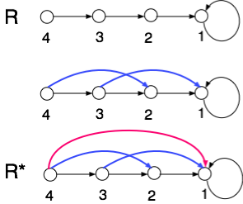
Transitive Closure: A graph view

Slide 21
n-ary relations
Has important applications in computer databases.
DEFINITION. Let A₁, A₂, A₃, …, A_{n} be n sets. An n-ary relation
is a subset of A₁ x A₂ x A₃ x… x A_{n}
EXAMPLE. R is a relation on N x N x N consisting of triples
(a, b, c) where a < b < c. Thus (1, 2, 3) ∈ R but (3, 6, 2) ∉ R

Slide 22
Relational Data Model
Student Record
Name | ID | Major | GPA
Alice | 211 324 | Physics | 3.67
Bob | 123 456 | ECE | 3.67
Carol | 351 624 | ECE | 3.75
David | 000 888 | Computer Science | 3.25
The above table can be viewed as a 4-ary relation consisting of the 4-tuples
(Alice, 211324, Physics, 3.67)
(Bob, 123456, ECE, 3.67)
(Carol, 351624, ECE, 3.75)
(David, 000888, Computer Science, 3.25)

Slide 23
Relational Data Model
Name | ID | Major | GPA
Alice | 211 324 | Physics | 3.67
Bob | 123 456 | ECE | 3.67
Carol | 351 624 | ECE | 3.75
David | 000 888 | Computer Science | 3.25
A domain is called a primary key when no two n-tuples
in the relation have the same value from this domain.
(These are marked red).

Slide 24
Operations on n-ary relations
SELECTION
Let R be an n-ary relation, and C be a condition that the
elements in R must satisfy. Then the selection operator
S_{C} maps the n-ary relation R to the n-ary relations from R
that satisfy the condition C.
So, from the previous table, one can use a selection operator
to filter out the record of all student with GPA > 3.50

Slide 25
Operations on n-ary relations
PROJECTION
The projection P_{i,j,k,…,m} maps each n-tuple (a₁, a₂, a₃, …, a_{n})
to the tuple (a_{i}, a_{j}, a_{k}, …, a_{m}).
Essentially it helps you delete some of the components of each n-tuple.
Thus, in the table shown earlier, the projection P_{1,4} will retain only that
part of the table that contains the student names and their GPAs.

Slide 26
Use of the operations on n-ary relations
SQL queries
SQL queries carry out the operations described earlier:
SELECT GPA
FROM Student Records
WHERE Department = Computer Science

Slide 27
Representing Relations Using Matrices
A relation between finite sets can be represented using a 0-1 matrix.
Let A = {a₁, a₂, a₃} and B = {b₁, b₂, b₃}. A relation R from A to B can be
represented by a matrix M_{R}, where m_{ij} = 1 if (a_{i}, b_{j}) ∈ R, otherwise m_{ij} = 0
b1=1
b2=2
b3=4
a1=1
0
0
0
a2=2
1
0
0
a3=3
1
1
0
The above denotes a relation R from A = {1,2,3} to B = {1,2,4}, where for each element
(a, b) of R, a > b

Slide 28
Representing Relations Using Matrices
A reflexive relation on a given set A is recognized by a 1 along the diagonal
1
1
0
0
0
1
1
0
1
1
1
1
0
A reflexive relation
A symmetric relation
How would the matrix of an anti-symmetric relation look like?

Slide 29
Representing Relations Using Digraph
A relation on a given set A can also be represented by a directed graph
1
2
3
2
1
1
0
0
1
1
2
1
0
1
3
3
1
1
A directed graph representation
of the relation shown on the left
Let A = {1, 2, 3}

Slide 30
Equivalence Relations
An equivalence relation on a set S is a relation that is
reflexive, symmetric and transitive.
Examples of equivalence relations are:
Congruence relation R = {(a,b) | a = b (mod m)}
(2) R = {(a, b) | L(a) = L(b)} in a set of strings of
English characters}, L(a) denotes the length of English
character string “a”

Slide 31
Equivalence Class
Let R be an equivalence relation on a set A. The set of all elements
that are related to an element a of A is called the equivalence class
of a. The equivalence class of a with respect to R is denoted by [a]_{R}.
Example 1. What is the equivalence class of 0 for the relation
congruence mod 4?
[0]_{mod 4} = [… -8, -4, 0, +4, +8, …]
Relations partition the elements of a set into equivalence classes
Question. What are the sets in the partition of the integers arising
from congruence modulo 4?

Slide 32
Partial Orders
A relation R on a set S is a partial order if it is reflexive,
anti-symmetric and transitive. The set (S, R) is called a
partially ordered set, or a poset.
Examples are
(1) the ≥ relation,
(2) “x divides y” on the set of positive integers
(3) The relation ⊆ on the power set of a set S

Slide 33
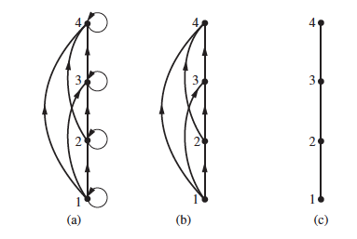
Hasse Diagram
Constructing the Hasse diagram for ({1, 2, 3, 4}, ≤}

Slide 34
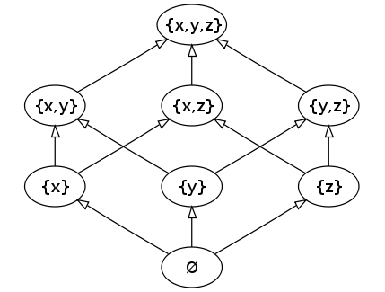
More examples
The relation ⊆ on the power set of a set S forms a partially ordered set
Source: http://en.wikipedia.org/wiki/Partially_ordered_set

