Slide 1
22C:19 Discrete Math
Induction and Recursion
Fall 2011
Sukumar Ghosh

Slide 2
What is mathematical induction?
It is a method of proving that something holds.
Suppose we have an infinite ladder, and we want to know
if we can reach every step on this ladder.
We know the following two things:
We can reach the base of the ladder
If we can reach a particular step, then we can reach the
next step
Can we conclude that we can reach every step of the ladder?

Slide 3
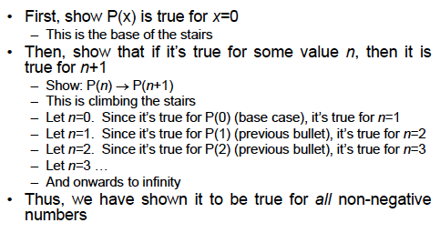
Understanding induction
Suppose we want to prove that P(x) holds for all x

Slide 4
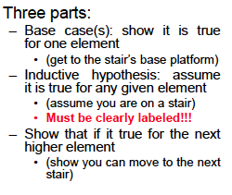
Proof structure

Slide 5
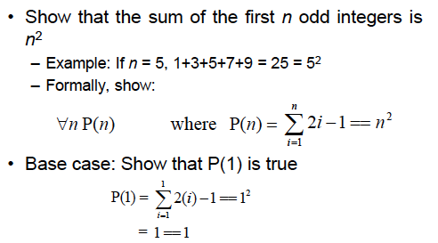
Example 1

Slide 6
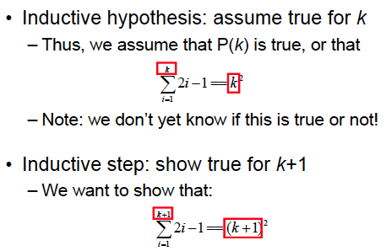
Example continued

Slide 7
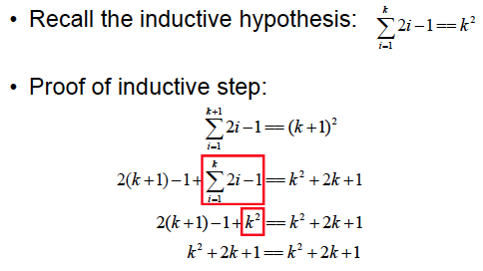
Example continued

Slide 8
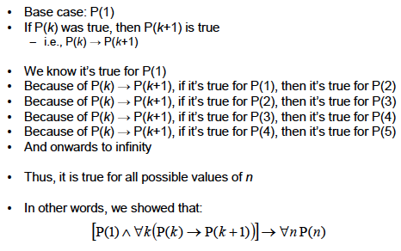
What did we show?

Slide 9
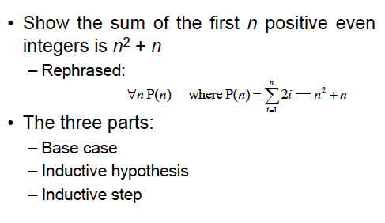
Example 2

Slide 10
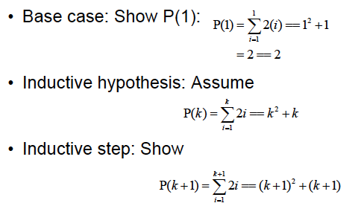
Example continued

Slide 11
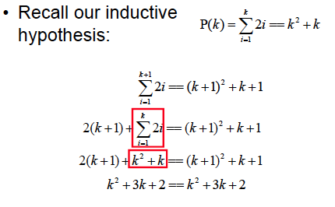
Example continued

Slide 12
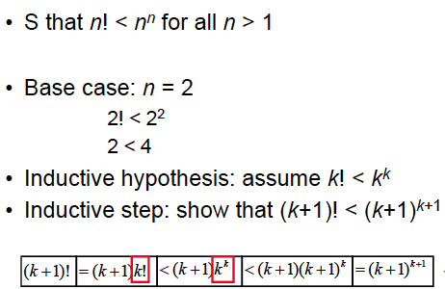
Example 3

Slide 13
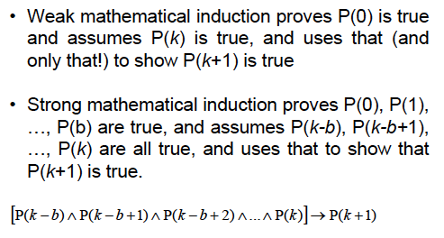
Strong induction

Slide 14
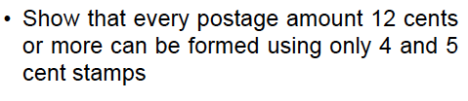
Example

Slide 15
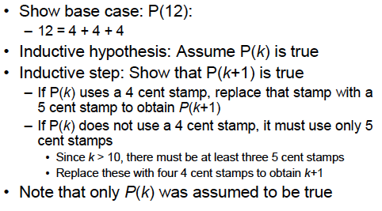
Proof using Mathematical Induction

Slide 16
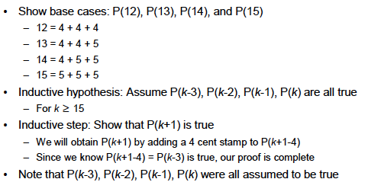
Same Proof using Strong Induction

Slide 17
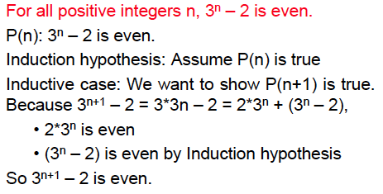
Errors in Induction
Question: What is wrong here?

Slide 18
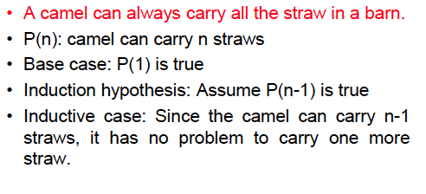
Errors in Induction
Question: What is wrong here?

Slide 19
Recursion
Recursion means defining something, such as a
function, in terms of itself
– For example, let f(x) = x!
– We can define f(x) as f(x) = x * f(x-1)

Slide 20


Recursive definition
Two parts of a recursive definition:
Base case and a Recursive step
.

Slide 21
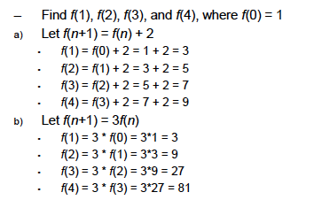
Recursion example

Slide 22
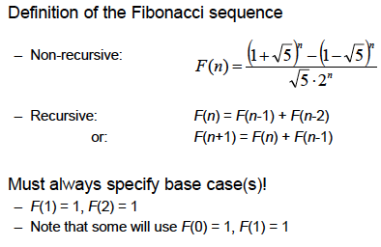
Fibonacci sequence

Slide 23
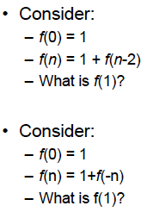
Bad recursive definitions
Why are these definitions bad?

Slide 24
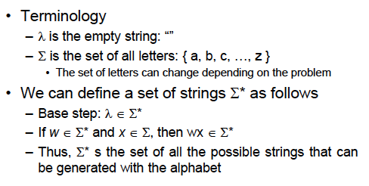
More examples of recursion: defining strings

Slide 25
Structural induction
A technique for proving a property of a recursively defined object.
It is very much like an inductive proof, except that in the inductive
step we try to show that if the statement holds for each of the
element used to construct the new element, then the result holds
for the new element too.
Example. Prove that if T is a full binary tree, and h(T) is the height of the tree
then the number of elements in the tree n(T) ≤ 2 ^{h(T)+1} -1.
See the textbook (pages 306-307) for a solution.

Slide 26
Recursive Algorithm
Example 1. Given a and n, compute a^{n}
procedure power (a : real number, n: non-negative integer)
if n = 0 then power (a, n) := 1
else power (a, n) := a. power (a, n-1)

Slide 27
Recursive algorithms: Sorting
Here is the recursive algorithm Merge sort. It merges two sorted
Iists to produce a new sorted list
8 2 4 6 10 1 5 3
8 2 4 6
10 1 5 3
8 2
4 6
10 1
5 3

Slide 28
Mergesort
The merge algorithm “merges” two sorted lists
2 4 6 8 merged with 1 3 5 10 will produce 1 2 3 4 5 6 8 10
procedure mergesort (L = a₁, a₂, a₃, … a_{n})
if n > 0 then
m:= n/2
L1 := a₁, a₂, a₃, … a_{m}
L2 := a_{m+1}, a_{m+2}, a_{m+3}, … a_{n}
L := merge (mergesort(L1), mergesort(L2))

Slide 29
Example of Mergesort
1 2 3 4 5 6 8 10
8 2 4 6 10 1 5 3
2 4 6 8
8 2 4 6
10 1 5 3
1 3 5 10
2 8
8 2
4 6
4 6
10 1
1 10
5 3
3 5

Slide 30
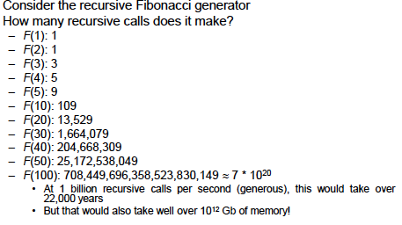
Pros and Cons of Recursion
While recursive definitions are easy to understand
Iterative solutions for Fibonacci sequence are much faster (see 316-317)

