Slide 1
22C:19 Discrete Math Discrete Probability
Fall 2011
Sukumar Ghosh

Slide 2
Sample Space
DEFINITION. The sample space S of an experiment is the set
of possible outcomes. An event E is a subset of the sample space.

Slide 3
What is probability?

Slide 4
Probability distribution
Consider an experiment where there are n possible outcomes
x₁, x₂, x₃, x₄, … x_{n} . Then
1. 0 ≤ p(x₁) ≤ 1
2. p(x₁) + p(x₂) + p(x₃) + p(x₄) + … + p(x_{n}) = 1
You can treat p as a function that maps the set of all outcomes to
the set of real numbers. This is called the probability distribution
function.

Slide 5
Probability of independent events
When two events E and F are independent, the occurrence of one gives no information about the occurrence of the other.
The probability of two independent events
p(E∩F) = p(E) . p(F)

Slide 6
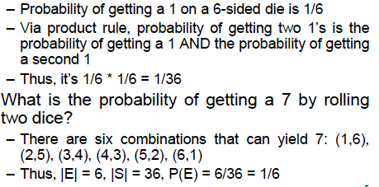
Example of dice
What is the probability of two 1’s on two six-sided dice?

Slide 7
Poker game: Royal flush

Slide 8
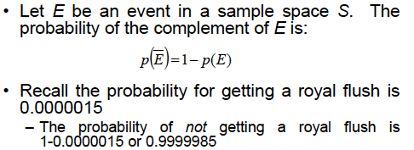
More on probability

Slide 9
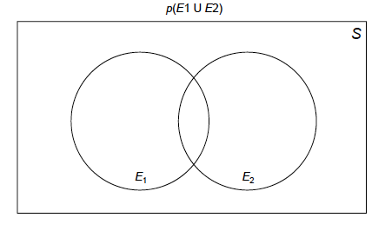
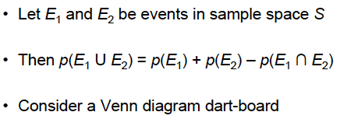
Probability of the union of events

Slide 10
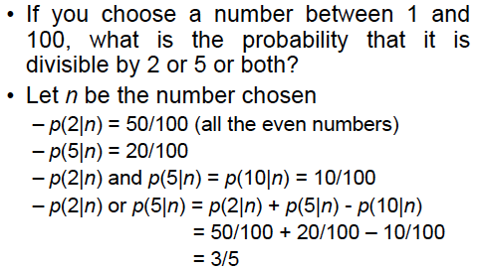
Example

Slide 11
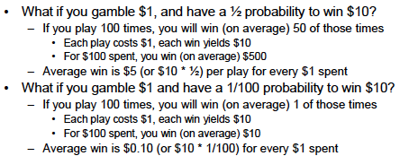
When is gambling worth?
Disclaimer. This is a statistical analysis, not a moral or
ethical discussion

Slide 12
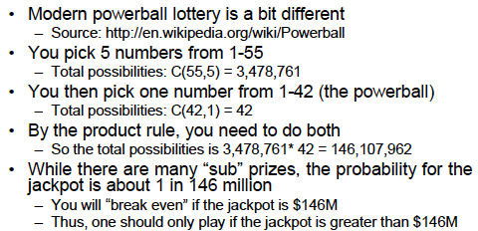
Powerball lottery
Disclaimer. This is a statistical analysis, not a moral or
ethical discussion

Slide 13
Conditional Probability
You are flipping a coin 3 times. The first flip is a tail. Given
this, what is the probability that the 3 flips produce an odd
number of tails?
Deals with the probability of an event E when another event
F has already occurred. The occurrence of F actually shrinks
the sample space.
Given F, the probability of E is
p(E|F) = p(E ⋂ F) / p(F)

Slide 14
Example of Conditional Probability
What is the probability that a family with two children has
two boys, given that they have at least one boy?
F = {BB, BG, GB}
E = {BB}
If the above four events are equally likely, then
p(F) = ¾, and p(E ⋂ F) = ¼
So the answer is ¼ divided by ¾ = 1/3

Slide 15
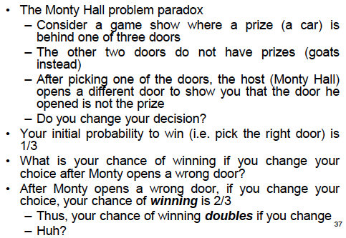
Monty Hall 3-door Puzzle

Slide 16
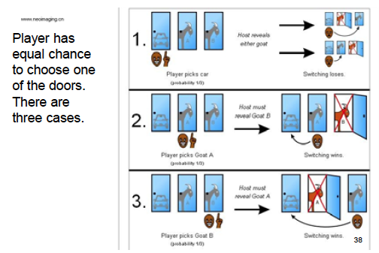
What is behind door number 3?

Slide 17
Bernoulli trials
An experiment with only two outcomes (like 0, 1 or T, F) is called a Bernoulli trial . Many problems need to compute the probability of exactly k successes when an experiment consists of n independent Bernoulli trials.

Slide 18
Bernoulli trials
Example. A coin is biased so that the probability of heads is 2/3. What is the probability that exactly four heads come up when the coin is flipped exactly seven times?

Slide 19
Bernoulli trials
The number of ways 4-out-of-7 flips can be heads is C(7,4).
H H H H T T T
T H H T H H T
T T T H H H H
Each flip is an independent flips. For each such pattern, the probability of 4 heads (and 3 tails) = (2/3)⁴. (1/3)^{3.} So, in all, the probability of exactly 4 heads is C(7,4). (2/3)⁴. (1/3)³ = 560/2187

Slide 20
Random variables
DEFINITION. A random variable is a function from the sample space of an experiment to the set of real numbers
Note. A random variable is a function, not a variable ☺
Example. A coin is flipped three times. Let X(t) be the random variable that equals the number of heads that appear when the outcome is t. Then
X(HHH) = 3
X(HHT) = X(HTH) = X(THH) = 2
X(TTH) = X(THT) = X(HTT) = 1
X(TTT) = 0

Slide 21
The Birthday Problem
The problem. What is the smallest number of people who should be in a room so that the probability that at least two of them have the same birthday is greater than ½?
3
2
1
Consider people entering the room one after another. Assuming birthdays are randomly
assigned dates, the probability that the second person has the same birthday as the
first one is 1 - 365/366
Probability that third person has the same birthday as one of the previous persons is
1 – 364/366 x 365/366

Slide 22
The Birthday Problem
Continuing like this, probability that the n^{th} person has the same birthday as one of the previous persons is 1 – 365/366 x 364/366 x … x (367 –n)/366
3
2
1
Solve the equation so that for the n^{th} person, this probability
exceeds ½. You will get n = 23
Also sometimes known as the birthday paradox.

Slide 23
Expected Value
Informally, the expected value of a random variable is its average value. Like, “what is the average value of a Die?”
DEFINITION. The expected value of a random variable X(s) is equal to ∑_{s∈S} p(s)X(s)
EXAMPLE 1. Expected value of a Die
Each number 1, 2, 3, 4, 5, 6 occurs with a probability 1/6. So the expected value is 1/6 (1+2+3+4+5+6) = 21/6 = 7/2

Slide 24
Expected Value (continued)
EXAMPLE 2. A fair coin is flipped three times. Let X be the random variable that assigns to an outcome the number of heads that is the outcome. What is the expected value of X?
There are eight possible outcomes when a fair coin is flipped three times. These are HHH, HHT, HTH, HTT, THH, THT, TTH, TTT. Each occurs with a probability of 1/8. So,
E(X) = 1/8(3+2+2+2+1+1+1+0) = 12/8 = 3/2

Slide 25
Geometric distribution
Consider this:
You flip a coin and the probability of a tail is p. This coin is repeatedly flipped until it comes up tails. What is the expected number of flips until you see a tail?

Slide 26
Geometric distribution
The sample space {T, HT, HHT, HHHT …} is infinite.
The probability of a tail (T) is p.
Probability of a head (H) is (1-p)
The probability of (HT) is (1-p)p
The probability of (HHT) is (1-p)²p etc. Why?
Let X be the random variable that counts the number of flips to see a tail. Then p (X=j) = (1-p)^{j-1}. p
This is known as geometric distribution.

Slide 27
Expectation in a Geometric distribution
X = the random variable that counts the number of flips to see a tail.
So, X(T) = 1, X(HT) = 2, X(HHT) = 3 and so on.
E(X) = ∑∞₁ j. p(X=j) = ∑∞₁ j. (1-p)^{j-1}.p
= 1. p + 2.(1-p).p + 3.(1-p)².p + 4. (1-p)³.p +
This infinite series can be simplified to 1/p. Thus, if p = 0.2 then the expected number of flips after which you see a tail is 1/0.2 = 5

Slide 28
Explanation
Probability | Value
0.2 0.3 0.5 | 30 40 20
What is the average value?
0.2 x 30 + 0.3 x 40 + 0.5 x 20 = 28

Slide 29
Expected value of a geometric distribution
Probability | Value of random variable X
p (1-p).p (1-p)².p (1-p)³.p .. | 1 2 3 4 ..
What is the average value (same as the expected value) of
the random variable X?
p + 2p(1-p) + 3p(1-p)² + 4p(1-p)³+ … = 1/p

