Slide 1
CS 5620
Distributed Systems and Algorithms
Sukumar Ghosh
Department of Computer Science
University of Iowa
Fall 2019

Slide 2
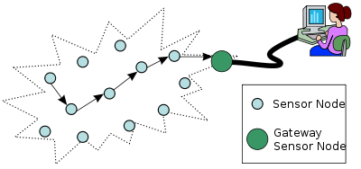
What is a distributed system?
A network of processes –
the processes interact with one another to achieve a goal.
Example
(The nodes are processes, and the edges are communication channels.)
A channel may be physical (wired, wireless) or logical

Slide 3
Facts
It is now hard to find systems that are not distributed.
Technology has dramatically reduced the cost of processors, so their population is exploding.
User demands for services have increased the scale of systems (Facebook has almost two billion users). Big Data has added fuel to it
We live in a networked society.

Slide 4
Examples
- The World Wide Web runs on the Internet and provides service
eBay for internet-based auction
Sensor networks for monitoring environmental data
Skype, FaceTime for making audio and video communication
Facebook, Twitter (the oxygen of modern society)
Internet of Things (IoT) enables everyday object to communicate with one another
Computational grids (Open Science Grid, SETI@home)
Network of mobile robots collectively doing a job
Distance education, net-meeting etc.
Networked services in everyday life (bank, travel etc)
Vehicular networks (VANET)
Blockchain (Bitcoin, Etherium, Libra)

Slide 5
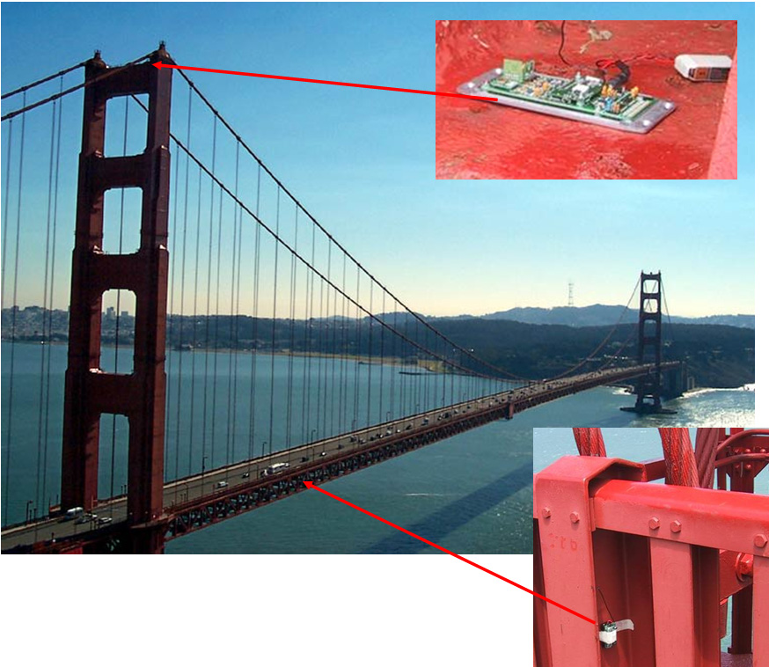
Sensor Network
The sensor network is checking the
structural integrity of the bridge

Slide 6
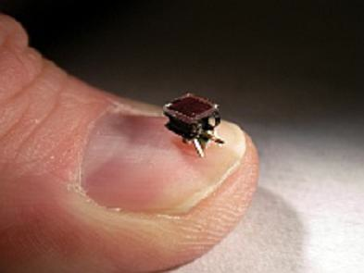
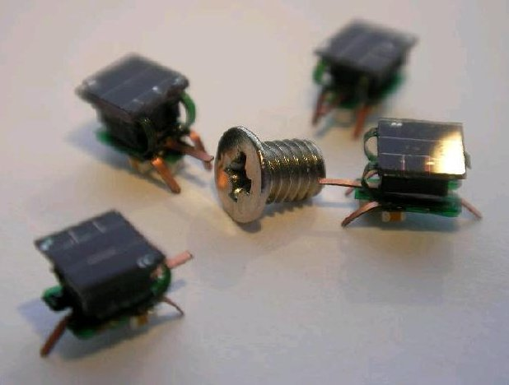
Mobile robots
I-Swarm Robot
(See a video of the I-Swarm
Robots on YouTube)
The I-Swarm project (2008), consisting of 10 research
institutes, was coordinated by Professor Heinz Wörn and
Jörg Seyfried of the University of Karlsruhe in Germany.
Check out more info on recent microbots and nanobots from the web

Slide 7
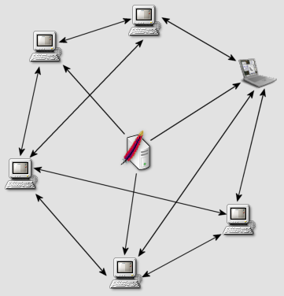
Goal of a distributed system
Processes coordinate their activities to share hardware and software and data, so that users perceive it as a single, integrated computing service with a well-defined goal. Think of transferring money from one account to another, or making a flight reservation
Downloading music in Bittorrent

Slide 8
Helps create abstractions
Distributed computing helps create simple abstractions to facilitate inter-process communication. Examples:
TCP implements a reliable end-to-end communication channel, even if messages may be lost or reordered at the lower layers of the network stack.
Media Access protocol used in Ethernet LAN or Wireless networks helps resolve network access conflict.
P
Q
Create a reliable channel between P and Q that are 10,000 miles away

Slide 9
Why distributed systems
Geographic distribution of processes is often natural
Resource sharing (example: video distribution via Facebook/Twitter)
Computation speed up via parallelism (as in a grid or cloud)
Fault tolerance and uncertainty management
The Worldwide LHC Computing Grid consists of a grid-based infrastructure with 170+
170 computing centers in 42 countries. As of 2017, it processed 25 petabytes of data/year.
- Source Wikipedia

Slide 10
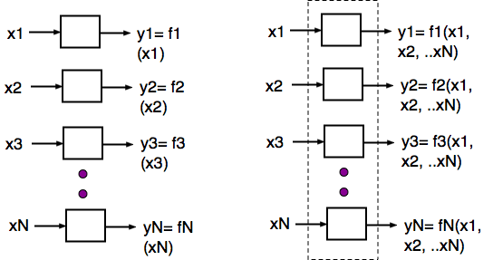
Distributed computation
Not distributed
Isolated collection of processes
Distributed Computation

Slide 11
Important challenges
Knowledge is local
Clocks are not synchronized
No globally shared address space
Topology and routing : everything is dynamic
Scalability: what is this
Processes and links fail:
  Fault tolerance and system availability

Slide 12
Some common subproblems
Leader election
Mutual exclusion
Time synchronization
Distributed snapshot
Reliable multicast
Replica management
Consensus

Slide 13
Implementation
Practical distributed systems have a real network as its backbone.
However, such systems can also be simulated on a shared-memory multiprocessor, or even on a single processor.
(How will you do it? Think of simulating multiple processes, and mailboxes between pairs of communicating processes)

Slide 14
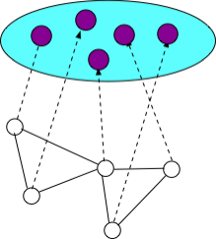
Implementation
Clouds are attractive platforms for the implementation of distributed systems. Processes are mapped to virtual machines. Communication channels between virtual machines are implemented using different kinds of tools (like virtual serial ports).
These solutions easily scale with no investment on the infrastructure.

Slide 15
Abstraction
We reason about distributed systems using models. There are many dimensions of variability in distributed systems. Examples:
types of processors
inter-process communication mechanisms
timing assumptions
failure classes
security features, etc.

Slide 16
Models
Models are simple abstractions that help overcome the variability -- abstractions that preserve the essential features, but hide the implementation details and simplify writing distributed algorithms for problem solving
Optical or radio communication?
PC or Mac?
Are clocks perfectly synchronized?
algorithms
models
Implementation of models
Real hardware

Slide 17
A classification
Server
Clients
Client-server model
Server is the coordinator
Peer-to-peer model
No unique coordinator

Slide 18
Parallel vs Distributed
In both parallel and distributed systems, the events are
partially ordered. The distinction between parallel and distributed is not always very clear. In parallel systems, the primarily issues are speed-up and increased data handling capability. In distributed systems the primary issues are fault-tolerance, synchronization, uncertainty management etc.
Depending on what you focus on, you can label a system as
parallel or distributed.

Slide 19
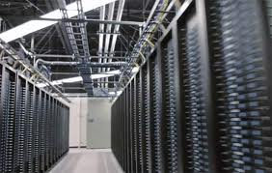
Example from Facebook
Coordinates among data centers
across the globe to keep the system
scalable, reliable and robust
user
The set up mimics client-server kind of operation, with the servers having a high level of parallelism. However, the network of servers also form a distributed system.
user
60,000 servers
user
The Facebook data center in Prineville, Oregon

Slide 20
Objective of the course
With some knowledge of networking and its associated tools, it
is not difficult to put together a distributed system. It is however,
much more difficult guarantee that it behaves the way we want it
to behave. Here lies the challenge.
A system that “sometimes works” is no good. We will study
how to guarantee our design for a given model.

Slide 21
Understanding models and abstractions
algorithms
models
Implementation of models
Real hardware

Slide 22
Message passing vs. shared memory
Difference between two inter-process communication models

Slide 23
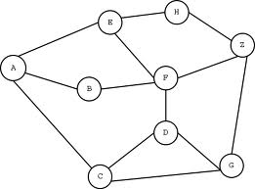
Modeling Communication
System topology is a graph G = (V, E), where V = set of nodes (sequential processes) E = set of edges (links or channels, bi/unidirectional).
Four types of actions by a process:
1. internal action
2. input action
3. communication action
4. output action

Slide 24
A Message Passing Model
Example of a Reliable FIFO Channel
Axiom 1. Message m sent ⇔ message m received
Axiom 2. Message propagation delay is arbitrary but finite.
Axiom 3. m1 sent before m2 ⇒ m1 received before m2.
P
Q

Slide 25
Life of a process
When a message m arrives
1. Receive it
2. Evaluate a predicate (with message m and the local variables);
3. if predicate = true then
update zero or more internal variables;
send zero or more messages;
end if
A
m
B
C
D
E

Slide 26
(Locally) shared memory models
0
1
2
State reading model
Each process can read
the states of its neighbors
3
Link register model
Each process can read from
and write to adjacent registers. The entire local state may not be shared.
0
1
2
3

Slide 27
Central vs. Distributed Schedulers
Central scheduler implies that at most one process can execute
its action at a time. A bit unrealistic, but it simplifies reasoning
about program correctness
Distributed scheduler allows any number of eligible processes
to execute their actions at the same time. It is more realistic, but
reasoning about correctness is more difficult.

Slide 28
An Example Program
Here is a completely connected network of n processes
Assume that interprocess communication uses the state
reading model. Each process i has a local variable p.
{Program for process i. Initially,∀i p(i) = 0}
repeat
  if ∀j ≠i p(i) < 1+p(j) then p(i) := p(i) + 1 end if
forever
Q1. How will the different p values change?
Q2. How will the different p values change
if their initial values are arbitrary?
0
1
4
2
3

Slide 29
Difference between a synchronous and asynchronous distributed systems

Slide 30
Synchrony vs. Asynchrony
Synchronous clocks | Physical clocks are synchronized
Synchronous processes | Lock-step synchrony
Synchronous channels | Bounded delay
Synchronous message-order | First-in first-out channels
Synchronous communication | Communication via handshaking
Send & receive can be blocking or non-blocking
Postal communication is asynchronous:
Telephone communication is synchronous
Synchronous communication or not?
Remote Procedure Call,
Email
Any constraint defines some form of synchrony

Slide 31
Modeling wireless networks
Communication via broadcast
Limited range
Dynamic topology
Collision of broadcasts
(handled by CSMA/CA)
Request To Send
RTS
RTS
CTS
Request To Send
Clear To Send

Slide 32
Weak vs. Strong Models
Examples
High level language is stronger than assembly language.
Asynchronous is weaker than synchronous (communication).
Bounded delay channel is stronger than unbounded delay channel
One object (or operation) of a strong model = Multiple simpler objects (or simpler operations) of a weaker model.
Often, weaker models are synonymous with fewer restrictions.
One can add layers (additional restrictions) to create a stronger model from weaker one.

Slide 33
Model transformation
Stronger models
- simplify reasoning, but
- needs extra work to implement
Weaker models
- are easier to implement.
- Have a closer relationship with the real world
“Can model X be implemented using model Y?” is an interesting question in computer science.
Sample exercises
Non-FIFO to FIFO channel
Message passing to shared memory
Non-atomic broadcast to atomic broadcast

Slide 34


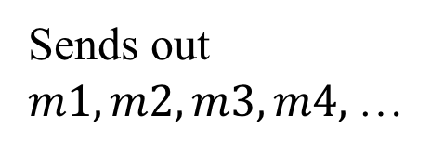


Non-FIFO to FIFO channel
FIFO = First-In-First-Out
Non-FIFO = messages can reach out-of-order
P
$$m2$$
$$m3$$
$$m4$$
$$m1$$
Q
Sends out
$m1, m2, m3, m4,$…
7
6
5
4
3
2
1
buffer

Slide 35
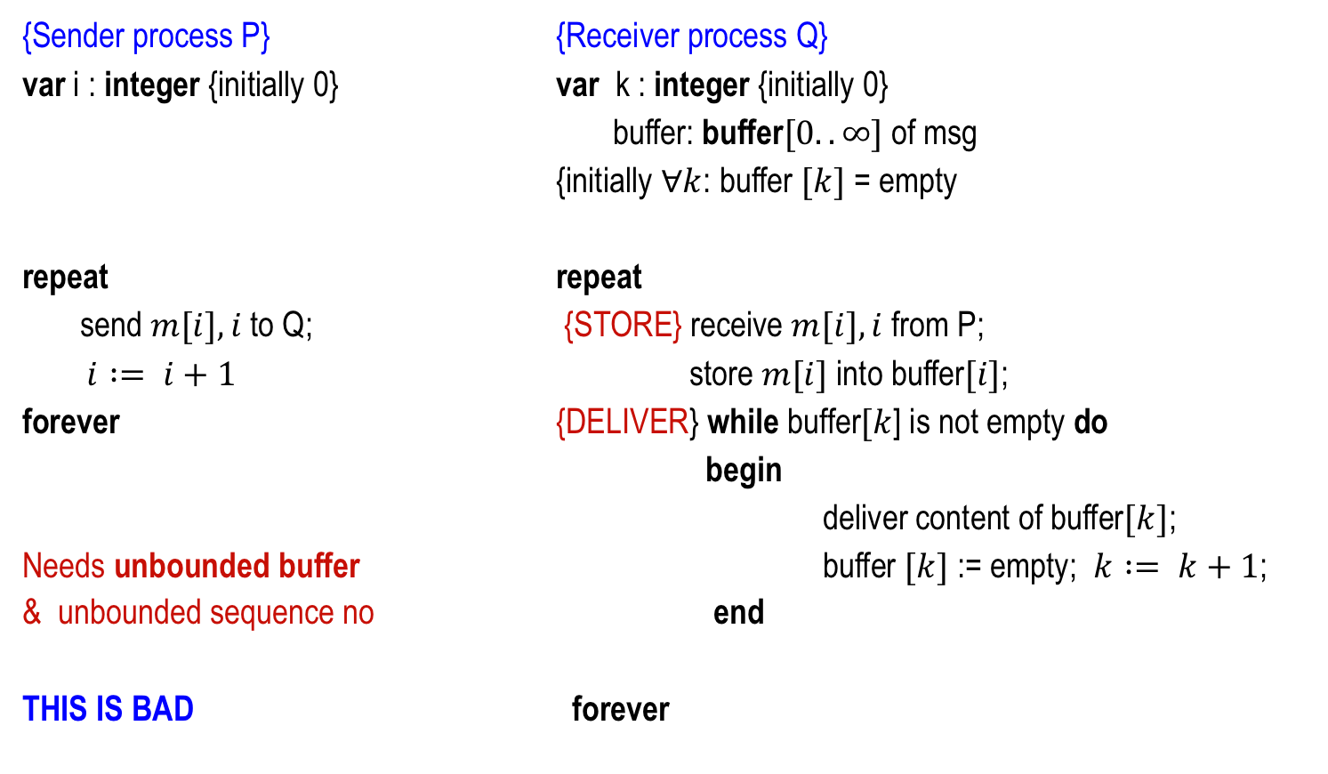
Non-FIFO to FIFO channel
{Sender process P} {Receiver process Q}
var i : integer {initially 0} var k : integer {initially 0}
buffer: buffer$[0..∞]$of msg
{initially $∀k$: buffer $[k]$ = empty
repeat repeat
send $m[i],i$to Q; {STORE} receive $m[i],i$ from P;
$i := i+1$ store $m[i]$ into buffer$[i]$;
forever {DELIVER} while buffer$[k$] is not empty do
begin
deliver content of buffer$[k]$;
Needs unbounded buffer buffer $[k]$ := empty; $k := k+1$;
& unbounded sequence no end
THIS IS BAD forever

Slide 36
Observations
  Now, solve the same problem on a model where
  (a) The propagation delay has a known upper bound of T.
  (b) The messages are sent out @ r per unit time.
  (c) The messages are received at a rate faster than r.
  The buffer requirement drops to r.T.
  (Lesson) Stronger model helps.

Slide 37
Example
1 second window
sender
First message
Last message
receiver

Slide 38
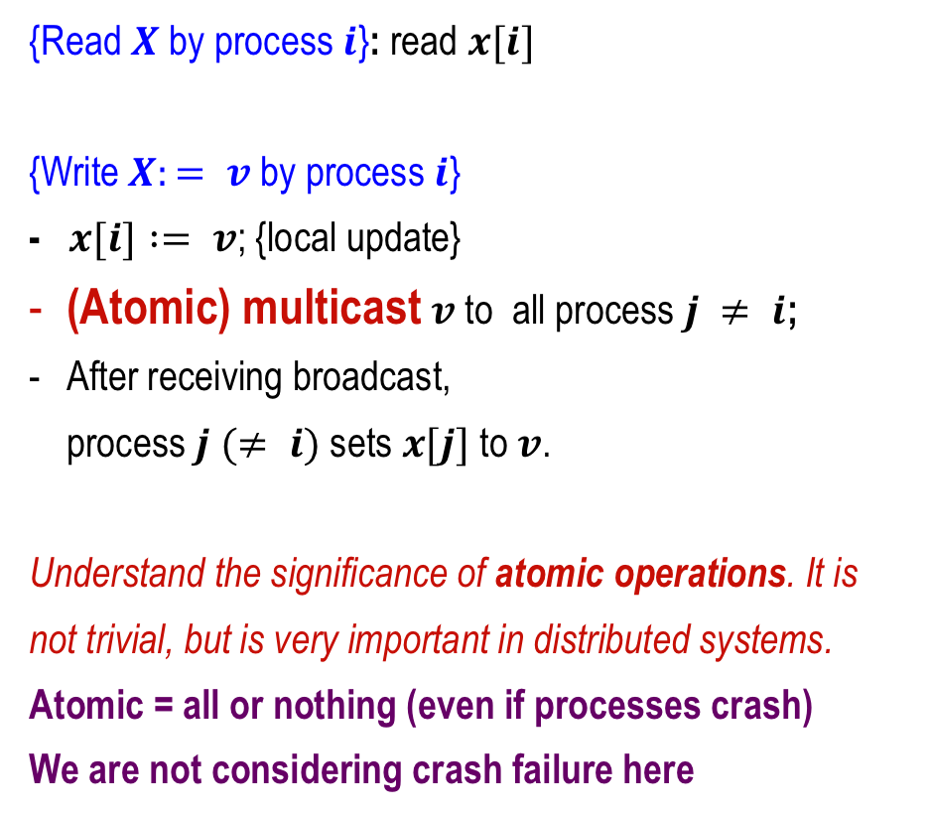
Message-passing to Shared memory
{Read $X$ by process $i$}: read $x[i]$
{Write $X:= v$by process $i$}
- $x[i] := v$; {local update}
(Atomic) multicast $v$ to all process $j ≠ i$;
After receiving broadcast,
process $j (≠ i)$sets $x[j]$ to $v$.
Understand the significance of atomic operations. It is
not trivial, but is very important in distributed systems.
Atomic = all or nothing (even if processes crash)
We are not considering crash failure here
Still not correct. How will you regulate the order of arrival of the messages to the recipient nodes?

Slide 39
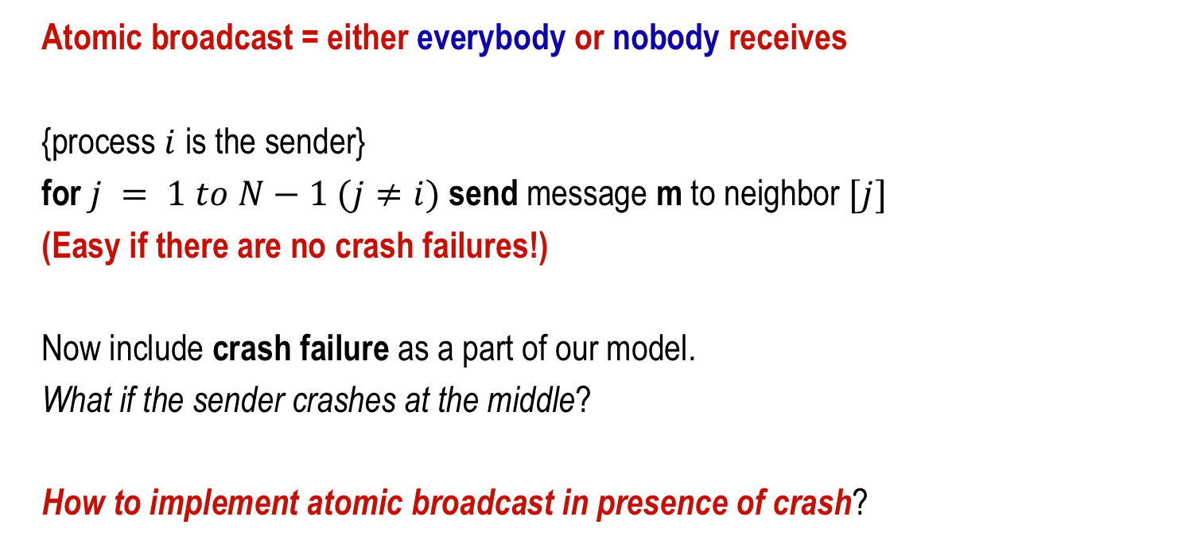
Non-atomic to atomic broadcast
Atomic broadcast = either everybody or nobody receives
{process $i$ is the sender}
for $j = 1 to N−1 (j≠i)$send message m to neighbor $[j]$
(Easy if there are no crash failures!)
Now include crash failure as a part of our model.
What if the sender crashes at the middle?
How to implement atomic broadcast in presence of crash?

Slide 40
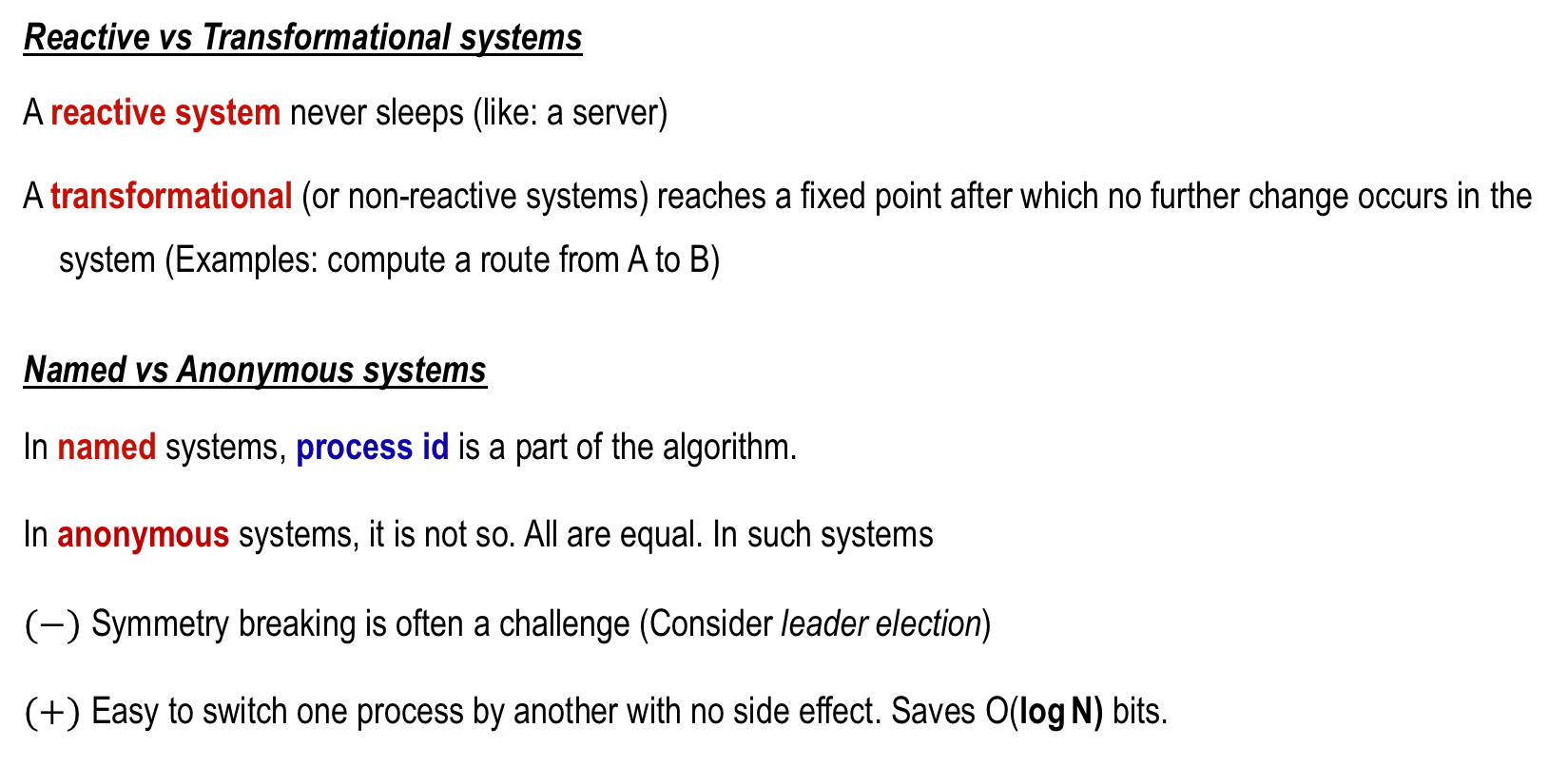
Other classifications of models
Reactive vs Transformational systems
A reactive system never sleeps (like: a server)
A transformational (or non-reactive systems) reaches a fixed point after which no further change occurs in the system (Examples: compute a route from A to B)
Named vs Anonymous systems
In named systems, process id is a part of the algorithm.
In anonymous systems, it is not so. All are equal. In such systems
$(−)$ Symmetry breaking is often a challenge (Consider leader election)
$(+)$ Easy to switch one process by another with no side effect. Saves O(log N) bits.

Slide 41
Knowledge based communication
Alice and Bob enter into an agreement: whenever one falls sick, (s)he will call the other person. Since making the agreement, no one called the other person, so both concluded that they are in good health. Assume that the clocks are synchronized, communication links are perfect, and a telephone call requires zero time to reach.
What kind of interprocess communication model is this?

Slide 42
History
The paper “Cheating Husbands and Other Stories: A Case Study of Knowledge, Action, and Communication” by Yoram Moses, Danny Dolev, Joseph Halpern (PODC 1985) illustrates how actions are taken and decisions are made without explicit communication using common knowledge. (Adaptation of Gamow and Stern, “Forty unfaithful wives,” Puzzle Math, 1958)

Slide 43
Observations
Knowledge-based communication often relies on making deductions from the absence of a signal or actions. (or from subtle hints).
Bidding in the card game Bridge is a good example …

Slide 44
Cheating Husband’s puzzle:
In a matriarchal town, the Queen read out the following in a meeting at the town square.
There are one or more unfaithful husbands in our community.
None of you know whether your husband is faithful. But each of you know which of the other husbands are unfaithful.
Do not discuss this with anyone, but should you discover that your own husband is unfaithful, you should shoot him on the midnight of the day you find out about it.

Slide 45
The story continues …
Thirty nine silent nights went by, and on the fortieth night, gunshots were heard.
What was going on for 39 nights?
How many unfaithful husbands were there?
Why did it take so long?

Slide 46
A simple case
W2 does not know of any other unfaithful husband.
W2 knows that there is at least one (common knowledge)
W2 concludes that it must be H2, and kills him on the first night.
W1 | H1
W2 | H2
W3 | H3
W4 | H4

Slide 47
Theorem
If there are N unfaithful H’s, then they will all be killed
on the midnight of the N^{th} day.
Interested in learning more? Then read the original paper.

Slide 48
Complexity Measures of Distributed Algorithms

Slide 49
Common measures
Space complexity. Max space (bytes/bits) is needed per process to run an algorithm? (measured in terms of n, the size of the network)
Time complexity. Max time (number of steps) needed to complete the execution of the algorithm.
Message complexity. Max number of messages exchanged to complete the execution of the algorithm.
Bit complexity. Max # of bits are transmitted when the algorithm runs.
Bit complexity may be a more precise measure than
message complexity, since message sizes may be arbitrary.

Slide 50
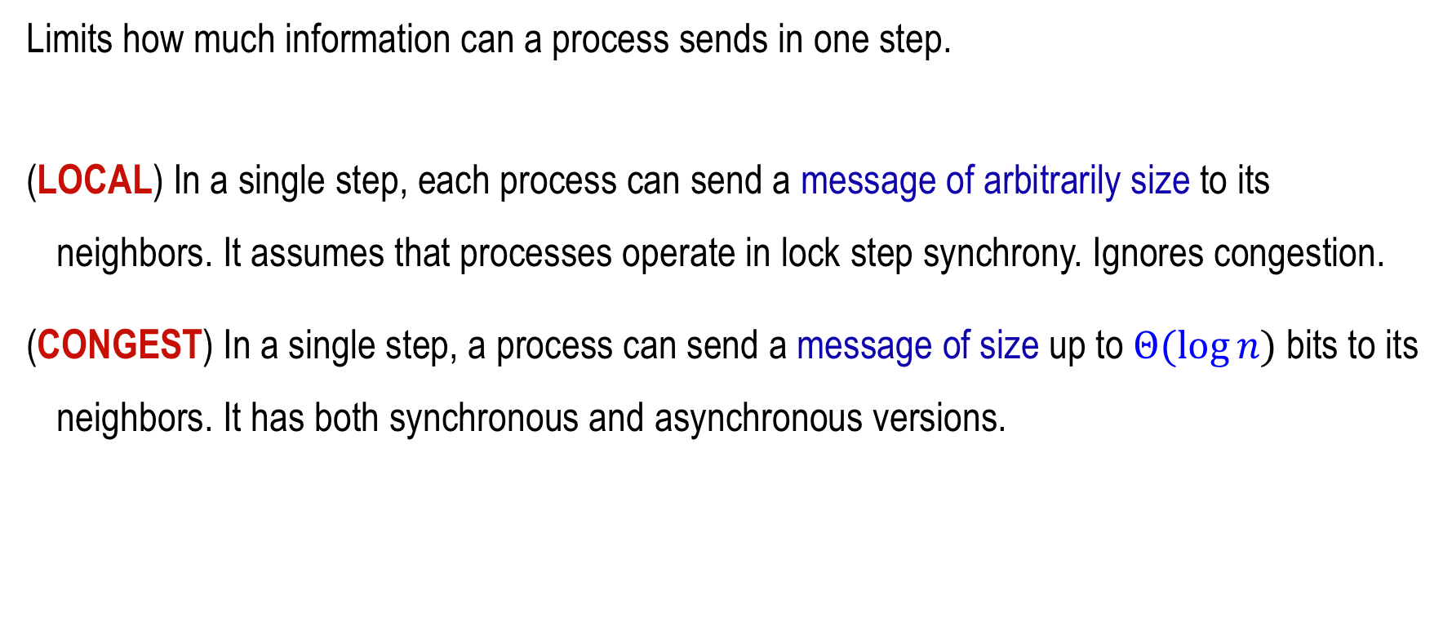
LOCAL vs CONGEST models
Limits how much information can a process sends in one step.
(LOCAL) In a single step, each process can send a message of arbitrarily size to its neighbors. It assumes that processes operate in lock step synchrony. Ignores congestion.
(CONGEST) In a single step, a process can send a message of size up to $Θ(log⁡n)$bits to its neighbors. It has both synchronous and asynchronous versions.

Slide 51
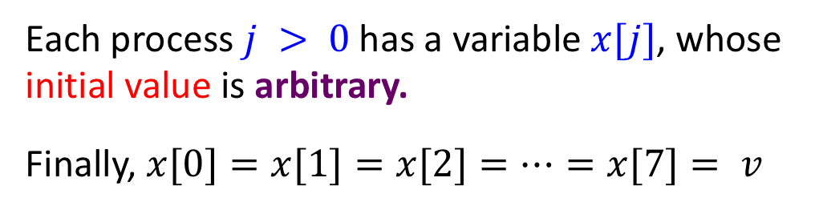
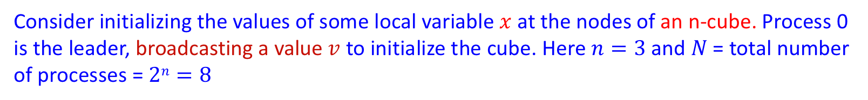
An example
Consider initializing the values of some local variable $x$ at the nodes of an n-cube. Process 0 is the leader, broadcasting a value $v$ to initialize the cube. Here $n=3$ and $N$ = total number of processes = $2n=8$
Each process $j > 0$has a variable $x[j]$, whose initial value is arbitrary.
Finally, $x[0]=x[1]=x[2]=…=x[7]= v$
source

Slide 52
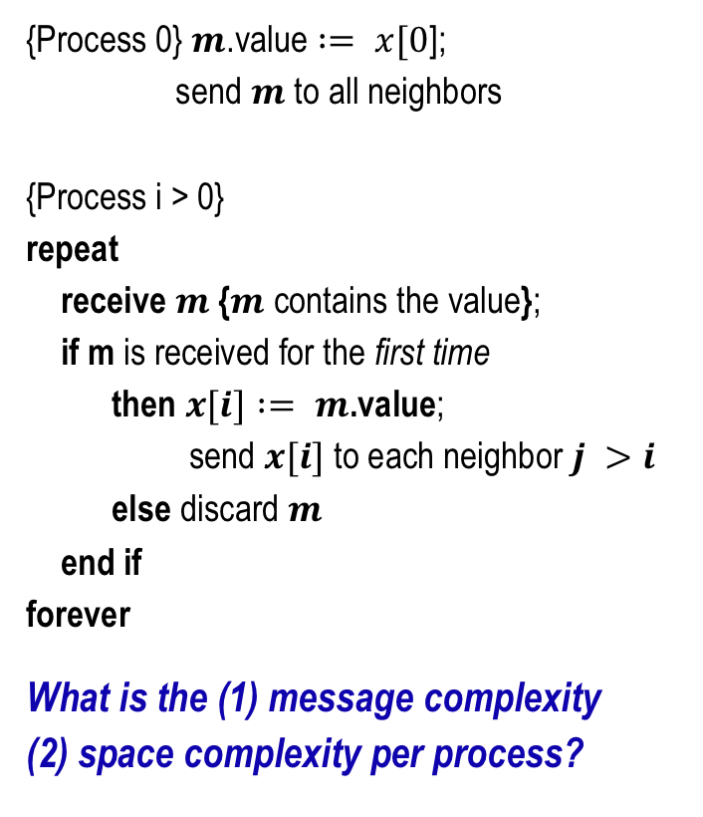
Broadcasting using message passing
{Process 0} $m$.value $:= x[0$];
send $m$ to all neighbors
{Process i > 0}
repeat
receive $m$ {$m$ contains the value};
if m is received for the first time
then $x[i] := m$.value;
send $x[i]$ to each neighbor $j >i$
else discard $m$
end if
forever
What is the (1) message complexity
(2) space complexity per process?
m
m
m
Number of edges
log₂N

Slide 53
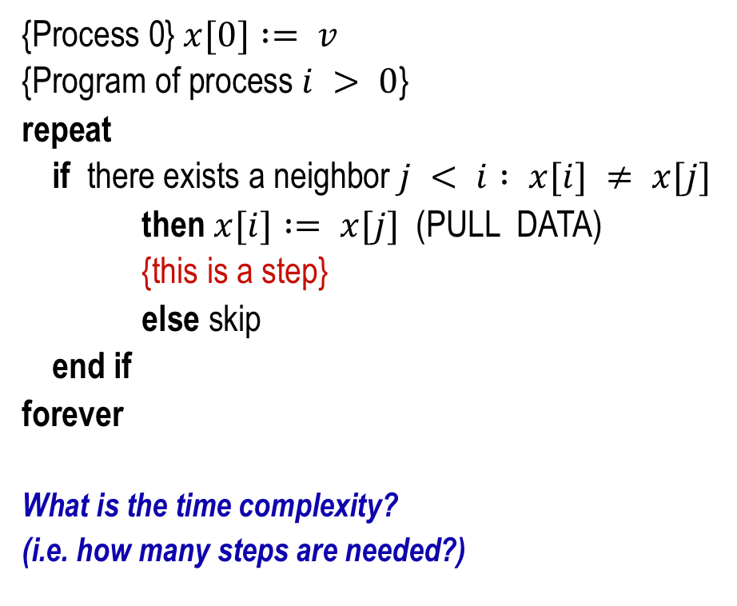
Broadcasting using shared memory
Now solve the same problem in the shared memory model.
{Process 0} $x[0] := v$
{Program of process $i > 0$}
repeat
if there exists a neighbor $j < i : x[i] ≠ x[j]$
then $x[i] := x[j]$(PULL DATA)
{this is a step}
else skip
end if
forever
What is the time complexity?
(i.e. how many steps are needed?)
12
15
12
15
27
10
Copy
53
32
99
14
Arbitrarily large. Why?
Node 7 can keep copying from 5, 6, 3 indefinitely long, before the value in node 0 is eventually copied into it.

Slide 54
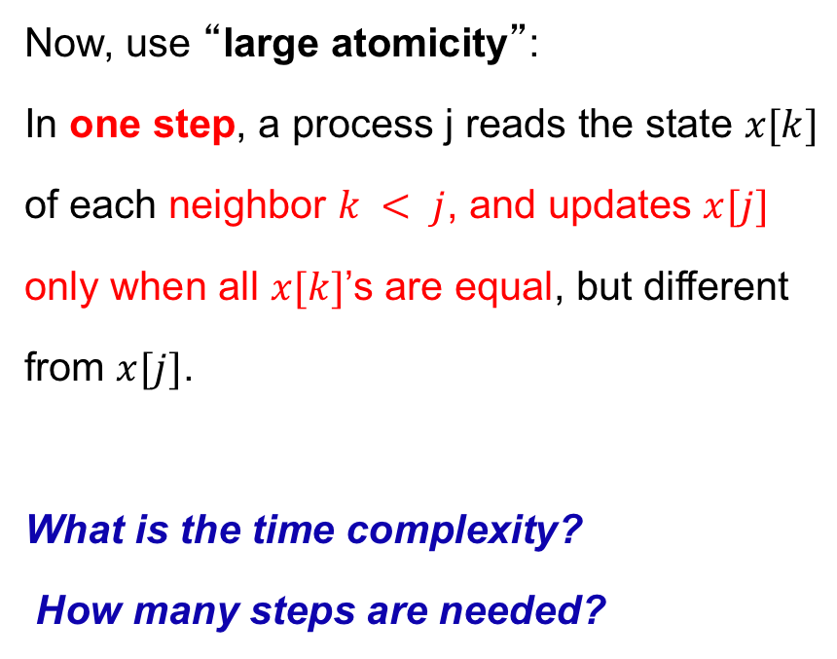
Broadcasting using shared memory (2)
Now, use “large atomicity”:
In one step, a process j reads the state $x[k]$
of each neighbor $k < j$, and updates $x[j]$
only when all $x[k]$’s are equal, but different
from $x[j]$.
What is the time complexity?
How many steps are needed?

Slide 55
Time complexity in rounds
Rounds have a natural definition for synchronous systems. An asynchronous round consists of a number of steps where every eligible process takes at least one step (including the slowest active process)
How many rounds will it take to complete the broadcast using the “large atomicity” model ?
An easier way to interpret round complexity is to assume
that processes executing their steps in lock-step synchrony

