Slide 1
22C:19 Discrete Math Boolean Algebra & Digital Logic
Fall 2010
Sukumar Ghosh

Slide 2
Boolean Algebra
In 1938, Shannon showed how the basic rules of logic
first given by George Boole in his 1854 publication
The Laws of Thought, can be used to design circuits
that enables computer hardware to perform various
arithmetic and logical operation. These rules form the
basis of Boolean Algebra. These rules involve two
Symbols 1 and 0 (synonymous with true and false) and
the operators AND, OR, NOT.

Slide 3
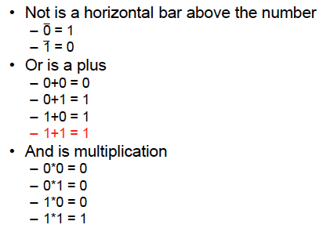
Boolean Algebra

Slide 4
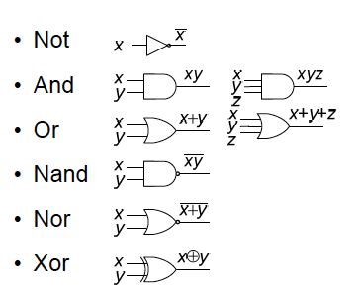
Basic Logic Gates

Slide 5
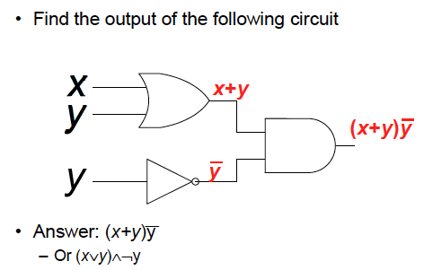
Circuits to Equations

Slide 6
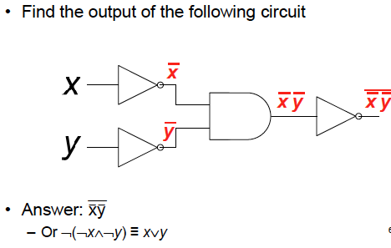
Circuits to Equations

Slide 7
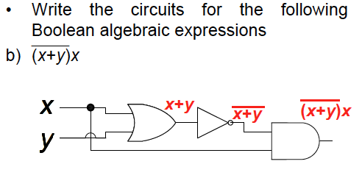
Equations to Circuits

Slide 8
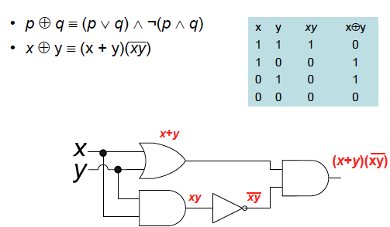
Implementing XOR

Slide 9
Boolean function
An n-variable Boolean function f : {0.1}^{n} ⟶ {0,1}
It can be expressed as a truth table.

Slide 10
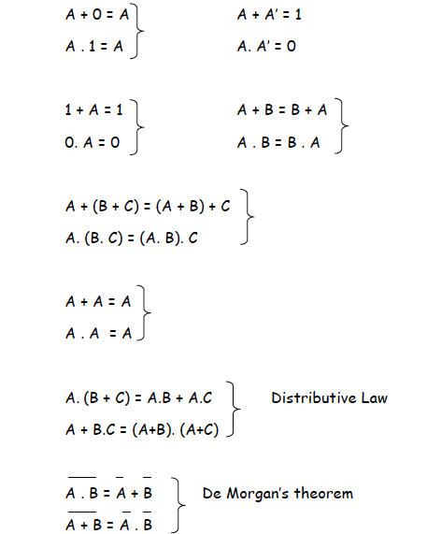
Boolean Algebra

Slide 11
Sum-of-product form
minterm

Slide 12
Examples of simplification
A . B’ + A . B = A. (B’ + B) = A.1 = A
(A + B).(A + B’) = (A + B.B’) = A + 0 = A
In the reverse way, you can expand a expression,
Like X.Y = X.Y.1 = X.Y (Z + Z’) = X.Y.Z + X.Y.Z’

Slide 13
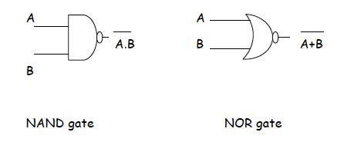
NAND and NOR gates
Alternative notations: A | B = A NAND B
A ↓ B = A NOR B

Slide 14
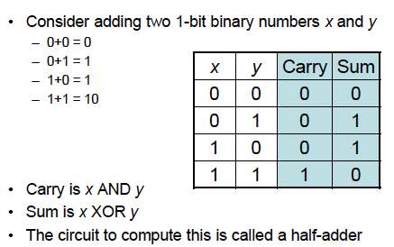
Binary addition

Slide 15
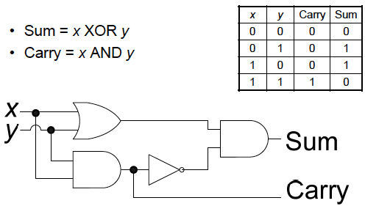
Half-adder

Slide 16
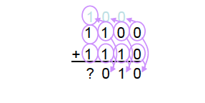
Is half-adder enough?
Can we add two binary numbers using half adders only?
There is a problem here

Slide 17
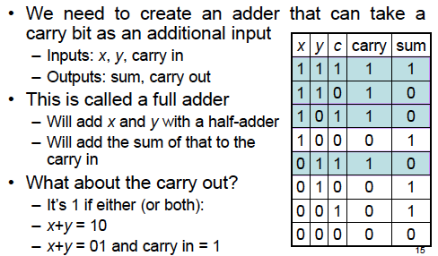
Is half-adder enough?

