Slide 1
Overlay Networks : An Akamai Perspective
Ramesh K. Sitaraman, Mangesh Kasbekar, Woody Lichtenstein, Manish Jain
Akamai Technologies Inc

Slide 2
Why Overlay Networks?
Today's Internet is a vast patchwork of more than 13,000 autonomous networks that often compete for business.
Failures and security breach are routine occurrences.
The gap between what the Internet offers and what the user wants is bridged by Overlay networks

Slide 3
Virtualization
The fundamental idea is rooted in the age-old computing paradigm of virtualization that states that “if you do not have what you want, then you can virtually create what you want with what you have.”

Slide 4
Types of Overlay Networks
Caching overlays deliver online immutable content at a larger scale
Routing overlays deliver dynamic content with good efficiency – improves latency and throughput
Security overlays improve the security and mitigates DDoS
Often used together as a part of a single solution

Slide 5
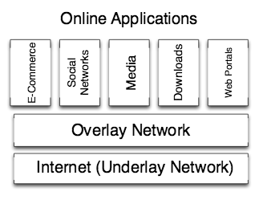
Overlay Networks
An overlay network is built on top of the public Internet to provide
the stringent requirements that rich Internet-based services need

Slide 6
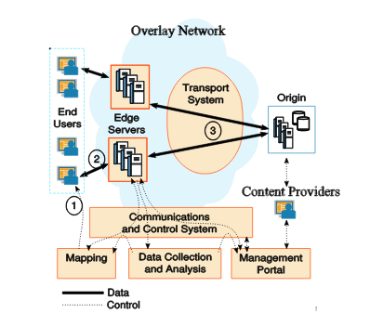
Overlay Networks
Sometimes there is an
additional layer of
cache servers between
the edge and the origin
The architecture of a a caching overlay for content delivery

Slide 7
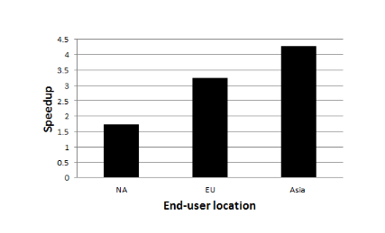
Overlay Networks
Performance benefits of a caching overlay

Slide 8
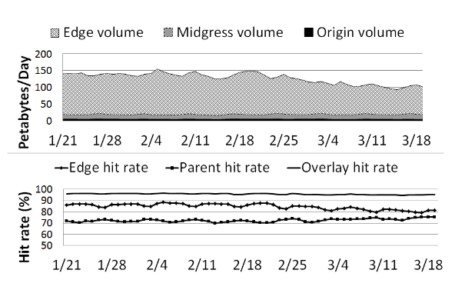
Origin offload rate
Determined by what fraction of the content is served by the edge servers. It depends on the cache hit rate, which is high for the popular items, but low for the infrequently accessed objects.
Mostly popular
contents

Slide 9
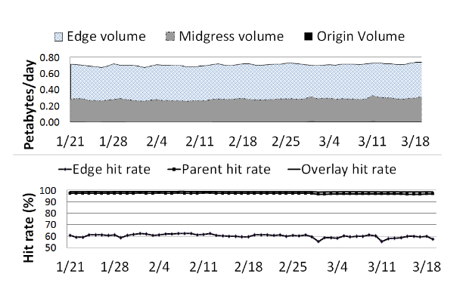
Caching unpopular contents
Unpopular contents have a much lower hit rate for the edge server, but Akamai uses a sophisticated content location technique to direct these requests to the right parent server. This facilitates origin offload.
Mostly unpopular
contents

Slide 10
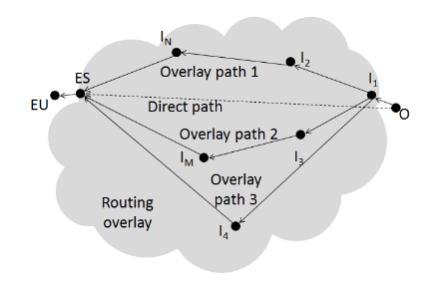
Routing Overlays
Required for scaling up the delivery of dynamic contents
and live streams. These are not cacheable.
An end-user (EU) downloads dynamic content from an edge server (ES). The edge server
in turn can download directly from origin (O) or through a set of alternate overlay paths
constructed between the edge server (ES) and a reverse proxy (I₁)

Slide 11
Routing Overlays
The overlay construction algorithm typically chooses a reverse proxy close to or even co-located with the origin. The reverse proxy must have the smallest possible latency. Further, while the overlay provider can ensure persistent TCP connections between any two nodes of the overlay, the first hop is dependent on the origin that is controlled by the content provider.

Slide 12
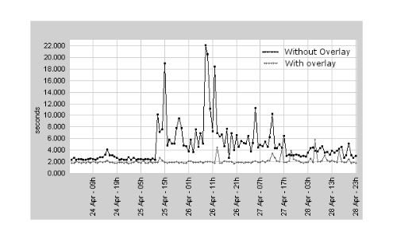
Routing Overlays
Download time
Performance of the routing overlay during an undersea cable cut
from Europe to Asia in 2010

Slide 13
Security Overlay
To combat DDoS, one approach taken by Akamai is to deploy shared spare
capacity of servers. The spare capacity that can be made available should be
large enough so that it is unlikely to be overwhelmed even by the largest DDoS
attacks that are likely to occur. Thus the spare capacity can be used to hold a
high-volume attack away from the origin servers.
Other approaches include firewalling the origin from users not in a specified
ip address range, thus easily identifying and blocking any traffic that arrives at
the origin from outside the secure overla

Slide 14
The Last Mile
Content from an edge server is distributed by a BitTorrent-like mechanism to the end users. However, Red Swoosh (acquired by Akamai for $15 million in 2007 did not last for more than a year.
Facebook to optimize mobile CDN with QuickFire purchase
January 9, 2015
Facebook is targeting mobile video with the QuickFire Networks, in a bid to upgrade its mobile video hosting capabilities. The San Diego-based startup utilizes bandwidth compression technology to reduce the amount of capacity required to host video online.

