Slide 1
Peer-to-Peer and Social Networks
An overview of Gnutella

Slide 2
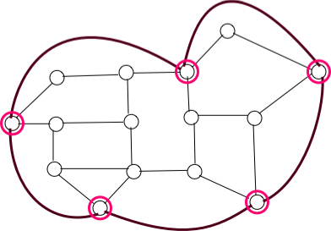
Overlay networks
Overlay networks are logical networks defined on top of a physical network. The nodes (peers) are a subset of the nodes in the physical network, but the links are logical links. The links can be modified by then peers if necessary.

Slide 3
History
The Gnutella network is a fully distributed alternative
of the centralized Napster. Initial popularity of the network received a boost after Napster's legal demise in early 2001.

Slide 4
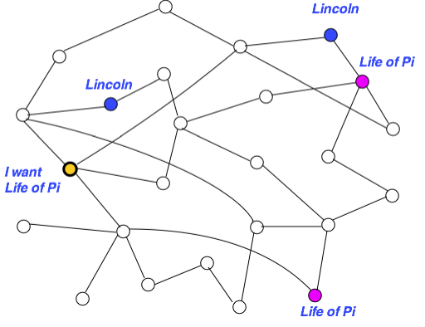
What is Gnutella
Gnutella is a protocol for search with no central authority.

Slide 5
Gnutella Jargon
Servent: A Gnutella node. Each servent is both a server and a client.
2 Hops
Hops: a hop is a pass through an intermediate node
1 Hop
client
TTL: how many hops a packet can go before it dies (default setting is 7 in Gnutella)

Slide 6
Gnutella Scenario
Step 0: Join the network
Step 1: Determining who is on the network
  "Ping" packet is used to announce your presence on the network.
  Other peers respond with a "Pong" packet.
  Also forward your Ping to other connected peers
  A Pong packet also contains:
    an IP address
    port number
    amount of data that peer is sharing
    Pong packets come back via same route
Step 2: Searching
  Gnutella "Query" ask other peers if they have the file you desire. A Query packet might ask, "Do you have any content that matches the string ‘Double Helix"?
  Peers check to see if they have matches & respond (if they have any matches) & send packet to connected peers
  Continues for TTL
Step 3: Downloading
  Peers respond with a “QueryHit” (contains contact info)
  File transfers use direct connection using HTTP protocol’s GET method
Notes:
Step 1: Determining who is on the network

Slide 7
Remarks
Simple idea , but lacks scalability, since query flooding wastes bandwidth. Sometimes, existing objects may not be located due to limited TTL.
Subsequently, various improved search strategies have been proposed.

Slide 8
Searching in Gnutella
The topology is dynamic, i.e. constantly changing. How do
we model a constantly changing topology? Usually, we begin
with a static topology, and later account for the effect of churn.
Measurements provide useful information about the topology.
Candidate topologies are
-- Random graph
-- Power law graph
-- Small world graphs

Slide 9
Gnutella topology
Gnutella topology is actually a power-law graph
Power-law graph = The number of nodes with degree k = c.k ^{- r}
(Contrast this with Gaussian distribution as understood by bell curve)
The primary reason appears to be the idea of “rich gets richer”
- popular web pages attract more pointers from peers
- peers prefer to connect to the well-connected nodes

Slide 10
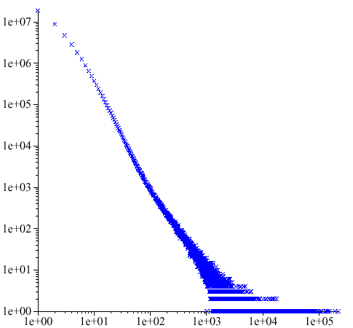
AT&T Call Graph
How many telephone
numbers receive calls from k
different telephone numbers?
# of telephone numbers
from which calls were made
# of telephone numbers called
4

Slide 11
Gnutella network
data
10
2
power-law fit
τ
= 2.07
10
1
number of nodes
10
0
10
0
10
1
number of neighbors
summer 2000,
data provided by Clip2
power-law distribution
5

Slide 12
Search strategies
Flooding
Random walk /
- Biased random walk/
- Multiple walker random walk
(Combined with)
One-hop replication /
Two-hop replication
k-hop replication

Slide 13
On Random walk
Let p(d) be the probability that a random walk on a d-dimensional lattice returns to the origin. In 1921, Pólya proved that,
(1) p(1)=p(2)=1, but
(2) p(d)<1 for d>2
There are similar results
on two walkers meeting
each other via random walk

Slide 14
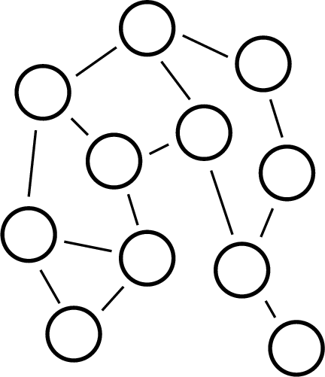
Search via random walk
Existence of a path does
not necessarily mean that
such a path can be discovered
Notes:
Gnutella networks are dumb.
Just a bunch of nodes connected together with 3 or 4 connections each
What’s the only way they can communicate??
- They have to asked their neighbours – and then ask their neighbours to ask their neighbours
- peers provide client-side interfaces for issuing queries and viewing search results AND accept search queries from other peers
Due to its distributed nature, a network of Gnutella nodes is highly fault-tolerant i.e. operation of the network will not be interrupted if a subset go offline.

Slide 15
Search via Random Walk
Search metrics
Delay = discovery time in hops
Overhead = total distance covered (i.e. total nodes visited by the walker)
(Both should be as small as possible).
For a single random walker, these are equal.
K random walkers is a compromise.
For search by flooding, if delay = h then
overhead ≤ d + d² + … + d^{h} where d = max degree of a node.
Bad!

Slide 16
A simple analysis of random walk
Searching for
Let p = Population of the object. i.e. the fraction of nodes hosting the object
T = TTL (time to live)
Hop count h | Probability of success
1 | p
2 | (1-p).p
3 | (1-p)².p
T | (1-p)^{T-1}.p
Geometric
distribution

Slide 17
A simple analysis of random walk
Expected hop count E(h) =
1.p + 2.(1-p).p + 3(1-p)².p + …+ T.(1-p)^{T-1}.p
= 1/p. (1-(1-p)^{T}) - T(1-p)^{T}
With a large TTL, E(h) = 1/p, which is intuitive.
With a small TTL, there is a risk that search will time out before an existing object is located.

Slide 18
K random walkers
Assume they all k walkers start in unison. Probability that none could find the object after one hop = (1-p)^{k}. The probability that none succeeded after T hops = (1-p)^{kT.} So the probability that at least one walker succeeded is 1-(1-p)^{kT.} A typical assumption is that the search is abandoned as soon as at least one walker succeeds.
As k increases, the overhead increases, but the delay decreases. There is a tradeoff.

Slide 19
Increasing search efficiency
Major strategies
Biased walk utilizing node degree heterogeneity.
Utilizing structural properties like random graph, power-law graphs, or small-world properties
Topology adaptation for faster search
Introducing two layers in the graph structure using supernodes

Slide 20
One hop replication
Each node keeps track of the indices of the files belonging to its
immediate neighbors. As a result, high capacity / high degree nodes
can provide useful clues for a large number of search queries.
Where is

Slide 21
Biased random walk
P=5/10
P=2/10
P=3/10
Each node records the degree of the neighboring nodes. Search gravitates towards high degree nodes that hold more clues.

Slide 22
The next step
This growing surge in popularity revealed the limits of
the initial protocol's scalability. In early 2001, variations
on the protocol improved the scalability. This was done
by treating some resource-rich nodes as "ultrapeers” or
“supernodes,” routing and search requests and responses
for users connected to them.

Slide 23
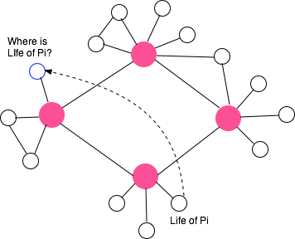
The KaZaA approach
Powerful nodes (supernodes) act as local index servers, and
client queries are propagated to other supernodes. Two-layered
architecture reduces search time

