Slide 1
Peer-to-Peer and Social Networks
Revisiting Small World

Slide 2
Limitation of Watts-Strogatz model
Kleinberg argues …
Watts-Strogatz small-world model illustrates the existence of
short paths between pairs of nodes. But it does not give any clue about how those short paths will be discovered. A greedy search for the destination will not lead to the discovery of these short paths.

Slide 3
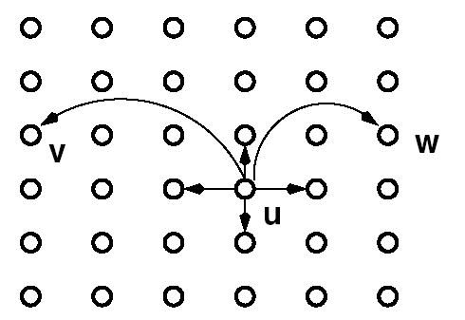
Kleinberg’s Small-World Model
Consider an grid. Each node has a link to every node at lattice distance
(short range neighbors) & long range links. Choose long-range links at
lattice distance with a probability proportional to
n
p = 1, q = 2
r = 2
n

Slide 4
Results
Theorem 1. There is a constant (depending on and
but independent of ), so that when , the expected
delivery time of any decentralized algorithm is at least

Slide 5
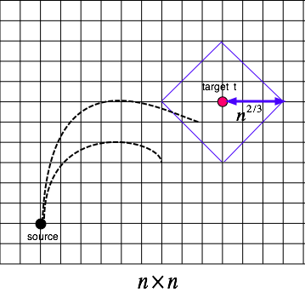
Proof of theorem 1
Probability to reach within
a lattice distance from
the target is
So, it will take an expected
number of steps
to reach the target.

Slide 6
More results
Theorem 2. There is a decentralized algorithm A and a constant dependent on and but independent of
so that when and , the expected
delivery time of A is at most

Slide 7
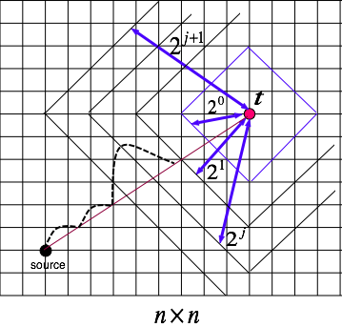
Proof of theorem 2

Slide 8
Proof continued
Main idea.
We show that in phase j, the expected time before the current message holder has a long-range contact within lattice distance 2^{j} from t is O(log n); at this point, phase j will come to an end. As there are at most log n phases, a bound proportional to log²n follows.

Slide 9
Observation
Number of nodes at a lattice
distance from a given node =
How many nodes are at a lattice
distance from a given node?

Slide 10

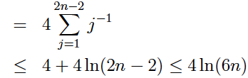

Proof continued
Probability (u chooses v as a long-range contact) is
But
There are 4j nodes
at distance j
(Note: 1= ln e)
So, Probability that node v is chosen as a long range contact)
≤

Slide 11

Proof
Ball B_{j} consists
Of all nodes within
Lattice distance
2^{j} from the target
The maximum value of j is log n.
When will phase j end? What is the
probability that it will end in the next step?
No of nodes within ball B_{j} is at least
v
u
Phase j
Phase (j+1)
each within distance 2^{j+1} + 2^{j} < 2^{j+2}
from the current message holder u

Slide 12


Proof continued
So each has a probability
of being a long-distance contact of u, So, the search enters ball Bj with a probability of at least
Ball Bj consists
of all nodes within
lattice distance
2^{j} from the target
v
So, the expected number of steps
spent in phase j is 128 ln (6n). Since
There are at most log n phases, the
Expected time to reach v is O(log² n)
u

Slide 13
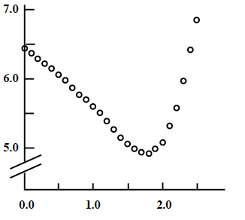
Variation of search time with r
Log T
Exponent r

