Slide 1
Peer-to-Peer and Social Networks
Power law graphs
Small world graphs

Slide 2
Preferential attachment
Barabási and Albert showed that when large networks are formed
by the rules of preferential attachment , the resulting graph shows
a power-law distribution of the node degrees.
We will derive it in the class, so follow the lecture.

Slide 3
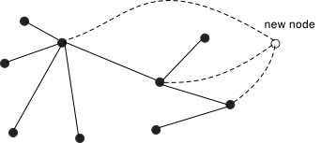
Preferential attachment
At t = 0, there are no nodes.
At t = 1, one node appears.
Thereafter, each time unit,
a new node is added
Degree of node =
The probability that the new node connects with an existing node =
Since and so

Slide 4
Preferential attachment
= number of nodes with degree k after time step t

Slide 5
Preferential attachment
is then fraction of nodes
with degree k at time t

Slide 6
Preferential attachment
As
Call it

Slide 7
Preferential attachment
*
* Before time step (t+1), the new node
is the only node with degree 0, and its
degree will change to 1
is of the order of

Slide 8
Other properties of power law graphs
Graphs following a power-law distribution
have a small diameter (n = number of nodes).
The clustering coefficient decreases as the node degree increases
(power law)
Graphs following a power-law distribution tend to be highly resilient
to random edge removal, but quite vulnerable to targeted attacks on
the hubs.

Slide 9
The small-world model
Due to Watts and Strogatz (1998)
They followed up on Milgram’s work and reason about why there is a small degree of separation between individuals in a social network. Research originally inspired by Watt’s efforts to understand the synchronization of cricket chirps, which show a high degree of coordination over long ranges, as though the insects are being guided by an invisible conductor.
Disease spreads faster over a small-world network.

Slide 10
Questions not answered by Milgram
Why six degrees of separation? Any scientific reason? What properties do these social graphs have? Are there other situations in which this model is applicable?
Time to reverse engineer this.

Slide 11
What are small-world graphs
Completely regular
Small-world graphs (n >> k >> ln (n) >>1)
Completely random
n = number of nodes, k= number of neighbors of each node

Slide 12
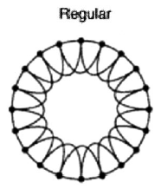
Completely regular
n=20, k= 4
High clustering coefficient
and high diameter L.
C = 3/6 = 1/2, L ~ n/k
A ring lattice

Slide 13
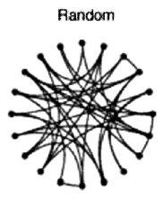
Completely random
LOW clustering coefficient
and LOW diameter.
C ~ k/n, L ~ (log n)/(log k)

Slide 14
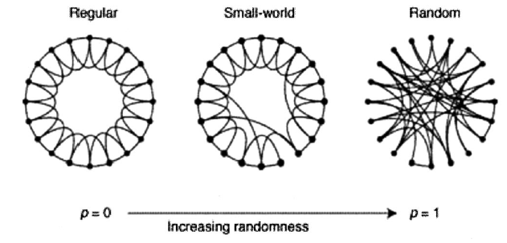
Small-world graphs
Start with the regular graph, and with probability p rewire each link to a randomly selected node. It results in a graph that has high clustering coefficient but low diameter …

Slide 15
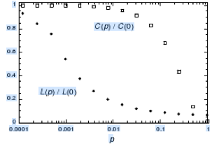
Small-world graphs
Small-world
properties hold

