Slide 1
Peer-to-Peer and Social Networks
Random Graphs

Slide 2
Random graphs
Erdös-Renyi model
One of several models …
Presents a theory of how social webs are formed.
Start with a set of isolated nodes
Connect each pair of nodes with a probability
The resulting graph is known as

Slide 3
Random graphs
ER model is different from the model
The model randomly selects one from the entire
family of graphs with nodes and edges.

Slide 4
Properties of ER graphs
Property 1. The expected number of edges is
Property 2. The expected degree per node is
Property 3. The diameter of is
[deg = expected degree of a node]

Slide 5
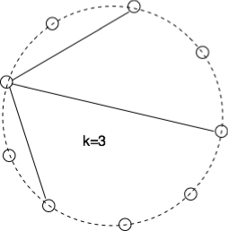
Degree distribution in random graphs
Probability that a node connects with a given set of nodes (and not to the remaining remaining nodes) is
One can choose out of the remaining
nodes in ways.
So the probability distribution is
(This is a binomial distribution)
(For large and small it is equivalent to Poisson distribution)

Slide 6
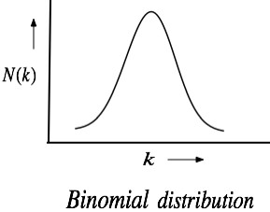
Degree distribution in random graphs

Slide 7
Properties of ER graphs
-- When , an ER graph is a collection of
disjoint trees.
-- When suddenly one giant (connected)
component emerges. Other components have a much smaller size [Phase change]

Slide 8
Properties of ER graphs
When the graph is almost always connected
These give “ideas” about how a social network can be formed.
But a social network is not necessarily an ER graph! Human society
is a “clustered” society, but ER graphs have poor (i.e. very low)
clustering coefficient (what is this?)

Slide 9

Clustering coefficient
For a given node, its local clustering coefficient (CC) measures what fraction of its various pairs of neighbors are neighbors of each other.
B’s neighbors are
{A,C,D,E}. Only (A,D), (D,E), (E,C) are connected
CC of a graph is the
mean of the CC of its
various nodes
CC(B) = 3/6 = ½ CC(D) = 2/3 = CC(E)

Slide 10
How social are you?
Malcom Gladwell, a staff writer at the New Yorker magazine
describes in his book The Tipping Point, an experiment to measure
how social a person is.
He started with a list of 248 last names
A person scores a point if he or she knows someone with a last name
from this list. If he/she knows three persons with the same last name,
then he/she scores 3 points

Slide 11
How social are you?
(Outcome of the Tipping Point experiment)
Altogether 400 people from different groups were tested.
(min) 9, (max) 118 {from a random sample}
(min) 16, (max) 108 {from a highly homogeneous group}
(min) 2, (max) 95 {from a college class}
[Conclusion: Some people are very social, even in small or homogeneous
samples. They are connectors]

Slide 12
Connectors
Barabási observed that connectors are not unique to human society
only, but true for many complex networks ranging from biology to
computer science, where there are some nodes with an anomalously
large number of links. Certainly these types of clustering cannot be
expected in ER graphs.
The world wide web, the ultimate forum of democracy, is not a
random network, as Barabási’s web-mapping project revealed.

Slide 13
Anatomy of the web
Barabási first experimented with the Univ. of Notre Dame’s web.
325,000 pages
270,000 pages (i.e. 82%) had three or fewer links
42 had 1000+ incoming links each.
The entire WWW exhibited even more disparity. 90% had ≤ 10 links, whereas a few (4-5) like Yahoo were referenced by close to a million pages! These are the hubs of the web. They help create short paths between nodes (mean distance = 19 for WWW).

Slide 14
Power law graph
The degree distribution in of the webpages in the World Wide Web follow a power-law. In a power-law graph, the number of nodes with degree satisfies the condition
Also known as scale-free graph. Other examples are
-- Income and number of people with that income
-- Magnitude and number of earthquakes of that magnitude
-- Population and number of cities with that population

Slide 15
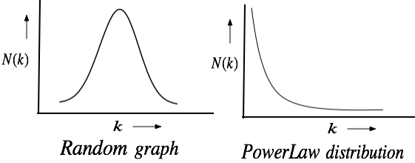
Random vs. Power-law Graphs
The degree distribution in of the webpages in the
World Wide Web follows a power-law

Slide 16
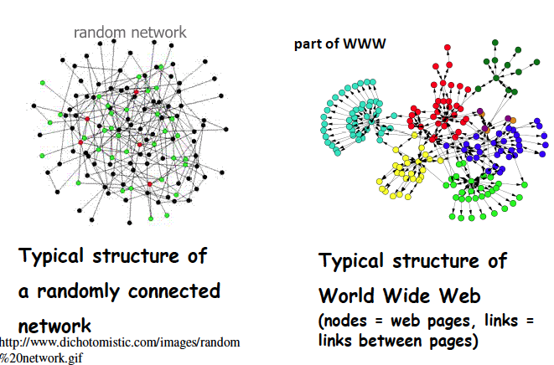
Random vs. Power-law Graphs

Slide 17
Random vs. Power-Law networks

Slide 18
Evolution of Scale-free networks

Slide 19
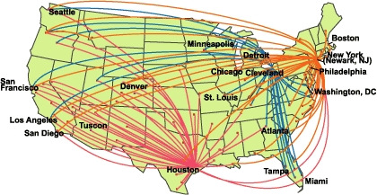
Example: Airline Routes
Think of how new routes are added to an existing network

Slide 20
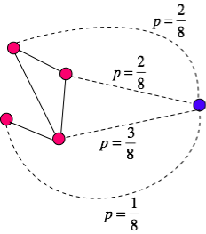
Preferential attachment
A new node connects with an
existing node with a probability
proportional to its degree. The
sum of the node degrees = 8
Existing
network
New node
Also known as “Rich gets richer” policy
This leads to a power-law distribution (Barabási & Albert)

