Slide 1
Peer-to-Peer and Social Networks
Introduction

Slide 2
What is a P2P network
Uses the vast resource of the machines at the edge of the Internet to build a network that allows resource sharing without any central authority.
Client-Server vs. Peer-to-peer. A peer is both a client and a server. Control is decentralized.
Much more than a system for sharing pirated music.

Slide 3
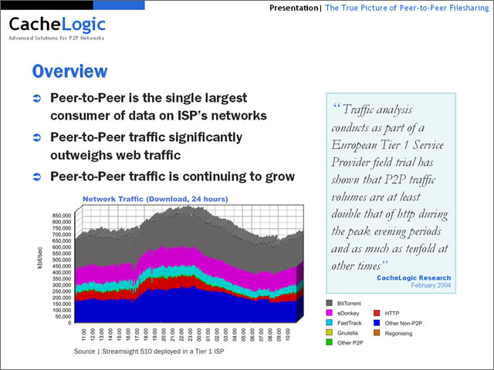
Why does P2P need attention?
*This is old data*

Slide 4
Recent stuff
Compared to CacheLogic’s 2004 data, the percentage of traffic consumed by P2P now may be somewhat lower, but on the other hand, Facebook and Twitter started using BitTorrent for video distribution

Slide 5
Historical Perspective
The Internet originally emphasized working in the P2P mode instead of the client-server mode.
SRI, UCLA, UCSB and University of Utah had powerful host machines forming a league of equals. ARPANET arranged to integrate them in the late 1960’s.

Slide 6
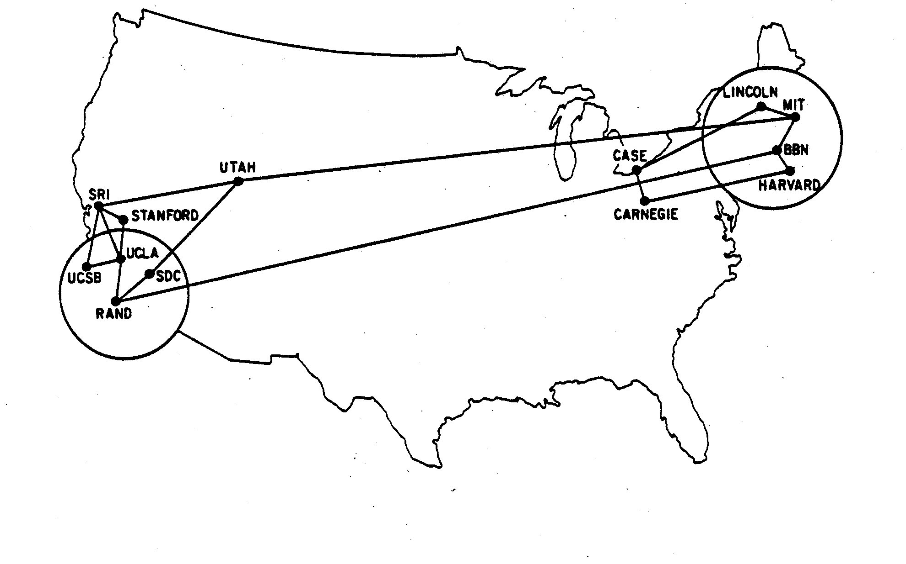
Historical Perspective
The APRANET (predecessor of Internet) sites in December 1970
(taken from Kleinberg’s book)

Slide 7
Social Network
[Wikipedia definition]
A social network is a social structure made up of a set of actors (such as individuals or organizations) and the dyadic ties between these actors. The social network perspective provides a clear way of analyzing the structure of whole social entities.

Slide 8
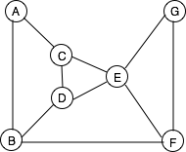
Social networks
Abstract representation is a graph G=(V,E)
This graph can represent various things. For example,
Each node is a friend and each edge is a friendship relation
Each node is an airport and each edge is an air route
Each node is power generating station, and each edge is a high voltage
link connecting a pair of generating stations

Slide 9
Social networks
Social networks existed from the dawn of civilization, much
before Facebook was invented ☺. Facebook only created an
electronic platform to facilitate socialization.
Peer-to-peer networks are a much more recent invention
primarily aimed at content sharing and content distribution
without the assistance of a central server.

Slide 10
Six degrees of separation
Six Degrees of Separation is a 1993 American film.
(Real History)
(1929) Frigyes Karinthy, a novelist in of Budapest wrote a book that contained a story called “Chains.” A character in this story suggested that he could link to any other inhabitant in the world through a chain of five acquaintances.
(1967) Stanley Milgram conducted an experiment that validated this.

Slide 11
Milgram’s experiment
Milgram arranged to send 160 envelopes to a group of randomly
selected people from Wichita, Kansas and Omaha, Nebraska.
Each envelope contained the following:
1. A document with the logo of Harvard on it.
2. Name, address and occupation (stock broker) of Milgram's friend
in Boston, MA.
3. Instructions to get the package to the target person following
specific rules: each person could only send the package
to an acquaintance defined as being on "first name basis".

Slide 12
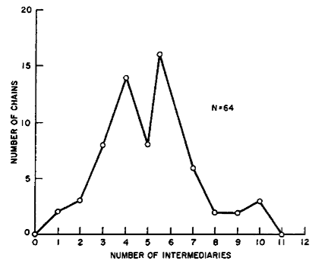
Milgram’s experiment
Taken from Kleinberg’s book
64 of the 160 envelopes reached the target person. The median length of the chain was six

Slide 13
Shortcomings of Milgram’s experiment
There were several shortcomings of this experiment.
Many envelopes did not reach the target person.
The sample size were too small
There was not much flexibility in the choice of the source
and the target
Should we still believe these results?

Slide 14
Facebook experiment
Karl Bunyan (2009)
Ran experiments on the Facebook platform with an application named "Six Degrees”, and calculated the degrees of separation between different pairs of users. Facebook had over 5.8 million users as seen from the group's page. The average separation between all pairs users of the application was 5.73 and the maximum degree of separation was found to be 12.

Slide 15
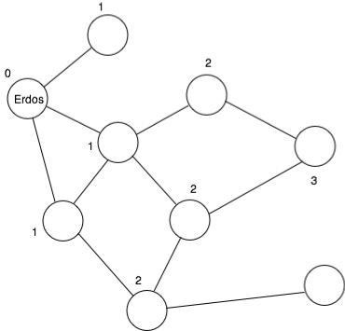
Erdős number
ErdősNumber (Erdős) = 0
If X is the coauthor of at least one
paper with a person whose Erdős
number is n, then Erdős number
of X = n+1.
These numbers are surprisingly small.
Albert Einstein’s ErdősNumber is 2
Sriram Pemmaraju’s ErdősNumber is 2
Doug Jones’ ErdősNumber is 4
My ErdősNumber is 3
Co-authorship network

Slide 16
Kevin Bacon number
Refers to distance measures in the co-actor network
(available from Internet Movie Database)
Similar to Erdős number but applies to movie actors.
Actor Kevin Bacon’s number is 0 by definition.
Anyone who has acted in a film with an actor whose Kevin
Bacon number is has a Kevin Bacon number of
IMDb database has more than 200,000 actors and actresses, but the Kevin Bacon numbers for them are surprisingly small.

Slide 17
Important questions
How does a social network evolve?
What are their structural properties?
Why are the degrees of separation so small?
How can we use some of these structural properties?
What are some of the important issues in social networks?

