Slide 1

Sub2Vec: Feature Learning for Subgraphs
Bijaya Adhikari, Yao Zhang, Naren Ramakrishnan, and
B. Aditya Prakash
Department of Computer Science
Virginia Tech
PAKDD, Melbourne,
June 5th, 2018

Slide 2
Outline
Motivation
Problem Formulation
Method
Experiments
Conclusion

Slide 3
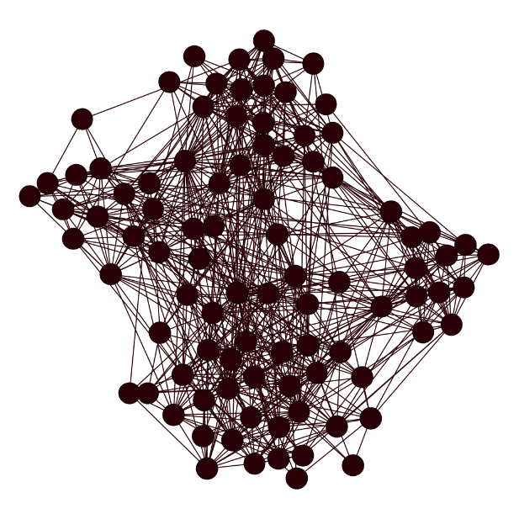
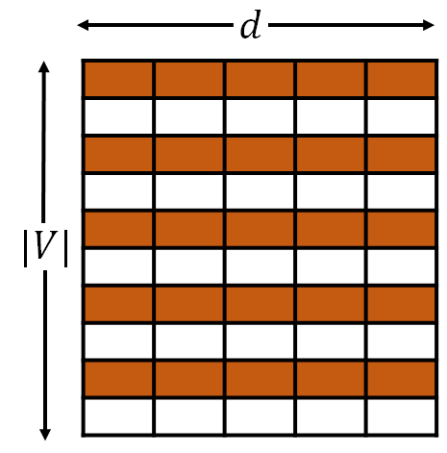
Motivation
Most Network Embedding Methods
Input Network
Node Embeddings
Data Mining Tasks
Classification
Community Detection
Link Prediction
Anomaly Detection
Sense Making
…
Many Possible Applications!

Slide 4
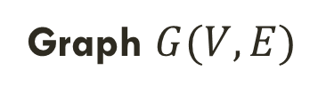
Motivation: Previous work
Popular previous works include
DeepWalk[Perozzi+, KDD2014]
Node2vec[Grover+, KDD 2016]
SDNE[Wang+, KDD 2016]
LINE[Tang+,WWW 2015]
Graph $G(V,E)$
Vectors
Limited just to the node embeddings

Slide 5
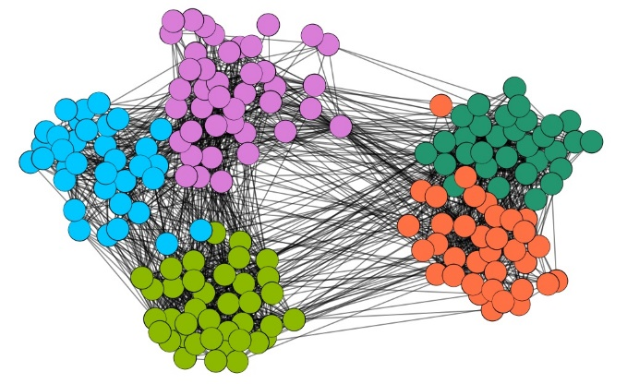
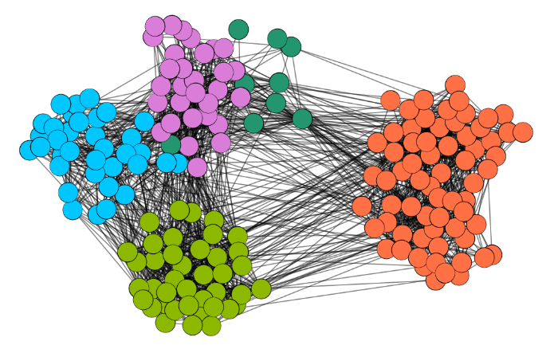
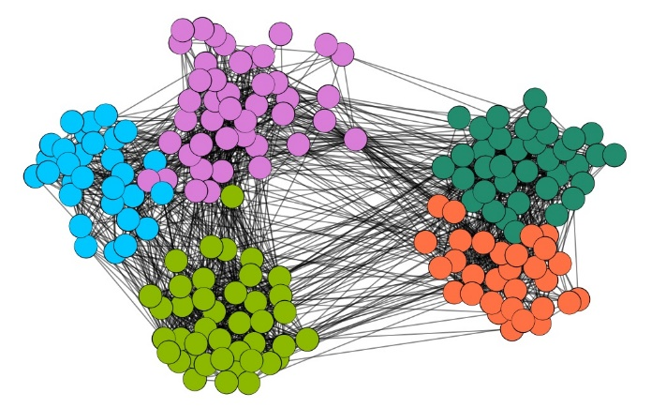
Limitation of node embeddings
Ground Truth Communities in High-School Dataset
Node Embedding Approach
Ego-net Embedding Approach
Problem: How to embed entire ego-nets?

Slide 6
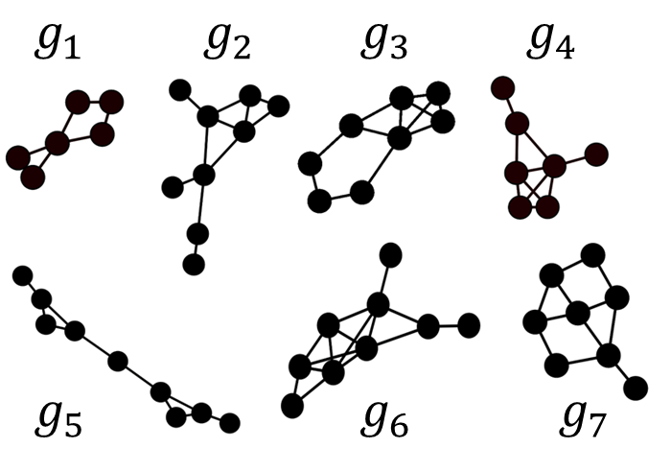
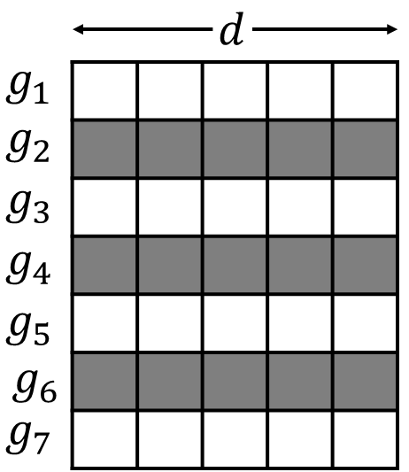
More Applications
Set of Subgraphs
Ego-net embedding
Cascade embedding
Classification
Clustering
Domain Specific Applications
  Malware Detection
  Cyber-Security
  Epidemiology
Subgraph Embedding

Slide 7
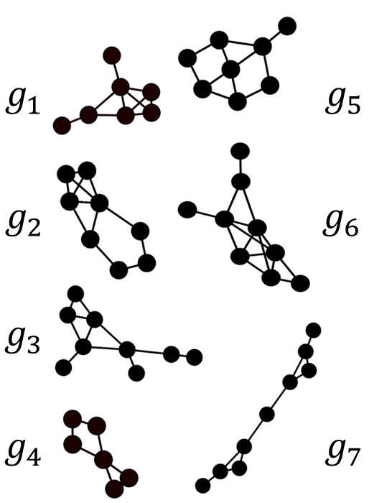
Motivation: Our Approach
Given a set of subgraphs from the same graph
  Learn feature representations of each subgraph
Set of Subgraphs
Subgraph Embedding
“Preserve” pre-defined “subgraph property”

Slide 8
Outline
Motivation
Problem Formulation
Method
Experiments
Conclusion

Slide 9
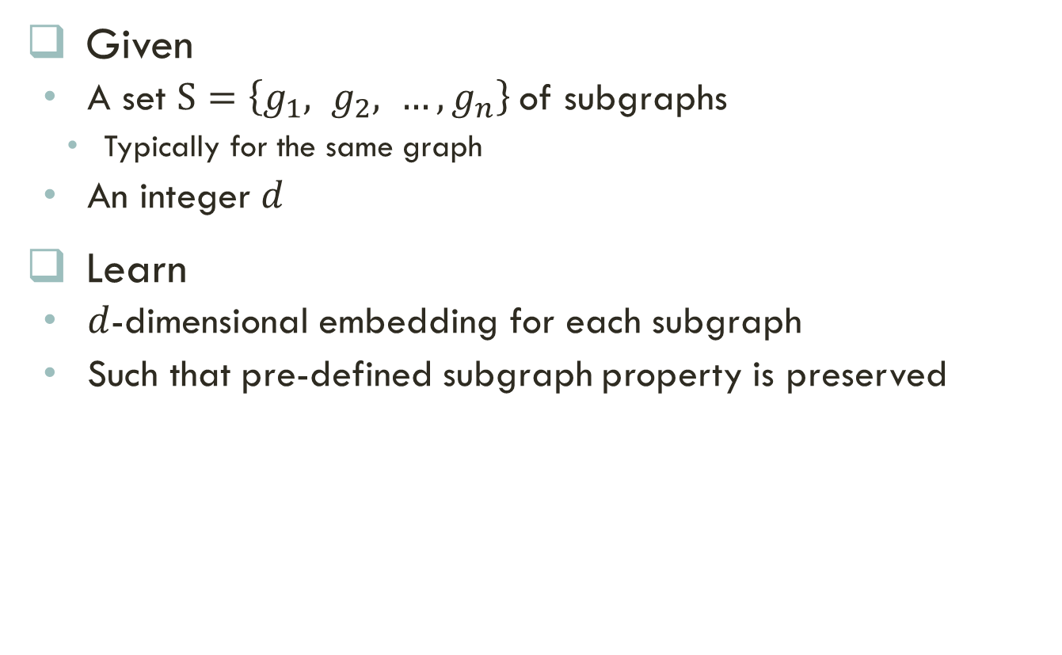
Problem Formulation: Setting
Given
  A set $S=\left\{g_{1}, g_{2}, …, g_{n}\right\}$of subgraphs
    Typically for the same graph
  An integer $d$
Learn
  $d$-dimensional embedding for each subgraph
  Such that pre-defined subgraph property is preserved
Set of Subgraphs
Subgraph Embedding

Slide 10
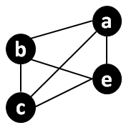
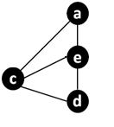
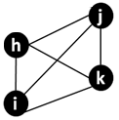



Problem formulation: Challenges
  What subgraph property to preserve?
  How to characterize the property?
$$g_{1}$$
$$g_{2}$$
$$g_{3}$$

Slide 11




Property 1: Neighborhood
Neighborhood Property:
  Captures neighborhood information within the subgraph
$$g_{1}$$
$$g_{2}$$
$$g_{3}$$
Subgraph $g_{1}$ and $g_{2}$ share neighborhood
Subgraph $g_{3}$does not

Slide 12




Capturing neighborhood property
Neighborhood property of a subgraph
  is defined as the set of all paths annotated by node ids (ID-Paths) in the subgraph
{(a,b,a,c), (c,e,a), (e,c,a,c), (b,e,c,e,c), … }
$$g_{1}$$
{(c,d,d,c), (c,e,a), (e,c,a,c), (d,c,d,e,a), … }
$$g_{2}$$
{(i,h,i), (h,k,i,h,i), (k,h,j,i), (i,h,k,j,i), … }
Able to capture
similarity in the
neighborhood
$$g_{3}$$

Slide 13

Property 2: Structural
Structural Property:
  Captures structural information within the subgraph
$$g_{1}$$
$$g_{2}$$
$$g_{3}$$
Subgraph $g_{1}$ and $g_{3}$ are structurally equivalent
Subgraph $g_{2}$ is not

Slide 14
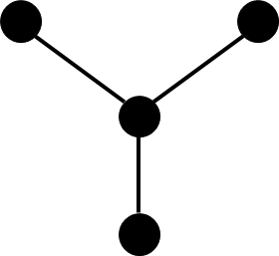
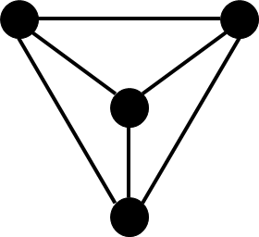
How to capture structural property of a subgraphs?
Degree of nodes determines structural role [Ribeiro+, 2017]
Our Idea: Annotate paths by degree (Degree-Paths)
4 Star
4 Clique
Degree-Path: 3,1,3,1,3,1,3
Degree-Path: 3,3,3,3,3
Degree-Paths capture structural differences

Slide 15
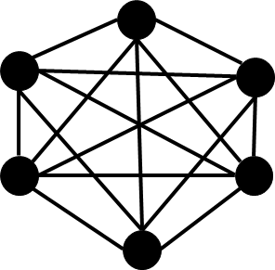
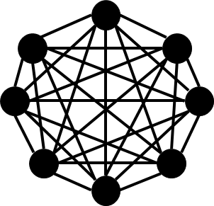
Capturing Structural Property
How to capture structural similarity between graphs of different sizes?
  Our Idea: Normalize degree by the size
How to convert real numbers to labels?
  Our Idea: Use binning strategy to assign labels to real values

Slide 16



Capturing Structural property
Structural property of a subgraph
  is defined as the set of all degree-paths in the subgraph
$$g_{1}$$
{(x,x,x,x), (x,x,x,x), (x,x,x,x), (x,x,x,x), … }
$$g_{2}$$
{(x,y,y,z), (x,z,x,z), (x,y,y,x), (z,x,x,z), … }
$$g_{3}$$
{(x,x,x,x), (x,x,x,x), (x,x,x,x), (x,x,x,x), … }
Able to capture
similarity in the
structure

Slide 17
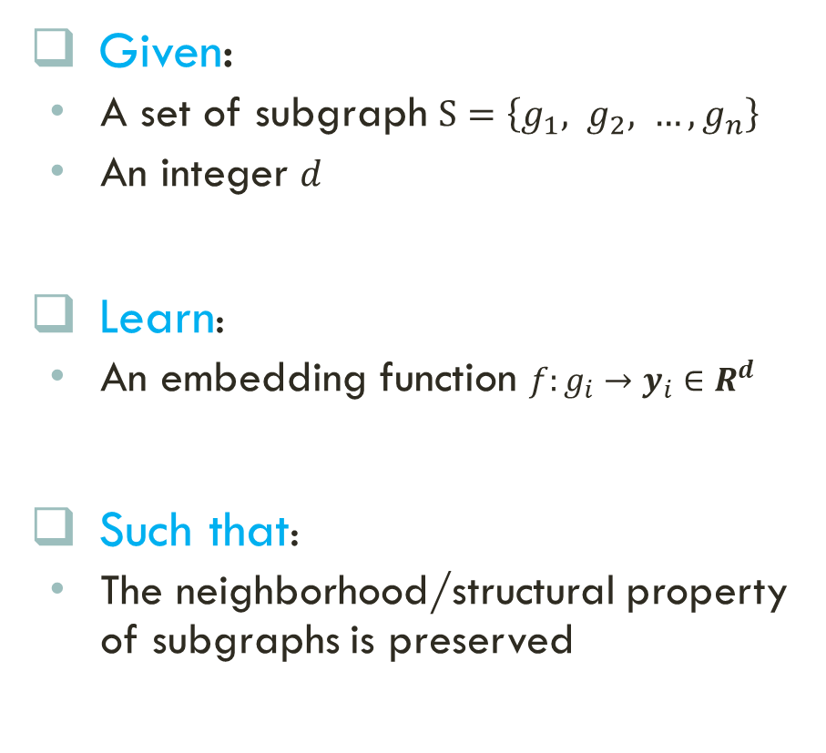
Problem Statement
Set of Subgraphs
Given:
  A set of subgraph $S=\left\{g_{1}, g_{2}, …, g_{n}\right\}$
  An integer $d$
Learn:
  An embedding function $f:g_{i}→y_{i}∈R^{d}$
Such that:
  The neighborhood/structural property of subgraphs is preserved
Subgraph Embedding

Slide 18
Outline
Motivation
Problem Formulation
Method
Experiments
Conclusion

Slide 19
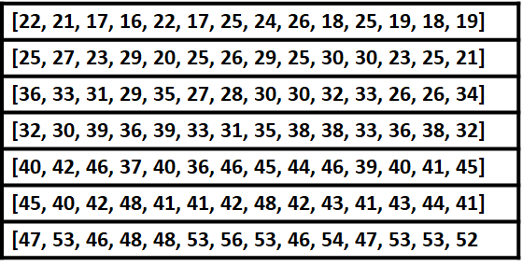
Sub2vec Framework
Overview
  Generate samples of Id/Degree paths
    Enumerating all path is not possible
  Leverage the Id/Degree Paths to learn embeddings
    Learn the embedding such that nodes in the subgraph can be predicted

Slide 20
Samples of paths
How to efficiently generate samples of Id/Degree-Paths?
  Subgraph Truncated Random Walks
Similar process for Degree-Paths

Slide 21
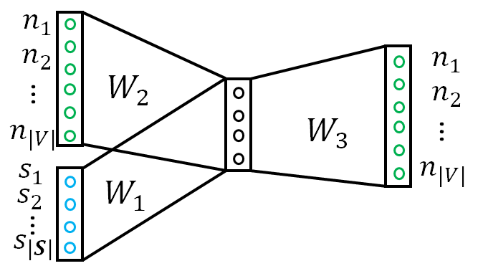
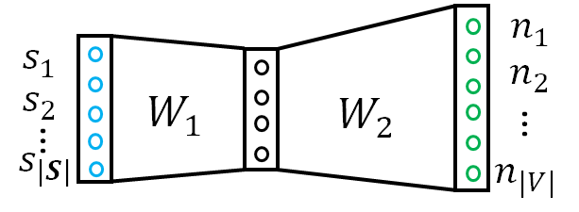
Feature learning
How to learn feature vectors for each subgraphs?
  Leverage Paragraph2vec’s idea [Quoc+, ICML 2014]
Sub2Vec: Distributed Memory Model
DM
Sub2Vec: Distributed Bag of Nodes
DBON

Slide 22
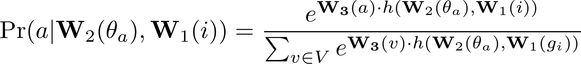
Sub2vec: DM
Models the probability of node/label occurring in the Id/Degree-Path
Probability depends on
  Embedding of the node/label
  Embedding of other nodes/label in path
  Embedding of the subgraph

Slide 23
Sub2vec: DM Objective
The overall objective of Sub2Vec DM is to maximize the log-likelihood

Slide 24
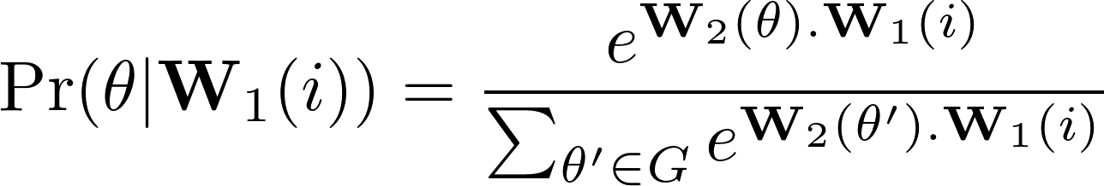

Sub2vec: DBON
Models the probability of a short walk $θ$ appearing in the Id/Degree-Path of a subgraph
Probability depends on
  Embedding of the nodes/labels in the walk
  Embedding of the subgraph

Slide 25
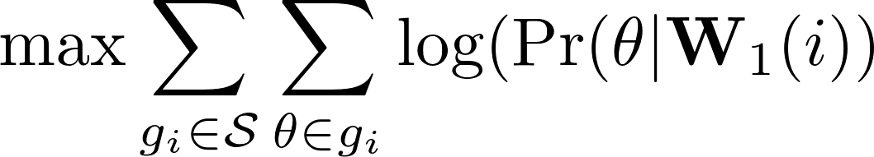
Sub2vec: DBON Objective
The overall objective of Sub2Vec DBON is to maximize the log-likelihood

Slide 26
Complete algorithm
The pseudo-code is as following

Slide 27
Outline
Motivation
Problem Formulation
Method
Experiments
Conclusion

Slide 28
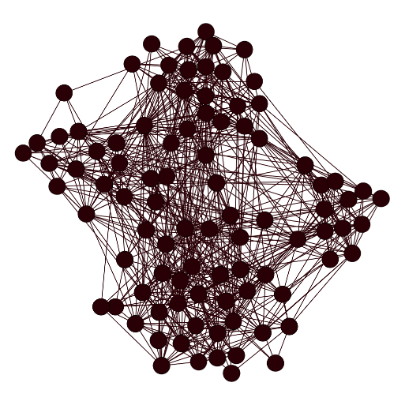
Community detection using subvec
Problem: Give a network
  find partitions of the network
  Such that intra-partition density is high and inter-partitions density is low

Slide 29
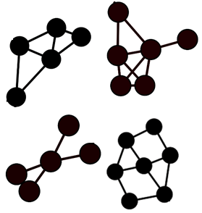
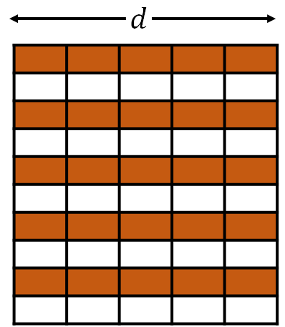
Community detection: Method
Graph
Ego-Nets
Embeddings
Clusters

Slide 30
Community Visualization
Ground Truth Communities in High-School Dataset
Node2Vec
Sub2Vec
Sub2Vec works well in identifying dense communities

Slide 31
Community detection: datasets
Dataset | |V| | |E| | Domain
Workplace | 92 | 757 | Contact
Cornell | 195 | 304 | Web
HighSchool | 182 | 2221 | Contact
Texas | 187 | 328 | Web
Washington | 230 | 446 | Web
Wisconsin | 265 | 530 | Web
PolBlogs | 1490 | 16783 | Web
Youtube | 1.13M | 2.97M | Social

Slide 32
Community detection: Baselines
Newman [Newman, 2006]
  Classical Modularity based Community Detection algorithm
Louvian [Bondel+, 2008]
  Fast Modularity based Community Detection algorithm
DeepWalk [Perozzi+, 2014]
  Node embeddings based on vanilla random walk
Node2Vec [Grover+, 2014]
  Node embeddings based on second order random walk

Slide 33
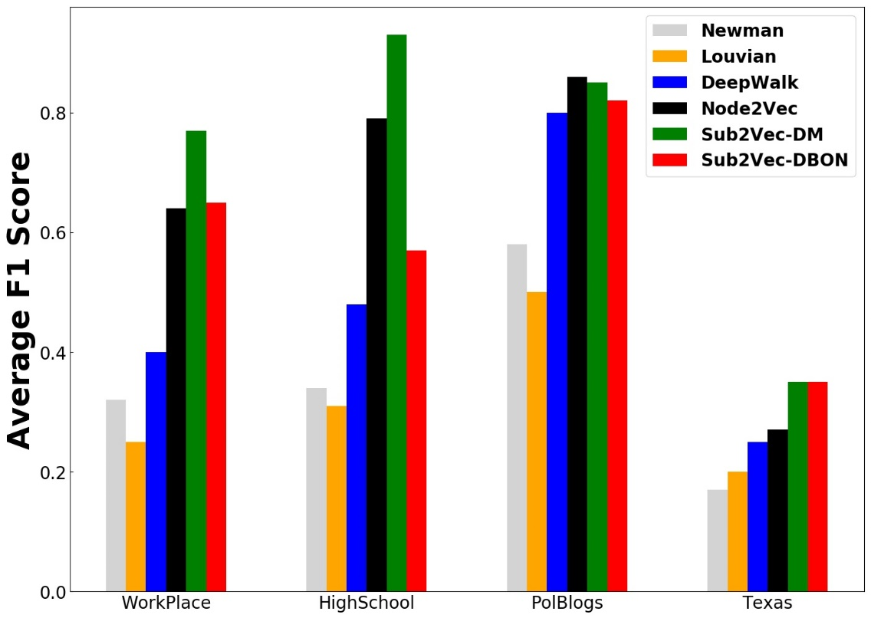
Community detection: results
More results in paper
Measure Average F1-Score of the communities
Higher
is better
Sub2Vec outperforms competitors in most datasets

Slide 34
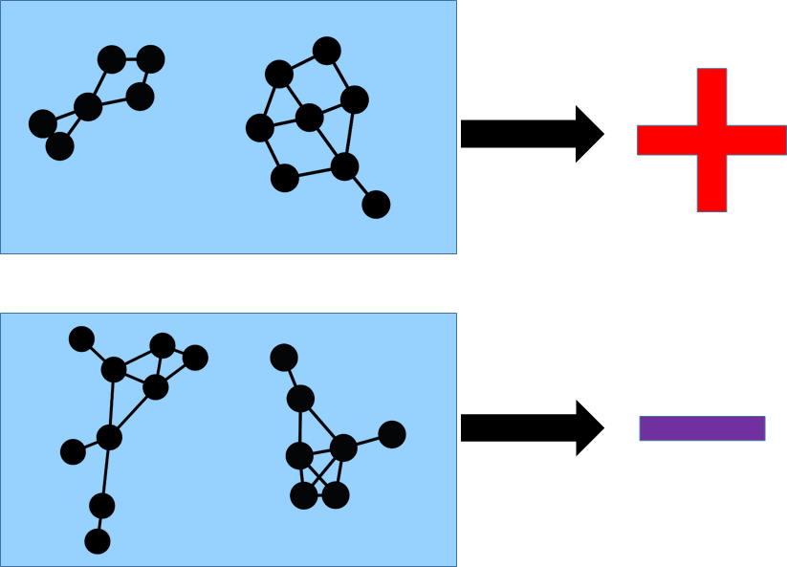
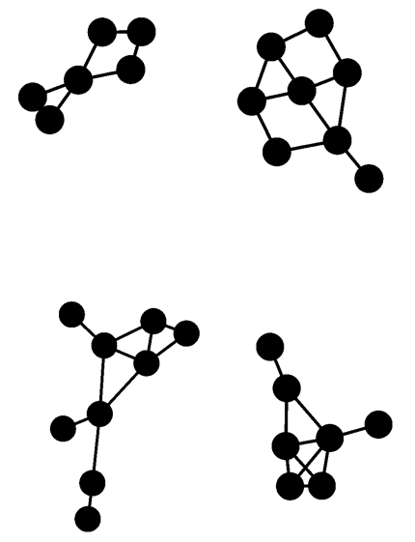

Graph Classification using sub2vec
Problem: Give a set of network $S=\left\{G_{1}, G_{2}, …, G_{n}\right\}$ classify them according to their class labels

Slide 35
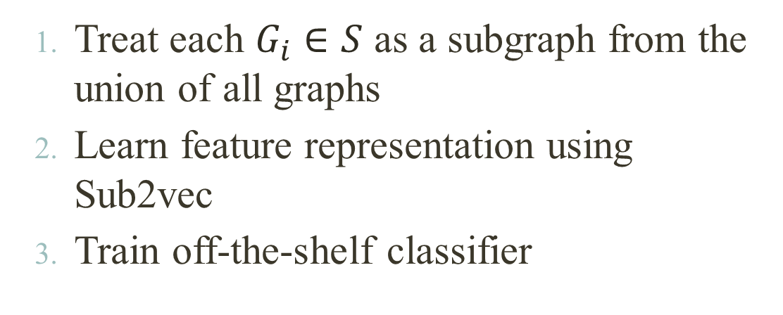
Graph Classification: Approach
Graph Classification using SUB2VEC
  Treat each $G_{i}∈S$ as a subgraph from the union of all graphs
  Learn feature representation using Sub2vec
  Train off-the-shelf classifier
Networks
Embeddings
Classification

Slide 36
Dataset for Graph Classification
Dataset | # Graphs | # classes | # nodes | # labels
MUTAG | 188 | 2 | 17.9 | 7
PTC | 344 | 2 | 25.5 | 19
ENZYMES | 600 | 6 | 32.6 | 3
PROTEINS | 1113 | 2 | 39.1 | 3
NC1 | 4110 | 2 | 29.8 | 37
NC109 | 4127 | 2 | 29.6 | 38

Slide 37
Graph Classification: Baselines
WL-Kernel [Schweitzer+, 2011]
  Graph kernel based on the Weisfeiler-Lehman test of graph isomorphism.
DG-Kernel [Yanardag+, 2015]
  Extension of WL Kernel using Neural Language Model

Slide 38
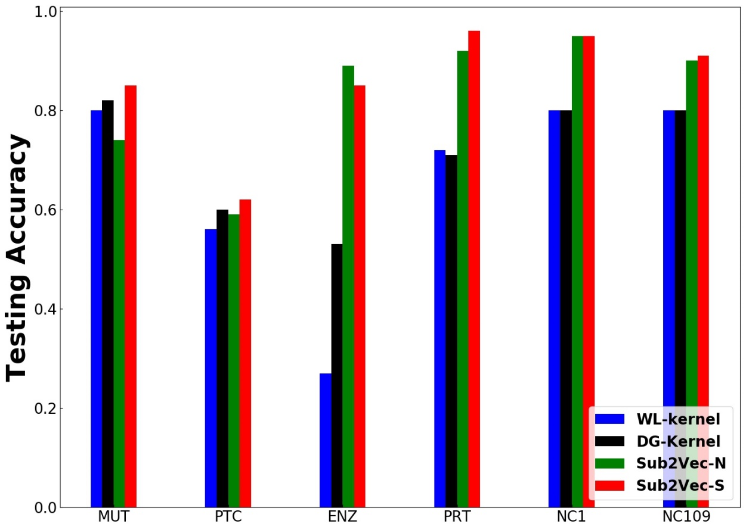
Graph Classification: Results
Measuring testing accuracy on 5 fold cross validation
Higher
is better
Sub2Vec outperforms competitors

Slide 39
Case-study: MeMetracker Dataset
Blog and News Network
Consists of cascades of memes
A meme is a short phrase
  Lipstick on the pig
  Yes, we can!
Cascades flows though news and blog websites
Each cascade induces a subgraph
Yes, we can!
BBC
Yes, we can!
Yes, we can!
NBC
CNN
Yes, we can!
FOX
Blog1
Blog2
Yes, we can!
Blog3

Slide 40
Case-study: MeMetracker Approach
Question: Is the subgraph induced by the flow of the cascade similar to the topic content?
Our Approach:
Embed the subgraphs educed by the cascades by leveraging sub2vec
Cluster the subgraph embedding
Observe the common ‘topics’ in each cluster

Slide 41
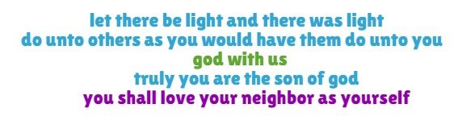
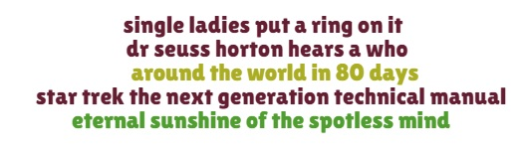
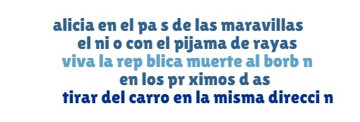
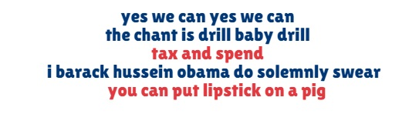
Case-study: MeMetracker
Religious
Entertainment
Spanish
Politics
Memes of similar topic induce similar subgraphs

Slide 42
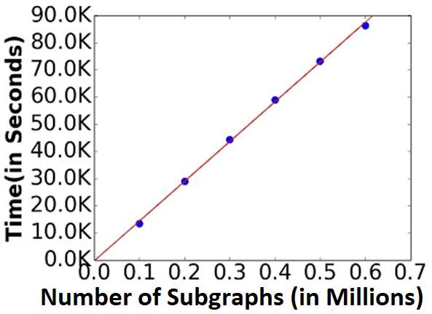
Scalability
More results in paper
Sub2Vec scales linearly w.r.t number of subgraphs

Slide 43
Outline
Motivation
Problem Formulation
Method
Experiments
Conclusion

Slide 44
Conclusion
Problems
  Formulated novel Subgraph Embedding Problem
  Introduced the Neighborhood/Structural Property
Algorithms
  Proposed effective and efficient Sub2Vec
Experiments
  Large Datasets, Performance, Scalability
Applications
  Community Detection
  Graph Classification
  Sense Making

Slide 45








Any questions?
Funding:
Code at:
http://people.cs.vt.edu/~bijaya
Set of Subgraphs
Subgraph Embedding
Data Mining Tasks
Classification
Community Detection
Link Prediction
Anomaly Detection
Sense Making
…

