Slide 1

Distributed Representations of Subgraphs
Bijaya Adhikari, Yao Zhang, Naren Ramakrishnan, and
B. Aditya Prakash
Department of Computer Science
Virginia Tech
IEEE ICDM DaMNet, New Orleans, Nov 18th, 2017

Slide 2
Outline
Motivation
Problem Formulation
Method
Experiments
Conclusion

Slide 3
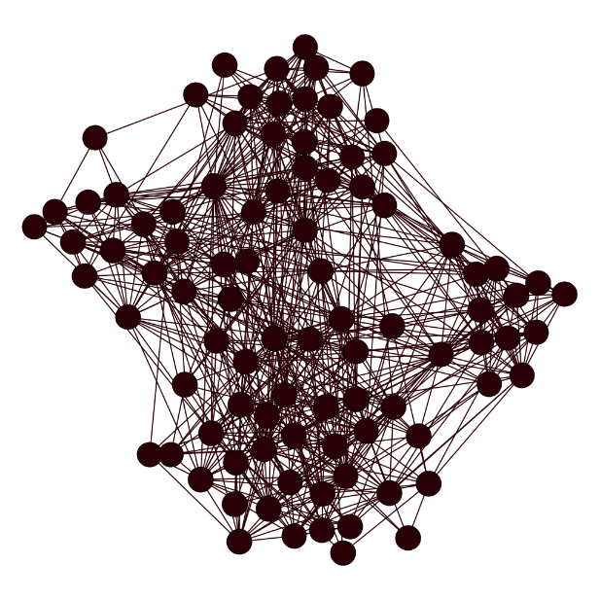
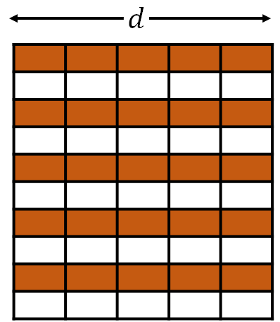
Motivation
Network Embedding Framework
Input Network
Embeddings
Data Mining Tasks
Classification
Community Detection
Link Prediction
Anomaly Detection
Sense Making
…
Many Possible Applications!

Slide 4
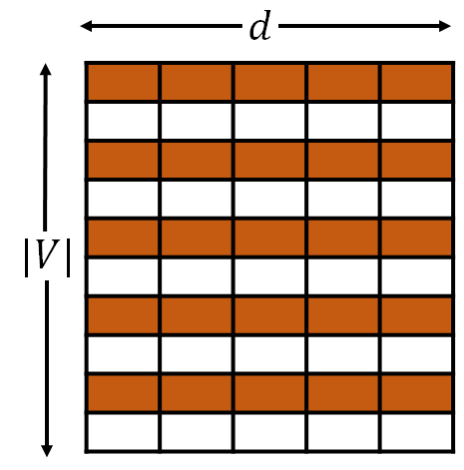
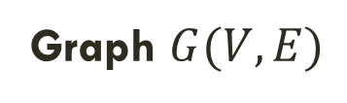
Motivation: Previous work
Most existing works are on node embeddings
DeepWalk[Perozzi+, KDD2014]
Node2vec[Grover+, KDD 2016]
SDNE[Wang+, KDD 2016]
LINE[Tang+,WWW 2015]
Graph $G(V,E)$
Vectors
How to embed entire subgraphs?

Slide 5
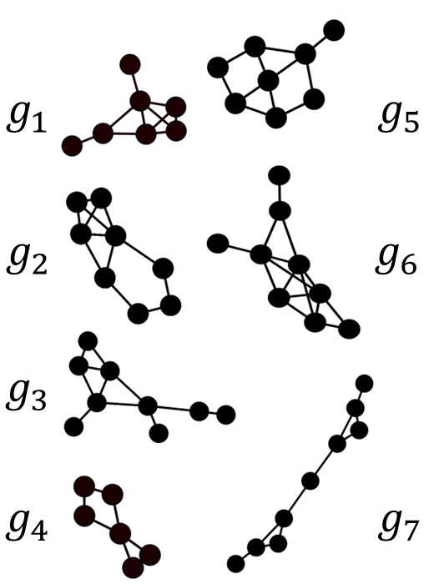
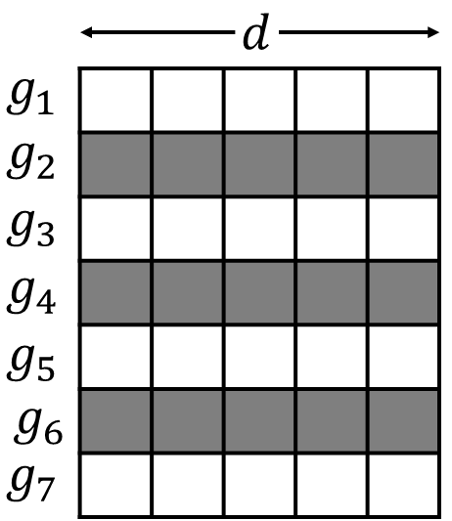
Motivation: Our Approach
Given a set of subgraphs from the same graph
  Learn feature representations of each subgraph
Set of Subgraphs
Subgraph Embedding
“Preserve” pre-defined “subgraph property”

Slide 6
Outline
Motivation
Problem Formulation
Method
Experiments
Conclusion

Slide 7
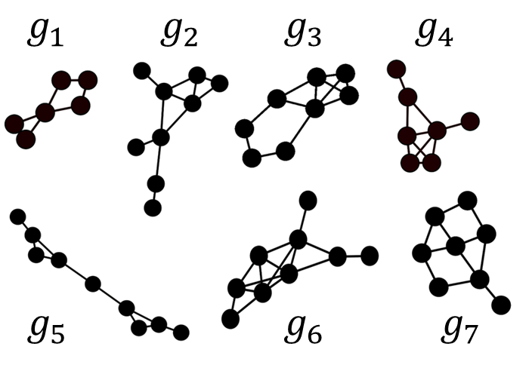
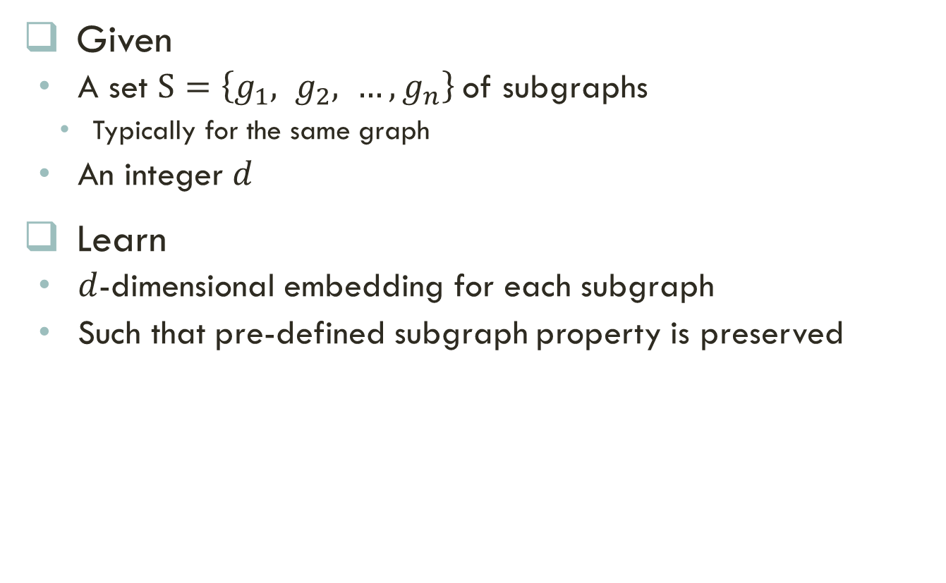
Problem Formulation: Setting
Given
  A set $S=\left\{g_{1}, g_{2}, …, g_{n}\right\}$of subgraphs
    Typically for the same graph
  An integer $d$
Learn
  $d$-dimensional embedding for each subgraph
  Such that pre-defined subgraph property is preserved
Set of Subgraphs
Subgraph Embedding

Slide 8
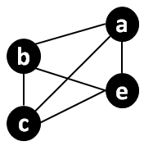
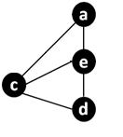
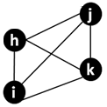



Problem formulation: Challenges
  What subgraph property to preserve?
  How to characterize the property?
$$g_{1}$$
$$g_{2}$$
$$g_{3}$$

Slide 9




Idea: Neighborhood property
Neighborhood Property:
  Captures neighborhood information within the subgraph
$$g_{1}$$
$$g_{2}$$
$$g_{3}$$
Subgraph $g_{1}$ and $g_{2}$ share neighborhood
Subgraph $g_{3}$does not

Slide 10

Capturing neighborhood property
Neighborhood property of a subgraph
  is defined as the set of all paths annotated by node ids (ID-Paths) in the subgraph
{(a,b,a,c), (c,e,a,e), (e,c,a,c), (b,e,c,e), … }
{(c,d,d,c), (c,e,a,e), (e,c,a,c), (d,c,d,e), … }
{(i,h,j,k), (h,k,i,h), (k,h,j,i), (i,h,k,j), … }
Able to capture
similarity in the
neighborhood

Slide 11
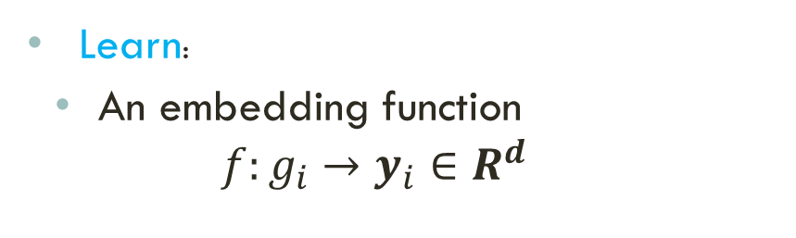
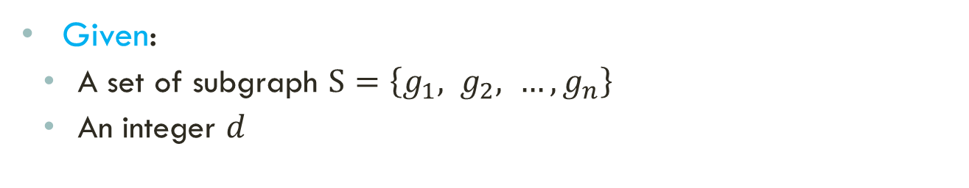
Problem Statement
Set of Subgraphs
  Given:
    A set of subgraph $S=\left\{g_{1}, g_{2}, …, g_{n}\right\}$
    An integer $d$
  Learn:
    An embedding function
    $$f:g_{i}→y_{i}∈R^{d}$$
Subgraph Embedding
  Such that:
    The neighborhood property of subgraphs is preserved

Slide 12
Outline
Motivation
Problem Formulation
Method
Experiments
Conclusion

Slide 13
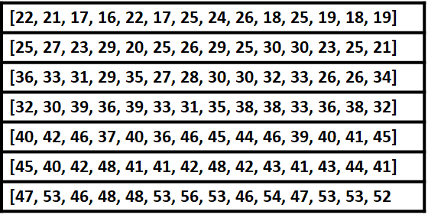
Subvec Framework
Overview
  Generate samples of Id-paths
    Enumerating all path is not possible
    Generate samples of paths
  Leverage the Id-Paths to learn embeddings
    Learn the embedding such that nodes in the subgraph can be predicted

Slide 14
Samples of id-paths
How to efficiently generate samples of Id-Paths?
  Subgraph Truncated Random Walks

Slide 15
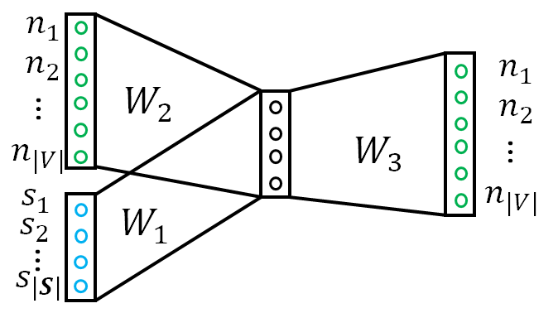
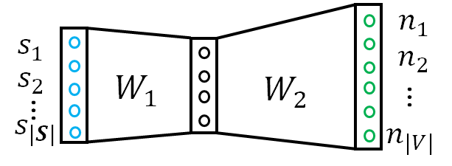
Feature learning
How to learn feature vectors for each subgraphs?
  Leverage Paragraph2vec’s idea [Quoc+, ICML 2014]
SubVec: Distributed Memory Model
DM
SubVec: Distributed Bag of Nodes
DBON

Slide 16
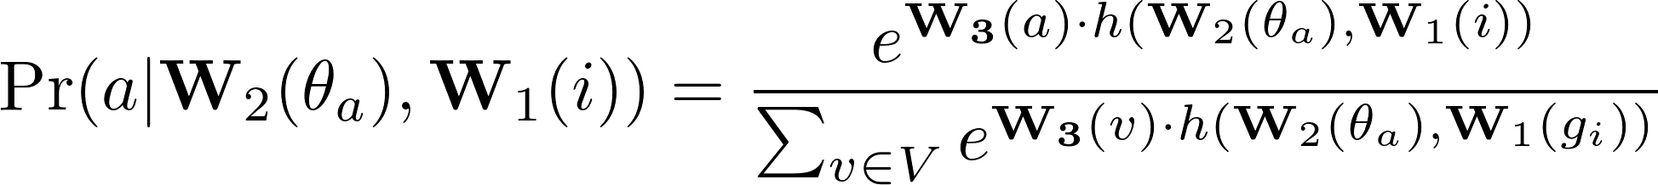
Subvec: DM
Models the probability of node occurring in the Id-Path
Probability depends on
  Embedding of the node
  Embedding of other nodes in the Id-Path
  Embedding of the subgraph

Slide 17
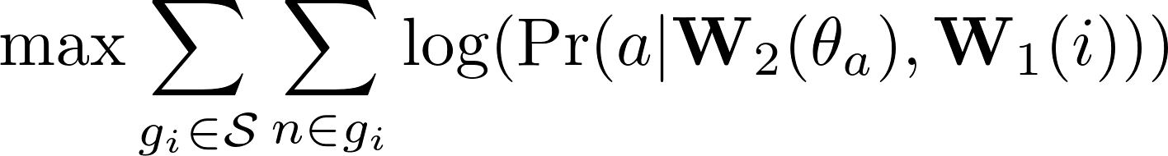
Subvec: DM Objective
The overall objective of SubVec DM is to maximize the log-likelihood

Slide 18
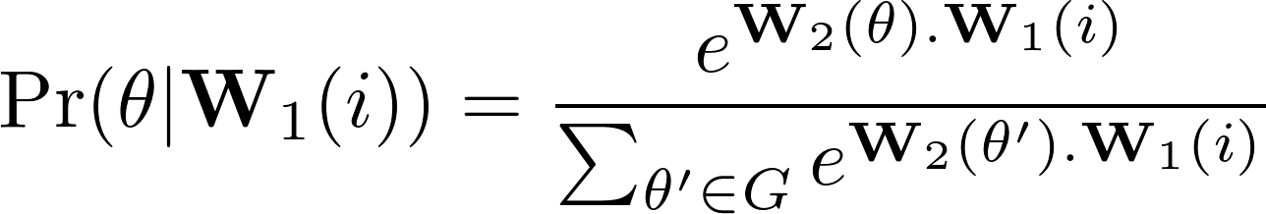

Subvec: DBON
Models the probability of a short walk $θ$ appearing in the Id-Path of a subgraph
Probability depends on
  Embedding of the nodes in the walk
  Embedding of the subgraph

Slide 19
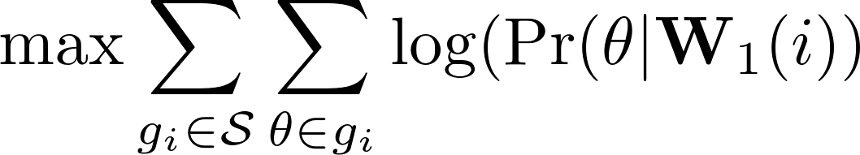
Subvec: DBON Objective
The overall objective of SubVec DBON is to maximize the log-likelihood

Slide 20
Complete algorithm
The pseudo-code is as following

Slide 21
Outline
Motivation
Problem Formulation
Method
Experiments
Conclusion

Slide 22
datasets
Dataset | |V| | |E| | Domain
Workplace | 92 | 757 | Contact
Cornell | 195 | 304 | Web
HighSchool | 182 | 2221 | Contact
Texas | 187 | 328 | Web
Washington | 230 | 446 | Web
Wisconsin | 265 | 530 | Web
PolBlogs | 1490 | 16783 | Web
Youtube | 1.13M | 2.97M | Social

Slide 23
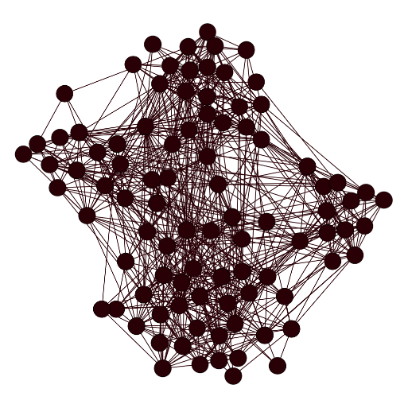
Community detection using subvec
Problem: Give a network
  find partitions of the network
  Such that intra-partition density is high and inter-partitions density is low

Slide 24
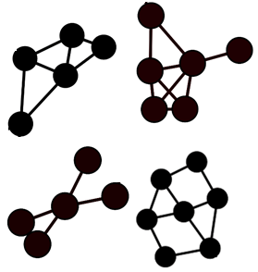
Community detection: Method
Graph
Ego-Nets
Embeddings
Clusters

Slide 25
Community detection: Baselines
Newman [Newman, 2006]
  Classical Modularity based Community Detection algorithm
Louvian [Bondel+, 2008]
  Fast Modularity based Community Detection algorithm
DeepWalk [Perozzi+, 2014]
  Node embeddings based on vanilla random walk
Node2Vec [Grover+, 2014]
  Node embeddings based on second order random walk

Slide 26
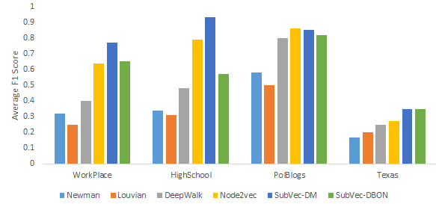
Community detection: results
More results in paper
Measure Average F1-Score of the communities
SubVec outperforms competitors in most datasets

Slide 27
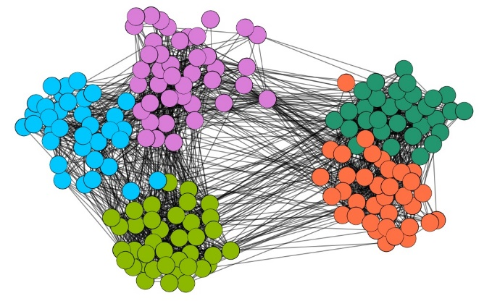
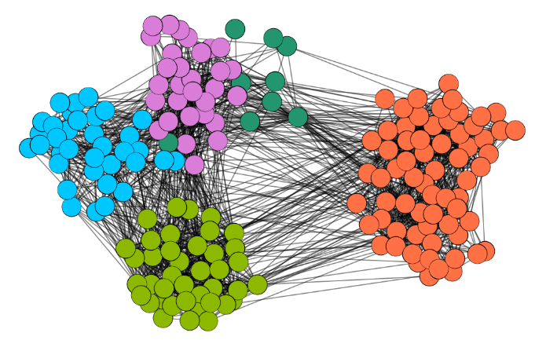
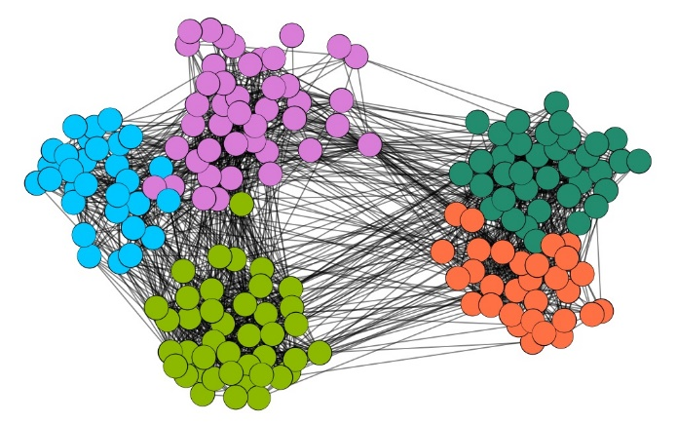
Community Detection: Visualization
Ground Truth Communities in HighSchool Dataset
Node2vec
SubVec
Our Framework works well even for dense graphs

Slide 28
Case-study: MeMetracker
Lipstick on a pig
Lipstick on a pig
Lipstick on a pig
Memetracker dataset
  Consists of cascades of memes
  A meme is a short phrase
  Cascades flows though news and blog websites
Steps
  Each cascade induces a subgraph in the network
  Embed the subgraphs enduced by the cascades
  Cluster the embedding
  Observe the common ‘topics’ in each cluster
NBC
BBC
CNN

Slide 29

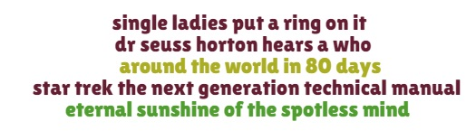
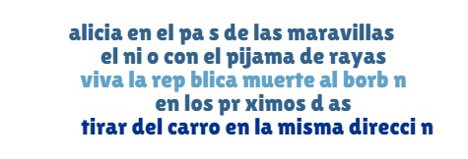
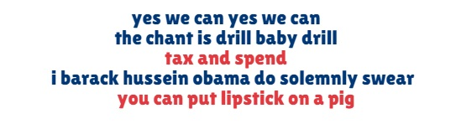
Case-study: MeMetracker
Religious
Entertainment
Spanish
Politics
SubVec vectors from meaningful clusters

Slide 30
Case-study: DBLP
DBLP is a co-authorship Network
  We extract subgraphs based on keywords in the title of the papers
  Keywords include ‘classification’, ‘clustering’, ‘XML’, and so on
  Each subgraph is annotated by a keyword
Steps
  Embed the subgraphs using SubVec
  Visualize in 2-dimensions
  Observe similarity between the keywords

Slide 31
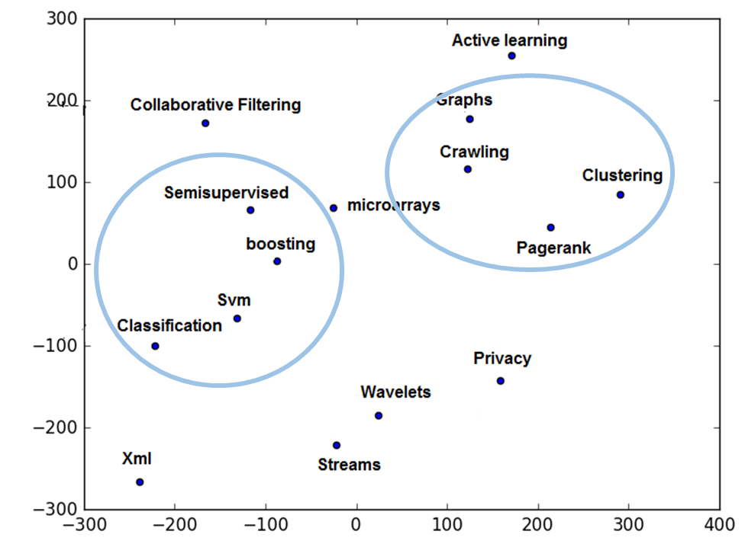
Case-study: DBLP
SubVec vectors are meaningful

Slide 32
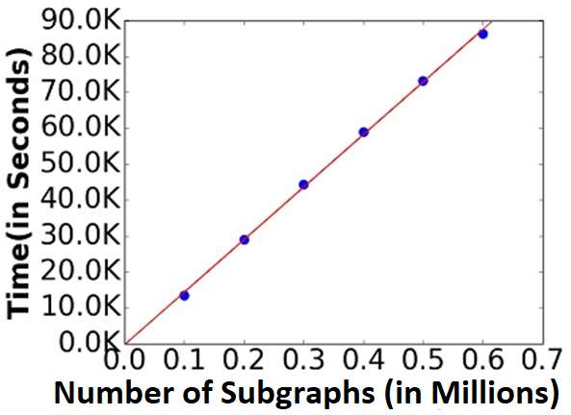
Scalability
More results in paper
SubVec scales linearly w.r.t number of subgraphs

Slide 33
Outline
Motivation
Problem Formulation
Method
Experiments
Conclusion

Slide 34
Conclusion
Problem
  Formulated novel Subgraph Embedding Problem
  Introduced the Neighborhood Property
Algorithm
  Proposed effective and efficient SubVec
Experiments
  Large Datasets, Performance, Scalability
Applications
  Community Detections
  Sense Making

Slide 35








Any questions?
Funding:
Code at:
http://people.cs.vt.edu/~bijaya
Set of Subgraphs
Subgraph Embedding
Data Mining Tasks
Classification
Community Detection
Link Prediction
Anomaly Detection
Sense Making
…

