Slide 1

NetGist: Learning to Generate Task-based Network Summaries
Sorour E. Amiri, Bijaya Adhikari, Aditya Bharadwaj, B. Aditya Prakash
Department of Computer Science
Virginia Tech
ICDM, Singapore, November, 2018

Slide 2
Real-world Networks
Facebook Network [2012]
Protein interaction Network [Wikipedia 2016]
The Internet
Human Disease Network [Kenneth 2011]

Slide 3


Graph Mining Tasks
Viral Marketing
Community Detection
Information Diffusion
Event Detection
Anomaly Detection
Immunization
Pattern Detection
…
Problem: How to handle large scale networks?

Slide 4
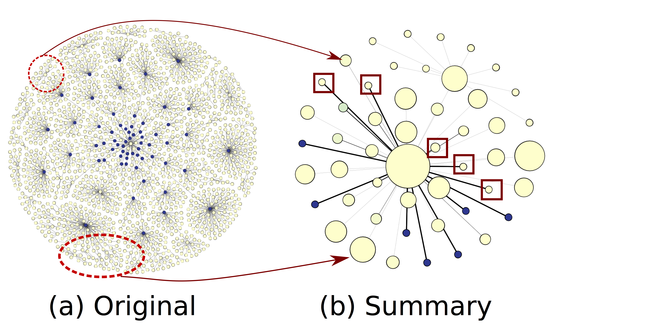
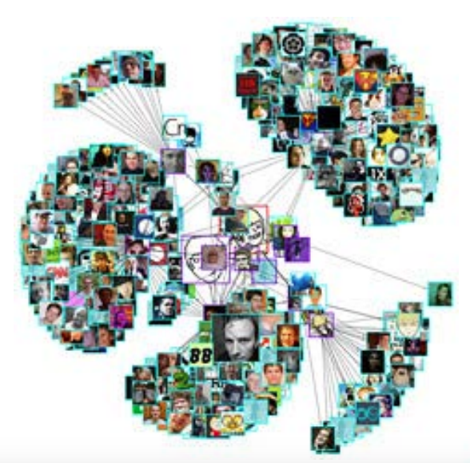
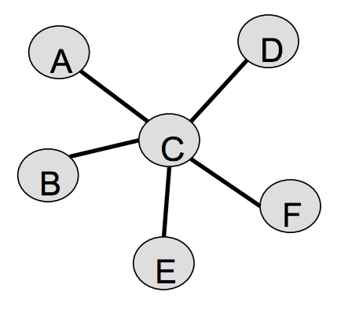
Graph Summarization
Original Network
Summary Network
A smaller graph that represents the original one.
Useful for:
  Visualization/Sense-Making [Koutra+, 2015]
  Speeding up algorithms [Purohit+, 2014]
  Anomaly detection [Amiri+, 2018]
  …
Super-nodes

Slide 5
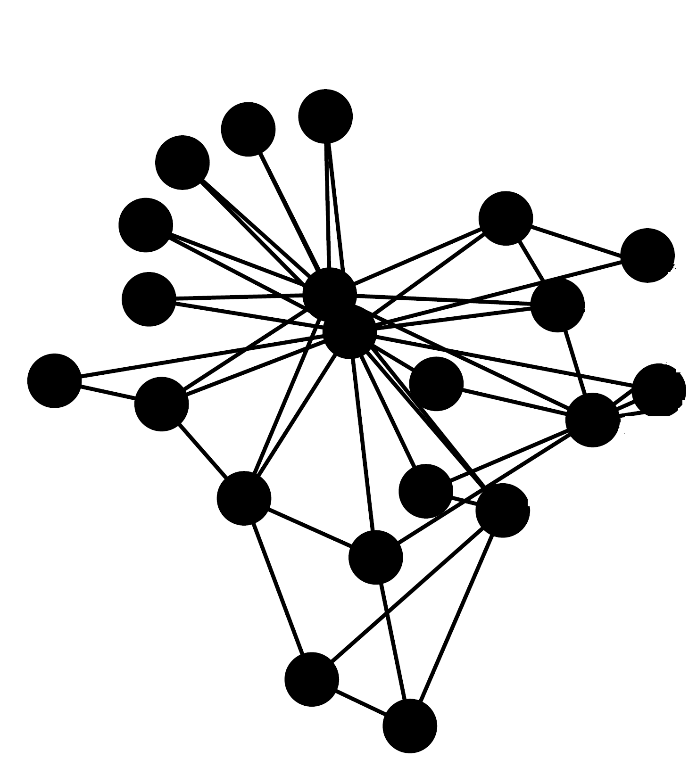
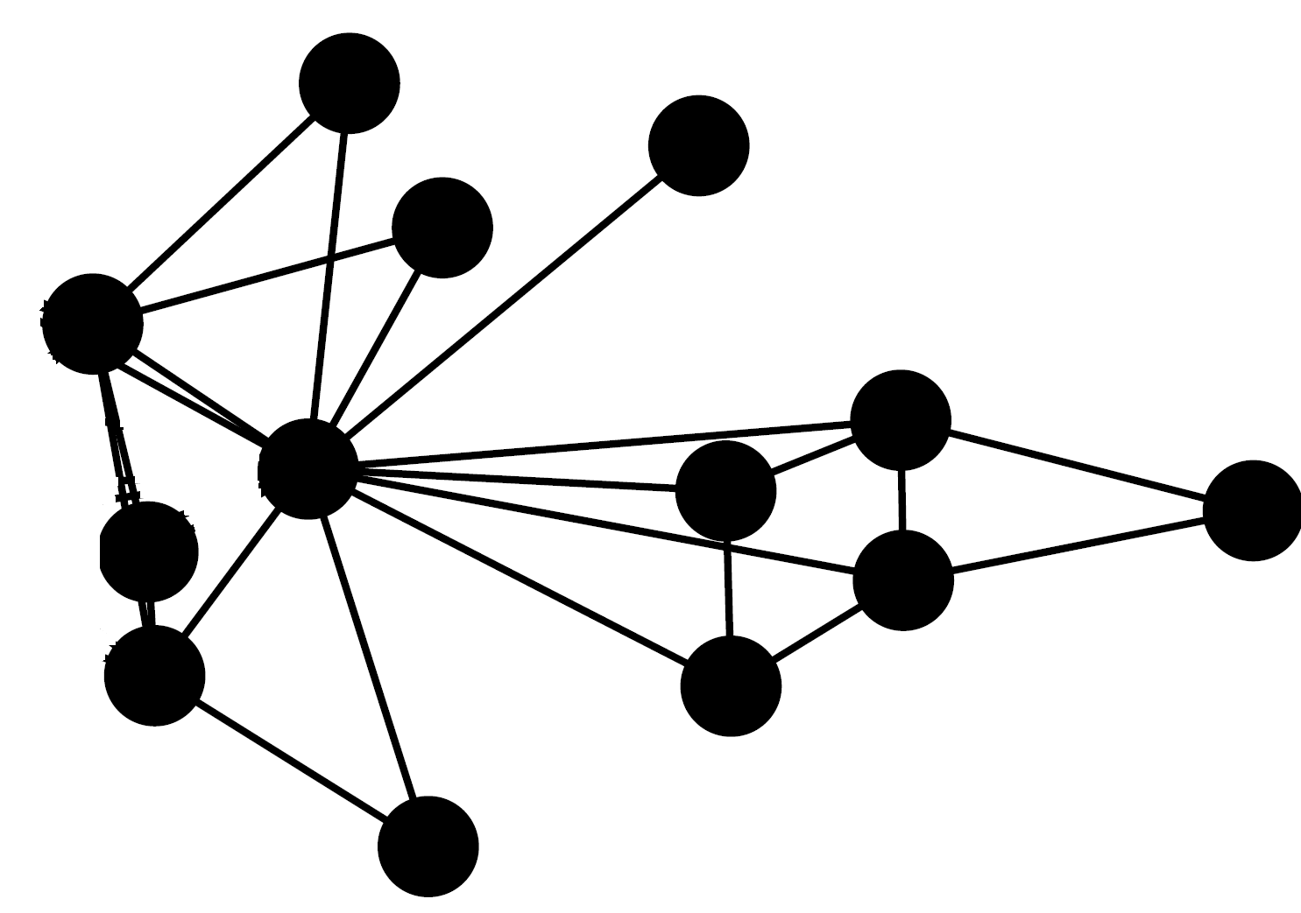
Summary is Task Dependent
Karate Network
Summary for Community Detection
Summary for Central Node Detection

Slide 6
Prior Works on Summarization
Prior graph summarization techniques are task specific
Community Detection | Influence-based Tasks | Sense Making | Graph Query
Metis [Karypis+,1998] | CoarseNet [Purohit+, 2014] | VOG [Koutra+,2014] | GraSS [LeFevre+,2010]
Spectral Clustering [Luxburg, 2007] | SPINE [Mathioudakis+,2011] | OntoViz [Shen+,2006] | VNM [Buehrer+, 2008]
Immunization | Graph Cut
What should we do?
Our Idea: Learn how to generate summaries

Slide 7






Why Learning Makes Sense
Tasks require repeated summary generation
Objectives for the tasks can be complicated
  Hard to formulate
  Domain dependent
  Black Box
$$G$$
$$G^{s}$$
Learn $h\left(G\right)=G^{s}$
Task: Viral Marketing
Apply
Apply
Task
$$G$$
$$G^{s}$$

Slide 8



Problem: Learning to Summarize
Given a problem Prob and a distribution D of network instances
Learn how to generate meaningful network summaries that generalizes to unseen instances from D?
Example:
Similar social networks
Protein interaction network of similar proteins
Viral Marketing
Transportation
$$G$$
$$G^{s}$$
Learn $h\left(G\right)=G^{s}$
Apply
Task (Prob)
Apply

Slide 9
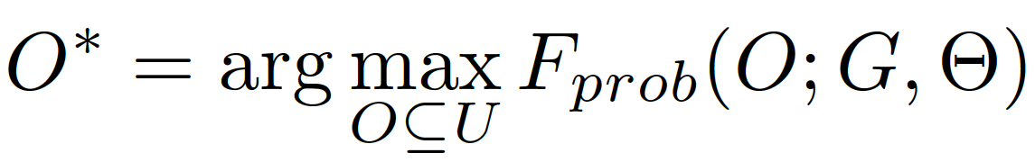
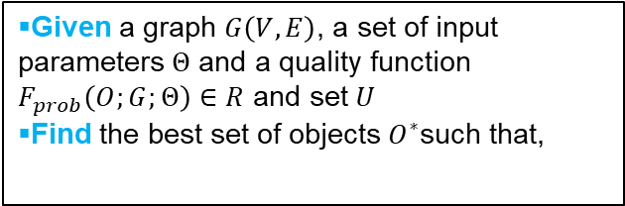
What is the Set of Prob.
More details in the paper
An example of GOP: Community Detection
Given a problem Prob and a distribution D of network instances Learn how to generate meaningful network summaries that generalizes to unseen instances from D?
We define a class of problems GOP
Given a graph $G\left(V,E\right)$, a set of input parameters $Θ$ and a quality function $F_{prob}\left(O;G;Θ\right)∈R$ and set $U$
Find the best set of objects $O^{∗}$such that,
Many Tasks are part of GOP
Immunization
Ncut
…

Slide 10
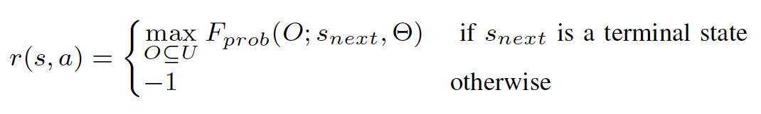


Method: NetGist Overview
Evaluate
Summarize
NetGist learns how to summarize from examples

Slide 11
NetGist: Reinforcement Learning
More details in the paper
Atari Game
Network Summarization
Universe of Actions
  left / right
Universe of States
  current screen
Reward
  score you earned at current step
Policy
  How to choose your action
Learning Procedure
  Maximize future reward
Universe of Actions
  Merge Nodes
Universe of States
  All possible summaries
Reward
  Solution to the Task
Policy
  How to generate summary
Learning Procedure
  Maximize future reward

Slide 12
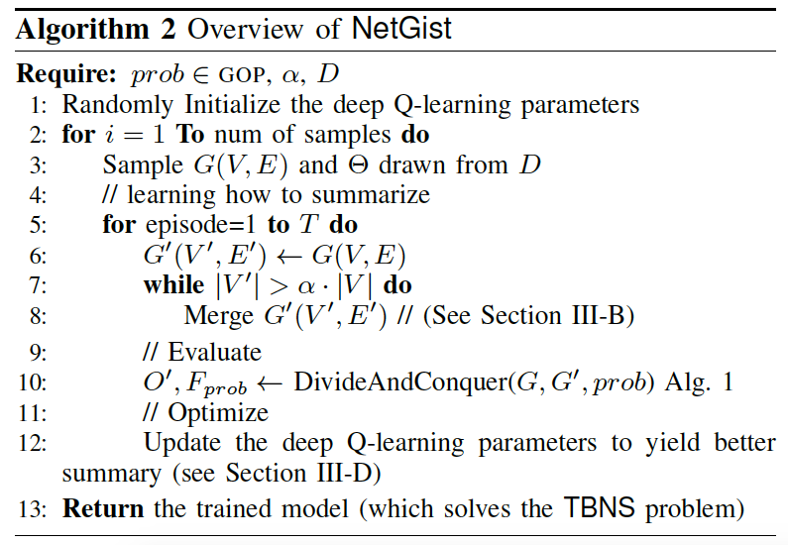
Complete NetGist Algorithm
Summarize
Original Graph
G’₁
Action
Episode
Evaluate
G’_{n}
Update
Evaluate

Slide 13
Outline
Background and Motivation
Problem Formulation
Method
Experiments
Conclusion

Slide 14
Experiments: datasets
Various datasets in different scales and domains.
 |  | Dataset | #Nodes | #Edges
 | 1 | ER | 20-2,000 | 50-10,000
 | 2 | BA | 20-2,000 | 40-4,000
 | 3 | Block Model | 20-2,000 | 40-30,000
 | 4 | Karate Club | 34 | 78
 | 5 | Work-place | 92 | 755
 | 6 | High-School | 327 | 5,818
 | 7 | Political blogs | 1,490 | 16,783
 | 8 | Facebook | 4,039 | 88,234
 | 9 | As-Oregon | 7,000 | 1,5743
Synthetic
social network
mobility networks
Real-World
blogs network
social network
autonomous systems

Slide 15
Experiments: baselines
Random: randomly merges nodes
Other task-specific methods
Community Detection | Influence-based Tasks
Metis [Karypis+,1998] | CoarseNet [Purohit+, 2014]
Spectral Clustering [Luxburg, 2007]

Slide 16
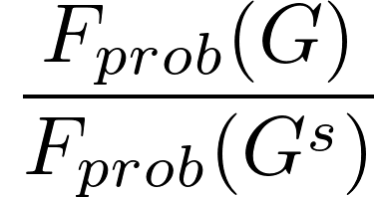
NetGist on Real Networks
Community detection
Influence maximization
Additional Results on
Varying Distribution
Generalization
…
In paper
NetGist outperforms the baselines

Slide 17
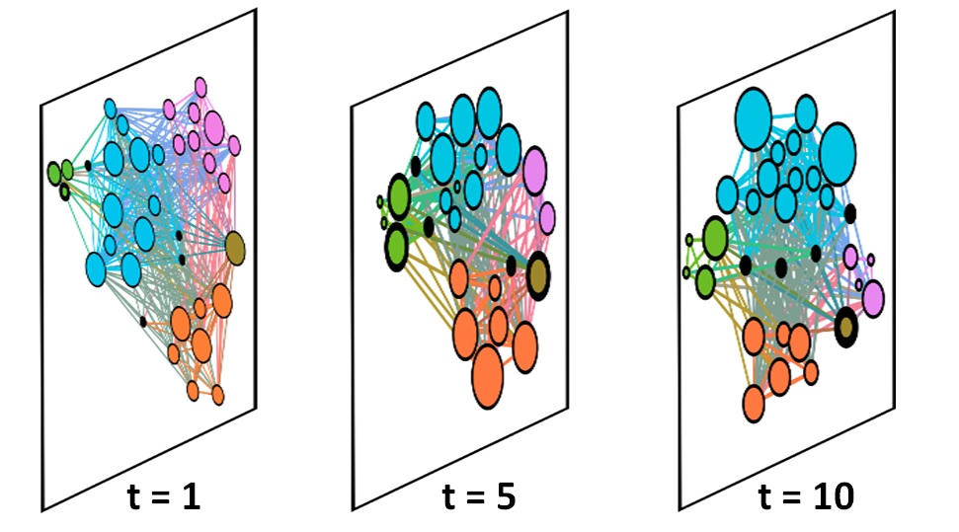
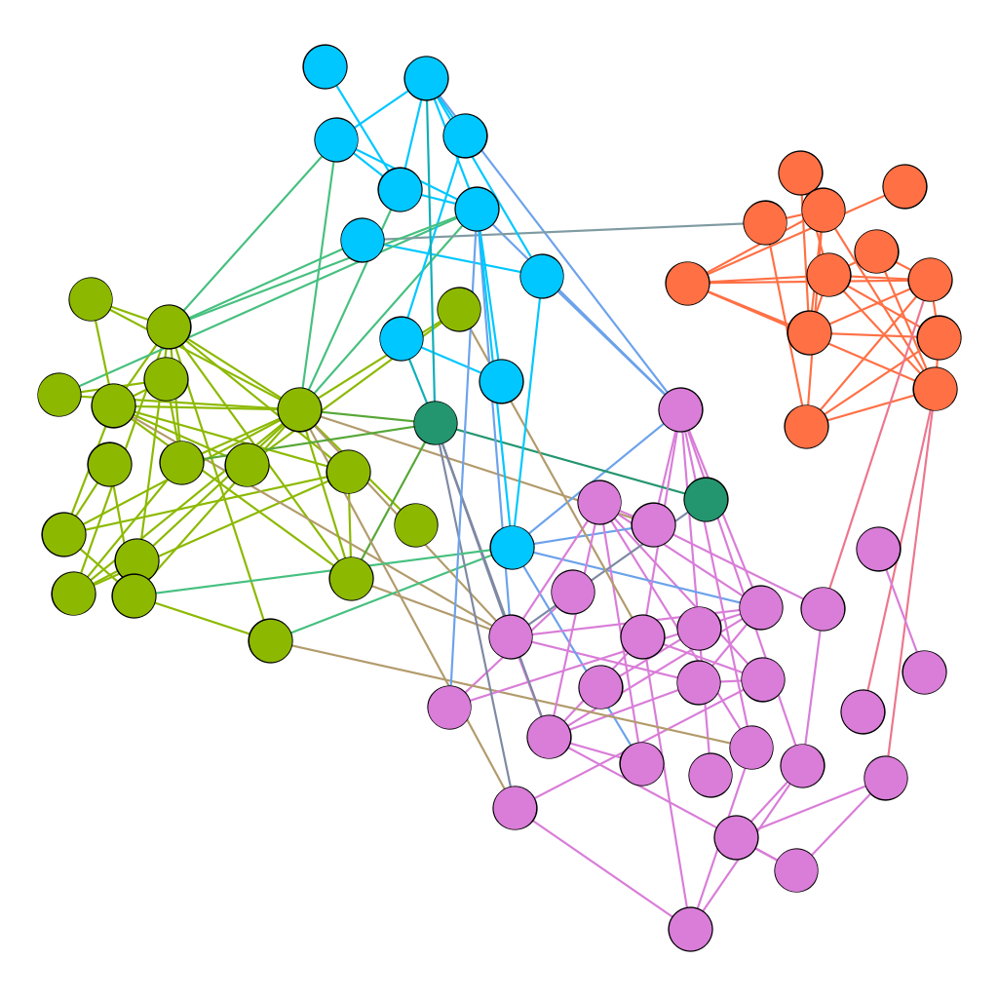
Detecting anomalies on mobility graphs
Work-Place network [Génois+, 2015] , contact network between employees in a work place
Color represents different departments
Anomalies
NetGist can detect correct anomalies that match the ground-truth

Slide 18
Conclusion
Novel Problem and Approach
  Learning to generate task based summaries
  Deep Reinforcement Learning
  Learns effective summaries
Applications
  Anomaly detection
  Sense making

Slide 19








Thank you!
Code: github.com/SorourAmiri/NetGist
Funding
Learning to generate network summaries
Summary graph
Feedback
Graph
Evaluate
Merging nodes

Slide 21
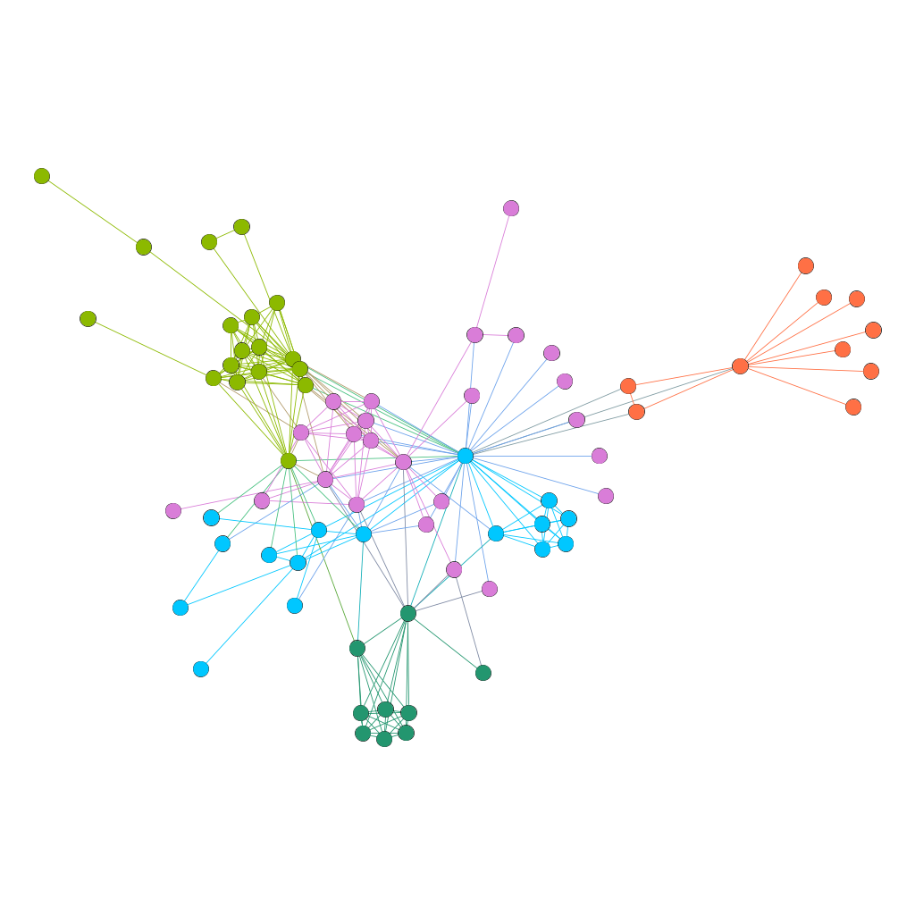
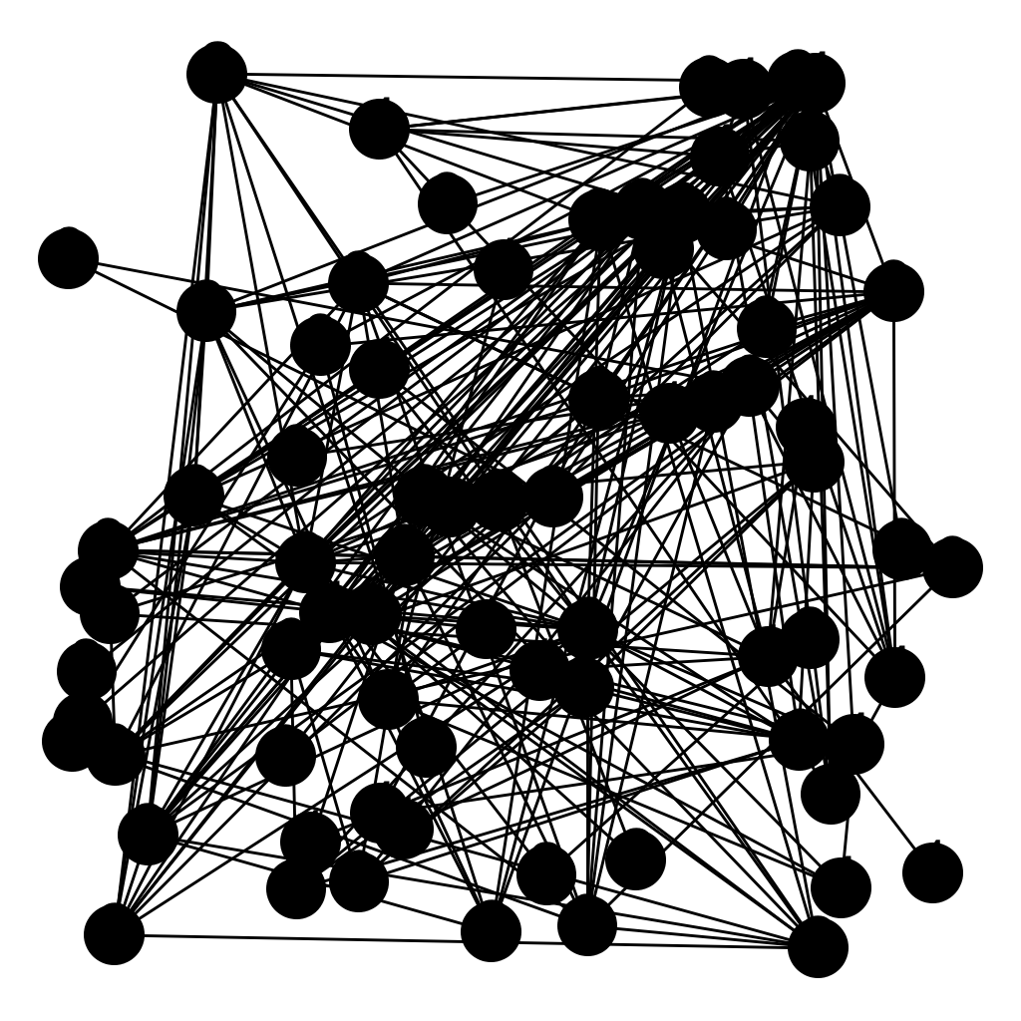
Sense Making: Visualizing Graphs
Drawing networks such as protein interaction networks in 2D space.
  Intuitively nodes in the same super-node are close in location
Original graph
Summary graph
Graph layout
Visualizing graphs is easier on summary graphs

Slide 22
Learning from Examples
Community Detection Task
Summarization
Evaluate
Summarization
Evaluate
Summarization
Evaluate
22

Slide 23
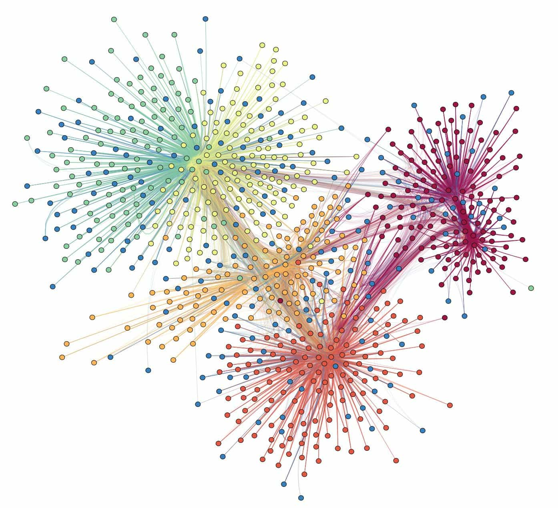
Graph Summarization
A smaller graph that represents the original one.
Can We Summarize Graphs?
  Skewed distributions imply most nodes are unimportant
Summarization
Original Graph
Summary Graph
Shrinking networks should be possible

Slide 24
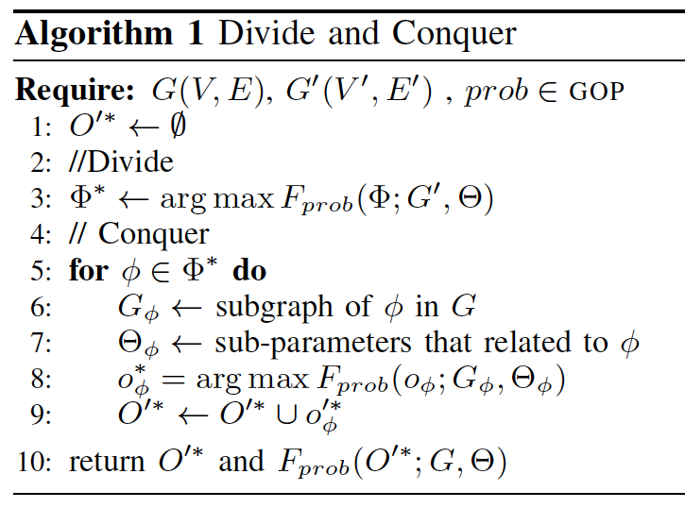
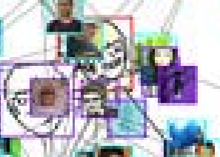
How to evaluate summaries
Our Idea: Divide and Conquer
A
D
Evaluate the structure of the summary graph
B
C
F
E
Summary graph
Divide and solve
Conquer
Evaluate super-nodes
C

Slide 25
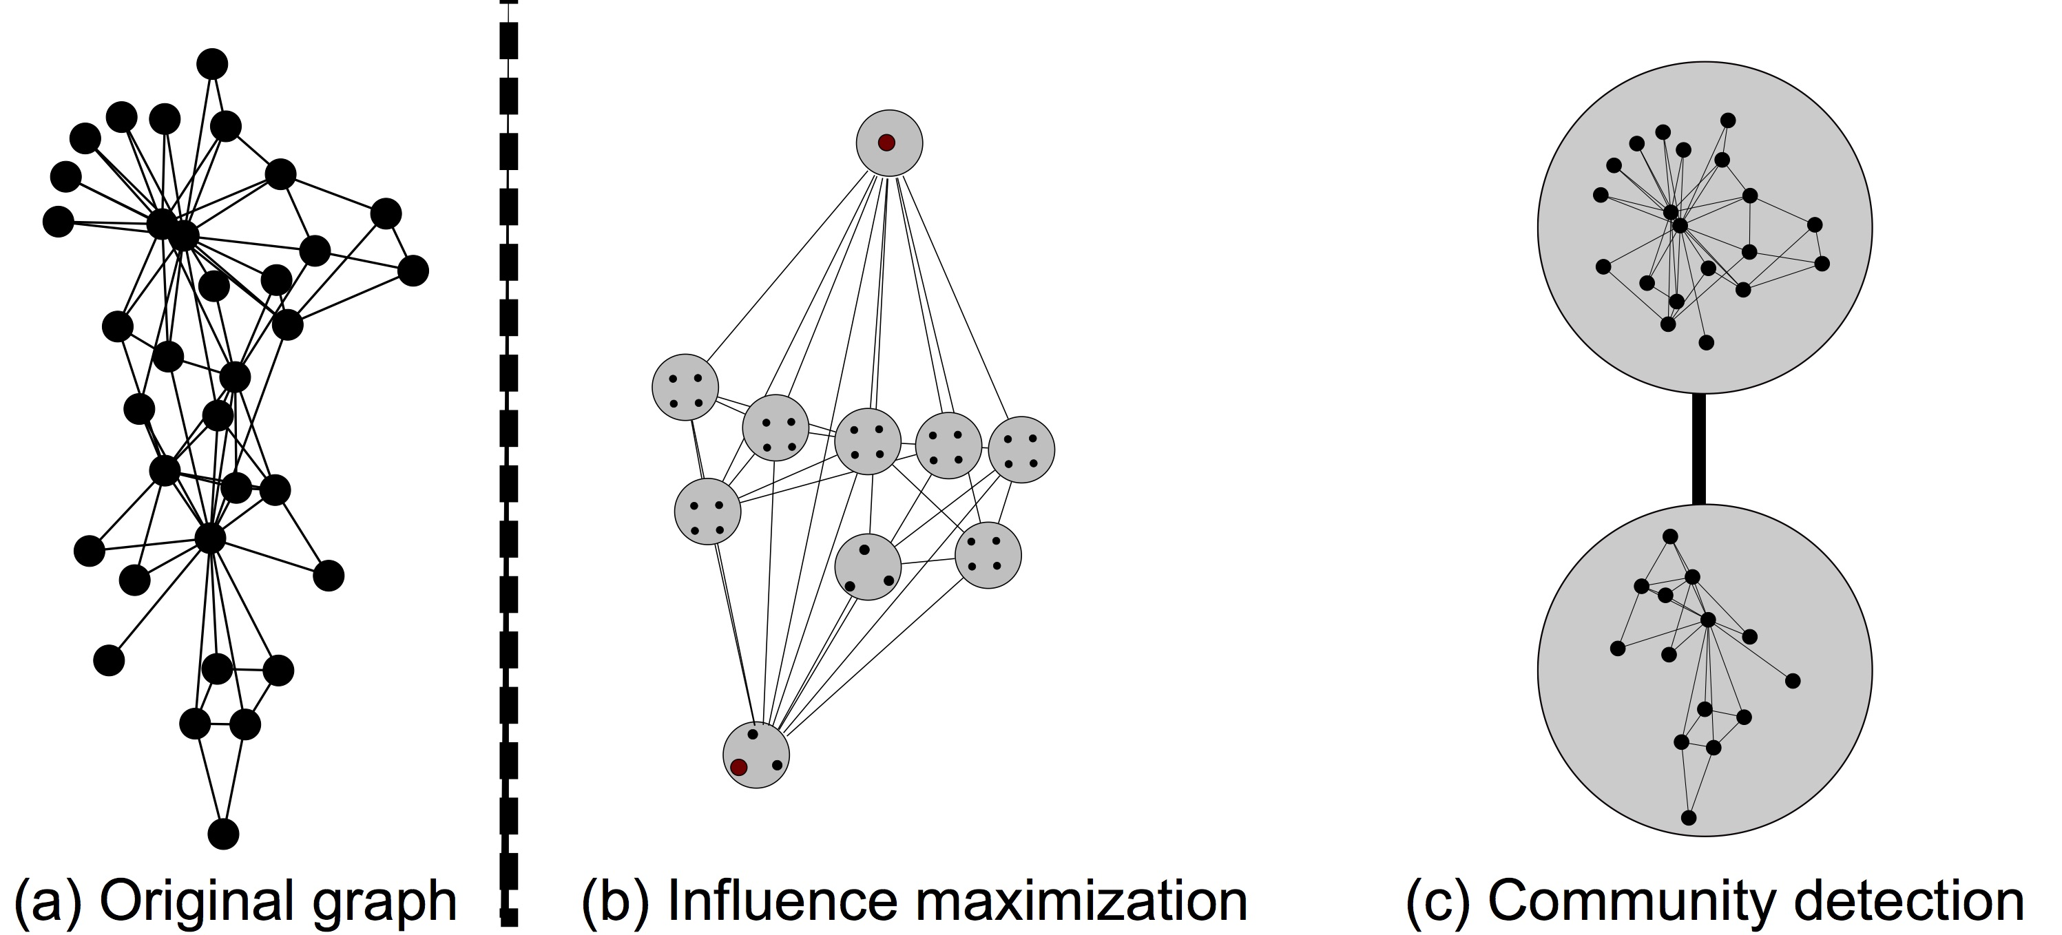
Sample Visualization
NetGist generates meaningful summaries
NetGist generates different summaries for different tasks

Slide 26
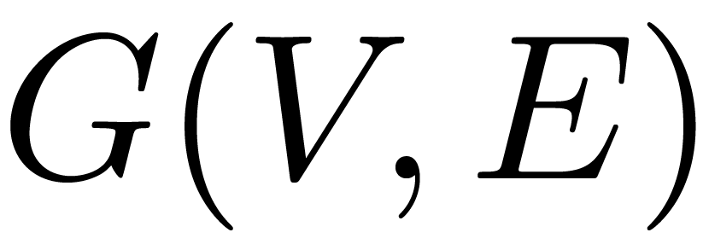

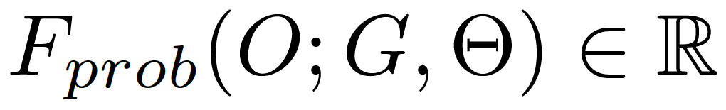


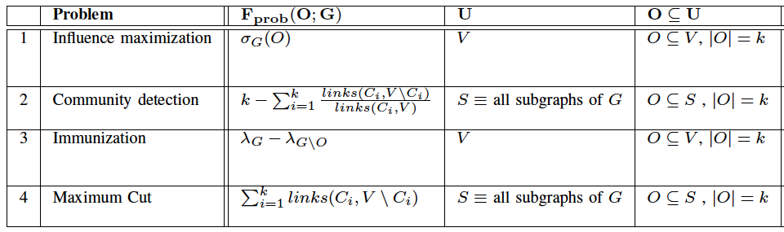
Graph Optimization Problem (GOP)
Given a graph , a set of input parameters
and a quality function and set
Find the best set of objects such that,

Slide 27
Why Learning Makes Sense
Original Graph
Tasks require repeated summary generation
New problems do not have summarization algorithm
Objectives for the tasks can be complicated
  Hard to formulate
  Domain dependent
  Black Box
Summary Graph
Layout

Slide 28
Background: Reinforcement Learning
Universe of Actions
  move your board left / right
Universe of States
  current screen
Reward
  score you earned at current step
Policy
  How to choose your action
Learning Procedure
  predicted future total rewards
Atari game
Observation
Reward
Agent
Environment
Action

Slide 29
Universe of Actions: Merge
Q: What kind of merge?
A: Sometimes it is not enough to merge adjacent nodes.
Merge spokes
Merge edges

Slide 30
Kth Order merge
More details in the paper
Before
After
1st order merge
2nd order merge
4th order merge

Slide 31
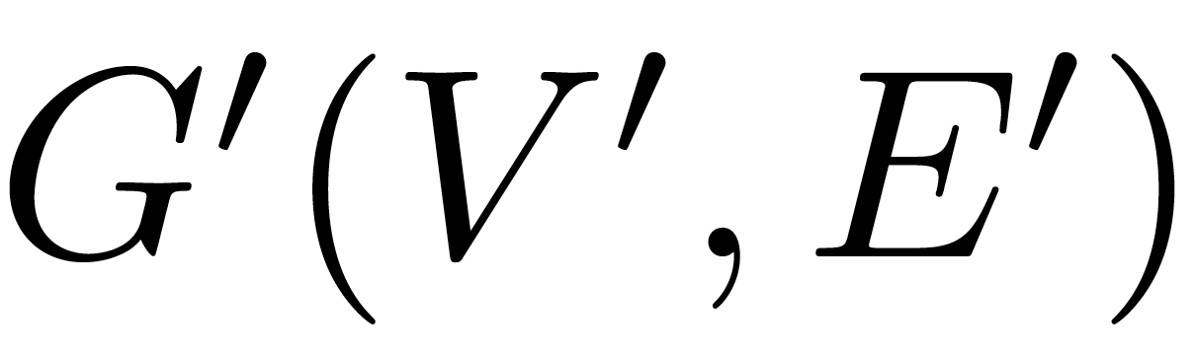
Universe of States
The universe of states is a set of networks
such that G’ is a result of zero or more merge operations on the a network G from D .
Original Graph
G’₁
G’₂
G’₃
…
G’_{n}

Slide 32
Reward function
Reward:
  -1 for non-terminal states
  Evaluate the quality of the terminal state (With desired size)
Low Reward
Medium Reward
High Reward

Slide 33
How to Evaluate a Summary?
More details in the paper
Evaluate structure
  High level understanding of the important regions in the graph
Evaluate homogeneity
  Based on the roles played in each region

Slide 34
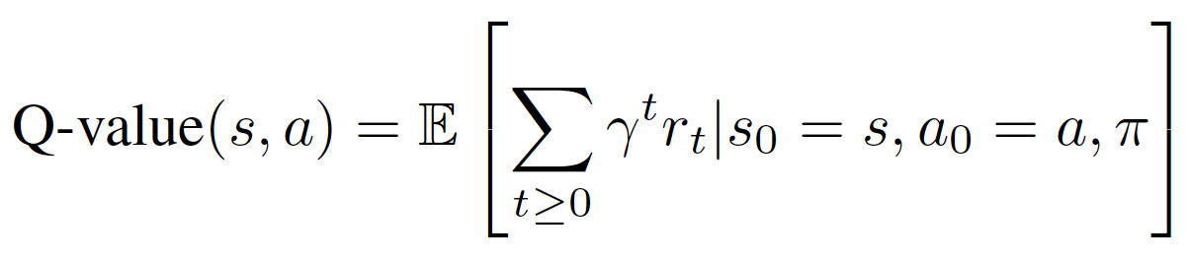
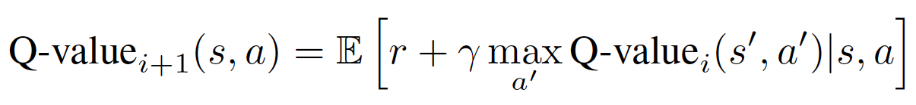
Learning Procedure: Deep Q-learning
Expected future reward
More details in the paper

Slide 35
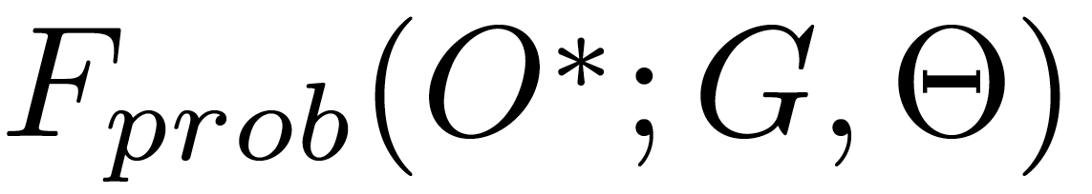
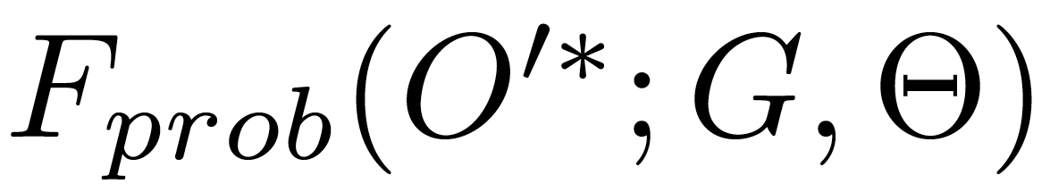

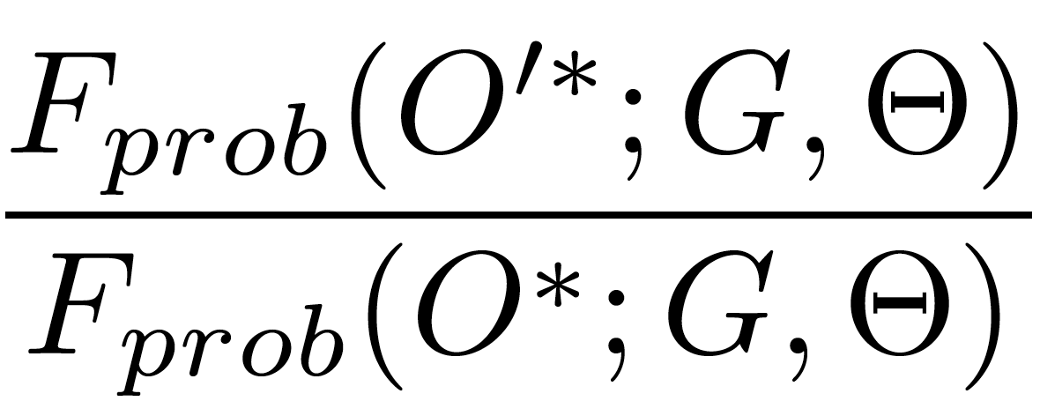
Measuring Success
More details in the paper
Original Graph G
Summary Graph G’
Evaluate given task on G
Evaluate given task on G’

Slide 36
Quality of NetGist on distribution D
Netgist consistently performs well
Influence maximization
Community detection

