Slide 1

Condensing Temporal Networks using Propagation
Bijaya Adhikari, Yao Zhang, Aditya Bharadwaj, and
B. Aditya Prakash
Department of Computer Science
Virginia Tech
SDM, Houston, April 28th, 2017

Slide 2
Outline
Motivation
Problem Formulation
Method
Experiments
Conclusion

Slide 3
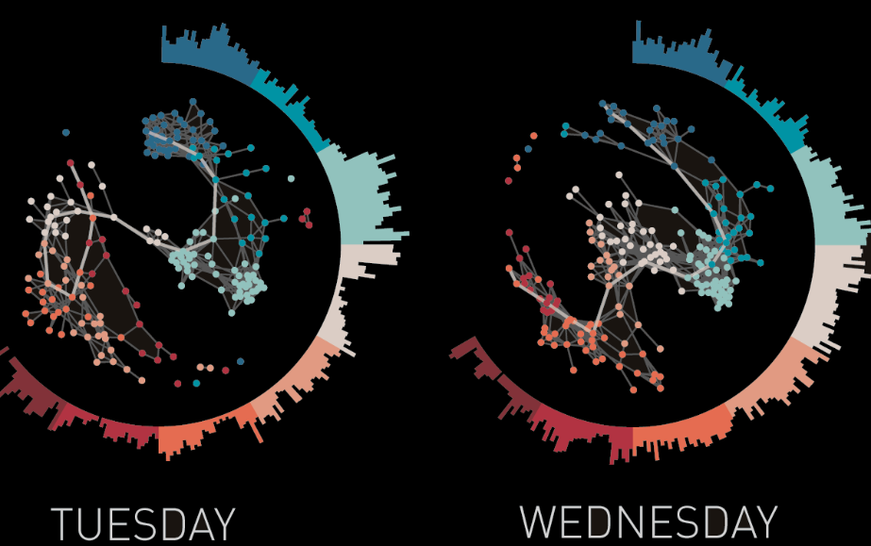

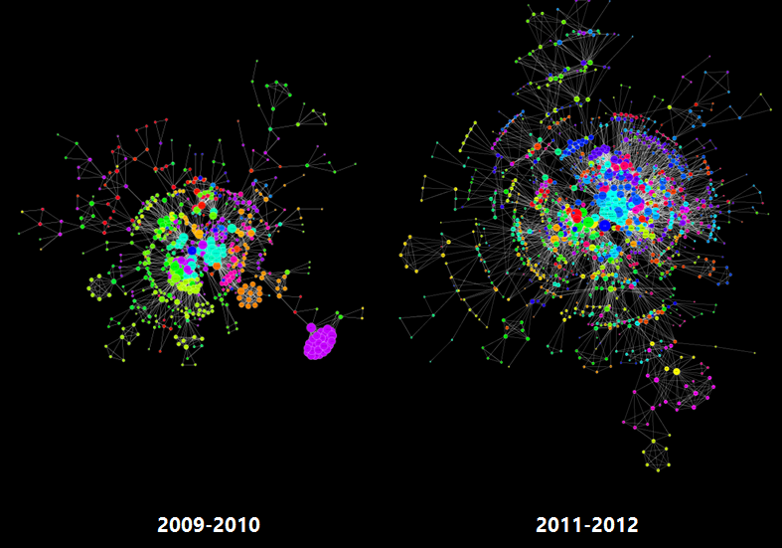


Networks Evolve over Time
And many more…
2015
2016
[Social Networks]
[Contact Networks, source: sociopatterns.org]
2015
2016
[Co-author Networks]
[Patent Collaboration, source: kenedict.com]

Slide 4




Propagation in networks
Social Media
Epidemiology
Cyber Security
Public Health
Viral Marketing
Human Mobility
….
Contact Network
Social Network
Diseases
Memes

Slide 5





Temporal Network Mining
Viral Marketing
Evolving Community Detection
Information Diffusion
Event Detection
Anomaly Detection
Immunization
Pattern Detection
…
How to handle large scale networks?

Slide 6
Motivation: Our Observation
In real temporal networks
  Skewed distributions imply most nodes are unimportant
  Most changes in snapshots are gradual
Time 1
Time 2
Summarization
Time 3
Can shrink the network

Slide 7


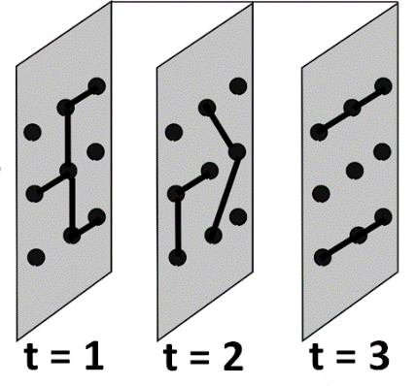
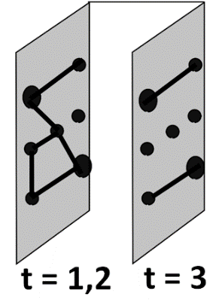
Motivation: Our Approach
Given a temporal network obtain condensed network
  Merge nodes
  Merge time-stamps
Data Mining Tasks
Influence Maximization
Community Detection
Immunization
Pattern Detection
Event Detection
…
“Preserve” the “propagation based property”

Slide 8
Outline
Motivation
Problem Formulation
Method
Experiments
Conclusion

Slide 9
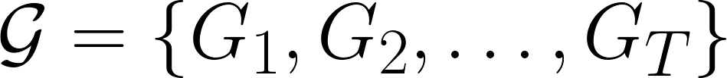





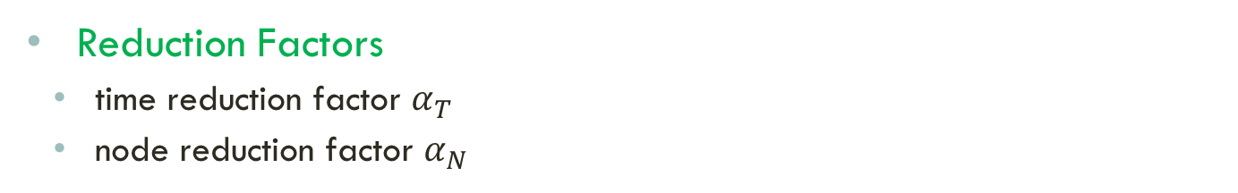
Problem Formulation: Setting
Given
  A temporal network with snapshots
    each time-stamp (snapshot) is weighted
    wlog edge-weights are between 0 and 1
    consider the SI model
Goal: Preserve the propagation
based property
  Reduction Factors
    time reduction factor $α_{T}$
    node reduction factor $α_{N}$

Slide 10
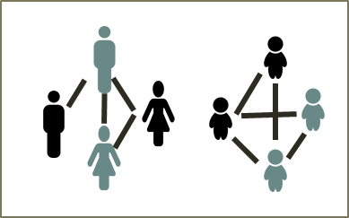
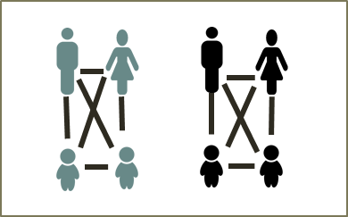
Background
Propagation: Temporal Network
SI MODEL
  “Infected” nodes infect “Susceptible’’ neighbors
  With probability given by edge-weight
  Once a node is infected, it remains infected
  Nodes get multiple chances to infect
IC MODEL
  Nodes get single chance to infect
  Nodes get cured in the next time-step
  Never become infected again
Day graph: Office/School
Night graph: Family
Notes:
Basic model

Slide 11
Problem Formulation: Challenges
  Challenge 1: What to preserve?
    How to characterize the propagation-based property?
  Challenge 2: How to define merge operations?

Slide 12
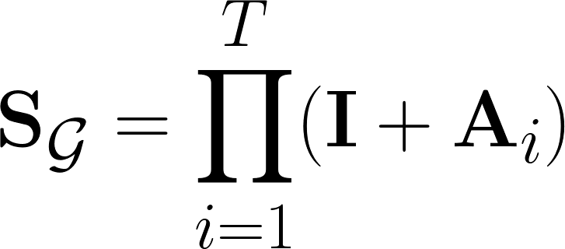


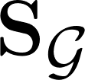




C1: Propagation Characteristics
System Matrix [Prakash+, 2010]
For the system matrix is defined as
where is the adjacency matrix of
…

Slide 13

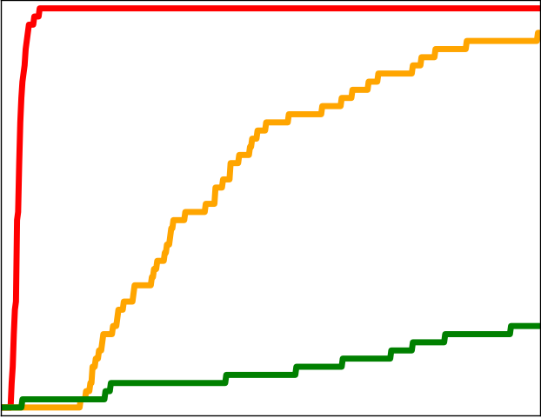





C1:Propagation Characteristics
Spectral Radius of System matrix [Prakash+, 2010]
  The largest eigenvalue of governs the rate of infection
SI Model
# Infection
Time
  Our Idea: Use to characterize the propagation
13

Slide 14

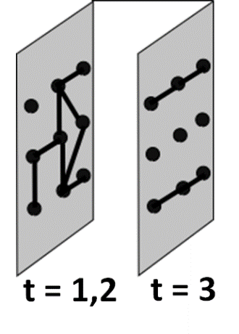
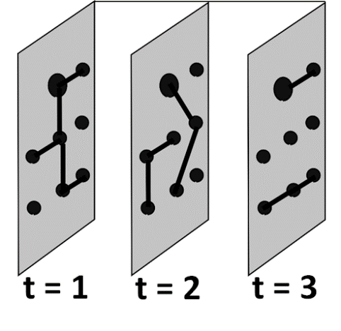
C2: Merge Operations
Time-Pair Merge
Node-Pair Merge

Slide 15
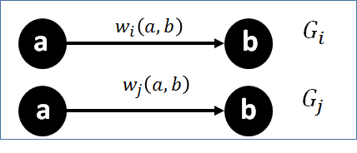

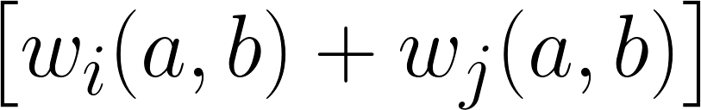
C2: Time Merge
Idea: Preserve Probability of Infection
Merge time-stamps i and j into k
Lemma 1
  The probability of node a infecting node b via time i and j is
  up to a first order approximation.

Slide 16
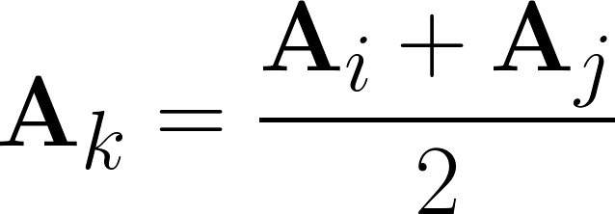
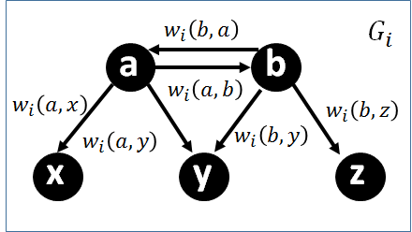
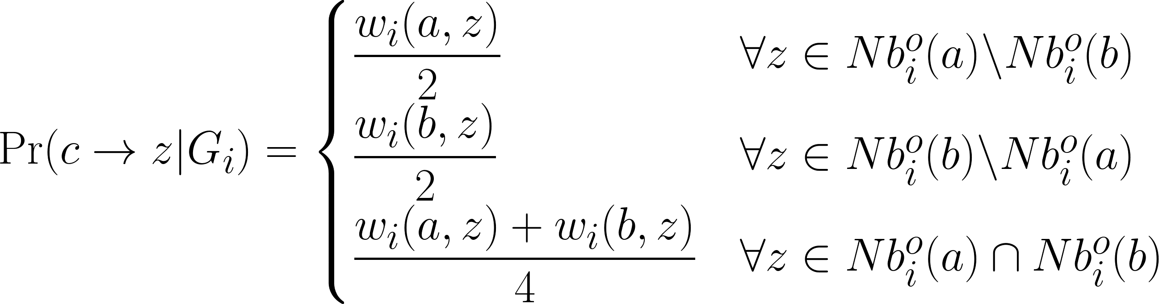
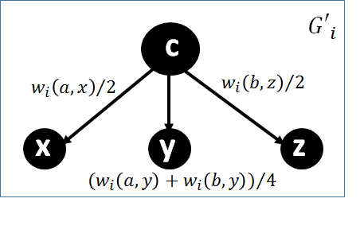
C2: Merges
More details in paper
Time Merge
Node Merge
  Similar Idea
Lemma 2
  The probability of node c infecting its neighbors is given by

Slide 17


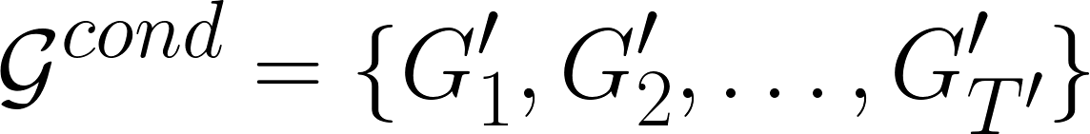
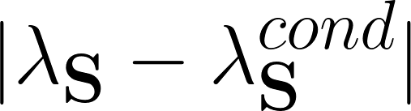
Problem Statement
Problem 1: Temporal Network Condensation Problem
  Given:
    A temporal network
    Reduction factors and
  Find:
    A condensed network
    Such that is minimized
  By:
    Applications of our node-pair and time-pair merge definitions

Slide 18
Outline
Motivation
Problem Formulation
Method
Experiments
Conclusion

Slide 19




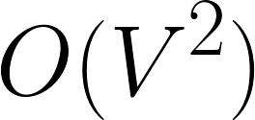

Difficulties in solving Problem 1
Computing poses many challenges:
  Computational
    Time complexity :
…
  Storage
    Space complexity:
  Numerical Issue
    The entries in become unstable
Bottom line : can’t compute for large networks

Slide 20
Our Main Idea
Transform the problem into a tractable static version

Slide 21
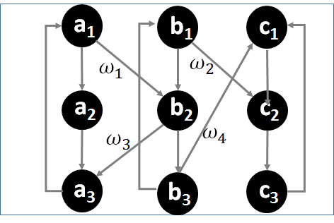
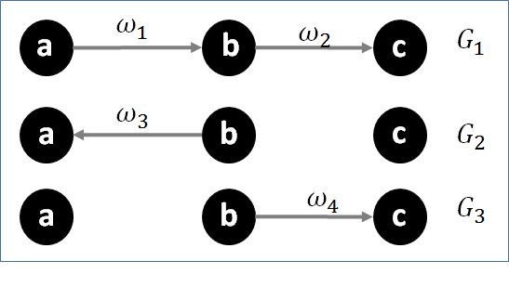
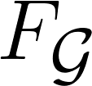
Step 1: Alternate static view
Create Flattened Network
  by creating layers of nodes
  each layer is roughly a snapshot
Temporal Network
Flattened Network
  Closely related to each other
Notes:
Propagation in closely related

Slide 22

Step 1: Properties of
Lemma 3
    The SI model in is equivalent to IC model in
Temporal Network
Flattened Network

Slide 23

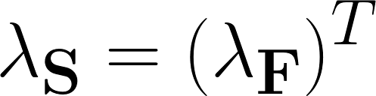
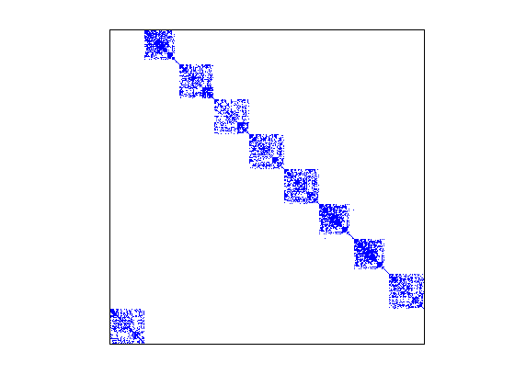
Step 1: Properties of
    Lemma 4
    The largest eigenvalue and of and respectively, are related by
Original Network
Flattened Network
…
Dense
Are we done?
Sparse

Slide 24

Step 1: Problems with
Flattened Network
Not yet!
is ill-conditioned
Cannot compute with high accuracy
Takes long to converge
Adjacency Matrix
What next?
Notes:
Sparse directed network

Slide 25
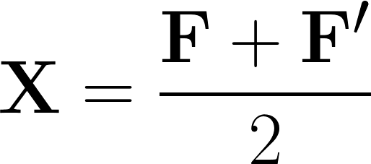
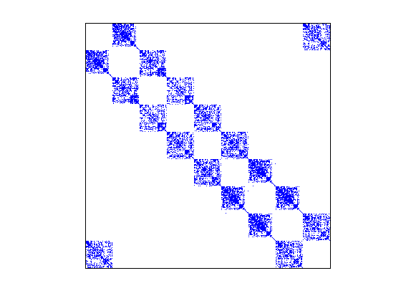


Step 2: A well conditioned network
We derive the Average Flattened Network whose adjacency matrix is

Slide 26


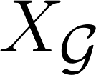
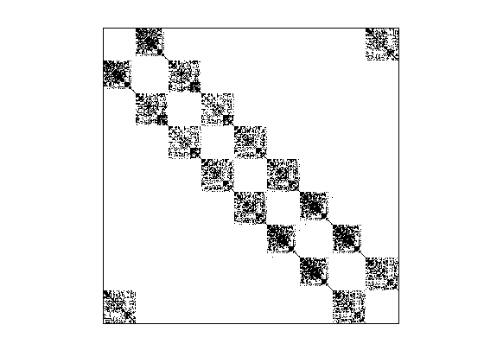
Properties of
Can easily compute the eigenvalues of
The largest eigenvalue of and are related as
There is no epidemic in (and hence in ) if there is no epidemic in

Slide 27

A revised problem
Problem 2: Revised Temporal Network Condensation Problem
  Given:
    A temporal network
    Reduction factors and
  Find:
    A condensed network
    Such that is minimized
  By:
    Applications of our node-pair and time-pair merge definitions

Slide 28

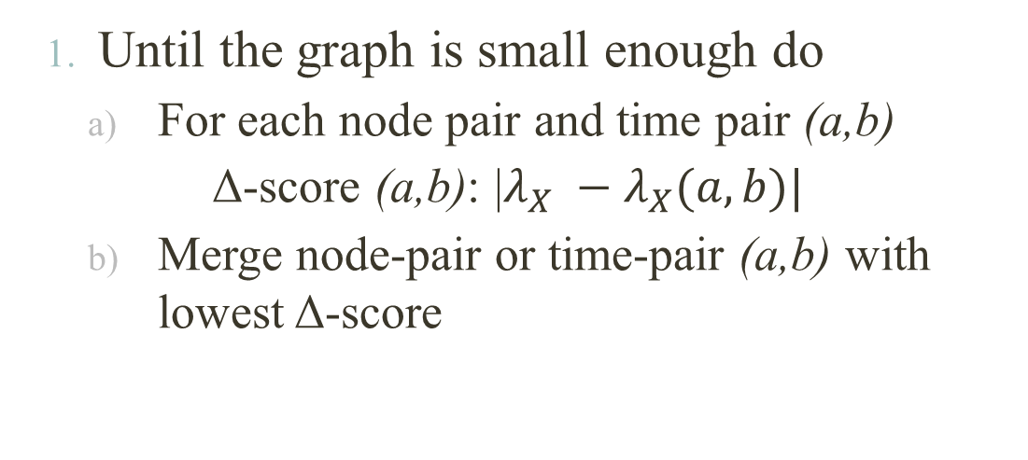
Naïve Heuristic
$Δ−Score (n1,n2)$
$Δ−Score (n2,n3)$
$Δ−Score (n1,n3)$
$Δ−Score (t1,t2)$
$Δ−Score (t2,t3)$
$Δ−Score (t3,t4)$
$Δ−Score (n1,n2)$
$Δ−Score (n2,n3)$
$Δ−Score (n1,n3)$
$Δ−Score (t1,t2)$
$Δ−Score (t2,t3)$
$Δ−Score (t3,t4)$
$Δ−Score (n1,n2)$
$Δ−Score (n2,n3)$
$Δ−Score (n1,n3)$
$Δ−Score (t1,t2)$
$Δ−Score (t2,t3)$
$Δ−Score (t3,t4)$
$Δ−Score (n1,n2)$
$Δ−Score (n2,n3)$
$Δ−Score (n1,n3)$
$Δ−Score (t1,t2)$
$Δ−Score (t2,t3)$
$Δ−Score (t3,t4)$
$Δ−Score (n1,n2)$
$Δ−Score (n2,n3)$
$Δ−Score (n1,n3)$
$Δ−Score (t1,t2)$
$Δ−Score (t2,t3)$
$Δ−Score (t3,t4)$
GREEDY
  Until the graph is small enough do
    For each node pair and time pair (a,b)
      Δ-score (a,b): |$λ_{X} −λ_{X}(a,b)|$
    Merge node-pair or time-pair (a,b) with lowest Δ-score
  Too slow: O(n³) calculation of eigenvalues

Slide 29
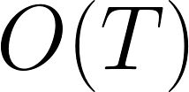
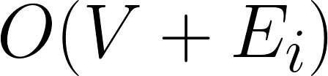
Our Method: NETCONDENSE
Can we compute Δ-score efficiently ?
IDEA: Use matrix perturbation theory
  Single eigenvalue calculation!
For a node-pair in
For a time-pair in

Slide 30



Δ-Score: Perturbation
Details
For time stamps i and j
Largest eigenvalue and corresponding eigenvector
=
More details in
Paper

Slide 31

Our Method
NETCONDENSE
Flatten the given to obtain
Compute and corresponding eigenvector
Estimate Δ-scores using perturbation
Sort them in increasing order
Until the graph is small enough do
  Repeatedly merge best time-pair and node-pair
Complexity
Time
Sub-quadratic
Space
Linear

Slide 32
Outline
Motivation
Problem Formulation
Method
Experiments
Conclusion

Slide 33
DatasetS
Dataset | Weight | |V| | |E| | T
Workplace | Contact Hrs | 92 | 1.5K | 12 days
School | Contact Hrs | 182 | 4.2K | 9 days
Enron | # Emails | 184 | 8.4K | 44 Months
Chess | # Games | 7.3K | 62.4K | 9 Years
Arxiv | # Papers | 28K | 3.8M | 9 Years
Wikipedia | #Pages | 118K | 2.1M | 10 Years
WikiTalk | #Messages | 497K | 2.7M | 12 Years
DBLP | #Papers | 1.3M | 18M | 25 Years

Slide 34
BASELINES
RANDOM
  Randomly merge node-pairs and time-pairs
TENSOR
  Pick candidates to merge based on centrality given by tensor decomposition
CNTemp
  Summarize static graph: Coarsenset [Purohit+, KDD 2014]
  Run Coarsenet on the union graph and repeat the summary

Slide 35

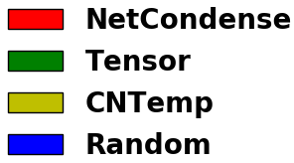
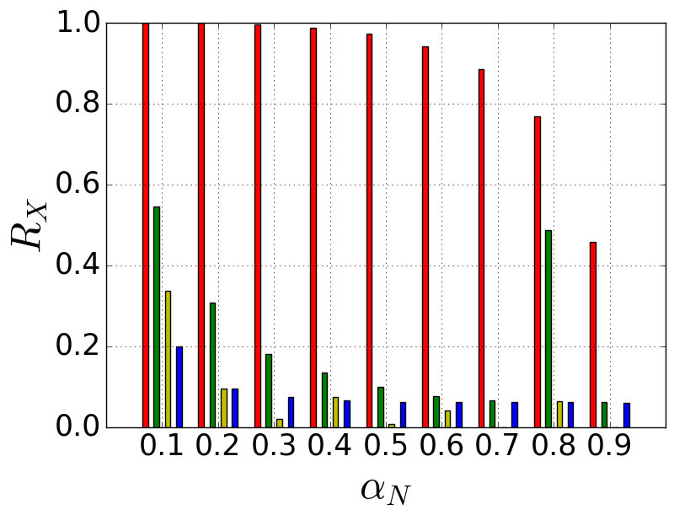
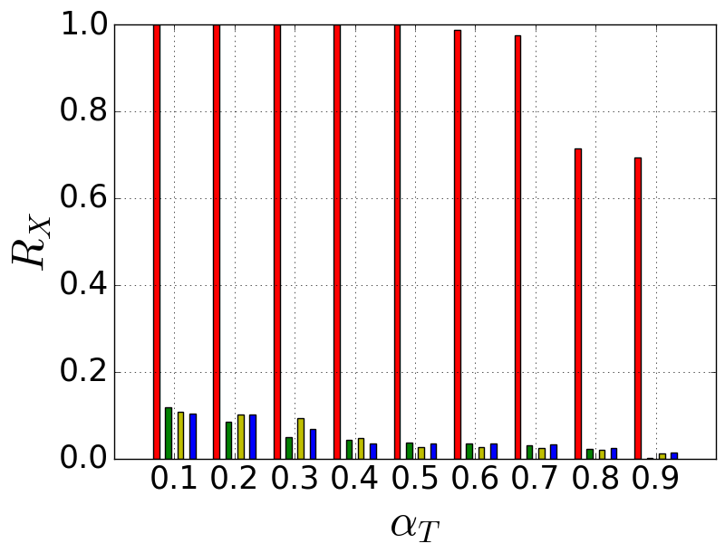
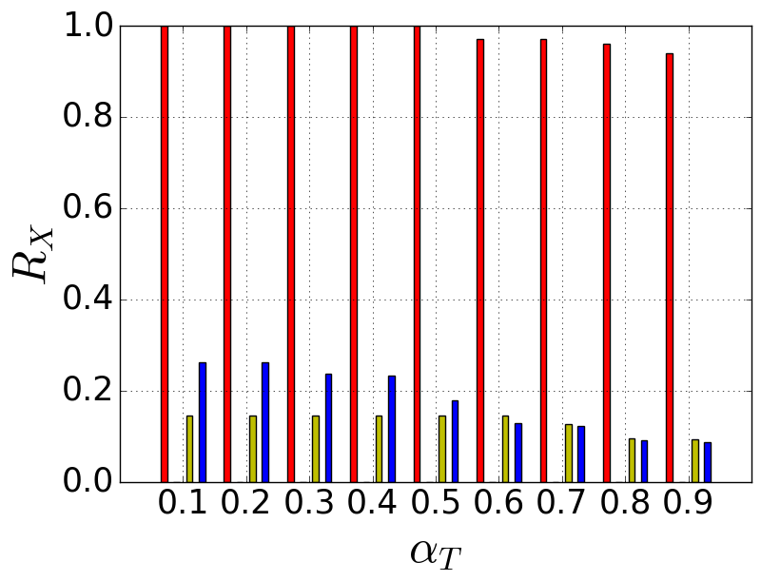
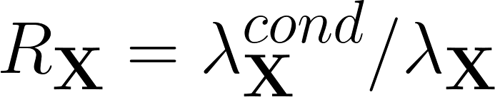


Performance: vs
WikiTalk
DBLP
Higher is better
where
NETCONDENSE preserves well even for large values of
Notes:
70%

Slide 36

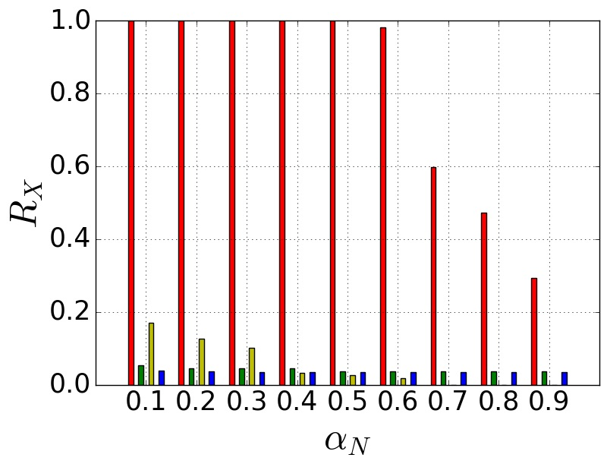
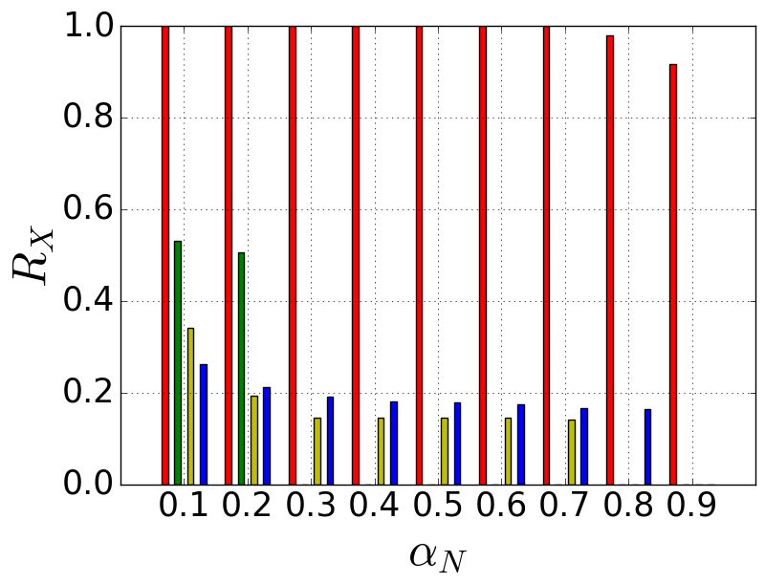

Performance: vs
WikiTalk
DBLP
Higher is better
where
NETCONDENSE preserves well even for large values of
Notes:
60% and 90%

Slide 37
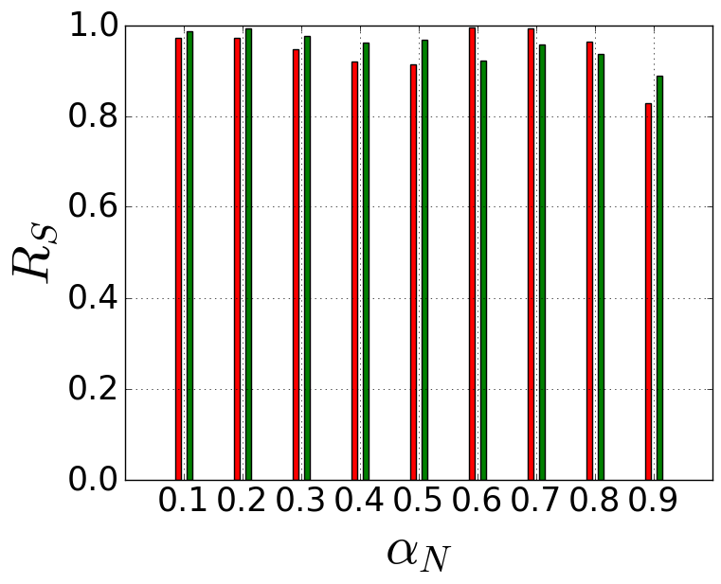
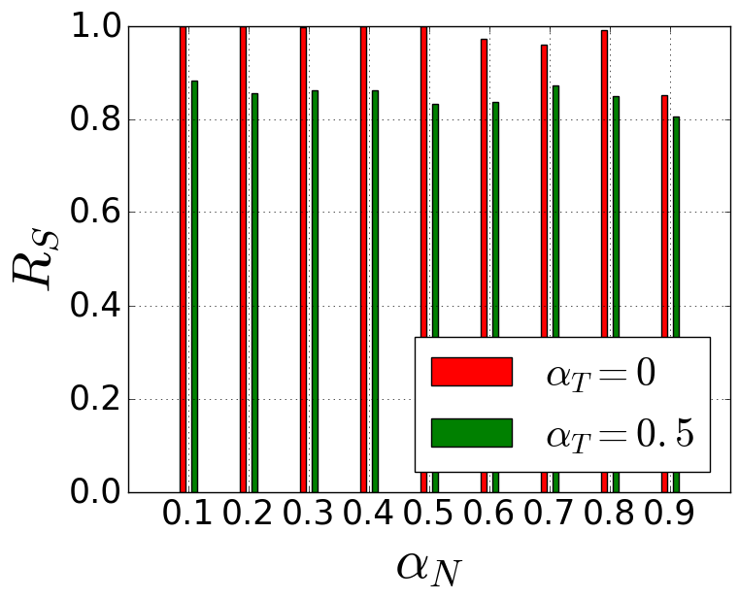
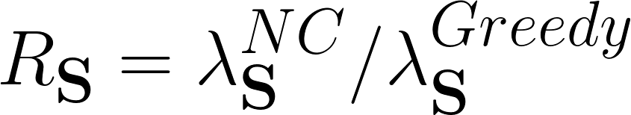
Performance w.r.t. Problem 1
How well does NETCONDENSE preserve ?
Workplace
School
Higher is better
where
NETCONDENSE preserves well
Notes:
Transformation from S->F->X works well

Slide 38
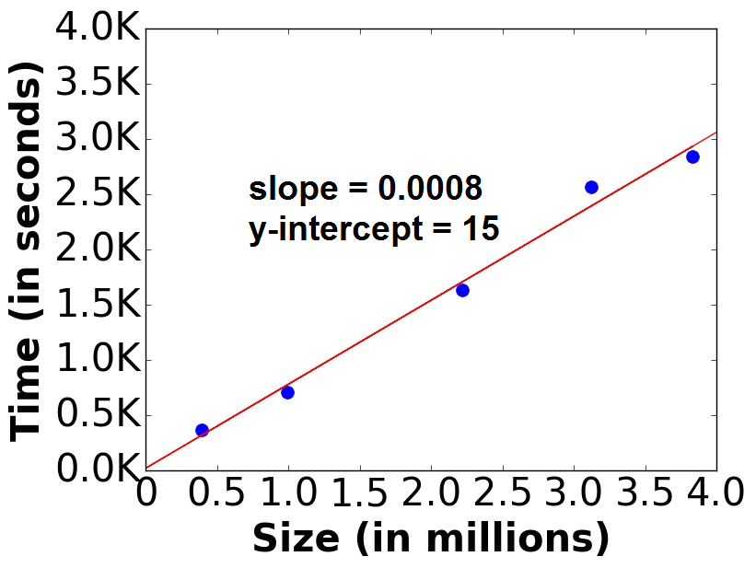
Scalability
NETCONDENSE scales near linearly

Slide 39
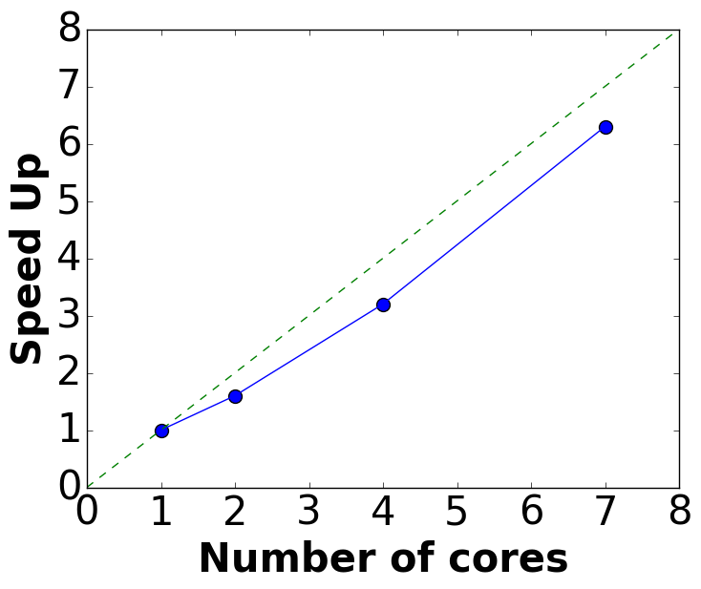
Parallelizability
More results in paper
NETCONDENSE achieves near linear speed-up

Slide 40
Application1: Temporal Influence Maximization
Problem: Give a temporal network [Aggarwal +, SDM 2012]
  choose best k nodes in first time-stamp as seed-set
  such that maximum diffusion is achieved in the last time-stamp
Day graph: Office/School
Night graph: Family

Slide 41

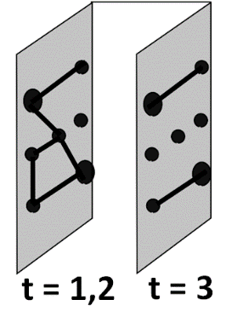
Our Algorithm: CONDINF
Condense the input using NETCONDENSE
Solve the temp inf max problem on the condensed network
Project the solution back to the original network
  Randomly return a node from a “super-node” is selected
Step 1: Condense
Step 2: Solve
Step 3: Project

Slide 42
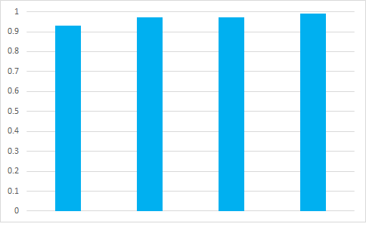
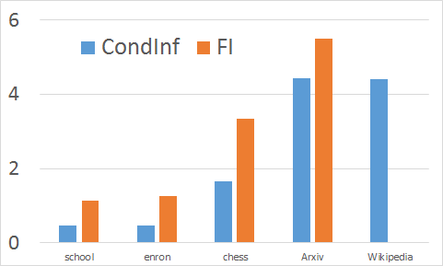
Performance of CONDINF
Base method: FI [Aggarwal+, SDM 2012]
Did not finish
From days
to hours
Ratio of Spread (CondInf/FI)
Time(in log scale)
School
Enron
Chess
Arxiv
School
Enron
Chess
Arxiv
Wikipedia
CONDINF finds good answer with significant speed-up

Slide 43

Application 2: Sense Making
Visualization of condensed Workplace dataset
Observations
  Important nodes in diffusion
  Color indicates department
wanderers
linkers
[Genois+, Network Science 2015]
  We find the “linkers” (in black)
  We find the “wanderers” (merged with other departments)

Slide 44
Application 2: Sense making
In DBLP we find
Well known researchers like Philip Yu, Christos Faloutsos, Rakesh Agrawal never get merged.
Famous people collaborate more often with other famous people.
In ENRON we find
Important officials like CEO, President do not get merged.
Time-stamps in 2001 were never merged, indicating importance of the time period to the scandal.
We find suspicious structures like stars and cliques which appear only in the non merged time-stamps

Slide 45
Outline
Motivation
Problem Formulation
Method
Experiments
Conclusion

Slide 46
Conclusion
Problem
  Formulated novel Temporal Network Summarization Problem
  Carefully made it tractable
Efficient Algorithm
  Proposed near-linear NETCONDENSE algorithm
Experiments
  Large Datasets, Performance, Parallelizability
Applications
  Influence Maximization
  Network Exploration
…

Slide 47




Any questions?
Funding:
Code at:
http://people.cs.vt.edu/~bijaya
Data Mining Tasks
Influence Maximization
Community Detection
Immunization
Pattern Detection
Event Detection
…
NETCONDENSE

