Slide 1
MEIKE: Influence-based Communities in Networks
Yao Zhang, Bijaya Adhikari, Steve Jan and B. Aditya Prakash
Department of Computer Science
Virginia Tech
SDM, Houston, April 27, 2017

Slide 2
Outline
Motivation
Problem Definition
Our Proposed Methods
Experiments
Conclusion
Zhang, Adhikari, Jan and Prakash, SDM 2017

Slide 3
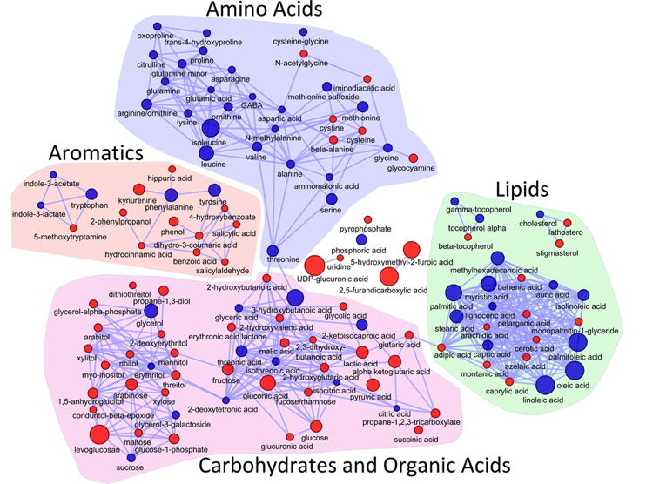
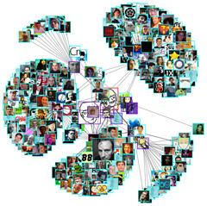
Motivation: Communities
Communities are important
Nodes in the same community: cohesive, behave similarly
Communities in biological networks
Communities in social networks
How to explore community structure by factoring in different roles of nodes during diffusion?
Zhang, Adhikari, Jan and Prakash, SDM 2017
Notes:
Communities are important; in bio: proteins have same functionalities; in social networks, share common interests; behave similarly

Slide 4
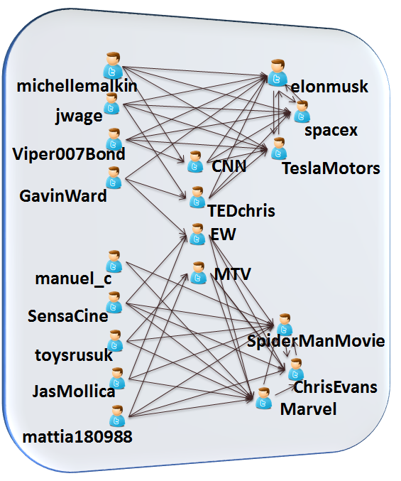
Motivation: Diffusion
How to explore community structure by factoring in different roles of nodes during diffusion?
Diffusion:
the phenomenon of spreading contagion on an underlying network
E.g.:
Memes propagate on social networks
Flu spreads over population contact networks
……
Twitter Following Network
Zhang, Adhikari, Jan and Prakash, SDM 2017

Slide 5
Motivation: Roles in Diffusion
How to explore community structure by factoring in different roles of nodes during diffusion?
Media nodes
Roles in Diffusion
Media: nodes who boost diffusion
“Bridges/media nodes”
Get influenced + influence others
Kernel: influential nodes
“Celebrities”
Communities
Kernel Communities: same topic
Ordinary communities
Corresponding to kernel communities
Ordinary communities
How to find these communities?
Kernel communities
In addition, elonmusk, spacex, and TeslaMotors has similar connections to CNN and TEDchris
Twitter Following Network
Zhang, Adhikari, Jan and Prakash, SDM 2017
Notes:
First, they belong to the same topic, then they connect to themselves

Slide 6
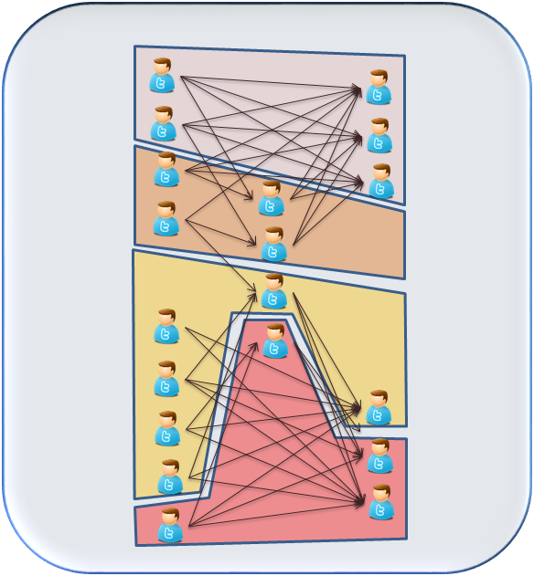
Motivation: Roles in Diffusion
How to explore community structure by factoring in different roles of nodes during diffusion?
Media nodes
Traditional community detection algorithms
Ordinary communities
Kernel communities
Twitter Following Network
Communities detected by NEWMAN’s algorithm
Zhang, Adhikari, Jan and Prakash, SDM 2017
Notes:
While they are useful, they give horizontal the community structure

Slide 7
Challenges
How to formally define media nodes and kernel communities?
How to develop effective methods based on the problem formulation?
Media nodes
Ordinary communities
Kernel communities
Zhang, Adhikari, Jan and Prakash, SDM 2017

Slide 8
Outline
Motivation
Problem Definition
Our Proposed Methods
Experiments
Conclusion
Zhang, Adhikari, Jan and Prakash, SDM 2017

Slide 9
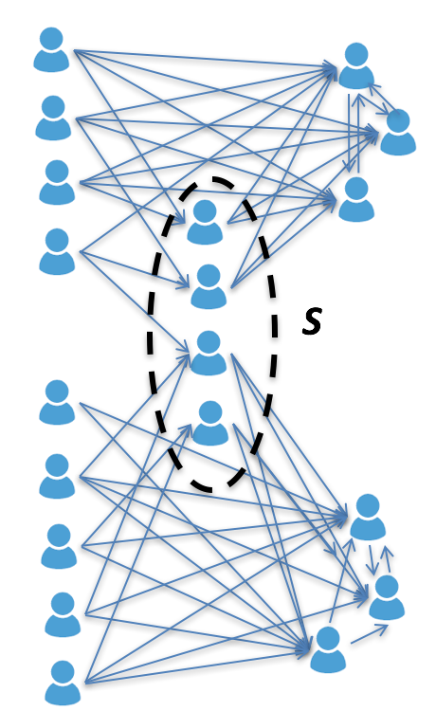

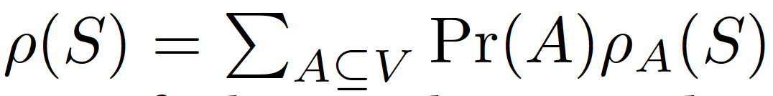
Defining Media Nodes
Properties of Media nodes
PM1: Upstream effect of diffusion
Capability of getting influenced from other nodes
: the expected number of infected nodes in S
Seed set A₁
Seed set A₂
All possible choices of the seed set
The number of infected nodes in set S at the end given A is a seed set
Upstream effect
Zhang, Adhikari, Jan and Prakash, SDM 2017

Slide 10

Defining Media Nodes
Properties of Media nodes
PM1: Upstream effect of diffusion
Capability of getting influenced from other nodes
: the expected number of infected nodes in S
PM2: Downstream effect of diffusion
capability of influencing other nodes
: the expected number of nodes S can infect
Downstream effect
Zhang, Adhikari, Jan and Prakash, SDM 2017
Notes:
\sigma(S) is the same objective function as the influence maximization problem

Slide 11

Defining Media Nodes
Properties of Media nodes
PM1: Upstream effect of diffusion
Capability of getting influenced from other nodes
: the expected number of infected nodes in S
PM2: Downstream effect of diffusion
capability of influencing other nodes
: the expected number of nodes S can infect
Media node set S has high value of both
full stream effect of diffusion
Defined as
S: media node set (high full stream effect)
Zhang, Adhikari, Jan and Prakash, SDM 2017
Notes:
Media nodes are “bridges”: get information and influence others

Slide 12
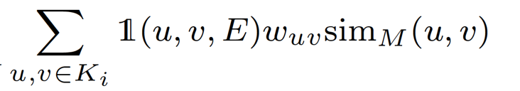
Defining Kernel and Ordinary Communities
Properties of a Kernel Community
Maximize
PK1: Connectivity among themselves
Nodes in the same kernel community have more connections to themselves
PK2: Similarity w.r.t. media nodes
Nodes in the same kernel community should connect to similar media nodes
Properties of a Ordinary Community
have more connections to its corresponding kernel community
PK1
PK2
Zhang, Adhikari, Jan and Prakash, SDM 2017
Notes:
PK2: how information flows from kernel to media nodes

Slide 13
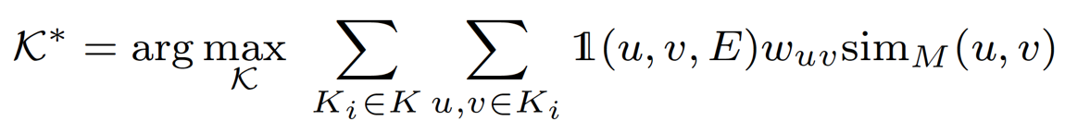
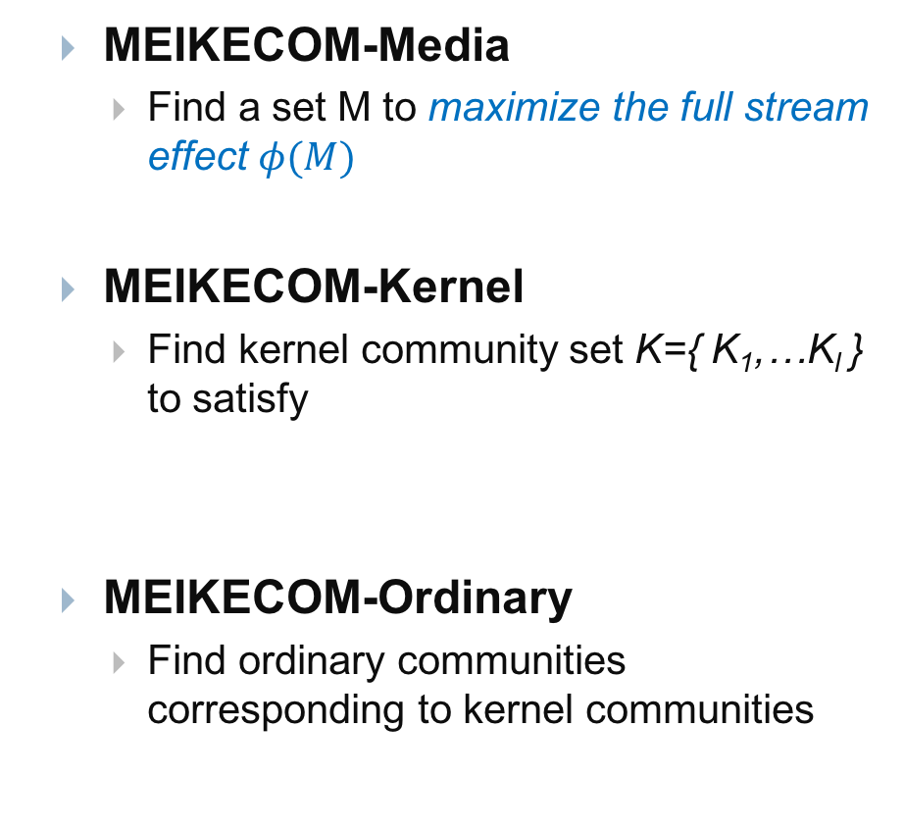
Problem Formulation
MEIKECOM: MEdIa and KErnel COMmunity detection
MEIKECOM-Media
Find a set M to maximize the full stream effect $φ(M)$
MEIKECOM-Kernel
Find kernel community set K={ K₁,…K_{l} } to satisfy
MEIKECOM-Ordinary
Find ordinary communities corresponding to kernel communities
Media nodes
Ordinary communities
Kernel communities
PK1
PK2
Zhang, Adhikari, Jan and Prakash, SDM 2017

Slide 14
Hardness of MEIKECOM
Media nodes
MEIKECOM-Media
MEIKECOM-Kernel
NP-hard
Reduce from the MAX-CLIQUE problem
Neither submodular, nor supermodular
Ordinary communities
Kernel communities
NP-hard
(Down-stream effect)
#P-hard
(Up-stream effect)
Zhang, Adhikari, Jan and Prakash, SDM 2017

Slide 15
Outline
Motivation
Problem Definition
Our Proposed Methods
Experiments
Conclusion
Zhang, Adhikari, Jan and Prakash, SDM 2017

Slide 16
Proposed Methods: MEIKE
Overview
Step 1 (MEIKE-Media): Find media nodes
Merge-based approach
Step 2 (MEIKE-Kernel): Find kernel communities
Iterative approach
Step 3 (MEIKE-Ordinary): Find ordinary communities
Zhang, Adhikari, Jan and Prakash, SDM 2017
Notes:
Leverage the idea

Slide 17
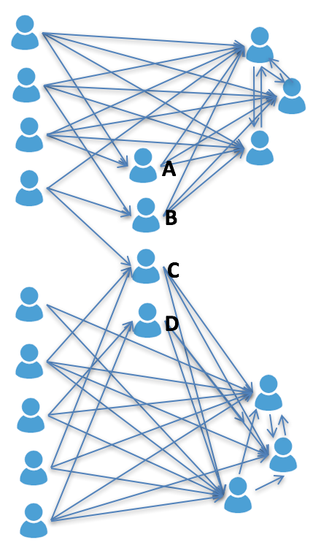
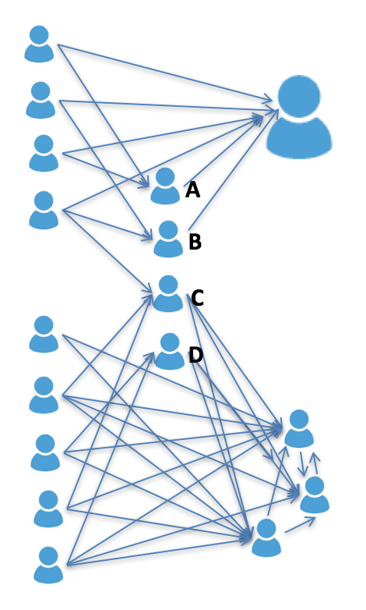
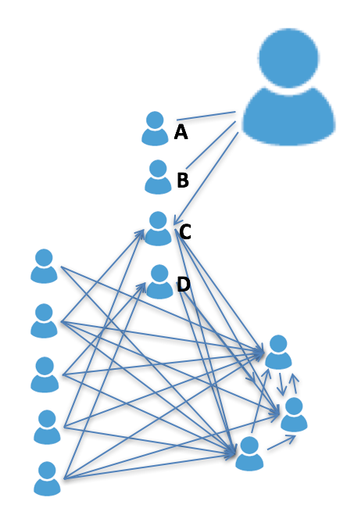
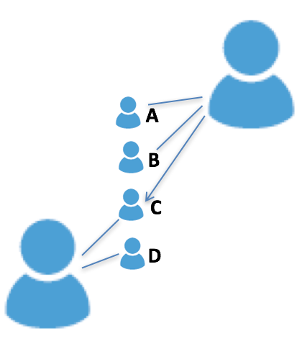
Step 1: MEIKE-Media
A Merge-based approach
merge unimportant edges (node pairs) to full stream effects successively
maintain the overall full stream effect
nodes that remain unmerged (the “singleton” nodes) are ones with highest full stream effect
Media nodes (unmerged)
Merged node
Merged node
Merging
Merging
Merging
Merged Graph
Zhang, Adhikari, Jan and Prakash, SDM 2017
Notes:
Emphasize “unmerged”

Slide 18
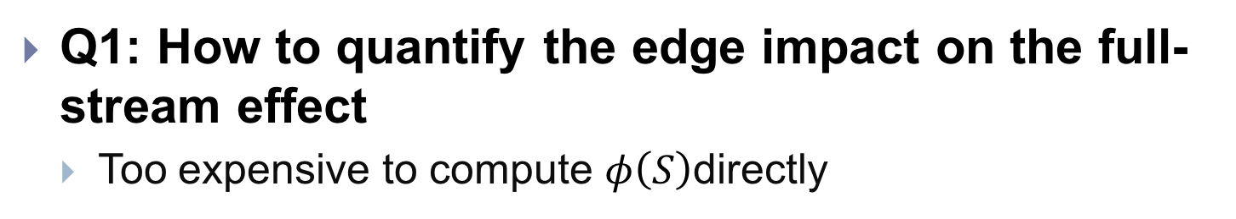
Step 1: MEIKE-Media
Q1: How to quantify the edge impact on the full-stream effect
Too expensive to compute $φ\left(S\right)$directly
Full stream effect
Downstream effect
Upstream effect
Zhang, Adhikari, Jan and Prakash, SDM 2017

Slide 19

Step 1: MEIKE-Media
Q1: How to quantify the edge impact on the full-stream effect
Too expensive to compute $φ\left(S\right)$directly
We use local effect instead
w_{ab}
Local effect φ_{b}(a) can be computed in constant time
a
b
We prove that φ_{b}(a)∝ u_{a} w_{ab}, where u_{a} is the eigenscore of node a
φ_{b}(a): Local effect of edge (a,b) on φ(a), i.e., contribution of edge (a,b) towards φ(a),
u_{a}
A
u
u
= λ₁ .
See paper for details
Zhang, Adhikari, Jan and Prakash, SDM 2017
Notes:
Once the eigenvalue is computed, it is constant time

Slide 20
Step 1: MEIKE-Media
Q2: How to maintain the overall full-stream effect based on local effects
Create a new graph G’ with the edge weight u_{a} w_{ab}
G’ shows contributions of full stream effects on edges
Leverage the idea from CoarseNet [Purohit+, KDD2014], preserve the first eigenvalue λ₁ of the new graph G’ , when merging edges in G’
φ_{b}(a)∝ u_{a} w_{ab}
u_{a} w_{ab}
w_{ab}
a
b
a
b
Original Graph G
New Graph G’
Zhang, Adhikari, Jan and Prakash, SDM 2017
Notes:
For ease of analysis

Slide 21
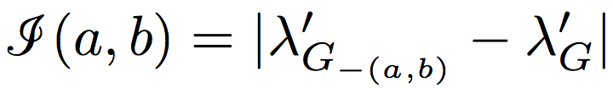

Step 1: MEIKE-Media
See paper for details
Q3: How to merge to maintain the first eigenvalue of G’
Merge edges with the smallest change of λ₁
Following the merge definition from CoarseNet
Define the change of λ₁ after merging edge (a,b) on G’:
Compute directly for all edges is expensive
Time complexity: O(|E|(|V|+|E|))
We use the matrix perturbation theory up to the first-order approximation to compute
Time complexity: linear for all edges
Merge (a,b)
a
b
c
d
c
Zhang, Adhikari, Jan and Prakash, SDM 2017

Slide 22
Step 1: Running Time
Time Complexity
O(|E|log|E|+D(|V|-m)), subquadratic
D: maximum degree; m: number of media nodes
Media nodes (unmerged)
Merged node
Merged node
Merging
Merging
Merging
Zhang, Adhikari, Jan and Prakash, SDM 2017

Slide 23
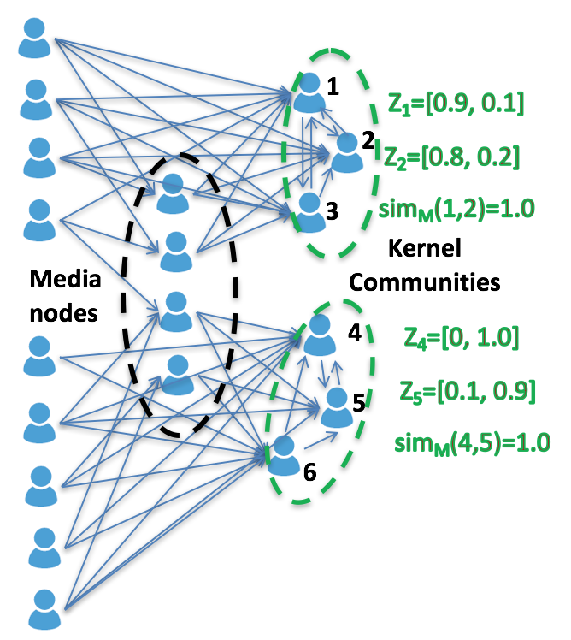
Step 2: MEIKE-Kernel
See paper for details
Reformulate MEIKECOM-Kernel problem using vector representations for each node
Main idea:
Each node u has a vector z_{u} representing the importance to each kernel community
Iterative heuristic algorithm
Pairwise relaxation
Change z_{u} iteratively to increase the objective function
Guarantee to converge
Running time: linear for each iteration
Zhang, Adhikari, Jan and Prakash, SDM 2017
Notes:
Briefly introduce kernel

Slide 24
Outline
Motivation
Problem Definition
Our Proposed Methods
Experiments
Conclusion
Zhang, Adhikari, Jan and Prakash, SDM 2017

Slide 25
Datasets
Datasets | Domain | #Nodes | #Edges
Enron | Emails | 156 | 2,061
MemeTracker | Cascades | 851 | 5,000
Citation | Citation | 8,046 | 18,322
Google+ | Social Media | 107K | 14M
Twitter | Social Media | 456K | 8M
Coauthor | Coauthors | 0.8M | 2M
Coauthor has the ground-truth
Media nodes: researchers who have publications in at least three areas
Kernel communities: PC members in five research areas
Zhang, Adhikari, Jan and Prakash, SDM 2017

Slide 26
Baselines
Media nodes
PMIA: maximize downstream effect
NETSHIELD: maximize upstream effect
HIS and MAXD: role discovery algorithms
BIGCLAM and CLIQUE: overlaps of communities
Kernel communities
NEWMAN, LOUVAIN, D-LOUVAIN and P-LOUVAIN: popular community detection algorithms
WEBA: celebrity based community detection algorithm
BIGCLAM and CLIQUE: overlapping community detection
Zhang, Adhikari, Jan and Prakash, SDM 2017
Notes:
Media nodes covers multiple areas Make sense

Slide 27
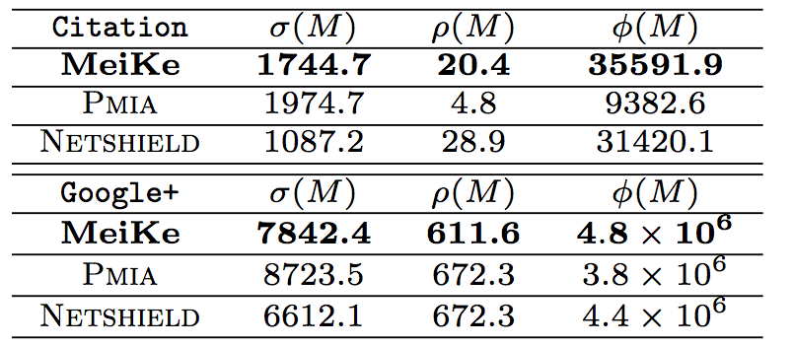
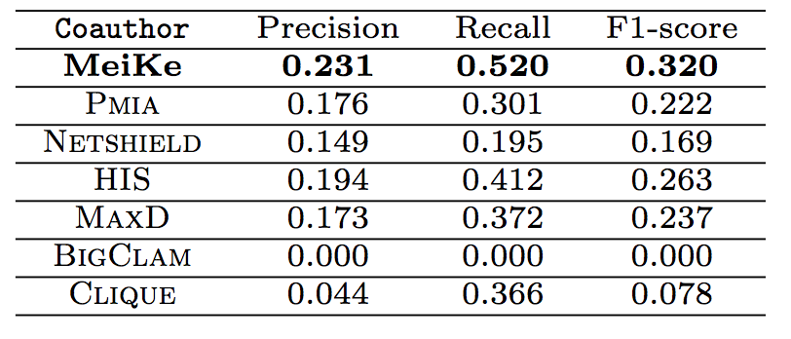
Performance of MEIKE-Media
Quality for full stream effects
Quality compared to the ground truth on Coauthor
MEIKE has the best results for full-stream effects.
MEIKE outperforms baselines like community based and role based approaches.
Zhang, Adhikari, Jan and Prakash, SDM 2017
Notes:
Explain\phi(M) really solves the problem; good for max. \phi(M)

Slide 28
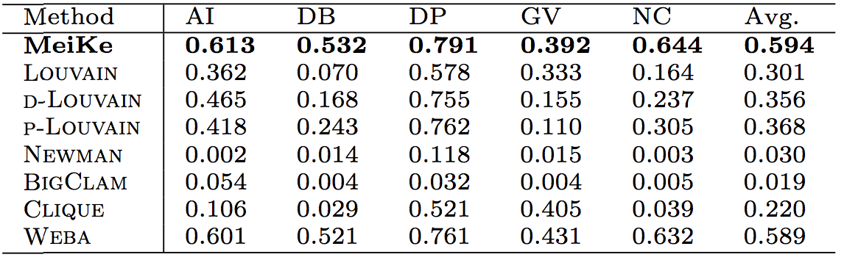
Performance of MEIKE-Kernel
Quality (F1-score) of kernel communities compared to other competitors on Coauthor.
MEIKE outperforms other community detection algorithms
Zhang, Adhikari, Jan and Prakash, SDM 2017

Slide 29
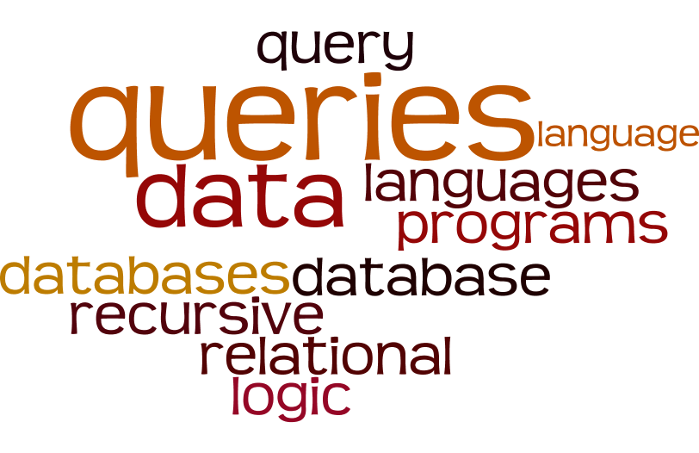
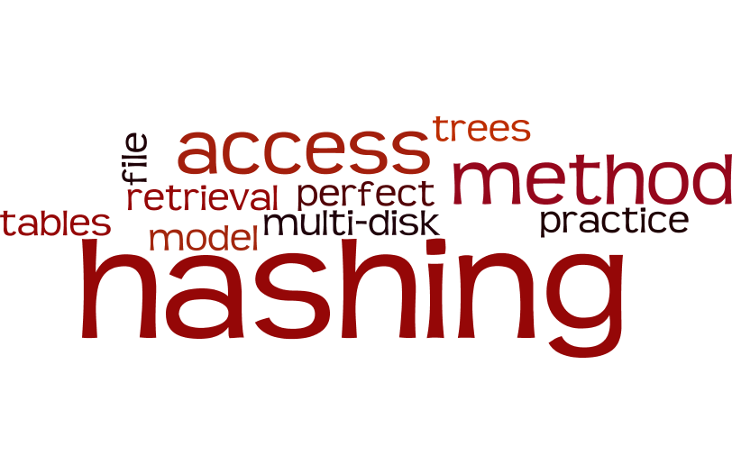
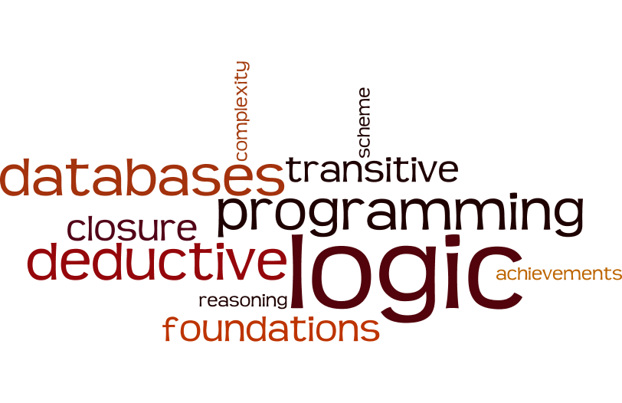
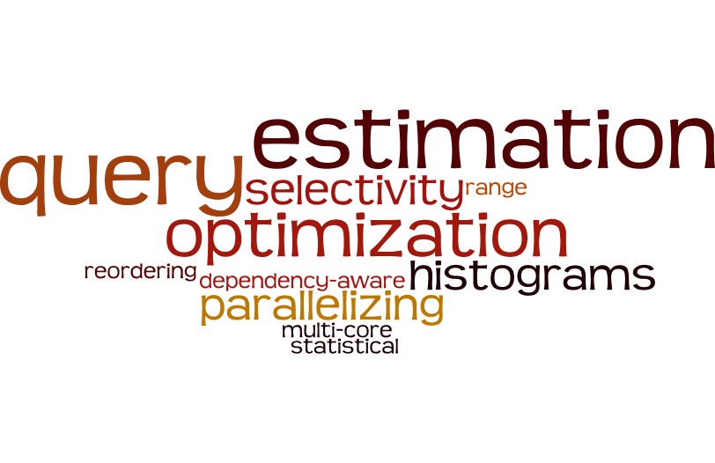
Case Studies
See more in the paper
Kernel Communities
Media nodes
propagate topics
survey existing methods
asking important open questions.
E.g., Cafarella et. al. ”Data management projects at Google”. SIGMOD2008.
cite popular projects such as Map-Reduce and GFS
K1:queries
K2: hashing
K3: logic
K4: optimization
Case study on a citation network (database area)
MEIKE finds interesting kernel communities, and intuitive and useful media nodes
Zhang, Adhikari, Jan and Prakash, SDM 2017

Slide 30
Outline
Motivation
Problem Definition
Our Proposed Methods
Experiments
Conclusion
Zhang, Adhikari, Jan and Prakash, SDM 2017

Slide 31
Conclusion
Intuitive Novel Problem: MEIKECOM
Media nodes
Get influenced + influence others
Kernel communities
Group of Celebrities
Ordinary communities
Corresponding to a kernel community
Effective and Efficient Methods
MEIKECOM-Media
Merge based approach
MEIKECOM-Kernel
Iterative pairwise relaxation approach
Experiments
Intuitive and interesting media nodes and kernel communities
Media nodes
Ordinary communities
Kernel communities
Zhang, Adhikari, Jan and Prakash, SDM 2017
Notes:
Different from standard community detection methods, ….

Slide 32



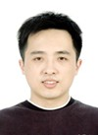
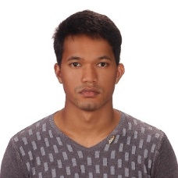
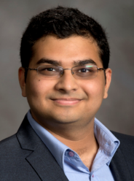
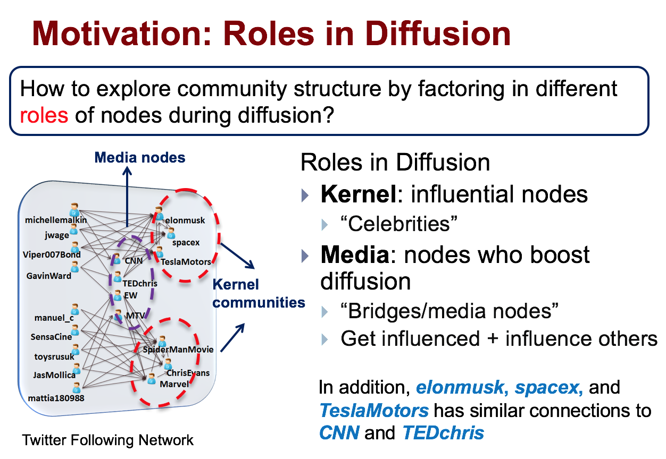
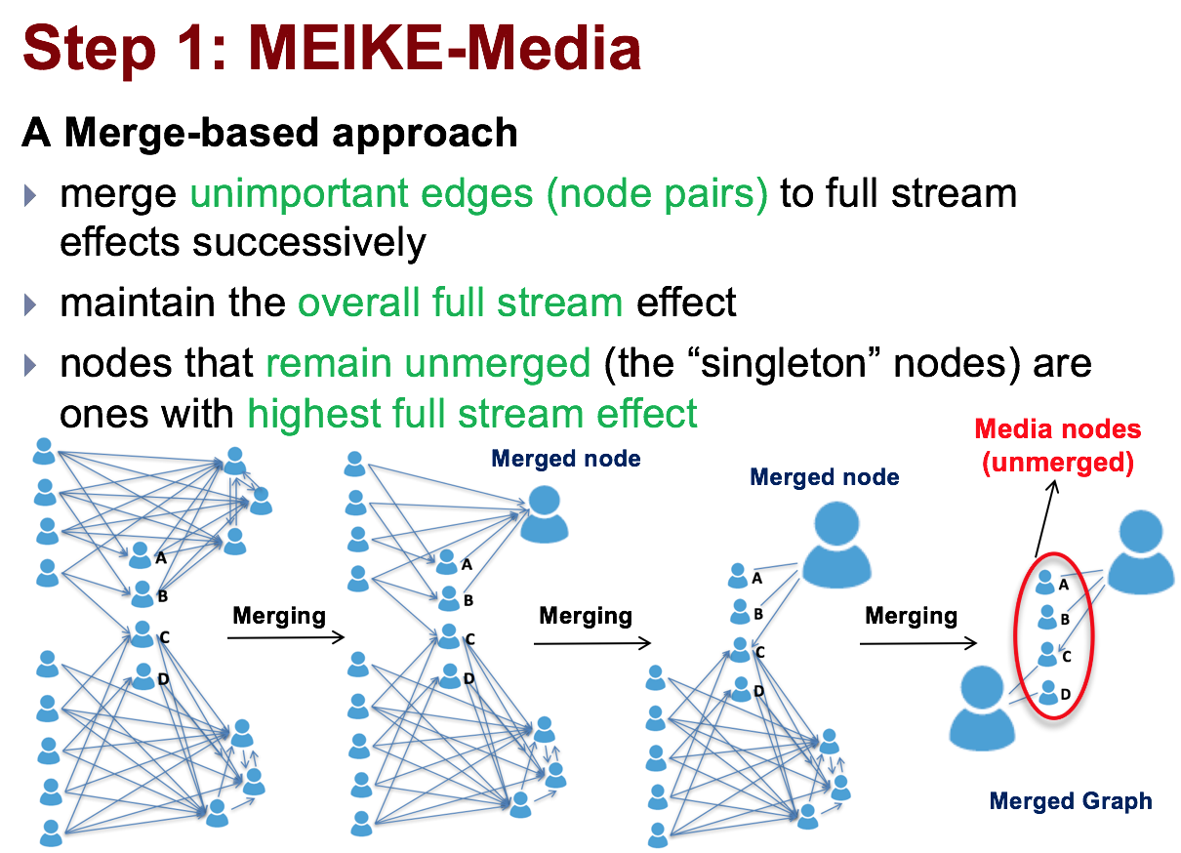
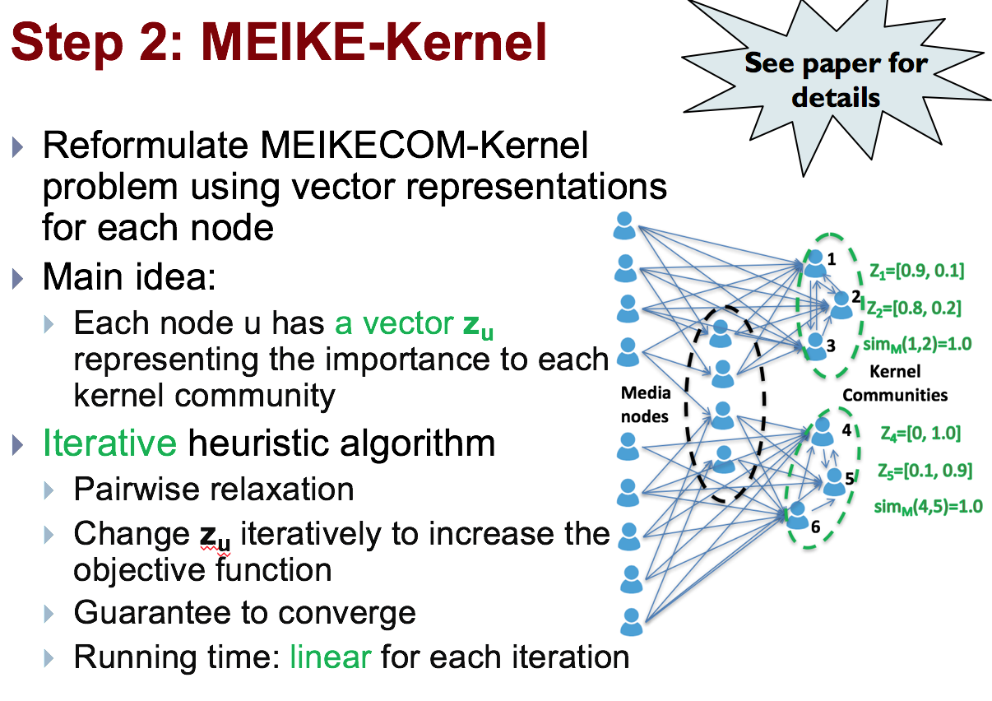
Thank you!
Funding:
Code at:
http://people.cs.vt.edu/~yaozhang
Zhang, Adhikari, Jan and Prakash, SDM 2017

