Slide 1


Tempus: Managing the energy-delay trade-off in mobile apps
Nima Nikzad†, Marjan Radi*, Octav Chipara*, and William G. Griswold†
*
†

Slide 2
Continuously Running Mobile Applications
Mobile phones run many CRM apps in the background
  account for 30% of energy consumption on mobile platforms
  impact will increase as context-aware apps become prevalent
Characteristics of CRM workloads
  most operations are delay-tolerant
  controlling the timing of operations can save significant energy
  … but introducing too much delay hurts user experience
How can we manage the
energy-delay tradeoff?
Notes:
Mobile phones are increasingly running applications in the background to synchronize with remote server, receive notifications from your favorite social networking platform, or make sense of the context in which it operates. In the aggregate, background applications account for 30% of the energy consumed on a mobile phone. We expect that this number to increase as we develop more context-aware applications.
Therefore, a key challenge is to reduce the energy foot print of background applications. We will address this challenge by taking advantage of their unique properties. First, most of the operations of these application are delay tolerant. For example, it is usually okay to delay synchronizing your email by say five minutes to save additional energy. Second, controlling when operations has the potential of significantly reducing energy consumption. However, delays cannot be introduced in a naïve manner as they will negatively impact user experience.
Thus, we have a trade-off between delay and energy and the question I will address in this presentation is how we can manage it effectively.

Slide 3
Approaches to Power Management
Low-level optimizations
  DVFS, tickless kernels, or intelligent flash storage
  limited knowledge of the application limits their applicability
Application-level optimizations
  workload shaping: delaying, batching, or merging
  take advantage of application-specific workloads
Notes:
Traditionally, power management approaches can be broadly classified as low-level optimizations and application-level optimizations. Low-level optimization include different techniques such DVFS or tickless kernels that provide OS level mechanisms for energy efficiency. These techniques excel at optimizing performance on short-time scales. Without visibility in the long-term term behavior of an applications, these low-level techniques cannot optimize long-term performance as well. Application-level power management take advantage of the application-specific power management to improve energy efficiency. These techniques typically include workload shaping, filtering, or piggybacking.
We will focus on application-level power management since we are interested in leveraging the user’s understand of how time-sensitive the operations of an application are in order to save energy.

Slide 4
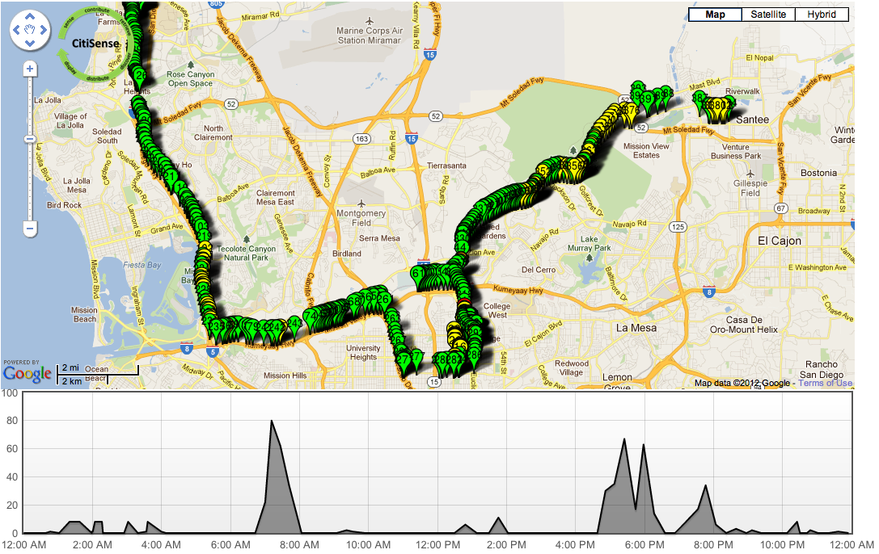
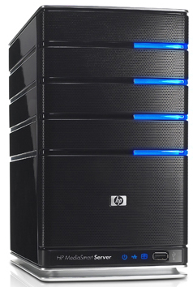

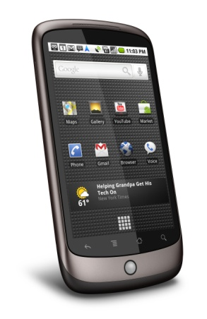
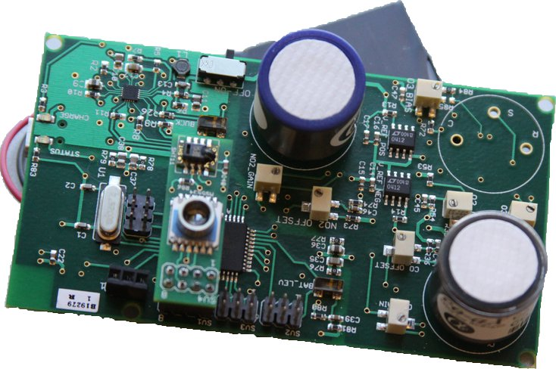
CitiSense Application
Alerts, Maps
CO, NO₂, O₃
Notes:
To better understand the problem and the associated challenges, let us consider a typical background application that collects personalized pollution data. A user carries around Bluetooth sensor and uploads the readings that are collected along with GPS coordinates to a server. The server periodically produces personalized pollution data by aggregating data from multiple users. Significant energy may be saved by controlling when data is uploaded to the server.

Slide 5


Annotations for Power Management
Sensing
Uploading
Shared Queue
while (true):
SensorReading r = Sensor.read();
if (r.getValue() > EXPOSURE):
reading.setUrgent(true);
else:
reading.setUrgent(false);
queue.put(reading)
while(true):
SensorReading m = queue.take();
upload(m);
  @Wait(UpTo=”20min”,
  For="Network.Active”)
6s
6s
12 s
12 s
Power
Power
t
t
Notes:
This is a bit of abstract, so lets try to make it concrete. Under the hood, CS has two threads: one that collects data from the sensor over BT, the other that uploads the data over 3G to the sever. To introduce power management, we can add a wait annotation to the upload function that controls when packets are transmitted. The more interesting problem is how to make this annotation context sensitive. We observed that the annotation may delay the operation of the object m that aliases to the sensor reading that we are obtaining. Accordingly, what we could do is to annotate the object containing the sensor reading with different budgets depending on whether or not it is critical. So, the amount of time that we will wait is actually the minimum of the time budgets of the specified objects and the 20minutes constrain specified in the annotation.

Slide 6
Situational Power Management Decisions
Sensing
Uploading
Shared Queue
while (true):
SensorReading r = Sensor.read();
if (r.getValue() < EXPOSURE):
r.setUrgent(false);
else:
r.setUrgent(true);
queue.put(r)
while(true):
SensorReading m = queue.take();
upload(m)
  @Wait(UpTo=”20min”,
  For="Network.Active”)
  @DelayBudget(”10min”, reading)
  @DelayBudget(”0min”, reading)
Default scope: {m, r}
  An operation may never be delayed more than the budget of any object it impacts
Notes:
This is a bit of abstract, so lets try to make it concrete. Under the hood, CS has two threads: one that collects data from the sensor over BT, the other that uploads the data over 3G to the sever. To introduce power management, we can add a wait annotation to the upload function that controls when packets are transmitted. The more interesting problem is how to make this annotation context sensitive. We observed that the annotation may delay the operation of the object m that aliases to the sensor reading that we are obtaining. Accordingly, what we could do is to annotate the object containing the sensor reading with different budgets depending on whether or not it is critical. So, the amount of time that we will wait is actually the minimum of the time budgets of the specified objects and the 20minutes constrain specified in the annotation.

Slide 7
Semantics of Delay Budgets
Sensing
r₁
r₃
Uploading
r₂
while (true):
SensorReading r = Sensor.read();
if (r.getValue() < EXPOSURE):
r.setUrgent(false);
else:
r.setUrgent(true);
queue.put(r)
while(true):
SensorReading m = queue.take();
upload(m);
  @Wait(UpTo=”20min”,
  For="Network.Active”)
  @DelayBudget(”10min”, reading)
  @DelayBudget(”0min”, reading)
r₁
r₂
r₃
Budget
Delaying operation
Resume operation
r₄
Notes:
This is a bit of abstract, so lets try to make it concrete. Under the hood, CS has two threads: one that collects data from the sensor over BT, the other that uploads the data over 3G to the sever. To introduce power management, we can add a wait annotation to the upload function that controls when packets are transmitted. The more interesting problem is how to make this annotation context sensitive. We observed that the annotation may delay the operation of the object m that aliases to the sensor reading that we are obtaining. Accordingly, what we could do is to annotate the object containing the sensor reading with different budgets depending on whether or not it is critical. So, the amount of time that we will wait is actually the minimum of the time budgets of the specified objects and the 20minutes constrain specified in the annotation.

Slide 8
Design of Tempus
How is power management code best introduced in apps?
  “Wait until before executing ”
  eliminates manually written power management code
How do we make situational power management decisions?
  data-centric approach: associate budgets with objects
  differentiated behavior over execution paths
How do we manage the passage of time?
  the budget of an object is reduced only in @Wait annotations
  shifts focus away from estimating operation delays
Notes:
Tempus builds on three key design decisions.
First, power management code is introduced via annotations. A power annotations defers the execution of a code block until a precondition holds. Preconditions are related to the state of the hardware. For example, the example annotation defers the execution of the annotated example until either (1) the network becomes active or (2) a timeout of 10 mins occurs.
Second, we make power management decisions situational by associating budgets with time-sensitive objects. A power management annotation will consume the delays of objects in its context. If the budget of any object in the scope becomes zero, the operation is resumed.
Finally, we need to decided how we manage the passing of time. An obvious choice would be to adopt real-time semantics according to which budgets are relative deadlines specifying by when operation should be completed and time passes according to the wall-clock. Unfortunately, real-time semantics would focus our attention on trying to predict how long operations such as uploadReport would take. The total delay of uploadReport is subject to significant variability as it depends on many factors including availability of a connec- tion, link quality, and congestion level. An alternative is to observe that the total latency of the operation includes the time spent saving energy and the operation’s time.

Slide 9
Static Analysis
Goal: Identify the objects that may be delayed by @Wait
Challenge: Handle concurrency in Android apps
Approach:
  construct a CFG representing the app using FlowDroid
  impacted by @Wait
    forward propagation of @Wait labels
  time sensitive variables
    directly annotated with @DelayBudget
    aliased to a @DelayBudget variable
  default scope: all time sensitive variables present at a labeled program point

Slide 10
CitiSense Example
Sensing
Uploading
while (true):
SensorReading r = Sensor.read();
if (r.getValue() > EXPOSURE):
r.setUrgent(true);
else:
r.setUrgent(false);
queue.put(reading)
while(true):
SensorReading m = queue.take();
upload(m);
w
  @Wait(UpTo=”20min”,
  For="Network.Active”)
  @DelayBudget(”0min”, reading)
w
may alias
  @DelayBudget(”10min”, reading)
Scope of the @Wait includes object r that is time-sensitive

Slide 11
Tempus Middleware
Coordinates the execution of multiple applications
Each @Wait annotation is transformed into a TempusLock
  power control + concurrency management
  a thread calling wait() on power lock will block until
    the phone enters the desired hardware state
    the budget of one of the objects in scope becomes zero
  (object, budgets) stored as a hash table of weak refs
Handles concurrent access to time-sensitive objects

Slide 12

NPR News Experiment
Policies implemented with Tempus
  on demand: downloads images when needed
  light prefetch: downloads batches of 3 images every 2 mins
  medium prefetch: download batches of 6 images every 2 mins
  full prefetch: fetches all images when the application is started
Data collected from 5 users
Piggy-backing opportunities every 3 mins

Slide 13
NPR News: Energy-Delay Tradeoff
Four annotations used to express each policy
A wide range of performance trade-offs

Slide 14
Conclusions
Tempus – effectively manages the energy-delay tradeoff
  a small yet effective annotation language
  static analysis for simplifying the use of the language
  middleware service to coordinate applications
Case studies and real-world experiments
  the flexibility and expressiveness of the language
  the range of energy-delay trade-offs
Future work
  tools to explore the trade-offs between energy and delay
  interactive synthesis of power management code

Slide 15




Acknowledgements
This work was supported by the National Science Foundation and the Roy J. Carver Charitable Trust
Nima Nikzad
Scripps Translational Science Institute
Marjan Radi
U of Iowa
Octav Chipara
U of Iowa
William Griswold
UCSD

Slide 16
Overhead
CitiSense: 1 object tracked
NPR news: 20 objects tracked

Slide 17
Tempus Annotations
Budget management
  @DelayBudget(o, b): object o is time sensitive with budget b
  @ClearBudget(o): object o is no longer time sensitive
  provides explicit control over the life-cycle of the object
Power annotations
  @Wait(UpTo=T, For=E): delays exec. up to T or power state E
  a @Wait has a default scope that the includes objects it impacts
  the default scope is determined by static analysis
Controlling the scope
  @Namespace(o, ns): add object o to namespace ns
  @ClearNamespace(o, ns): remove object o from namespace ns

Slide 18
Situational Power Management Decisions
Sensing
r₂
r₃
Uploading
r₁
r₄
Shared Queue
while (true):
SensorReading r = Sensor.read();
if (r.getValue() < EXPOSURE):
r.setUrgent(false);
else:
r.setUrgent(true);
queue.put(r)
while(true):
SensorReading m = queue.take();
upload(m);
  @Wait(UpTo=”20min”,
  For="Network.Active”)
  @DelayBudget(”10min”, reading)
  @DelayBudget(”0min”, reading)
Annotation scope:
variables: m/r
objects:
r₁, r₂,r₃,r₄, …
Notes:
This is a bit of abstract, so lets try to make it concrete. Under the hood, CS has two threads: one that collects data from the sensor over BT, the other that uploads the data over 3G to the sever. To introduce power management, we can add a wait annotation to the upload function that controls when packets are transmitted. The more interesting problem is how to make this annotation context sensitive. We observed that the annotation may delay the operation of the object m that aliases to the sensor reading that we are obtaining. Accordingly, what we could do is to annotate the object containing the sensor reading with different budgets depending on whether or not it is critical. So, the amount of time that we will wait is actually the minimum of the time budgets of the specified objects and the 20minutes constrain specified in the annotation.

Slide 19
Problem Formulation
Goal: Reduce the energy consumption of CRM
Workload insights:
  most operations are delay-tolerant
  controlling the timing of operations can save significant energy
  … but introducing too much delay hurts user experience
  ... and delays must be introduced in a contextual manner
Challenges:
  How is power management code best introduced in apps?
  How do we make situational power management decisions?
  How do we manage the passage of time?

