Slide 1
Measuring Hearing Aid Performance Using Mobile Phones
Octav Chipara
Department of Computer Science
Notes:
-My name is Ryan Brummet and I’m a third year ph.d student at the university of iowa.
-Today I’m going to be presenting my team’s most recent work with the mobile phone app AudioSense and our exciting results regarding identification and prediction of unsuccessful HA users.
-Before beginning I would like to briefly acknowledge the other members of our team.
-Shabih Hasan is a fourth year ph.d student and besides myself one of the main contributors to the work I will be presenting
-Professor Octav Chipara is Shabih’s and my academic advisor and both supervised and contributed significantly to this project
-Professor Tianbao Yang provided machine learning advice.
-And finally I would like to acknowledge Dr. Wu, our audiology collaborator, whose expertise made our project possible.

Slide 2
Hearing Loss in the United States
11.3% of Americans are affected by hearing loss
  left untreated, hearing loss can lead to depression, anxiety, and isolation
Hearing Aids (HAs) are the primary treatment for sensorineural hearing loss
  as many as 50% of HA users do not use their HAs
  of those that do, 40% are unsatisfied.
HA satisfaction has been shown to be correlated with use and effectiveness
Need to understand why users are dissatisfied
Notes:
Sensorineural hearing loss (SNHL) is a type of hearing loss, or deafness, in which the root cause lies in the inner ear (cochlear), vestibulocochlear nerve (cranial nerve 8), or central processing centers of the brain.
Sensorineural hearing loss can be mild, moderate, severe, profound, or total. All subjects from our study have mild to moderate hearing loss
Approximately 90% have sensorineural hearing loss.
It’s not clear what the causes of patient dissatisfaction are.

Slide 3
Assessment Approaches
Laboratory
Real-world

Slide 4
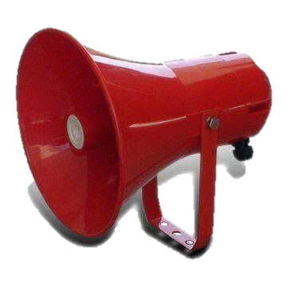

Impact of Visual Queues
Laboratory
Noise
Speech
Real-world
Noise
Speech

Slide 5
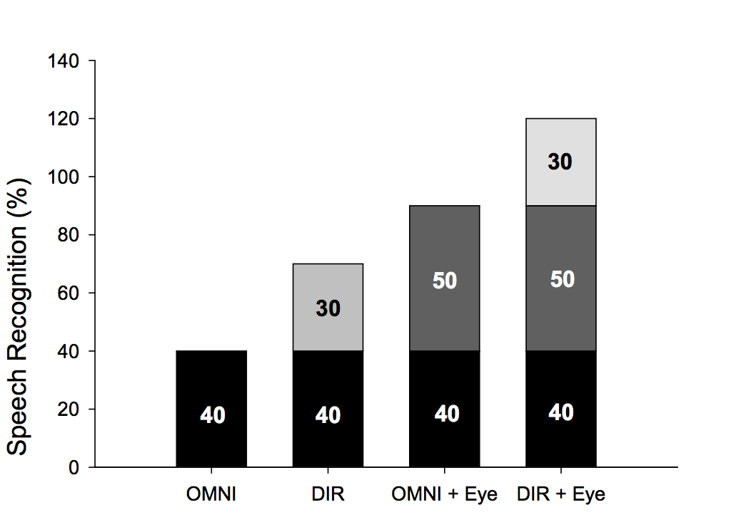
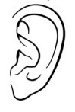
Visual Cues and DIR Benefit
DIR benefit with visual cues
DIR benefit without visual cues
Ceiling

Slide 6
Attempts at capturing context
“You are seated in the middle of a large, crowded, noisy cafeteria or dining hall having lunch and are conversing with the person seated directly across the table from you. There are the sounds of many people talking at tables all around you, trays, dishes, and cutlery clattering, etc.”
Cord et al., 2002, JAAA

Slide 7
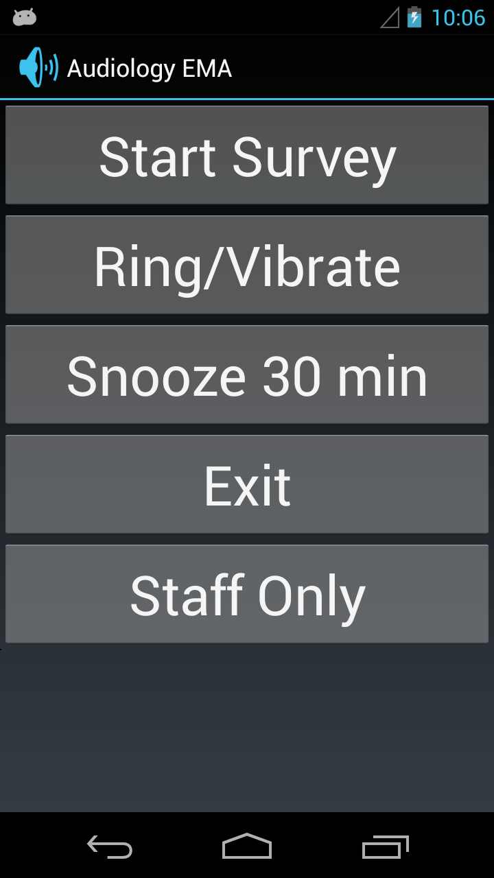
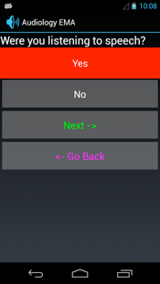
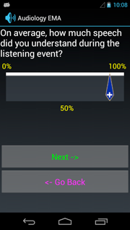
AudioSense
AudioSense – Ecological Momentary Assessment
  characterizes context + hearing aid performance
  done in the real-world => more accurate contextual information
  done in the moment => less recall bias
Combines user-initiated and time-initiated surveys
Notes:
In previous work we introduced AudioSense as an alternative to current methods of reducing recall bias and collecting audio context information such as Lab Simulation, Paper Surveys, and Diary Methods
Lab Simulation has been the historical approach of audiologists. Scales well, but may not accurately reproduce the real world.
Surveys and Diary Methods are collected in the real world. However, they don’t scale well and don’t offer any control to researchers. I.e. do we know that it is our subjects that are filling out the surveys? Are subjects filling out surveys when they say they are?
CBMS: Computer Based Medical Systems

Slide 8


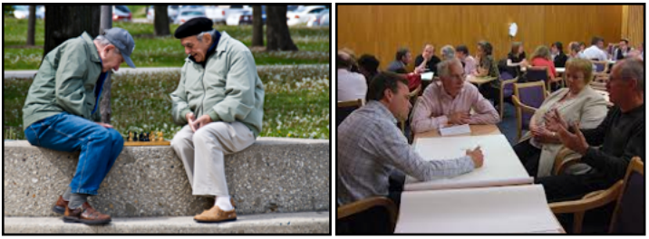
Auditory Context and Measurement
How satisfied were you with your HA?
Acoustic Environment
How noisy was it?
Social Interaction
Could you see the talker’s face?
Were you inside or outside?
Activity
How much effort was required to listen?
Notes:
Using AudioSense, we are able to information about 3 categories of Auditory Context.
This includes information such as
whether a patient could see a talker’s face
How many people he/she was talking to
What he/she was doing? Were they watching T.V. Are they even actively listening?
Were they inside or outside?
How noisy was it?
Switch slides 6 and 7. add HA measurements scores to slide 5 (this way context and scores are briefly outlined in same slide)

Slide 9
Remainder of the Talk
What is the auditory lifestyle of a subject?
  clinicians may prescribe hearing aids that better meet the subject’s demands
Can we predict if a new HA user will be successful with data collected via AuioSense?
  clinicians can take additional steps in the case that an user is predicted to be unsuccessful
Notes:
As stated before, our primary goal is to understand why HA users are dissatisfied and ultimately what causes HA treatment to be unsuccessful
A good starting point to begin tackling this problem is to determine whether data we collect can be used to determine if a patient will be a successful HA user or not.
In particular, we identify two questions audiologists are interested in.
Can we predict if a new HA user will be successful?
If a current HA user changes his/her HA, can we predict if they will be successful?

Slide 10
Study design
55 patients were evaluated using 4 different HAs
  two different HAs with two program settings
5671 surveys collected in total
  patients wore each HA one month before evaluating the HA for one week using AudioSense
  we refer to each HA and patient combination as a condition for a total of 136 conditions
Collect QuickSIN and PTA information (Lab Scores) during the enrollment process
Largest study to use computerized EMA within Audiology
Notes:
Do not talk about SNR and PTA. Just say they are standard hearing assessment scores. If you would like more information I would direct you to our paper.
Signal to noise Ratio (SNR) is measured by requiring patients to repeat sentences in increasingly noisy environments
Pure Tone audiometry (PTA) is measured by presenting pure tones at various frequencies and amplitudes
- To the best of our knowledge our study is the largest study within Audiology to use computerized EMA.

Slide 11
Activity context distribution
Most of the time spent in conversations or listening to media
Significant variation in auditory lifestyles

Slide 12
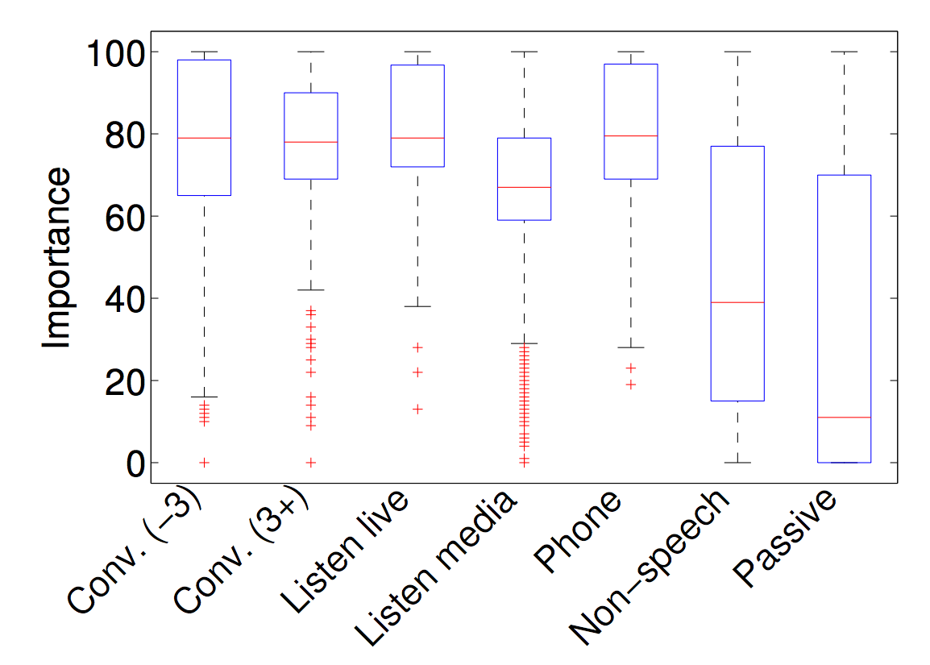
Importance of activity context
High importance to listening well in socially engaging activities
Relatively lower importance to passive listening activities
Listening to media
Passive listening
Listening to live events
Talking on the phone
Non speech listening
Conversation (up to 3 people)
Conversation (more than3 people)
Notes:
While analyzing contexts, we tried to gain insight into the importance of various activity and location types. we see that high importance is associated conversations and talking on the phone and lower with media and passive listening. This seems logical as the high importance activities require higher levels of social engagement.

Slide 13
Remainder of the Talk
What is the auditory lifestyle of a subject?
  clinicians may prescribe hearing aids that better meet the subject’s demands
Can we predict if a new HA user will be successful with data collected via AuioSense?
  clinicians can take additional steps in the case that an user is predicted to be unsuccessful
Notes:
As stated before, our primary goal is to understand why HA users are dissatisfied and ultimately what causes HA treatment to be unsuccessful
A good starting point to begin tackling this problem is to determine whether data we collect can be used to determine if a patient will be a successful HA user or not.
In particular, we identify two questions audiologists are interested in.
Can we predict if a new HA user will be successful?
If a current HA user changes his/her HA, can we predict if they will be successful?

Slide 14
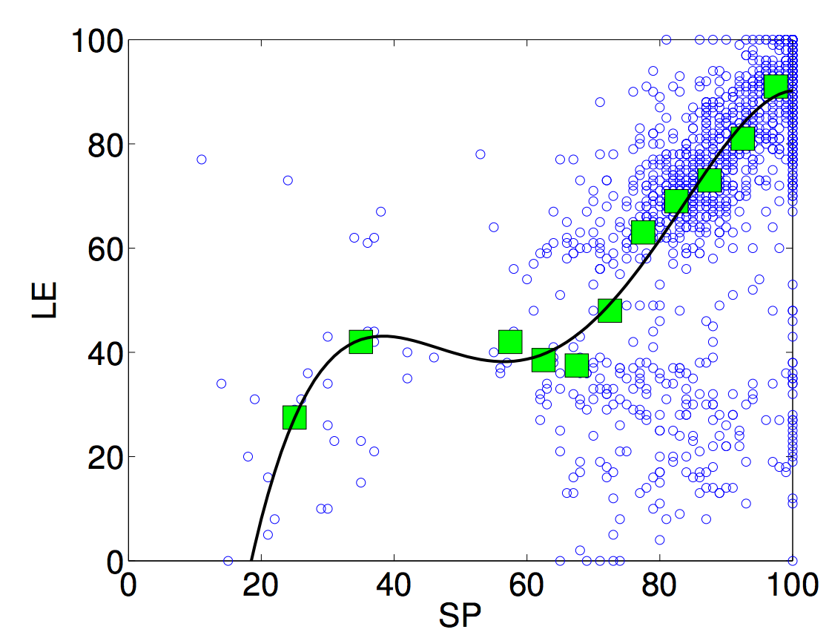
Combined score
Spearman’s Correlation
Highly correlated with aggregated ratings
ƒ_{LE}(SP)
 | SP | LE | ST | LCL | AP | CB
SP | 1.0 | 0.6 | 0.6 | 0.5 | 0.5 | 0.8
LE |  | 1.0 | 0.6 | 0.5 | 0.6 | 0.9
ST |  |  | 1.0 | 0.4 | 0.6 | 0.8
LCL |  |  |  | 1.0 | 0.3 | 0.5
AP |  |  |  |  | 1.0 | 0.8
CB |  |  |  |  |  | 1.0
Speech Perception (SP)
ƒ_{LE}
AVG
Listening Effort (LE)
HA Satisfaction (ST)
Combined Score (CB)
Sound Localization (LCL)
Activity Participation (AP)
Notes:
In order to measure a patient’s hearing ability in a given auditory context we ask patients to give ratings to various hearing related questions, on a 0-100 scale, such as
How much speech did you understand? (SP)
How much effort was required to listen? (LE)
How satisfied were you with your hearing aid? (ST)
Could you tell where the sounds were coming from? (LCL)
How has your hearing affected what you want to do? (AP)
To reduce noise and simplify prediction, we combined the highest correlated ratings to produce an aggregate socre
In particular, we built an aggregate score out of the four highest correlated ratings: SP, LE, ST, AP.
We then mapped three of these ratings onto the rating with the widest distribution, LE (better discrimination between outcome scores). This was done via a polynomial mapping.
These mapped ratings, along with LE, are then averaged to produce a single aggregate score which we call the Combined Score or CB
Notice that the combined score is highly correlated with the aggregated ratings, SP, LE, ST, and AP as desired.

Slide 15
Models and Features
Identify the best features for predicting success
Does model choice make a difference?
Features
Models
HA Score
HA Outcome
Lab Scores
Linear
Successful
Mean Predicted Combined Score
Patient ID
Linear Mixed
HA
Unsuccessful
Regression Trees
Audio Context
Only lab scores are continuous
Leave one out cross-validation
Predicted samples averaged
Comparison with threshold
Notes:
patientID may or may not be used based on whether we are predicting novel patient.
HA should always be used in every model
patientID and HA are random effects for the Linear Mixed model

Slide 16
Novel Patient
68% with only Lab Scores, Audio Context and HA
Lab Scores roughly equivalent to random chance
Including Auditory context improves accuracy over 10%
d:= Lab Scores
x:= Audio Context
Regression Trees
Linear
Linear Mixed
Notes:
Hold one patient out cross validation
Linear model and Linear mixed models are the same when looking at Lab Scores
We can predict whether a novel patient will be successful with 68% using the data we collected without collecting any information from a novel patient besides our Lab Scores and the HA they are using (assuming it’s one of the HAs used in our study)
Using only lab scores and the HA as predictors, are models had prediction accuracy roughly equivalent to random chance
INCLUDING AUDITORY CONTEXT INFORMATION FEATURES FROM OUR DATASET IMPROVES THE ACCURACY OF OUR MODELS BY OVER 10%
Audio Context is significant feature for the prediction of HA success. In addition, this result shows the clinical importance of collecting data from patients in-situ to predict HA success

Slide 17
Novel Patient With Some Data
Including 5% equates to ~2 samples
Equivalent to previous graph
Possible to predict HA success more efficiently than the current clinical approach with over 90% accuracy
d:= Lab Scores
x:= Audio Context
Regression Trees
Linear
Linear Mixed

Slide 18
Conclusion
AudioSense - a novel method of evaluating HA
  detailed description of auditory contexts
  higher temporal resolution than possible w/ manual methods
Models of HA performance
  auditory contexts significantly impact HA performance
  lab tests are not predictive of HA outcomes
  we can predict whether a Novel Patient will be a successful HA user with over 90% accuracy if we collect some information from them
Future work:
  reduce the effort of data collection by characterizing auditory contexts based on sound samples

Slide 19


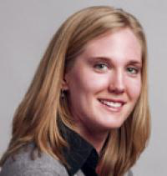


Acknowledgements
Collaborators:
Yu-Hsiang Wu
Communication Sciences and Disorders
Elizabeth Stangl
Communication Sciences and Disorders
Shabih Hassan
Computer Science
Ryan Brummet
Computer Science

Slide 20
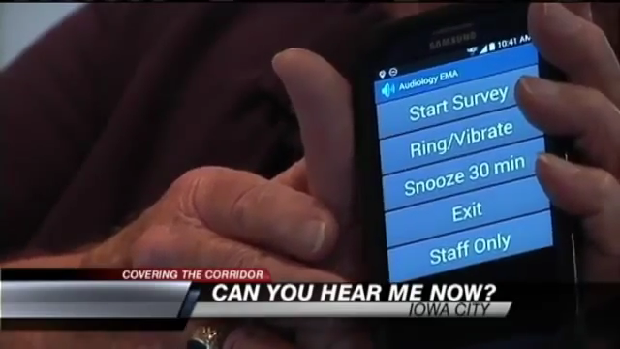
Our subjects

