Slide 1
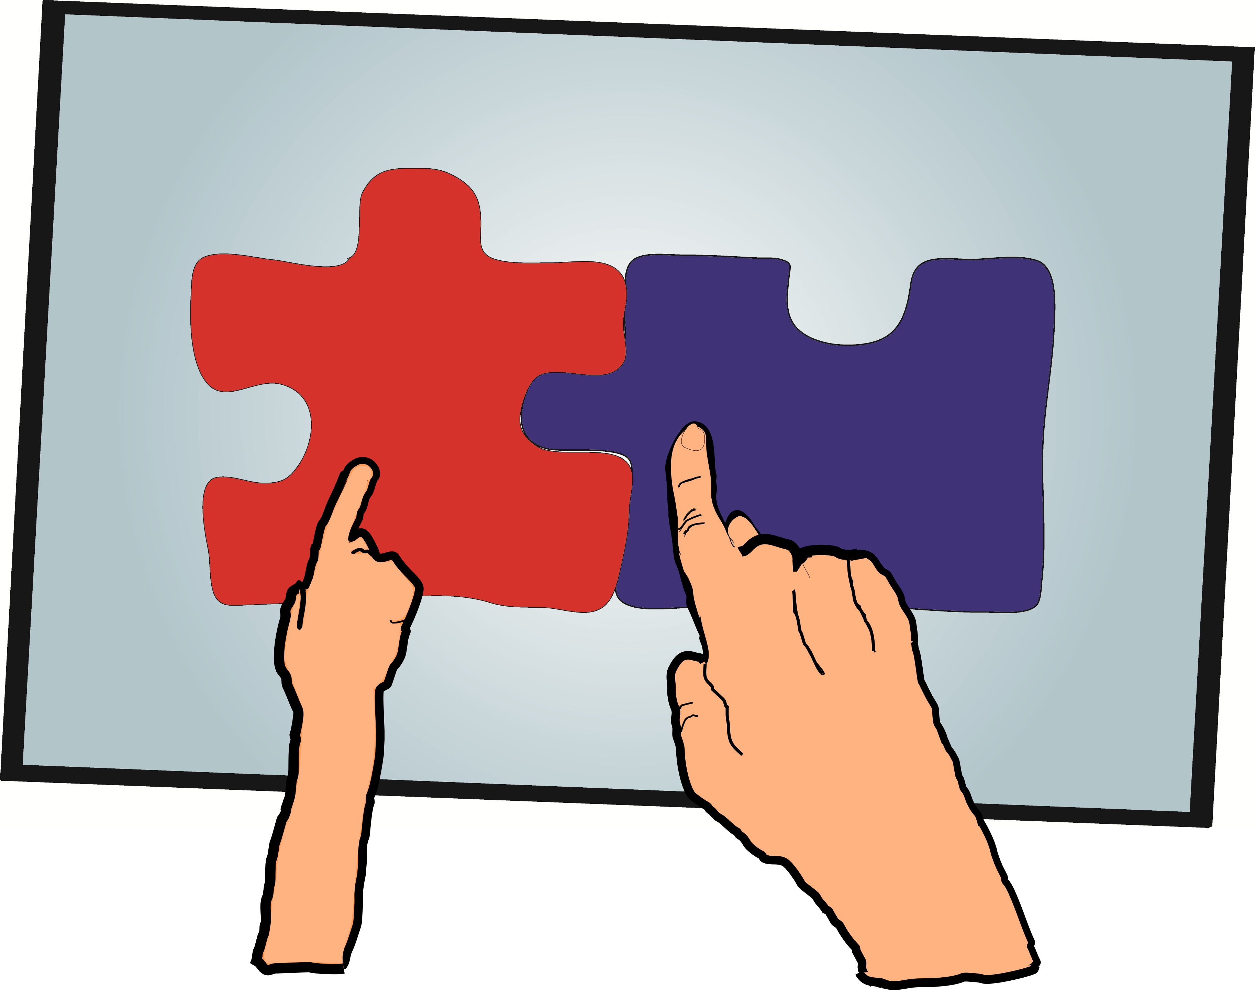
Improving the quality of communication and social interactions for children with Autism Spectrum Disorders through multi-touch tablet applications
Juan Pablo Hourcade, Natasha Bullock-Rest and Thomas Hansen
Department of Computer Science
University of Iowa

Slide 2
The challenges
Greater numbers of children diagnosed
Outcomes still poor for many
Engaging with all stakeholders
Lack of free, open resources
Computer interventions don’t support face-to-face activities
Finding an intervention that appeals to the child

Slide 3
Our principles
Participation
Access
Personalization
Sustainability

Slide 4
Our approach
Leverage interest in computers
Engage children in face-to-face activities with others
Multitouch tablets
Toolbox of activities and software
Participatory design
Free, open source
Use commoditized hardware

Slide 5
Targeted skills
Collaboration
Coordination
Creativity
Compromising one’s interests
Understanding emotions

Slide 6
Research goal
Explore the potential of multitouch tablets to:
Engage children with ASD in social activities
Encourage them to
communicate
collaborate
be creative
compromise their interests
understand emotions
express themselves

Slide 7
Process
Iterative development
Two sites
Hoover Elementary, Iowa City
16 children, wide range of abilities
Four Oaks, Cedar Rapids
10 children, high-functioning
13 two-hour sessions at each site
Feedback from teachers/special ed. staff
Meetings with parents
Meetings with adults with ASD

Slide 8
Applications and activities
Collaborative storytelling
Collaborative music composition
Collaborative puzzle solving
Emotion modeling with Photogoo
Notes:
Created a toolbox of applications, designed a set of activities to promote the targeted skills. In some ways, the activities are as important as the technology itself, in that we saw very different outcomes depending on the context in which the application was presented. The technology does not promote social behaviors in and of itself.

Slide 9
Collaborative storytelling
Notes:
-drawing application enables children to draw with stylus + pan and zoom with fingers
-collaborative storytelling activity
-children sat around a table
-we asked one child to begin to tell a story by drawing something on the screen with the prompt “once upon a time…”
-passed tablet to next child who gets to continue the story
-re-iterate story every time tablet is passed to a child
-children showed great interest in what will happen next
-children with ASD compromised their interests
-also enabled children to express themselves individually and share their creations with their peers
-activities to promote these skills:
-communication through storytelling, turn-taking, sharing and collaborating, compromising one’s interests with the interests of others, fine motor skills

Slide 10
Collaborative music composition
Notes:
--music application turns screen into harp-like device
each tile represents a note
columns played in sequence
can adjust tempo
-collaborative composition activity similar to collaborative storytelling
-passed tablet around a table
-children really enjoyed musical outcome
-we’ve had groups of children dancing to the music they make together
-promote these skills
-Creativity, turn-taking, sharing and collaborating, fine motor skills,

Slide 11
Collaborative puzzle solving
Notes:
Untangle application
--Visual puzzle
Set of circles, each connected to two other circles by lines
Goal is to make it so none of the lines overlap
Several levels of difficulty that correspond with how many circles are on the page
One or two color setting -- each child was assigned a color of circles that they were allowed to move
if a child wanted a certain circle moved, he had to verbally communicate this to his partner
Naturally encourages collaboration and coordination without requiring it
Up to 5 children have played at a time
Skills
-Talking aloud in order to cooperatively solve the puzzle, fine motor skills, turn-taking

Slide 12
Emotion modeling with Photogoo
Notes:
Photogoo -- photo distortion application
-modified faces by using their hands
-drew on top of them with a stylus
-asked child to show an emotion on a face; child modifies face to show emotion
-alternatively, present child with a scenario and ask how the character would feel
-or could ask child to modify their own face to show how they are feeling
-useful for children with “blank” stares
Skills:
-Understanding others' emotions, fine motor skills, theory of mind

Slide 13
Qualitative observations
Beth, 13 years old
Jane, 14 years old
Robert, 9 years old
Notes:
--worked with a wide variety of children on different points of the spectrum, ages 8-15
--describing three of them in more detail today to give you a sense of the range of experiences we had

Slide 14
Beth, 13 years old
From reluctance to enjoyment of social activities
Notes:
-Surprised us with artistic abilities during first session
-often expressed feeling sad, mad, or ill
-Declined to participate in activities for more than a month after that
--next session:
-Music application with two peers -- she collaborated well, but expressed frustration when her peers took too long a turn.
-Enjoyed Drawing application, but used in a solo fashion, not engaging with her peers
-Declined to participate again for more than a month
-- drawing application again. Enjoyed it, but was not collaborative
-At the end of the semester two very positive collaborative storytelling sessions
-described what she drew while laughing
-made positive comments about what her partner was doing “that is absolutely funny!”
-complaining about a headache and having a bad day, but forgot about it by participating in our activity
-Our activities helped her:
-express feelings
-enjoy social activities
-feel better about herself
-toolbox approach helped: only one application/activity worked for her, played to her strengths

Slide 15
Jane, 14 years old
Confidence enables social interactions
Always happy to participate
Challenges early in the semester
Quickly losing interest
Anxious
Difficulty giving up her turn
Gained confidence in one activity
Untangle
Much improved social skills
Sustained interest
Discussion of strategies
Asking for feedback
Giving encouragement
Notes:
-often volunteered to participate first
-very anxious, lost interest quickly and tended to dominate social interactions
-had trouble understanding how to play the Untangle application, moving circles quickly at random
-frustrating for peers to work with her
-over the following weeks, she gained confidence
- started listening to suggestions from partners, asking about their feelings, and seeking commonality with them, though still highly anxious
-by last sessions, she played with great skill
-taught others how to play
importance of learning about these interventions longitudinally
Importance of toolbox approach
Need to gain confidence in order to trigger pro-social behaviors

Slide 16
Robert, 9 years old
Highs and lows with low-functioning child
Mainly used Photogoo
Started with very repetitive, broad motions
High interest in activity
High engagement
Working with close aide
Followed prompts
Small incremental motions
Successful emotion modeling
Reverted to earlier behavior with aide not present
Took very negatively to changes in user interface
Notes:
-Mainly used Photogoo
-Started with very repetitive, broad motions
High interest in activity, High engagement, but Ignored prompts
-Working with close aide
Followed prompts
Small incremental motions
Successful emotion modeling -- show video
-Reverted to earlier behavior with aide not present
-Took very negatively to changes in user interface
Positive
-we were able to find an application that greatly appealed to him and enabled him to explore emotions
Challenges
-want to give children a voice in the development, by assessing their reactions and feedback to changes by including them in the design process
-might end up working better for them in the end, but we don’t want to cause unneeded frustration
-might have to change how we design with children with autism
-another thing we learned is what it’s like to work with children who take two steps forward and one step back in their developmental progress

Slide 17
Feedback from children
Notes:
At Hoover lunch bunches
Children emphasized enjoyment of social aspects:
-”liked working together” on untangle
-liked collaborative storytelling with Drawing app
-gets more interesting as more people add story components
-”you can make anything, even crazy stuff”
-music created together with friends was best part of music app
From Four Oaks (sticky notes)
Untangle:
-”work with someone else to solve it”
Photogoo
-enjoyed modifying own faces or those of friends
Musci:
-liked the sound of the music they created with friends

Slide 18
Feedback from teachers and parents
Very positive feedback
Back at both sites
Tablets available full-time to staff this year
Will use social skills questionnaires to track changes
Parents lobbying to have activities/hardware available at more schools

Slide 19
Related work
Virtual peer as communication intermediary- Tartaro and Cassell (2008)
Multitouch tabletop cooperative game- Piper et al. (2006)
StoryTable, enforced collaboration on multitouch tabletop- Gal et al. (2009)

Slide 20
Conclusion
Activities around multitouch tablets can enable
Collaboration
Creativity
Self-expression
Toolbox approach helps us reach more children

Slide 21
Acknowledgements
Thanks to the children, parents, teachers, and special education staff at Hoover Elementary School, Four Oaks and the Grant Wood Area Education Agency
This work was funded in part by the Iowa Department of Education through our University's Regional Autism Services Program, one of the Child Health Specialty Clinics

Slide 22
openautismsoftware.org

