Slide 1
CS 2210:0001 Discrete Structures Logic and Proof
Fall 2019
Sukumar Ghosh

Slide 2
Predicate Logic
Propositional logic has limitations. Consider this:
Is x > 3 a proposition? No, it is a predicate.
Call it P(x).
P(4) is true, but P(1) is false.
P(x) will create a proposition when x is given a value.
Predicates are also known as propositional functions.
Predicate logic is more powerful than propositional logic

Slide 3
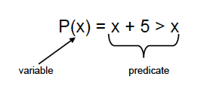
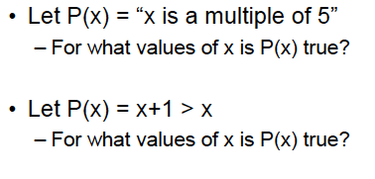
Predicate Logic

Slide 4
Examples of predicates

Slide 5
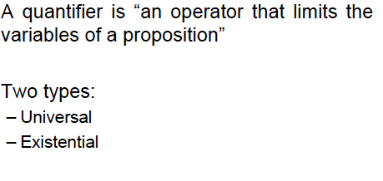
Quantifiers

Slide 6
Universal Quantifiers

Slide 7
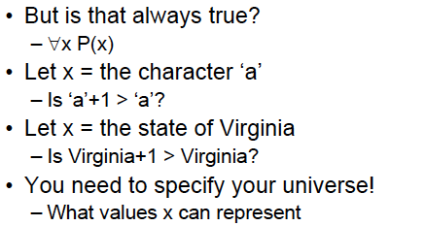
Universal Quantifiers
Perhaps we meant all real numbers.

Slide 8
Universal Quantifiers

Slide 9
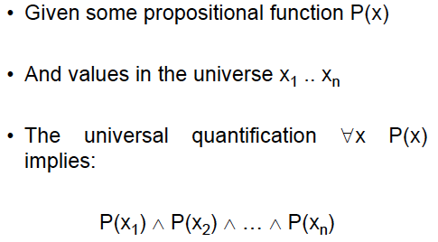
Universal Quantifiers

Slide 10
Existential Quantifiers
∃x (x is a student CS 2210⟶ x has traveled abroad)

Slide 11
Existential Quantifiers
Note that you still have to specify the domain of x.
Thus, if x is Iowa, then P(x) = x+1 > x is not true.

Slide 12
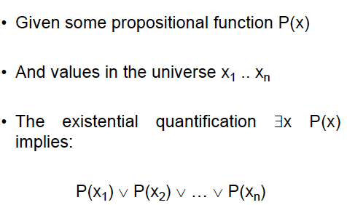
Existential Quantifiers

Slide 13
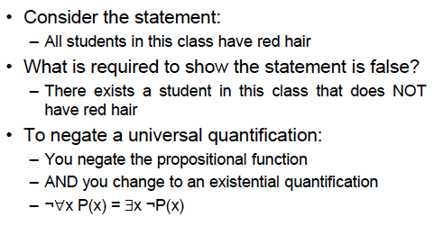
Negating quantification

Slide 14
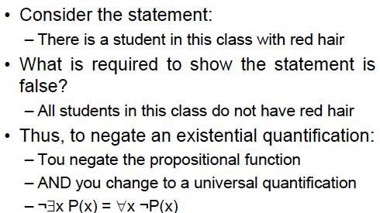
Negating quantification
You

Slide 15
Translating into English
Every student x in this class has studied Calculus.
Let C(x) mean “x has studied Calculus,” and
S(x) mean “x is a student in this class.”

Slide 16
Translating into English

Slide 17
Translating into English

Slide 18
Translating into English

Slide 19
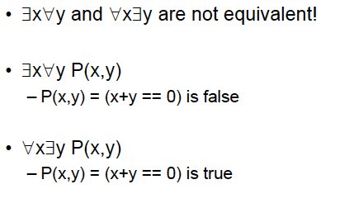
Order of Quantifiers

Slide 20
Negating Multiple Quantifiers

Slide 21
More on Quantifiers
∀x ∃y ( x + y = 10 )
∀x ∀y ( x + y = y+ x )
Negation of ∀x P(x) is ∃x (P(x) is false)
(there is at least one x such that P(x) is false)
Negation of ∃x P(x) is ∀x (P(x) is false)
(for all x P(x) is false)

Slide 22
Rules of Inference
p (Let p be true)
p ⟶ q (if p then q)
q (therefore, q is true)
Corresponding tautology [p ⋀ (p⟶ q)] ⟶ q
What is an example of this?

Slide 23
Other Rules of Inference
[(p ⟶ q) ⋀ (q ⟶ r)] ⟶ (p ⟶ r)
[(p ⋁ q) ⋀ ¬ p] ⟶ q
(p ⋀ q) ⟶ p
[(p ⋁ q) ⋀ (¬ p ⋁ r) ⟶ q ⋁ r
(if p is false then q holds, and if p is true then r holds)
same as (¬ p ⟶ q) ⋀ (p ⟶ r) )
Find example of each
Read page 72 of the book for various rules of inference.

Slide 24
Rules of Inference
¬ q (Let q be false)
p → q (if p then q)
¬ p (therefore, p is false)
Corresponding tautology [¬ q ⋀ (p→ q)] → ¬ p
What is an example of this?

Slide 25
Proofs
To establish that something holds.
Why is it important?
What about proof by example, or proof by simulation, or proof by fame? Are these valid proofs?

Slide 26
Proofs
1. It is not sunny this afternoon (¬ p) and
it is colder than yesterday (q) [¬ p and q]
2. We will go swimming (r) only if it is sunny [r →p]
3. If we do not go swimming, then we will take a canoe trip (s) [¬ r→s]
4. If we take a canoe trip, then we will be home by sunset (t) [s→t]
Do these lead to the conclusion
We will be home by sunset?

Slide 27
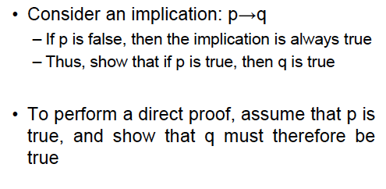
Direct Proofs

Slide 28
Direct Proofs
Example. Prove that if n is odd then n² is odd.
Let n = 2k + 1,
so, n² = 4k² + 4k + 1 = 2 (2k² + 2k) + 1
By definition, this is odd.
Uses the rules of inference

Slide 29
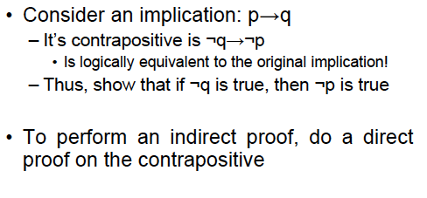
Indirect Proofs

Slide 30
Indirect Proof Example

Slide 31
Proof by Contradiction

Slide 32
Proof by contradiction: Example
Assume that the statement of the theorem is false. Then show that something absurd will happen
Example. If 3n+2 is odd then n is odd
Assume that the statement is false. Then n= 2k.
So 3n+2 = 3.2k + 2 = 6k+2 = 2(3k + 1).
But this is even! A contradiction!
This concludes the proof.

Slide 33
Proof by contradiction: Example
Theorem There is no smallest rational number
greater than 0
Prove this by contradiction.

Slide 34
Proof by contradiction: Example
Theorem. There are infinitely many prime numbers.
Proof by Euclid (300 BC)
Assume this is false, so we have a finite list of primes list p₁, p₂, ..., p_{r}.
Let P = p₁p₂...p_{r}+1
Case 1. Now P is either a prime or it is not. If it is prime, then P is a
new prime that was not in our list.
Case 2. If P is not prime, then it is divisible by some prime, call it p.
Notice p can not be any of p₁, p₂, ..., p_{r} (why?) So this prime p is
some prime that was not in our original list.

Slide 35
Proof by contradiction: Example
Example. Prove that square root of 2 is irrational.
Assume that the proposition is false.
Then square root of 2 = a/b (and a, b do not have a common factor)
So, 2 = a²/b²
So, a² = 2b². Therefore a² is even. So a = 2c
So 2b² = 4c² . Therefore b² = 2c^{2.} Therefore b² is even. This means b is even.
Therefore a and b have a common factor (2)
But (square root of 2 = a/b) does not imply that.

Slide 36
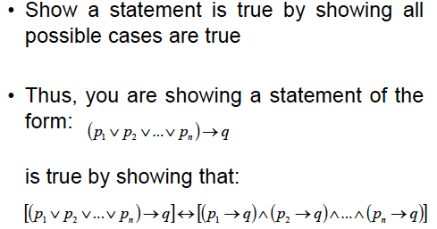
Exhaustive proof

Slide 37
Exhaustive proof
Example 1. If n is a positive integer, and n ≤ 4, then (n+1) ≤ 3^{n}
Prove this for n = 1, n = 2, n = 3, and n = 4, and you are done!
Note. An exhaustive proof examines every possible case to establish the proof of the claim.
Example 2. Every student of this class has a smartphone.
Check with every student of this class to prove it.

Slide 38
Existence Proofs
Constructive Proof
Non-constructive Proof

Slide 39
Mistakes in proofs
If you do every problem in this book, then you will learn Discrete Mathematics. (p $→$ q)
You learned discrete mathematics. (q holds)
Therefore, you did every problem in this book. (p holds)
Right or wrong?

Slide 40
Mistakes in proofs
a=b
So, a² = ab
Therefore a² - b² = ab – b²
So, (a+b).(a-b) = b.(a-b)
Therefore a+b = b
So, 2b = b
This implies 2 = 1
What is wrong here?

Slide 41
Counterexample
Given a proposition P, if you find a single counterexample to it,
then the proposition P is false.
Example (of a wrong claim) If n² is positive then n is positive
To prove it wrong, just show that when n²=4, n can be -2.
Once upon a time, there was a claim that if (2^{n}-1) divided by n
produces the remainder 1, then n is an odd prime. The claim
was later found to be false, when someone found a
counterexample: the predicate is true for n=341, but 341
is not a prime number (11 x 31 = 341)

Slide 42
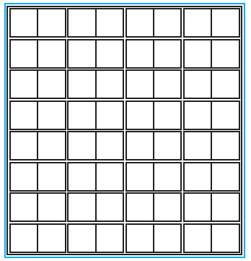
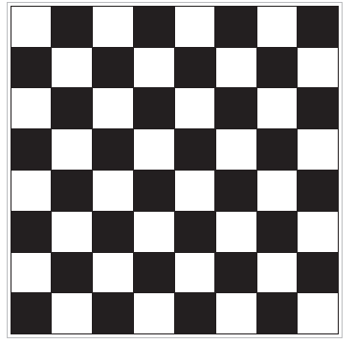
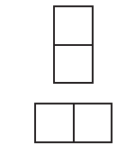
Proofs of tiling problems
(a)
(b)
Two dominoes

Slide 43
Proofs of tiling problems
(c)
(a)
(b) A checkerboard
Can you tile board (a) (with one corner square removed)
with the dominoes)? NO. Why?
2. Can you tile board (a) (with the top left and the bottom right corner
squares removed) with the dominoes? [Note that for correct tiling,
In each domino, there will be one black and one white square] We will
discuss it in the class. NO. Why?

Slide 44
Difficult problems
Let x be an integer
Let T(x) = x/2 if x is even
= 3x+1 if x is odd
The 3x+1 conjecture
For all positive integers x, when we repeatedly apply the transformation T , we will eventually reach the integer 1.
For example, starting with x = 13, we find T (13) = 3 .13 + 1 = 40,
T (40) = 40/2 = 20, T (20) = 20/2 = 10, T (10) = 10/2 = 5, T (5) = 3 .5 + 1 = 16,
T (16) = 8, T (8) = 4, T (4) = 2, and T (2) = 1.
The 3x + 1 conjecture has been verified using computers for all integers
x up to 5.6 .10¹³.

Slide 45
Difficult problems
Fermat’s last theorem
The equation
x^{n} + y^{n} = z^{n}
does not have an integer solution for x, y, z when
x ≠ 0 , y ≠ 0 , z ≠ 0 and n > 2
(The problem was introduced in 1637 by Pierre de Fermat. It remained unsolved since the 17th century, and was eventually solved around 1990 by Andrew Wiles)

