Slide 1
Distributed Transactions and Atomic Commit Protocols

Slide 2
Distributed Transactions
A Distributed Transaction involves two or more network hosts across a
connected network. Atomic Commit is an operation that applies a set of
distinct changes to the different hosts as a single indivisible operation (all or none).
Examples are inter-bank money transfers or vacation booking.
Transactions must eventually commit (when all parties agree) or abort (if any party
is not ready or willing to make the changes or commit resources)
So far, only Fail-stop and omission failures are allowed, but not Byzantine failures.

Slide 3
Atomic Commit Protocols
Consider booking a vacation, where you need to reserve
Flights
Hotels
Rental Cars
flight
S1
S2
S3
hotel
Rental Car
All or nothing --- atomicity is essential for such transactions

Slide 4
Atomic Commit Protocols
Network of servers
The initiator of a transaction is the coordinator, and the remaining servers are participants
S1
Servers may crash
S2
S3

Slide 5
Requirements of Atomic Commit Protocols
Servers may crash
Network of servers
Termination. All non-faulty servers must eventually reach an irrevocable decision.
Agreement. If any server decides to commit, then every server must have voted to commit.
Validity. If all servers vote commit and there is no failure, then all servers must commit.
S1
S2
S3

Slide 6
One-phase Commit
server
participant
Commit
server
server
client
participant
coordinator
server
participant
If a participant deadlocks or faces a local problem then the coordinator may never be able to find it until they recover on their own. Too simplistic.

Slide 7
Two-phase commit (2PC)
Phase 1 (Voting phase): The coordinator sends VOTE to the participants.
and receive yes / no from them.
Phase 2 (Commit phase):
if ∀server j: vote(j) = yes → multicast COMMIT to all severs
[] ∃ server j : vote (j) = no → multicast ABORT to all servers
fi
What if failures occur?

Slide 8
Failure scenarios in 2PC
(Phase 1)
Fault: Coordinator did not receive YES / NO: OR
Participant did not receive VOTE:
Solution: Broadcast ABORT;
Abort local transactions

Slide 9
Failure scenarios in 2PC
(Phase 2)
(Fault) A participant does not receive a COMMIT or an ABORT message from the coordinator
(it may be the case that the coordinator crashed after sending ABORT or COMMIT to a fraction of the servers). The participant remains undecided, until the coordinator is repaired and reinstalled into the system.
This blocking is a known weakness of 2PC.

Slide 10
Coping with blocking in 2PC
A non-faulty participant can ask other participants about what message
(COMMIT or ABORT) did they receive from the coordinator, and take
appropriate actions.
But what if no non-faulty participant* received anything?
What if the coordinator committed or aborted the local transaction before crashing?
The participants continue to wait until the coordinator recovers.
*May be some participants received COMMIT/ABORT, but they too crashed.

Slide 11
Three Phase Commit (3PC)
3PC better handles coordinator crashes, by adding an extra phase:
Phase 1 (as before) – a coordinator suggests a value to all nodes
Phase 2 (new step) – If all send YES, then the coordinator sends a “prepare to commit” message. Each node acknowledges the “prepare to commit” message.
Phase 3 (similar to phase 2 in 2PC) – If the coordinator receives acknowledgement from all on the “prepare to commit,” it asks all nodes to commit. However, if all nodes do not acknowledge, the coordinator aborts the transaction.
.

Slide 12
Three Phase Commit (3PC)
If coordinator crashes at any point, any participant can take over the role and query the state from other nodes. It becomes a recovery node.
If any participant reports to a recovery node about not receiving the “prepare to commit” message, the recovery node knows that the transaction has not been committed at any participant. Now either the transaction can be aborted.
If the coordinator crashes in phase 3 (perhaps after sending a fraction of the commit messages), then every other participant must have received and acknowledged the “prepare to commit” message (since otherwise the coordinator would not have moved to the commit phase (phase 3). Participants can now take independent decisions (since the only option is to commit), without waiting for further input from the coordinator, so the coordinator crash becomes a non-issue.

Slide 13
Limitations of 3PC
Apparently there are two issues with 3PC.
3PC falls short in the event of a network partition. Assume that all RMs that received “prepared to commit” are on one side of the partition, and the rest are on the other side. Now this will result in each partition electing a recovery node that would either commit or abort the transaction. Once the network partition gets removed, the system may get into an inconsistent state.
2. In real life, nodes can fail and recover (fail-recover model, or napping failure),
instead of being fail-stop nodes.

Slide 14
P a x o s

Slide 15
P a x o s
It is a distributed consensus protocol designed by Lamport (1998, 2001). It works on a completely connected network of processes, and tolerates up to m failures with n≥2m+1 processes. Has been used by industry for several years. A process can take up three different roles:

Slide 16
P a x o s
Basic steps
1. Client elects a node to be a Leader / Proposer
2. The Proposer selects a value and sends it to a few nodes (called Acceptors).
Acceptors eventually can reply with reject or accept.
3. When a majority of the nodes have accepted, consensus is reached.
Why is a majority adequate?

Slide 17
The background of Paxos
The leader itself may fail. So, Paxos does not mandate a single leader. When a leader crashes, another node steps in as a leader to coordinate the transaction. Thus, multiple leaders may coexist. To achieve consensus in this setup, Paxos uses two mechanisms.
Assigning an order to the Leaders. This allows a node to distinguish between the current leader and the older leader. An older leader (that may have recovered from failure) must not disrupt a consensus once it is reached.
Restricting a Leader’s choice in selecting a value. Once consensus has been reached on a value, Paxos forces future Leaders to select the same value to ensure that consensus continues.

Slide 18
P a x o s
What if there is only one Leader, and we mandate that instead of majority, all nodes must vote? It essentially reduces to 2PC.
Leader fails. Another Leader can take over the protocol.
Original Leader recovers. Mutiple Leaders can co-exist, thanks to the rules on agreeing only to higher numbered proposals and committing only previously accepted values.
Paxos is also more fault-tolerant than 2PC and 3PC.
Paxos is partition-tolerant. In 3PC, if two partitions separately agree on a value, when the partition merges back, an inconsistent state may result. In Paxos, this does not arise because of majority condition.

Slide 19
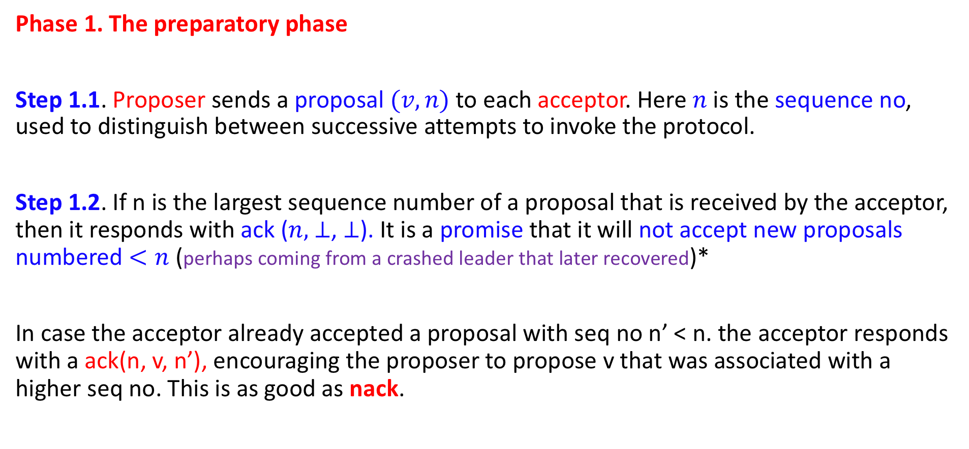
The phases of Paxos
Phase 1. The preparatory phase
Step 1.1. Proposer sends a proposal $(v, n)$to each acceptor. Here$n$is the sequence no, used to distinguish between successive attempts to invoke the protocol.
Step 1.2. If n is the largest sequence number of a proposal that is received by the acceptor, then it responds with ack ($n,$ $⊥$, $⊥$). It is a promise that it will not accept new proposals numbered $<n$ (perhaps coming from a crashed leader that later recovered)*
In case the acceptor already accepted a proposal with seq no n’ < n. the acceptor responds with a ack(n, v, n’), encouraging the proposer to propose v that was associated with a higher seq no. This is as good as nack.

Slide 20
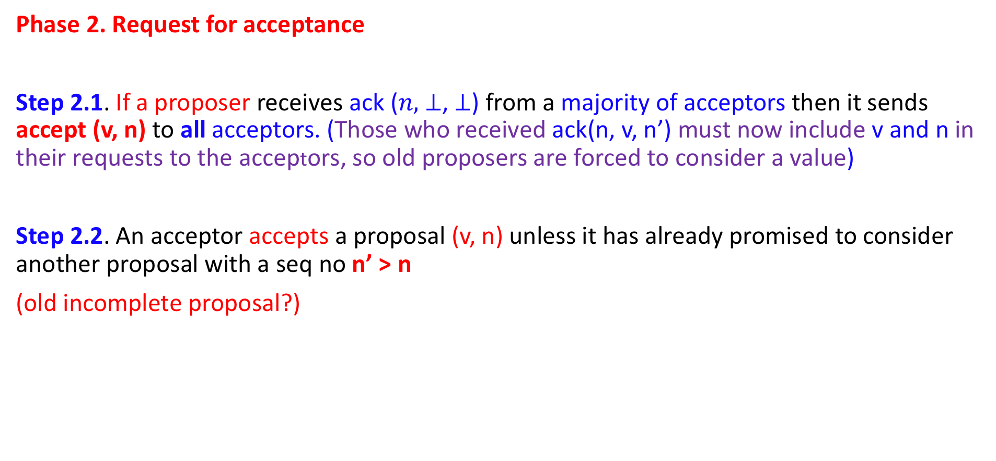
The phases of Paxos
Phase 2. Request for acceptance
Step 2.1. If a proposer receives ack ($n,$ $⊥$, $⊥$) from a majority of acceptors then it sends accept (v, n) to all acceptors. (Those who received ack(n, v, n’) must now include v and n in their requests to the acceptors, so old proposers are forced to consider a value)
Step 2.2. An acceptor accepts a proposal (v, n) unless it has already promised to consider another proposal with a seq no n’ > n
(old incomplete proposal?)

Slide 21
The phases of Paxos
Phase 3. The final decision
When a majority of the proposers accepts a proposal (v, n), it becomes the final decision.
The mechanism is as follows. The acceptors multicast the accepted value to the learners*. It enables them to figure out if the decision has been accepted by a majority.
The learners conveys the consensus value to the clients invoking consensus.
* A process thus plays three different roles: proposer, acceptor, learner

Slide 22
Two Safety Properties
Only a proposed value is chosen as the final decision. {Pretty obvious}
Two different processes cannot make different decisions
{This is due to the majority rule … the intersection of two majorities is non-empty.}

Slide 23
Liveness Properties
Termination may become an issue, when multiple proposers submit proposals with increasing sequence numbers. Consider the following:
(Phase 1) Proposer 1 sends out prepare (n1)
Proposer 2 sends out prepare (n2), n2 > n1
(Phase 2) Proposer 1’s accept(n1) is declined by the acceptor, {since the acceptor has promised Proposer 2 that it will not accept any proposal with seq no < n2}.
(Phase 1) Proposer 1 now restarts the proposal with a higher sequence number n3 > n2
(Phase 2) Proposer 1’s accept(n2) is declined by the acceptor on a similar ground.
This may go on … indefinitely …

Slide 24
Liveness Properties
No guarantee of termination

Slide 25
Comments
The possible non-termination is consistent with the results of FLP 85.
If the proposers retry after random time intervals as in CSMA CD (Ethernet) protocol, then termination is feasible with probability 1.
Paxos has been used in Chubby for multiple applications where the goal is to elect a master — the first one getting the lock wins and becomes the master (part of GFS and BigTable)

